Slide 1
Ben Orpwood
Assignment 2 BCDE224
(I’m not good at designing or making things look good)

Slide 2
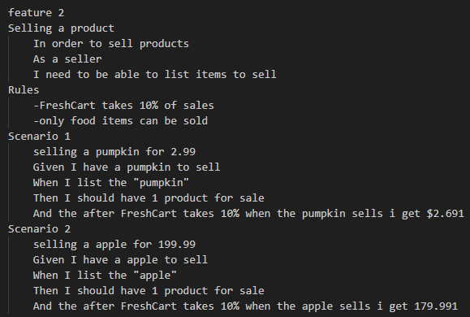
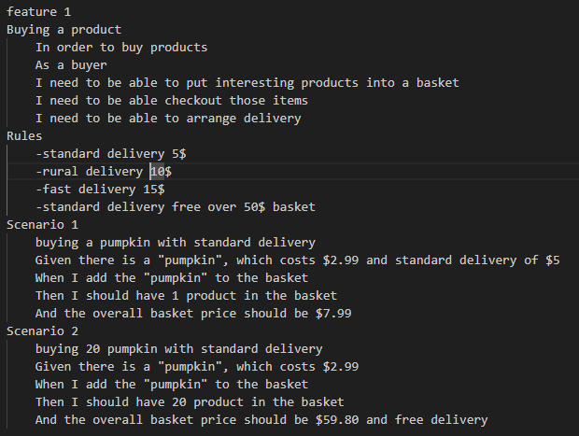
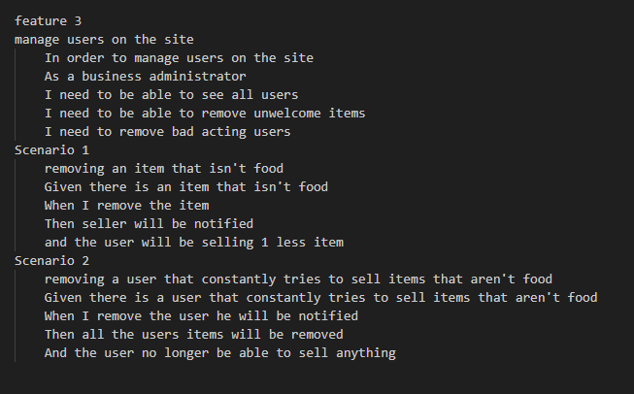
Behat features

Slide 3
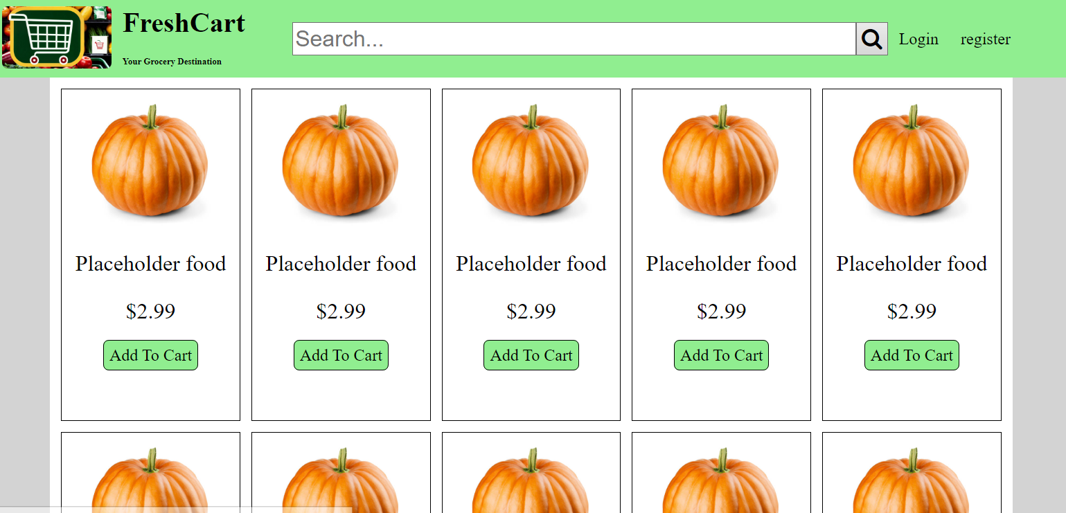
Mock hardcoded html main page logged out

Slide 4
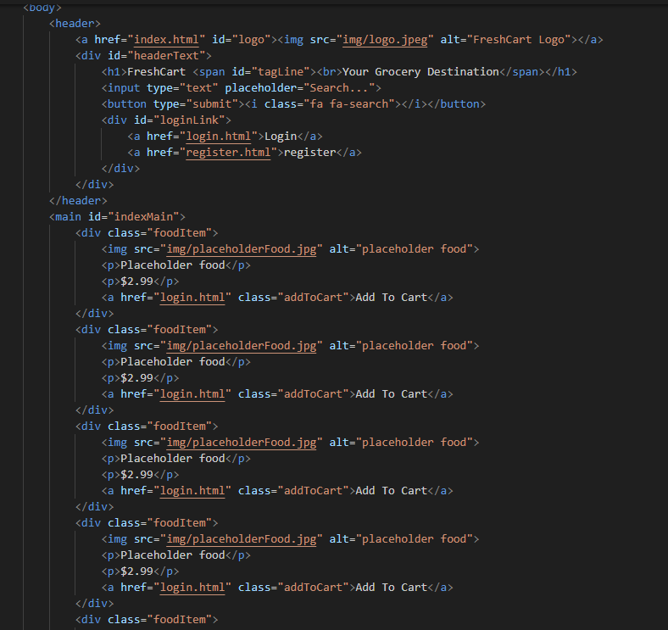
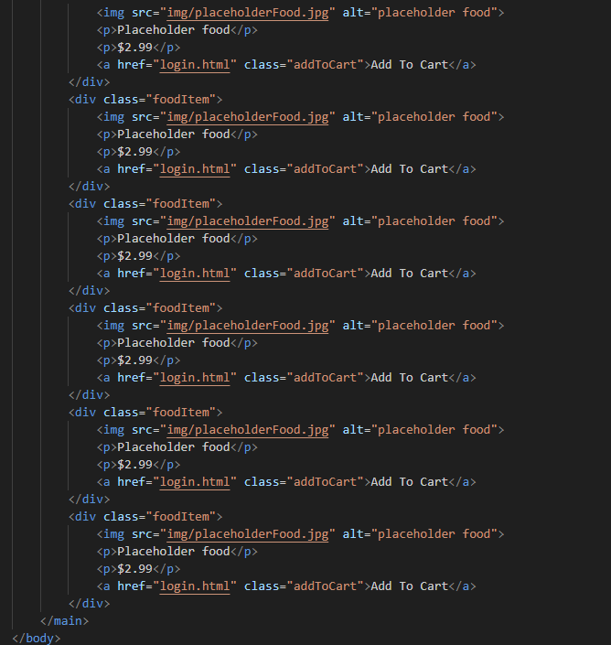
Source code main page logged out

Slide 5
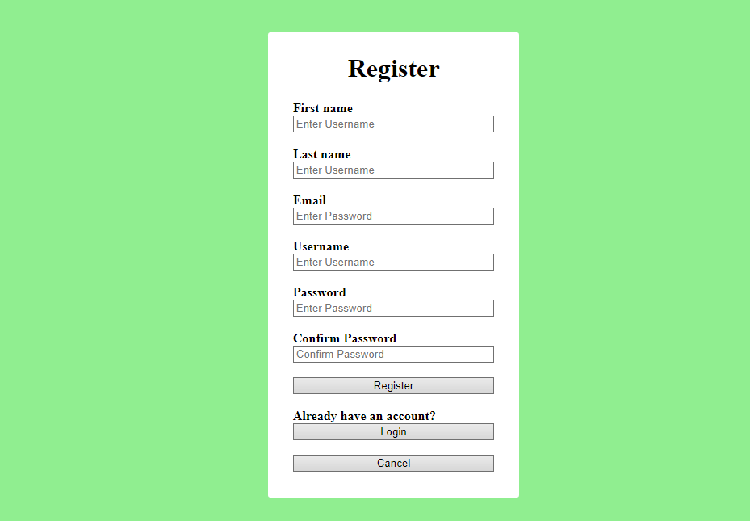
Mock hardcoded html register page

Slide 6
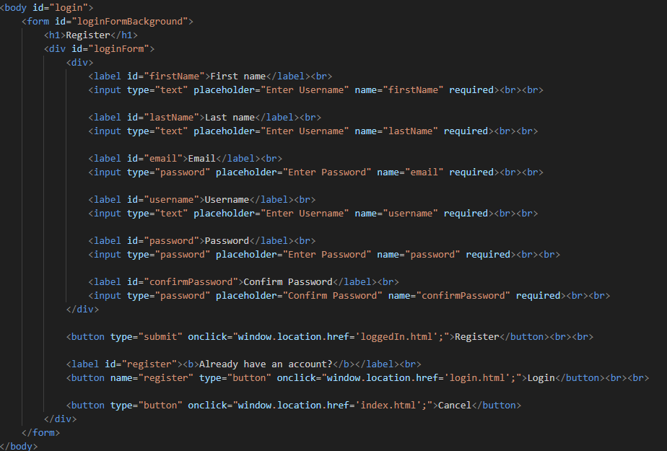
Source code register page

Slide 7
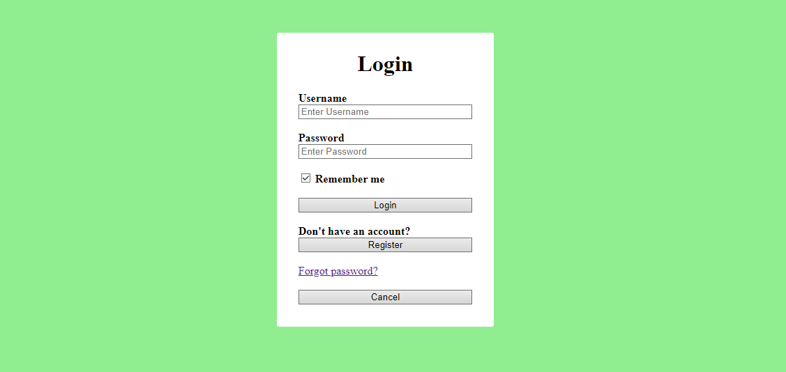
Mock hardcoded html log in page

Slide 8
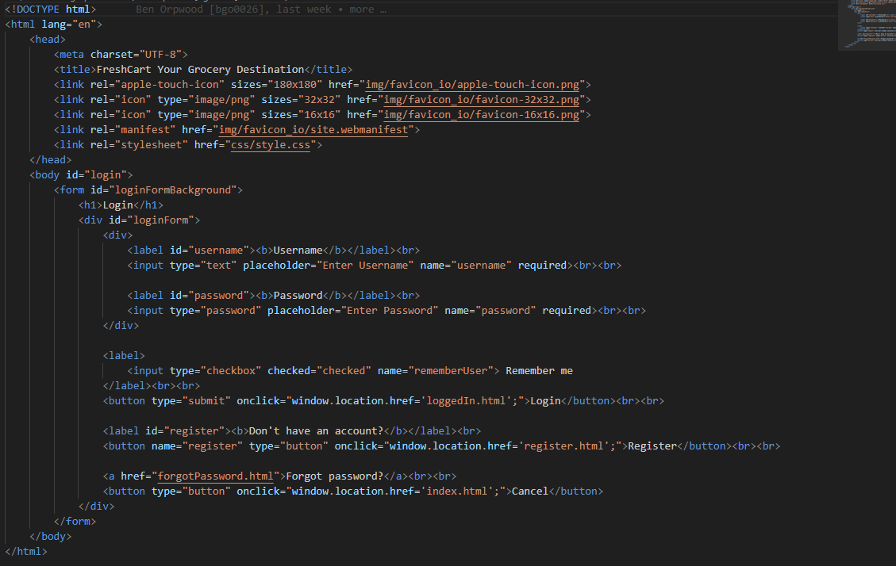
Source code login page

Slide 9
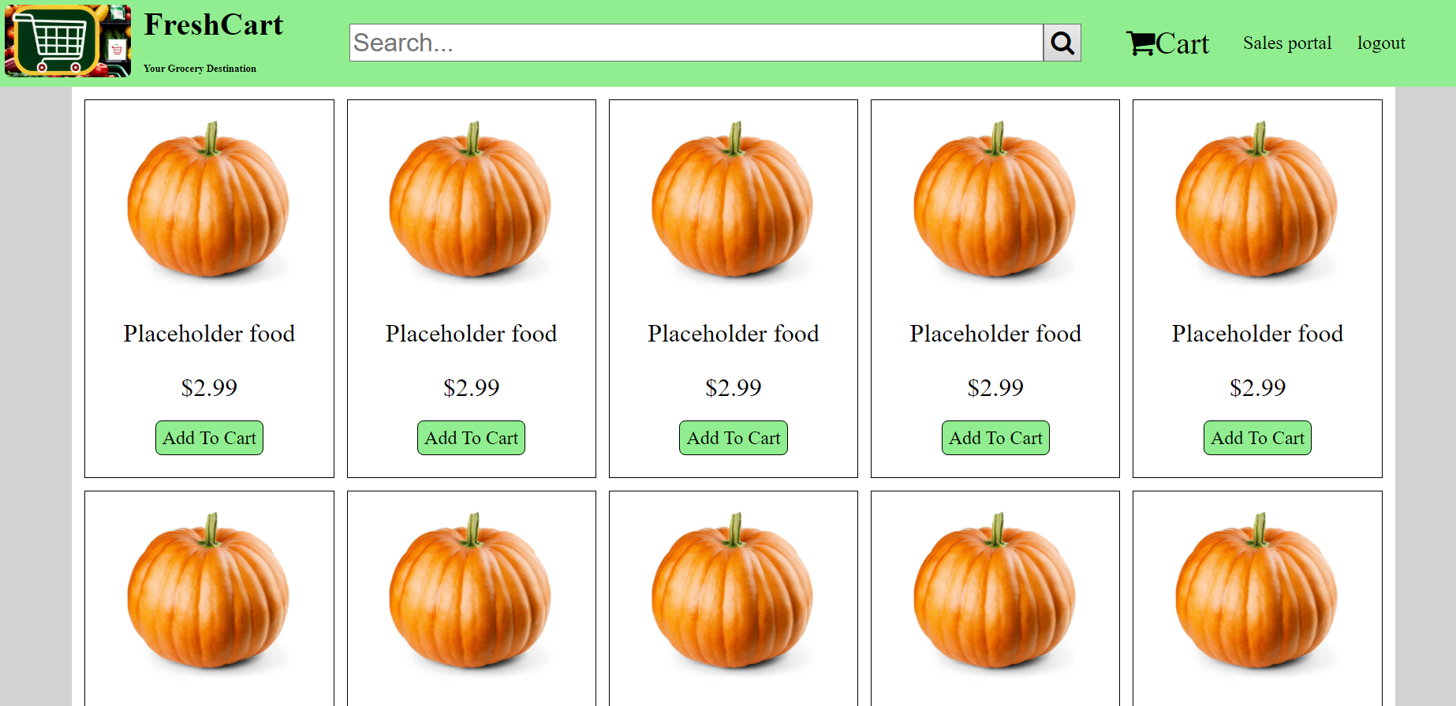
Mock hardcoded html main page logged in

Slide 10
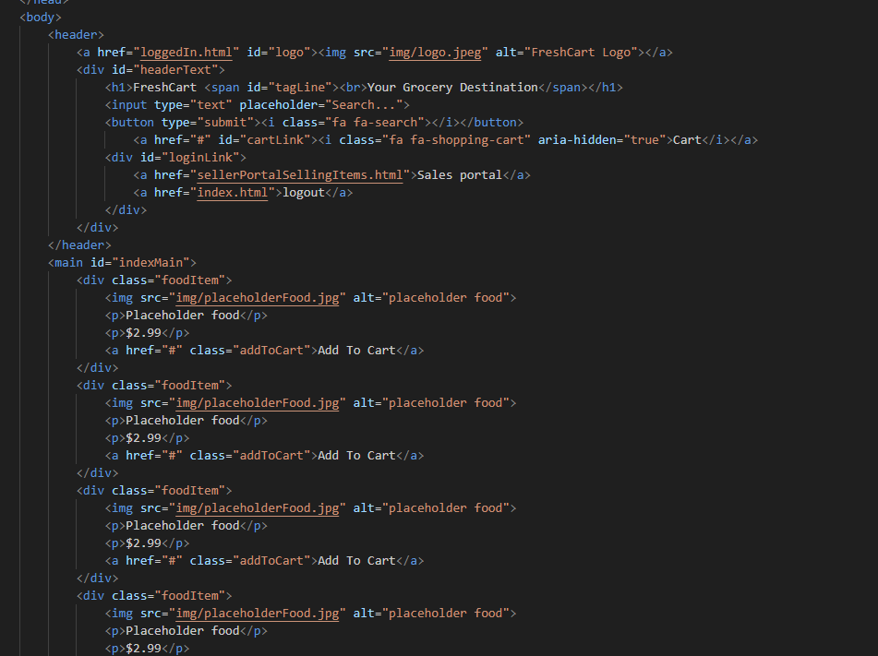
Source code main page logged in

Slide 11
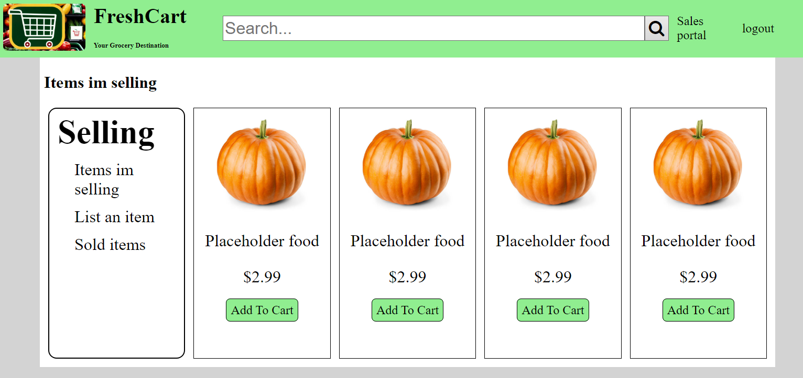
Mock hardcoded html sales portal

Slide 12
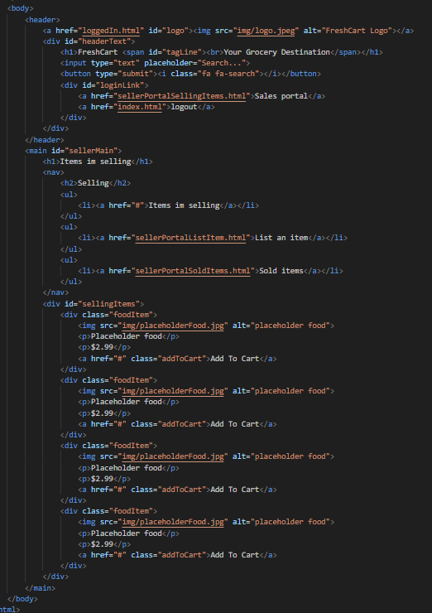
Source code sales portal

Slide 13
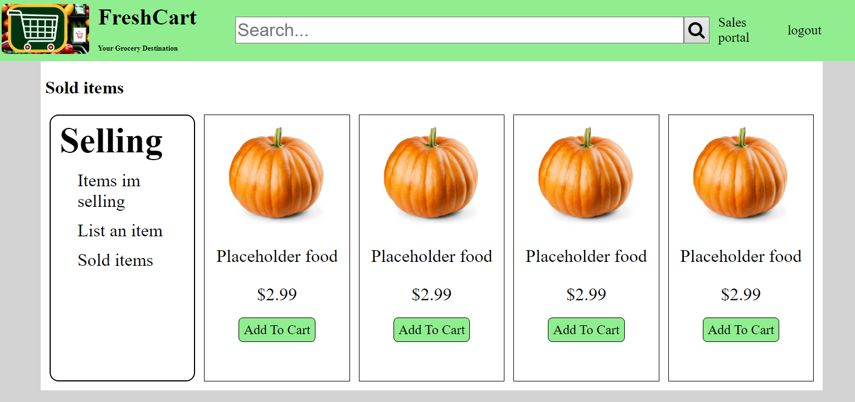
Mock hardcoded html sold items page

Slide 14
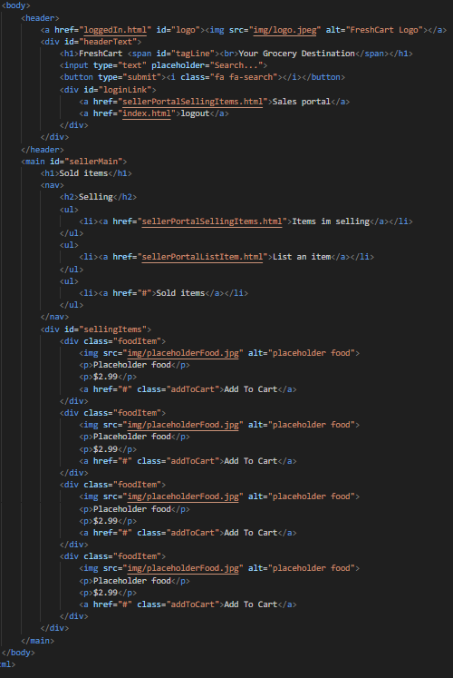
Source code sold items page

Slide 15
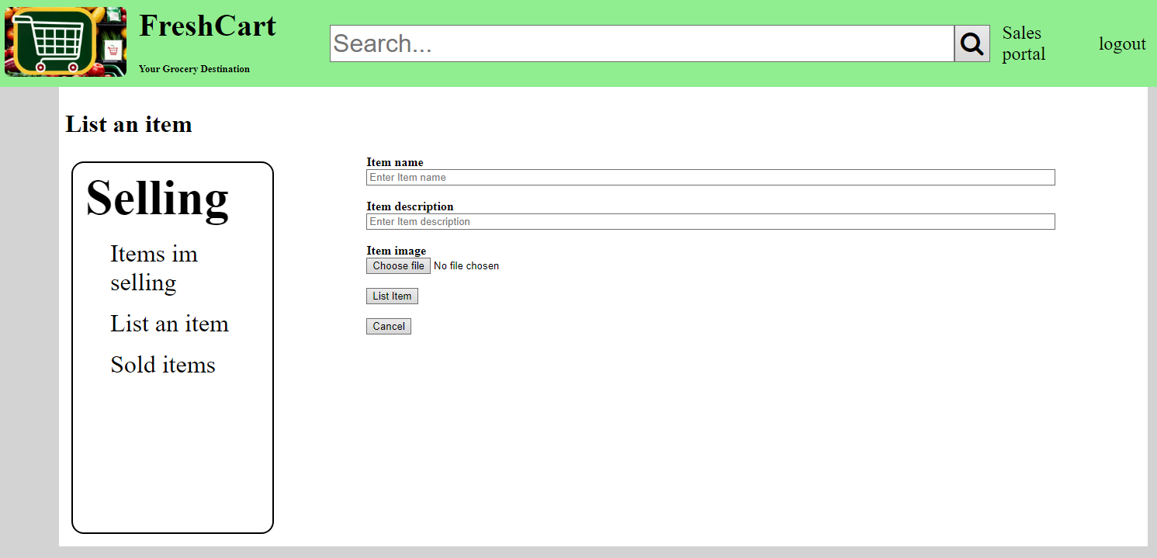
Mock hardcoded html list item

Slide 16
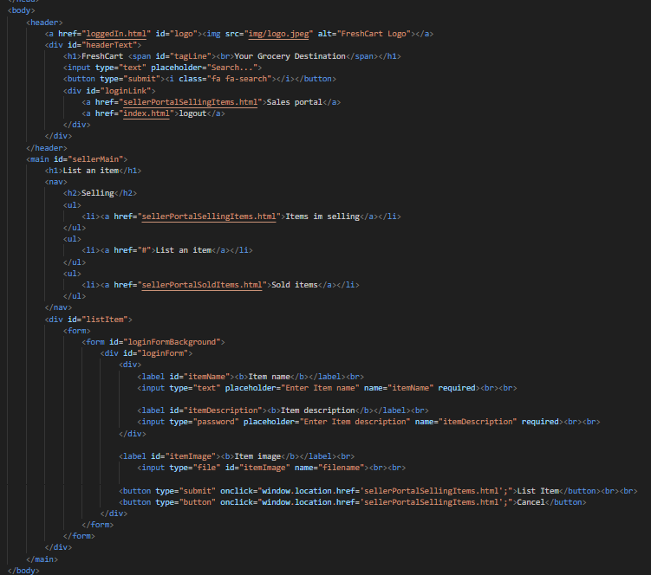
Source code list items

Slide 17
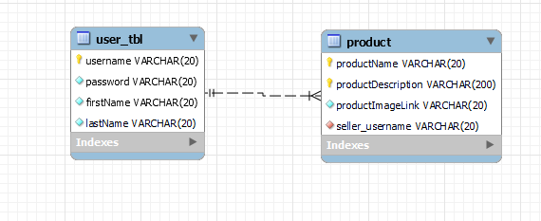
Database ERD

Slide 18
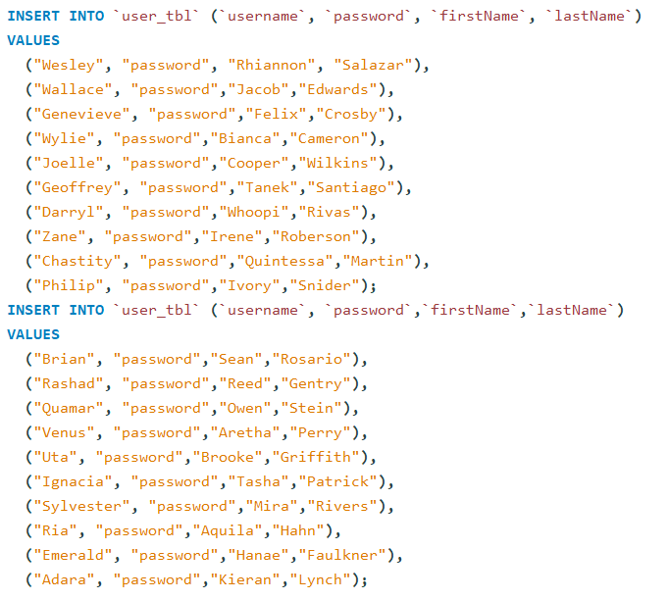
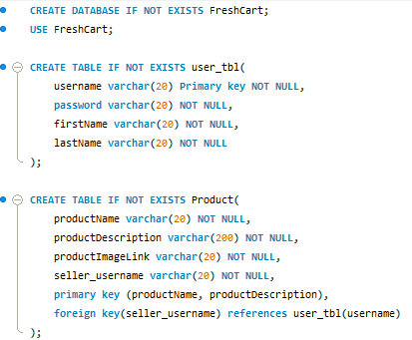
Database creation code

Slide 19

Insert data query

Slide 20


Simple query (1-2 tables)

Slide 21
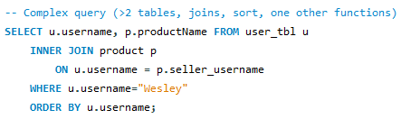

Complex query

Slide 22
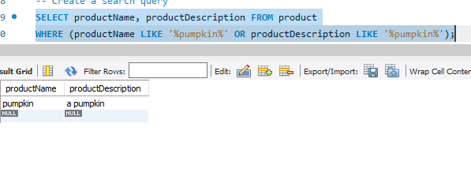
Create a search query

