Slide 2
Microservices communication
Basic communication between Services
HttpClient
MassTransit

Slide 3
DEMO

Slide 4
HttpClient
Same Contracts on Caller and Consumer Service
Hidding details for the Caller

Slide 5
Http vs Message
Http:
Blocking call
Otherservice needs to be running
Coupling of services
Message:
Garantied order (First in first out)
Retry
Deliver also if service is not running

Slide 6
MassTransit
Communicates via RabbitMQ
Connection Management
Retries, Exception handling
Serialization (JSON, BSON, XML, binary)
Extensible (Middlewares receive-sent)
Good documentation
https://masstransit-project.com/MassTransit/

Slide 7
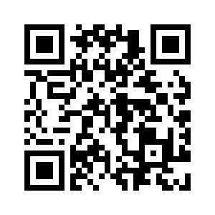
Thanks
Any Questions
Examples under: https://github.com/BenBorn/Gorod

