Slide 2
Microservices communication
Basic communication between Services
HttpClient
MassTransit

Slide 3
DEMO

Slide 4
HttpClient
Same contracts for caller and consumer service
Hiding details from the caller

Slide 5
HttpClient
DEMO

Slide 6
Http vs Message
Http:
Blocking call
Target service needs to be running
Coupling of services
Message:
Non blocking operation
Guaranteed order (First in first out)
Broadcasting (One publisher multiple subscribers)
Retry
Will be delivered also if service is not running yet

Slide 7
MassTransit
Communicates via RabbitMQ
Connection Management
Retries, Exception handling
Serialization (JSON, BSON, XML, binary)
Extensible (Middlewares receive-sent)
Good documentation
https://masstransit-project.com/MassTransit/

Slide 8
MassTransit
DEMO

Slide 9
Advanced Topics
MassTransit
Tracebility
Version of messages
Tests about all consumer registered
Queue initialization
Parallel consuming
Requeuing of errors (RabbitMq PlugIn: rabbitmq_shovel)

Slide 10
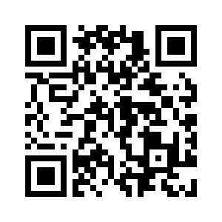
Thanks
Any Questions
Examples under: https://github.com/BenBorn/Gorod

