Slide 1
Behavioral Anomaly Detection
for Identity Threat Detection
A Multi-Signal, Multi-Model Approach to MITRE ATT&CK T1078 & T1041
Benjamin Brady
June 2026
Python · scikit-learn · pandas · Isolation Forest · One-Class SVM
Notes:
Open with: This project implements a behavioral anomaly detection pipeline targeting credential compromise — T1078 and T1041. Two unsupervised models, six detection signals, composite risk scoring, and ATT&CK taxonomy mapping.

Slide 2
The Problem: Credential Compromise is Invisible to Perimeter Defenses
MITRE ATT&CK T1078
Zero Trust Gap
Why Unsupervised ML
Valid Accounts — adversaries authenticate as legitimate users. Traditional controls see a valid login. The attack is invisible by definition.
Perimeter security trusts anything inside the network. A stolen VPN credential gives full internal access. Location is not identity.
You cannot label every attack variant in advance. Model what normal looks like — and flag everything that isn't. No labeled data required.
Source: MITRE ATT&CK T1078 | NIST SP 800-207
Notes:
T1078 succeeds because the attacker looks exactly like the real user. Zero Trust addresses this at the network layer — this project addresses it at the behavioral analytics layer.

Slide 3
6 Detection Signals Across 2 ATT&CK Techniques
Impossible Travel
Typing Speed
Click-Through Rate
Login velocity >1,200 km/h between consecutive events
Far below baseline (unfamiliar attacker) or above (scripted)
Near 0.0 (bot-like) or near 1.0 (scripted enumeration)
T1078
T1078
T1078
Session Timing
Privilege Escalation
Data Exfiltration
Login at 1–4 AM outside established user baseline hours
Resource access count spike: 20–50 vs. normal 2–5 per session
Transfer volume spike: 500–2,000 MB vs. normal 0.5–10 MB
T1078
T1078
T1041
Notes:
Six signals across behavioral biometric, geospatial, temporal, resource access, and data transfer domains. Signals 5 and 6 are the new additions — privilege escalation and data exfiltration — extending coverage from T1078 to T1041.

Slide 4
Modular Pipeline Architecture
generate_data.py
features.py
isolation_forest.py
Source
Feature Eng.
Model 1
Synthetic authentication telemetry — 3,100 events, 100 injected anomalies with ground truth labels
8 behavioral signals derived via Haversine formula and pandas shift(1) sequential operations
Isolation Forest — ensemble of 100 trees, contamination=0.033, raw anomaly scores
one_class_svm.py
evaluate.py
visualize.py
Model 2
Risk & Taxonomy
Outputs
One-Class SVM — RBF kernel, nu=0.033, comparative model for precision/recall tradeoff analysis
Composite risk score (weighted average) + MITRE ATT&CK technique ID mapping per event
Score distribution, confusion matrix, per-signal scatter plots, risk score box plots
Connection string in config.py — swap Data/login_events.csv for any Snowflake, BigQuery, or Redshift connection
Notes:
The modular structure means each file has one job. The connection string is a variable — in production you swap the CSV path for a warehouse connection and the rest of the pipeline is unchanged.

Slide 5
Synthetic Dataset with Ground Truth Labels
Synthetic data enables rigorous precision/recall evaluation — standard practice when real behavioral telemetry is unavailable due to privacy constraints.
Dataset Statistics
Anomaly Breakdown
Total Events
3,100
Impossible Travel
30
T1078
Normal Logins
3,000
Typing Speed
20
T1078
Injected Anomalies
100 (3.23%)
Click-Through Rate
15
T1078
Users
50
Session Timing
15
T1078
Privilege Escalation
10
T1078
Time Span
~2 months
Data Exfiltration
10
T1041
Notes:
Ground truth labels mean we know exactly which events are anomalous. This lets us calculate precision and recall on two unsupervised models — which is what makes this a rigorous evaluation rather than just a demo.

Slide 6
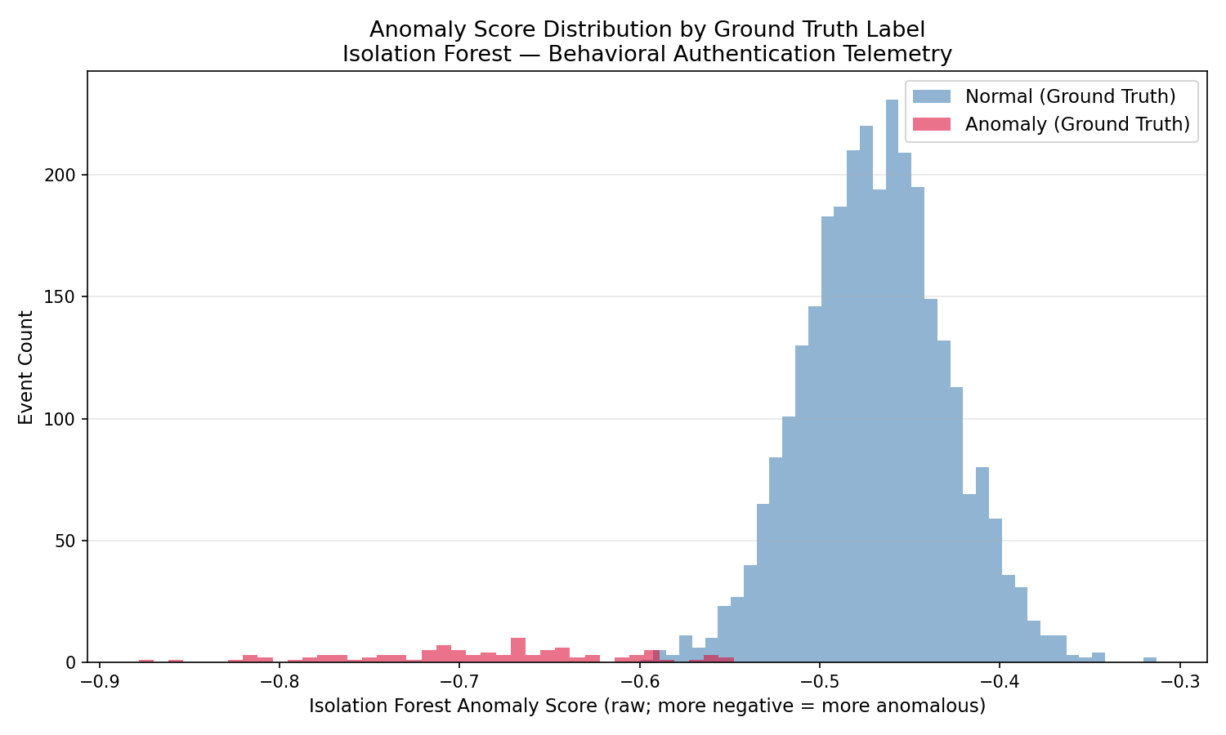
Results: Anomaly Score Distribution
Normal Events
Score -0.40 to -0.55. Dense cluster — many splits to isolate.
Anomalous Events
Score below -0.60. Fewer splits — sparse feature space.
Impossible Travel
Scores approaching -0.79 — most extreme outliers.
Overlap Region
False positives and negatives occur at distribution boundary.
sklearn IsolationForest.score_samples() — raw values, more negative = more anomalous

Slide 7
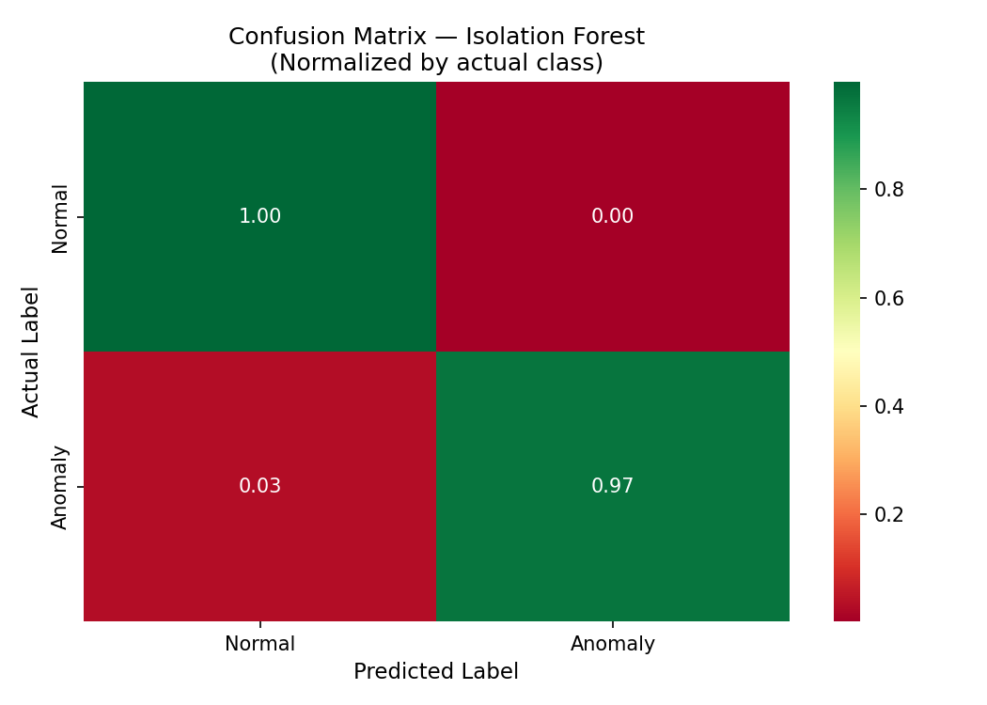
Results: Model Comparison — Isolation Forest vs One-Class SVM
97%
IF Recall
97 of 100 anomalies caught
94%
IF Precision
Only 6 false positives
84%
SVM Recall
84 of 100 anomalies caught
83%
SVM Precision
17 false positives
Isolation Forest outperforms One-Class SVM on this dataset. Consistent with literature: IF is more robust on multimodal behavioral data.
Notes:
IF wins here because it doesn't assume a distribution shape. One-Class SVM's RBF boundary doesn't fit the multimodal feature space as well. In production, you'd run both and use ensemble voting.

Slide 8
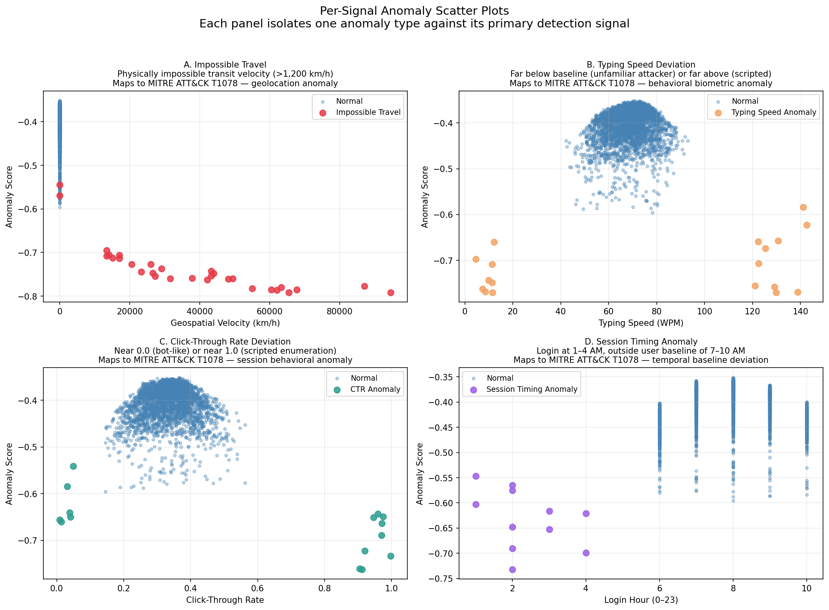
Results: Per-Signal Detection — Each Anomaly Type Isolated
Notes:
Six panels — one per anomaly type. The behavioral anomalies at low velocity (panels B, C, D, E, F) prove the model catches credential abuse even when the attacker masks their location. That's the key insight.

Slide 9
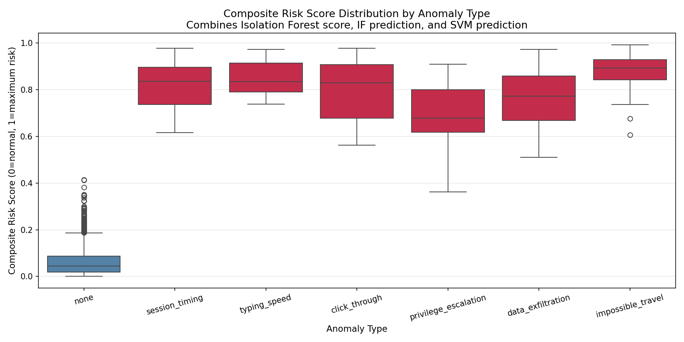
Results: Composite Risk Score by Anomaly Type
Risk Score Formula
IF Score (normalized)
× 0.50
+ IF Binary
× 0.25
+ SVM Binary
× 0.25
Continuous signal
weighted 2x over
binary predictions
Notes:
The composite score aggregates both models into one actionable number. Impossible travel scores highest and tightest — most confidently detected. Privilege escalation shows the widest spread — subtler signal, more model uncertainty.

Slide 10
ATT&CK Taxonomy — Every Detection Tagged
Each event in the output CSV carries a formal MITRE ATT&CK technique ID, enabling coverage gap analysis and alignment with enterprise detection frameworks.
T1078
Valid Accounts
Signals: Impossible Travel · Typing Speed · Click-Through Rate · Session Timing · Privilege Escalation
Adversaries obtain and abuse legitimate credentials to gain access. All behavioral biometric and geospatial signals map here.
T1041
Exfiltration Over C2 Channel
Signals: Data Exfiltration
Adversaries steal data by exfiltrating it over an existing command and control channel. Detected via abnormal transfer volume.
Notes:
ATT&CK taxonomy in the output means this pipeline plugs directly into any SOC or SIEM that uses ATT&CK for detection coverage tracking. T1078 and T1041 together represent the full credential-compromise-to-exfiltration kill chain.

Slide 11
Limitations & Production Considerations
01
02
03
Synthetic Data
Population-Level Baseline
Static Contamination
Performance metrics are inflated by clean distributional separation. Real telemetry has correlated noise and behavioral drift.
A production system needs per-user behavioral baselines. A 3 AM login is normal for an overnight analyst.
True anomaly rate is unknown in production. Requires adaptive estimation, not a fixed parameter.
04
05
06
No Temporal Model
No Held-Out Test Set
Feature Set Scope
Isolation Forest treats each event independently. Production needs session-level sequence modeling.
Both models evaluated on training data. Cross-validation would provide more conservative estimates.
8 features are a proof-of-concept subset. Production adds device fingerprinting, network characteristics, IdP signals.
Notes:
The limitations section is intentional. Knowing what your model doesn't do is as important as knowing what it does. A production deployment would address all six of these.

Slide 12
97% Recall. Zero Labeled Training Data.
Multi-signal behavioral anomaly detection across T1078 and T1041.
Benjamin Brady
github.com/BenBrady1/Behavioral_Anomaly_detection
Ben.Brady1989@gmail.com
References: Liu et al. (2008) IEEE · Schölkopf et al. (1999) NIPS · MITRE ATT&CK T1078/T1041 · NIST SP 800-207 · Chandola et al. (2009) ACM
Python · scikit-learn · pandas · matplotlib · seaborn
Notes:
Close with: 97% recall with no labeled attack data, across six detection signals and two models. The composite risk score and ATT&CK taxonomy make this pipeline pluggable into any enterprise detection framework.

