Slide 1




How to Hack PALMETTO BUG
Or, advanced directory control of PalmettoBUG projects & how to manually integrate it with alternate data analysis pipelines
By Ben Caiello at the MUSC Hollings Cancer Center Flow Cytometry and Cell Sorting Shared Resource Laboratory
These are AI images generated at Openart.ai, so they are in the public domain

Slide 2
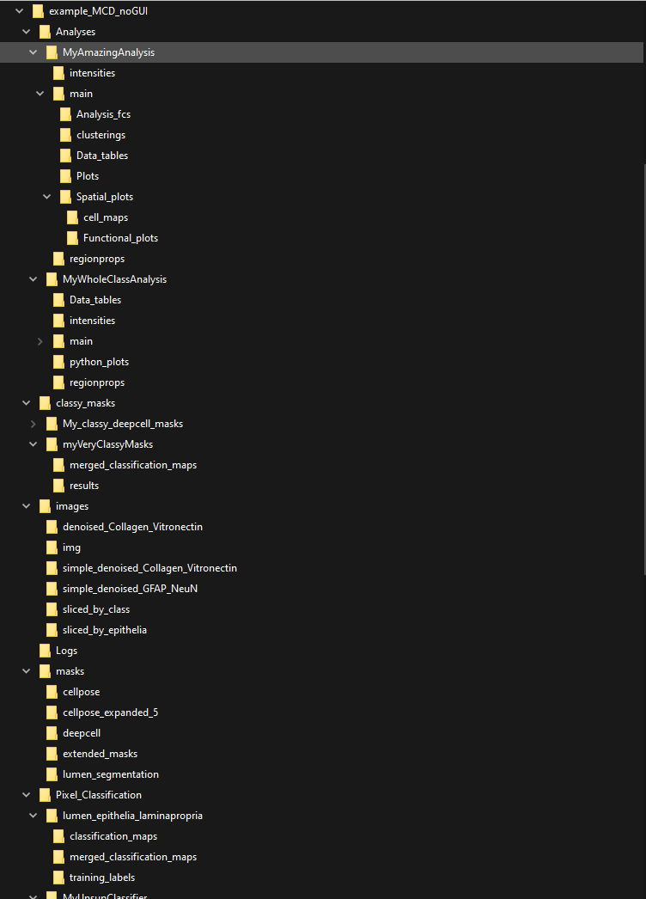
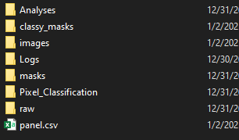
The Full PalmettoBUG directory
An entire PalmettoBUG directory – in this case for the example project used in the jupyter notebook tutorials – can be quite large, with many sub-folders
Note that the upper-level name of the directory (“example_MCD_noGUI”) is entirely flexible and up to the user, but many of the sub-folders are not.
At the upper level of the directory there are 7 folders and one panel file, we will go through each:
How to use the information in this powerpoint – common uses:
1). When working with the PalmettoBUG outside the GUI, certain output files / folders are not automatically created. If you want to completely mimic the GUI structure — which is not always necessary — you will need to re-create some parts of the structure manually (this re-creation is done in the jupyter tutorials in the documentation).
2). Knowing how the directory structure works can allow you to easily examine & move data intermediates (such as segmentation masks, region measurements, etc.) in and out of PalmettoBUG. This is both useful for checking the quality of these intermediates and for if you want to do part of your analysis in this software, and part of it in another.
3). Troubleshooting errors: Some errors in the program can be identified and fixed more easily if you know what should be in the directory of the project, and where it should be. Additionally, some actions (such as deleting files that are incorrect or that are creating an error) may be simpler to do in file explorer and not inside the PalmettoBUG GUI – but doing this requires understanding where and what the files are in the project directory

Slide 3
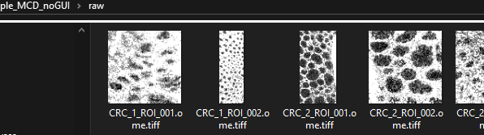
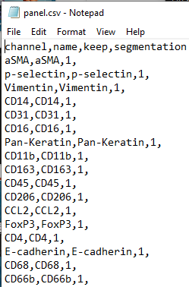
The /raw Folder
The /raw folder is the starting point of any image-based PalmettoBUG project, and is the only folder needed to start an imaging project from the GUI (the other folders will be automatically created in the proper structure as you go)
In the example, the raw files are (.ome).tiff files, due to the large size of the individual .mcd files from which these .tiff files came not playing nice with github
This panel.csv file contains the information about channel names, whether to keep them in the images, and whether to use them for segmentation.
Generating semi-automatically by the PalmettoBUG.
Common Errors:
1). Forgetting which filetype is in /raw (MCD vs. TIFF) & using the wrong settings.

Slide 4
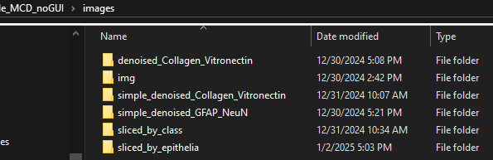
The /images Folder
The /images/img subfolder is special – it contains the images after conversion, often from MCDs, of the files in the /raw folder, before any denoising except (hot pixel filtering)
The /images folder contains subfolders of .ome.tiff files
Each subfolder contains a single multi-channel .ome.tiff for every ROI in the dataset.
How it works:
The first time images are converted from the starting files (MCD or TIFF) in the /raw folder, they are placed in /images/img.
Then, each time image denoising or image filtering (based on pixel class) is performed in the GUI, a new folder is created in this directory for the new transformed images. This folder can be named anything the user wants – except /img.
Later, when the GUI needs to access a set of images, it will search inside the /images folder and list ALL the sub-folders it finds.
Common Errors:
1). Forgetting that channels with keep == 0 in the panel file will not carry over from /raw to the rest of the data analysis, causing inaccurate channel order expectations (channel order & numbering changes after channels are dropped).
How to use:
If you have a custom denoising or other image preprocessing pipeline, you can simply place that pipeline’s output in a new folder inside the /images directory – provided that its output is one multi-channel .ome.tiff per ROI. It should then be visible to PalmettoBUG functions.
Additionally, the filenames, channel number, and channel order should match the rest of the dataset & the panel file! Otherwise, you may get errors & incomplete or incorrect outputs.

Slide 5
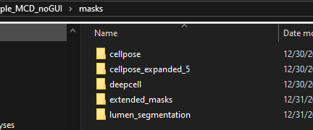
The /masks Folder
In the GUI, Deepcell and Cellpose segmentation automatically exports the segmentation masks to “cellpose” and “deepcell” subfolders in /masks.
This is also the default when outside the GUI, however then it is not as critical where the segmentation masks are placed, as long as you where you put the files to access them later.
The /masks folder contains subfolders of .ome.tiff files – these are single-channel segmentation masks.
Each segmentation mask will have an identical filename to the image it was generated from.
How it works in GUI:
Cellpose and Deepcell segmentation place the segmentation masks in special /masks/cellpose and /masks/deepcell folders.
When masks are expanded by a fixed number, and when they are created or extended using a pixel classifier, a new folder is created in /masks to hold those files.
The name of these new/custom folders is flexible, as whenever the PalmettoBUG GUI needs to use the segmentation masks, it will simply search in the /masks directory and list all the subfolders as options, regardless of their names.
Common Errors:
1). Forgetting to select segmentation channels in the panel file (nuclear / 1 and cytoplasmic / 2)
2). Only segmenting a single test image in the GUI and forgetting to do the rest of the folder. This can create incomplete results or errors in later steps!
How to exploit:
If you have an alternate or custom algorithm for segmentation, but still want to use the other capacities of PalmettoBUG, simply insert the output of your segmentation algorithm into a subfolder of the /masks directory.
This does require that your segmentation masks are single-channel .tiffs with the format of non-cell regions having pixel values = 0 , and every cell region having pixel values of a unique integer value.
Additionally, the filenames and order of the masks should be the same filenames as the matching images in the /images subfolder you intend to use for region measurements.

Slide 6
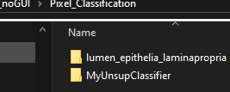
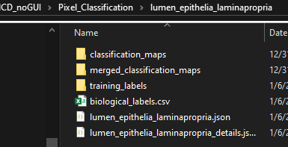
The /Pixel_Classification Folder p.1
In this example, we’ll look at the structure inside a supervised classifier
Every time a pixel classifier is created, a new sub-folder – named by that new pixel classifier’s name – is created inside the /Pixel_Classification folder to hold the information, training, and outputs of that classifier
/classification_maps holds the output of the classifier – single-channel .tiffs of integer labels for each pixel class region.
The filenames will match the filenames of the images the classifier is being predicted from
Training labels are single-channel .tiffs with integer labels for their pixels, denoting regions / classes of the image. They are generated manually by the user, and needed for training supervised classifiers (they are not used for unsupervised).
Their filenames also need to match the filenames of the images being trained on
The biological_labels.csv associates the integer numbers in the classification maps to biologically relevant labels.
The merged_classification_maps are outputs of the classifier when all classes with the same biological label are merged together into 1 (usually only important for unsupervised classifiers), and ‘background’ class are dropped to 0.
The .json files contain important information about the classifier (such as what images, channels, and features were used), as well as the entire neural network of supervised classifiers (in the form imported / exported by the opencv library)

Slide 7
The /Pixel_Classification Folder p. 2
How to use:
1). You can access a good deal information about the classifier itself in by opening the _details.json file (in notepad or a code editor). This can include the channels, features, and parameters used as well as the classes predicted.
2). The main .json file can be loaded into the opencv library to make predictions (although usefulness of this would depend on regenerating the features the classifier was trained on)
3). The quality of the training labels & pixel classifications can be checks by examining the images in the /(merged_)classification_maps folders. Napari is the typical viewer for this, as standard image display software can mistake the low-integer values of the classes as very dim grey-scale signal (which can’t be distinguished by eye from background). Additionally, the original images from which the classification was made can be overlayed in napari with the prediction/training, allowing easy comparison of the underlying data with the classes.
Common Errors:
1). Predicting classes for a subset of the images (such as doing a test images or two), and forgetting to make predictions for the rest of the dataset. This can create errors or incomplete results
2). Saving undesirable training labels, or unintentionally overwriting desirable labels. This can lead ot a mis-trained classifier that outputs bad results.

Slide 8
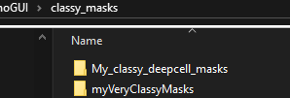
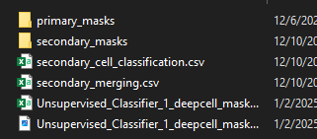
The /classy_masks Folder
Every time segmentation masks are classified, a new subfolder is created in /classy_masks
In the GUI, the names of these folders are automatically determined by the name of the segmentation masks folder and name of the pixel classifier, but outside the GUI the folders can be named whatever the user wants.
Classy masks are derived from pixel classification maps + segmentation masks, as a useful intermediate for either grouping cells based on pixel classification, or expanding segmentation masks using a classifier
Example of an unsupervised classy mask sub-folder (in this case, made by the GUI unlike the examples above):
Secondary_masks are ONLY produced when using a “secondary flowsom” to classify cells. These do not represent the output of that flowsom’s cell classifications, but rather the result of merging (using a merging.csv) the primary masks produced by the FlowSOM into biologically relevant classes
Single-channel tiff of the same format as pixel classification maps (integer labeled-regions, filenames matching source images). However, classy masks only classify within cell segmentation regions, and each cell is given a single class .
How to use:
1). You can examine the presence and quality of the cell-type predictions using Napari – much like for pixel classifiers – to overlay the predicted cell classes in /primary(secondary)_masks with the original images, masks, & pixel classes.
These csv files contain a classification for every cell in the dataset (in the order that matches region measurement steps). The “secondary” csv file contains the classifications after merging, while the csv named after the classy_masks folder itself contains the raw classifications before merging.
Note that for “mode” method of cell classification (commonly used for supervised classifiers) does not typically need any merging / secondary files
This .png file is a heatmap meant to assist in merging a FlowSOM’s primary classifications

Slide 9

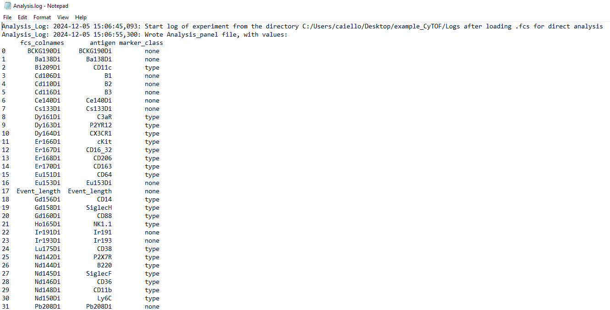
The /Logs Folders
The example (“Analysis.log”) is from the single-cell analysis portion of PalmettoBUG, however the image processing project portion of PalmettoBUG has its own Log. These separate logs exist because one imaging project can have multiple single-cell analyses associated with it..
Inside image projects, as well as within individual analyses, you may find a /Logs folder. This folder is only used by the GUI. Most actions by the user are written here.
When scripting with PalmettoBUG functions outside the GUI, the Logs folder may appear, but will be empty – your script IS your record!
Major actions & certain saved files (like the Analysis_panel file in the example above) are written to the log, along with the timestamp.
Usually, the key parameters accessible to the user within the constraints of the GUI are logged (example: when clustering cells by FlowSOM, parameters like the random seed, number of clusters, number of epochs, and XY dimensions of the SOM are recorded)
Some information, (such as image files) are not written to the log – so it may not always be possible to reconstruct prior actions using the log.
Additionally, any edits / actions taken outside the GUI will not be recorded.
In any case, while these logs may be helpful, it is essential to do careful recordkeeping of your analysis steps outside of PalmettoBUG!

Slide 10
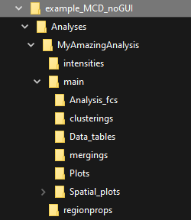
The /Analyses Folder
The /Analyses folder contains an entire set mini-universes of its own…
The extensive sub-folder structure of an individual analysis directory is a consequence of the complexity of a given single-cell analysis, but since 1 image project could theoretically have > 1 single-cell analyses (for example, if you wanted to compare how denoising images affected later cell clustering ), this directory structure is placed as a subfolder of the larger imaging project.
However, if you are not doing an imaging project (analyzing directly from .fcs files), then this directory structure is still used, but as its own stand-alone project!

Slide 11
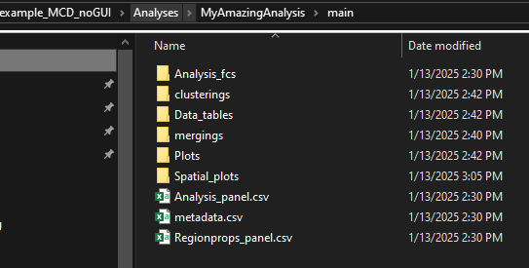
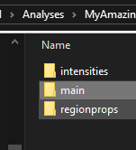
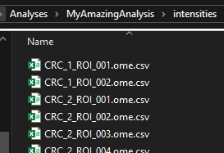
A single Analysis / solution-mode directory
The /main folder contains the meat of the analysis directory and contains many sub-folders that will need to be explained in future slides
You may also see a Logs folder – this is only important for the GUI
/intensities and /regionprops folders contain csv files (one for each image or ROI, with a matching filename) with the region measurements derived from the images + segmentation masks.
These files are the same format as steinbock’s intensities/regionprops folders, with a few minor difference (added / removed columns).
They are only needed in image-based projects! They exist, but are vestigial & empty in a solution-mode project.
If you’re wondering what a .ome.csv file is -- this is just a carry over of how PalmettoBUG handles the .ome.tiff filename. These are effectively just plain .csv files. You will also see similar inclusion of the .ome extension in other files whose filenames are copied from the image file names.

Slide 12
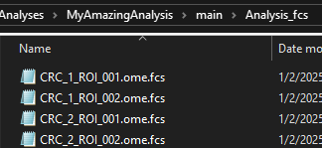
The /Analysis_fcs folder
The /Analysis_fcs folder is where the raw data of a single-cell analysis lives!
If derived from images, then these fcs files will effectively just be version of the “intensities” csv files from the previous slide.
If you are setting up an Analysis directly from solution-mode data, then you will place your FCS files inside this folder – i.e., within {your_project_directory}/main/Analysis_fcs , then load your project directory for single-cell analysis.
The metadata.csv and Analysis_panel.csv files are the core information tables you are prompted to create when inside the GUI. They closely match the format of the similal metadata & panel files used by CATALYST.
The Regionprops_panel.csv in this example has the same format as the Analysis_panel.csv file, but contains information for the channels in the regionprops csv’s (instead of the intensities / FCS files). These are cell morphology measurement like cell area, perimeter, centroids, etc. The Regionprops_panel only is needed if you want to analyze these cell morphology data alongside the standard antigen channels

Slide 13
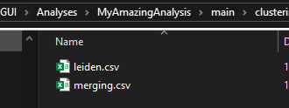
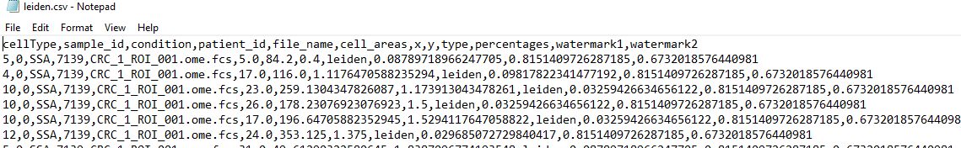
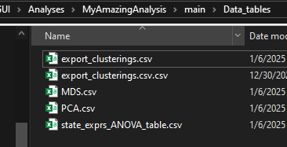
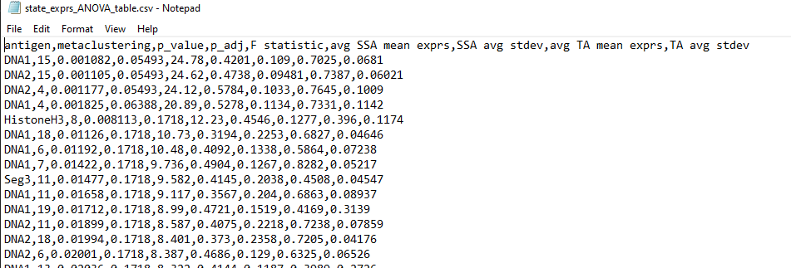
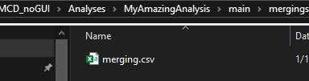
The /Plots, /clusterings and /Data_tables folders
/clusterings contains saved cell groupings, allowing for their re-import without needing to re-do cell clustering methods, such as FlowSOM clustering + merging/annotation
/Data_tables contains csv files of data obtained in the course of the single-cell analysis, such as statistics results (as in the example) and exported copies of all the single-cell data or of dimensionality reductions
/mergings contain tables of the annotations used to convert unlabeled / numbers-only output of unsupervised cell clusterings (FlowSOM or Leiden) into biologically relevant labels

Slide 14
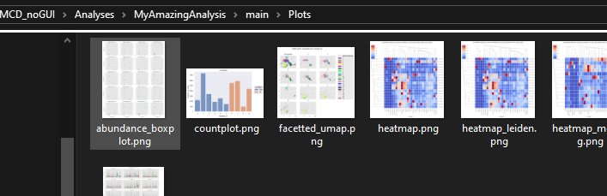
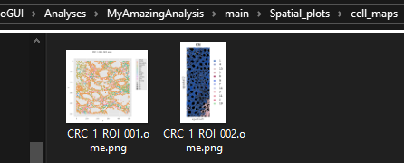
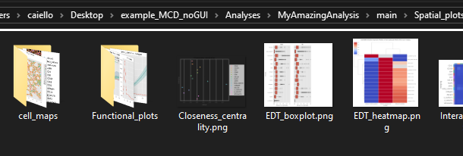
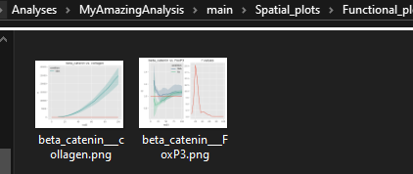
The /Spatial_plots folder
/Plots… contains the plots generated in the course of a single-cell analysis (except spatial plots)
/Spatial_plots contains all the outputs of the spatial module of the program, including cell maps and spaceANOVA functional plots in separate sub-folders. Additionally, any data tables / statistics produced by the spatial module are also exported here as csv files

Slide 15
A note of working outside the GUI
Ideally, this complicated state of the API will be simplified or standardized in the future – but for now I describe the current state of the package.
The jupyter tutorials in the documentation are a great resource for understanding how to use this package outside the GUI, because those tutorials are designed to mimic the GUI directory structures & I/O paths, such that the GUI can be opened inside the directories that those tutorials create and still run normally.
Data Export:
Within the GUI, all the structures described in this powerpoint arere auto-generated.
However, outside the GUI things are more….complicated. But also, more flexible.
The classes of PalmettoBUG (such as ImageProcessing, Analysis, SpatialAnalysis) accept a path to the project / analysis directory when they are created, with certain expectations. For example, ImageProcessing expects a /raw subfolder, containing the expected file type (MCD or TIFF). These classes will also set up many of the expected folders in the provided directory when they are created, and configure their default export paths to match the behavior of the GUI.
However, the data export behavior of PalmettoBUG functions / methods within these classes can still vary:
  Default exports like GUI: these methods’ default behavior is the same as in the GUI. However, if an explicit alternative folder is provided then they will use that folder instead of the default. Methods in the ImageProcessing & pixel classifier creation classes typically behave like this.
  No default: functions that require an export path (there is no default value). Functions that are not part of a class, including those that utilize pixel classifier outputs, are like this.
  Default does not export: if no filename is provided, these methods do not export anything to the disk. These function ALWAYS return an object that could be written to the disk, like a pandas dataframe (.csv), or a matplotlib plot (.png), regardless of whether a filename is provided – which allows the user to save the object to any file location they want. If a filename IS provided, then the file is saved in a default folder (such as /Plots during inside an analysis) under that filename. Some functions following this pattern accept a full file path for export instead of only a filename. Usually plotting / statistics methods in the Analysis and SpatialAnalysis classes follow this behavior.
  No export / function: Some steps of the pipeline (like creating a merging dataframe for annotating cell types) do not have a dedicated function at all or do not automatically export data, but instead require the user to manually create / export the data themselves – such as using pandas method dataframe.to_csv(export_path, index = False) to export data tables.
Data Import:
Many steps require reading data off the disk (often data previously exported to the disk by PalmettoBUG, like images or masks).
For this, the types of behaviors are simpler, as
  1). usually there is an option is available to explicitly provide the path to the data / data folder you want to read from –
  and
  2). In the few cases where an input path(s) option is not available, then you can assume that the class method in question is expecting the same data structure as the GUI. For example, the method that loads region properties into an analysis assumes there is a /regionprops folder in the usual location containing .csv files about the characteristics of the cell masks.

Slide 16
Fin

