Slide 1
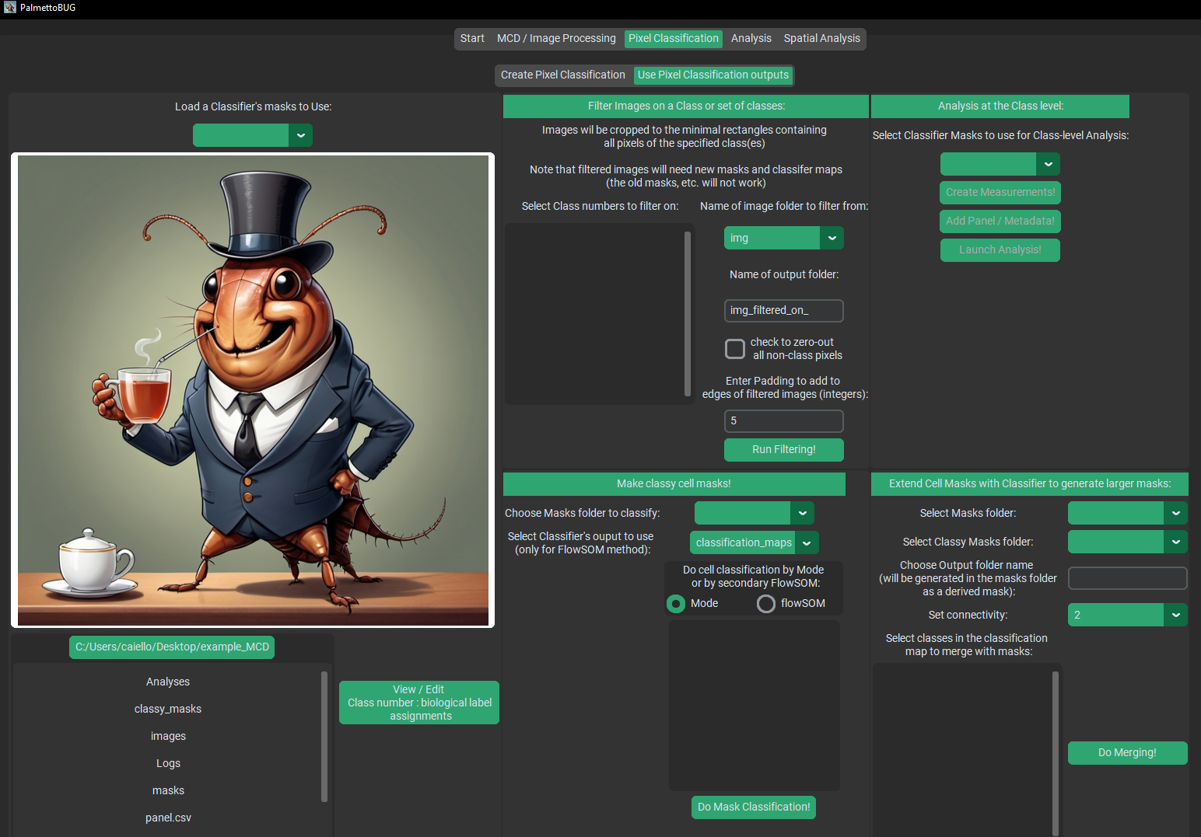

Load a Classifier to use
Filter images on class
Whole-class analysis
Classify cell masks
Extend cell masks

Slide 2
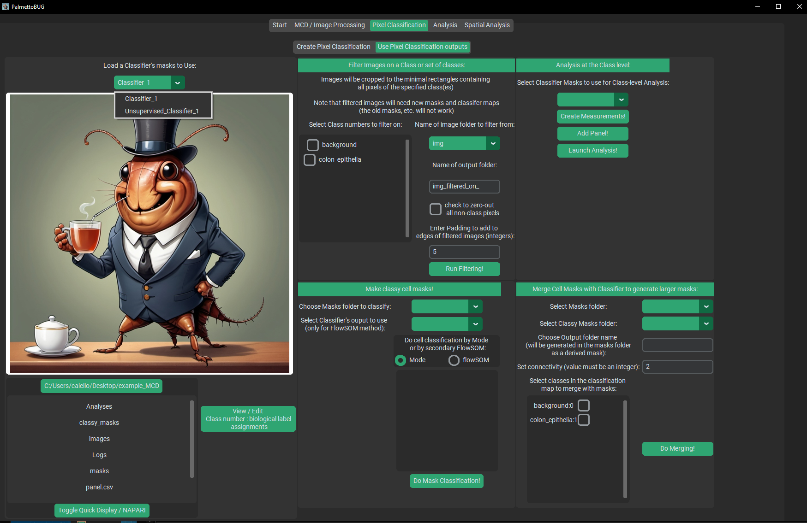
Loading a Classifier is a key first step – also look here to see what classifier you currently have loaded!!

Slide 3
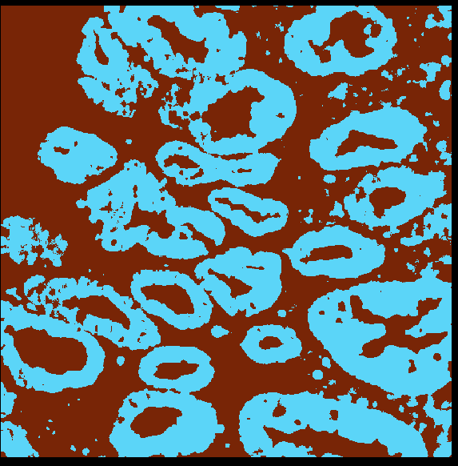
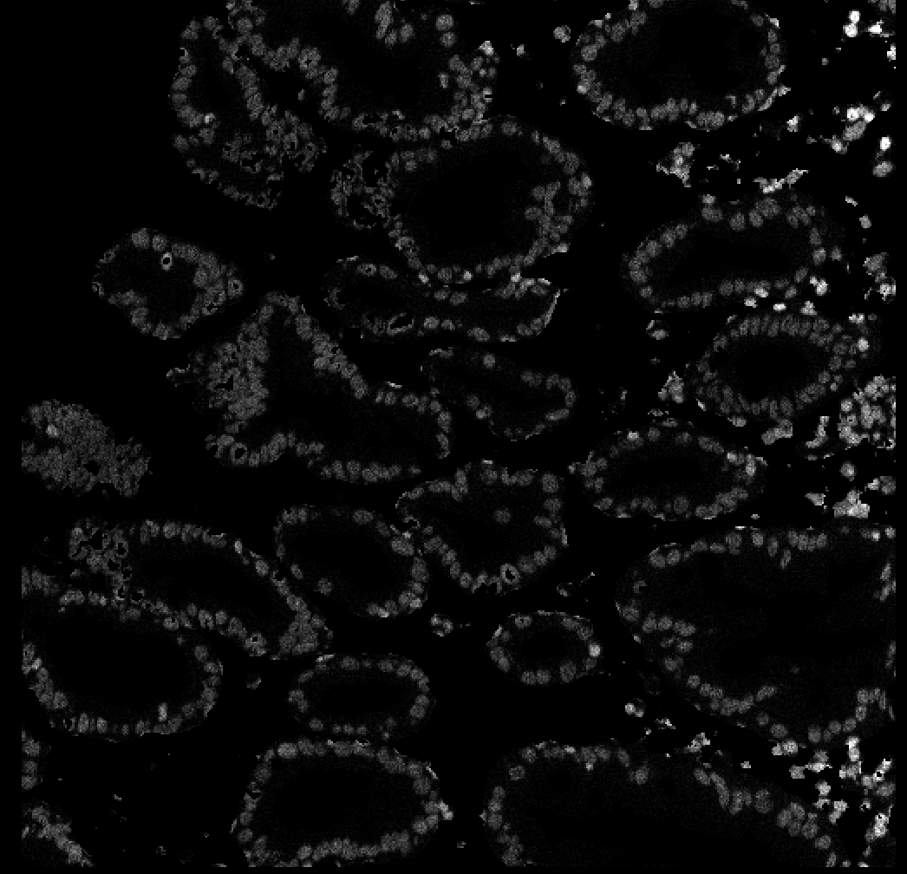
Select class of interest from classifier
Example Image filtering, with non-class pixels zeroed out (not common, but more dramatic for the example
Note regions of zeroed out (black) pixels, as they did not belong to the class of interest (colon_epithelia)
The image is effectively the same size as before because the class of interest is present on all the edges of the image.
If the class of interest was only in a small region, then the image would have been reduced to only the minimum bounding rectangle that captures the class + padding pixels.

Slide 4
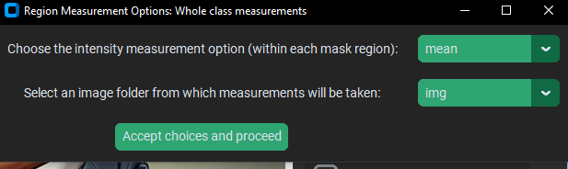
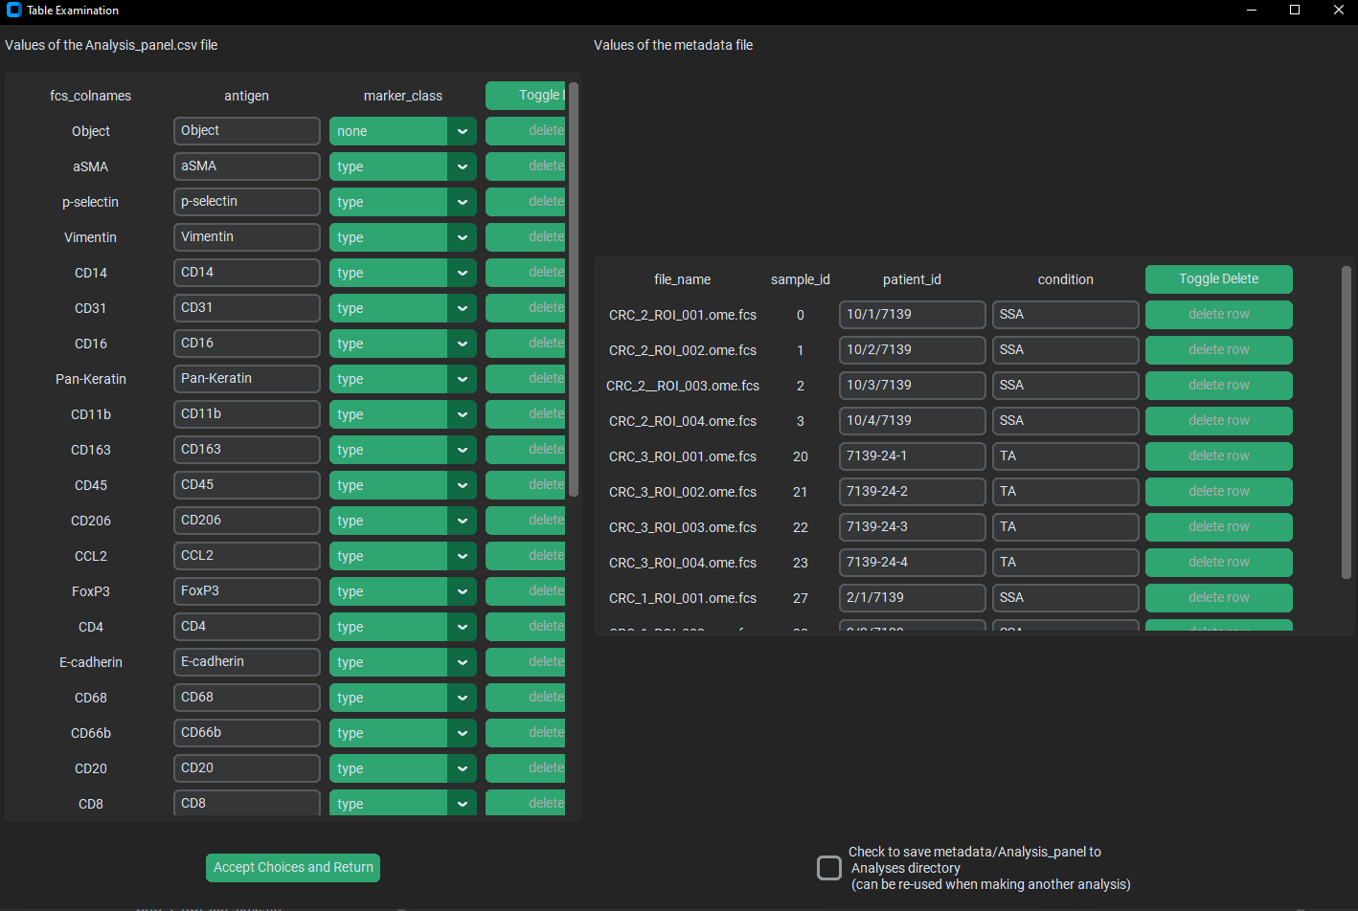
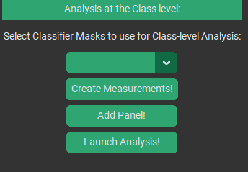
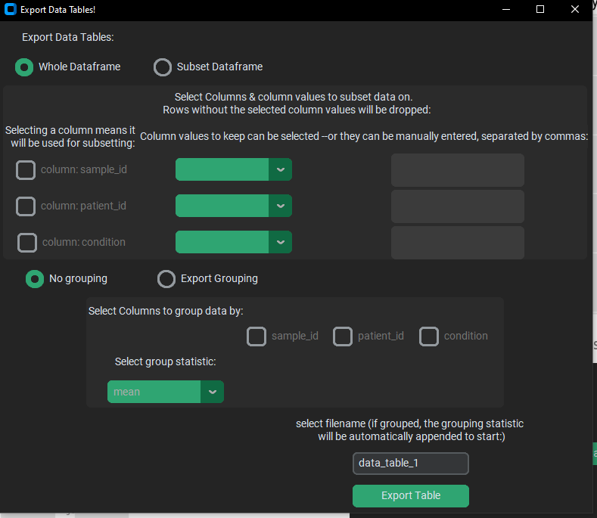
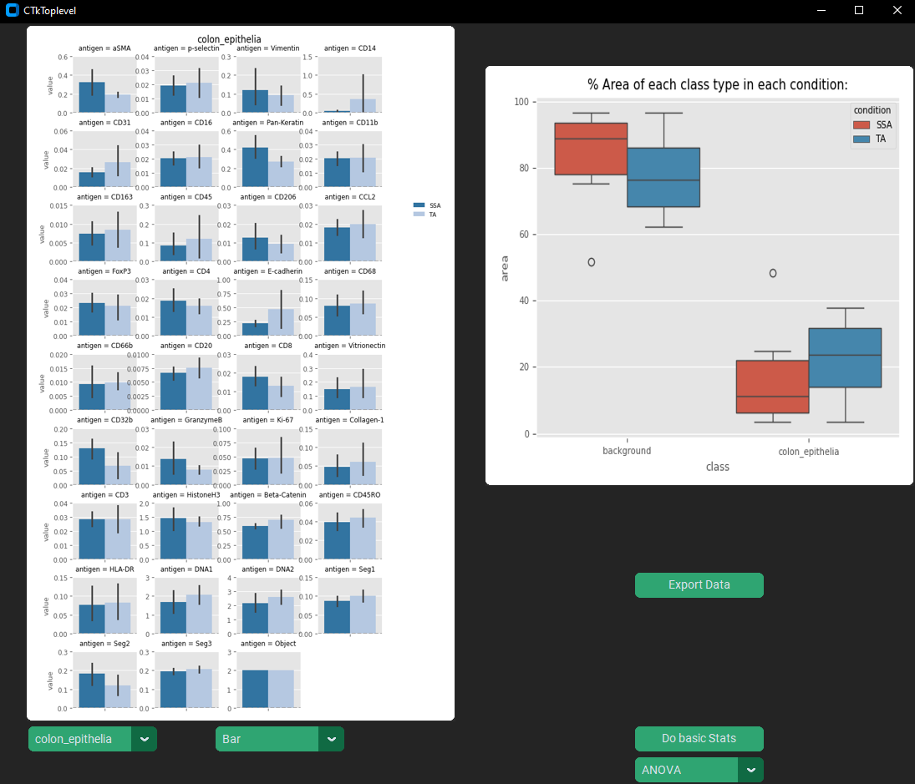
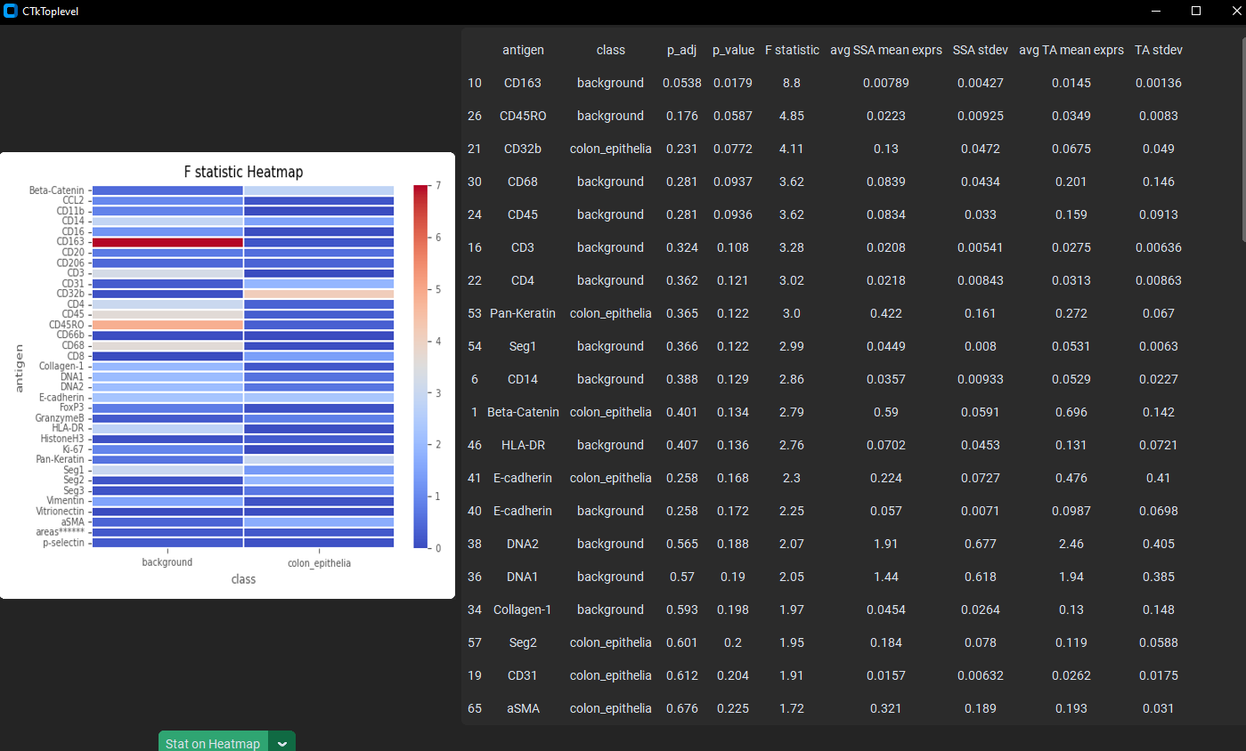
The creating measurements & adding panel steps are directly borrowed from the main pipeline of PalmettoBUG leading up to single-cell analysis.
The widgets and options here are very similar, except instead of measuring cells, we are measuring from the entire pixel class in an image at once (each unique class in an image is a single mask)
You must do these steps in order!
The Analysis panel is not used in the GUI currently not used in the GUI so you can ignore it for now – only the metadata table matters
Exporting the whole-class data is possible, to allow more thorough analysis in a separate software, if desired.
The Analysis window for this offers a few limited options
Basic stats are also available if desired.

Slide 5
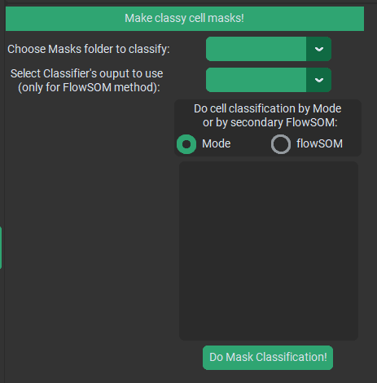
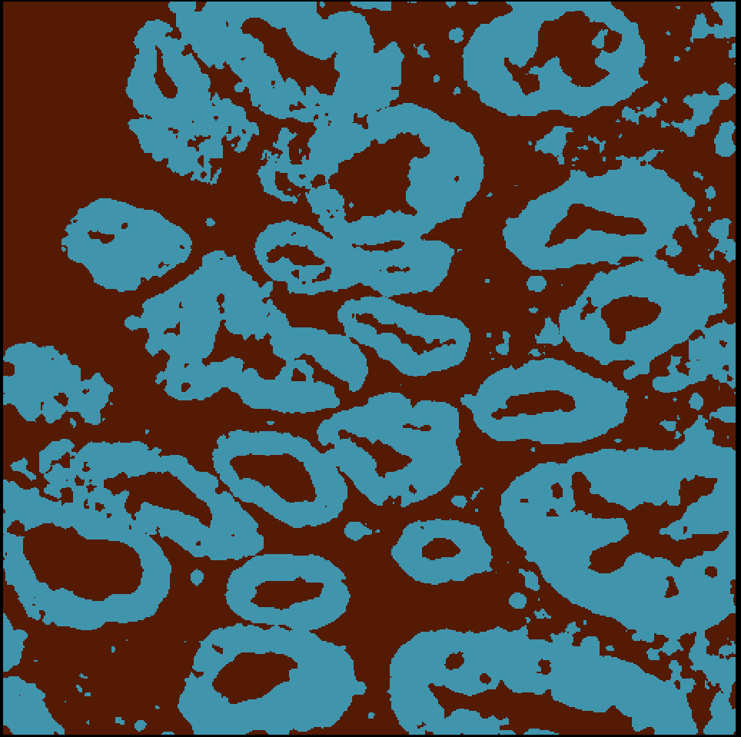
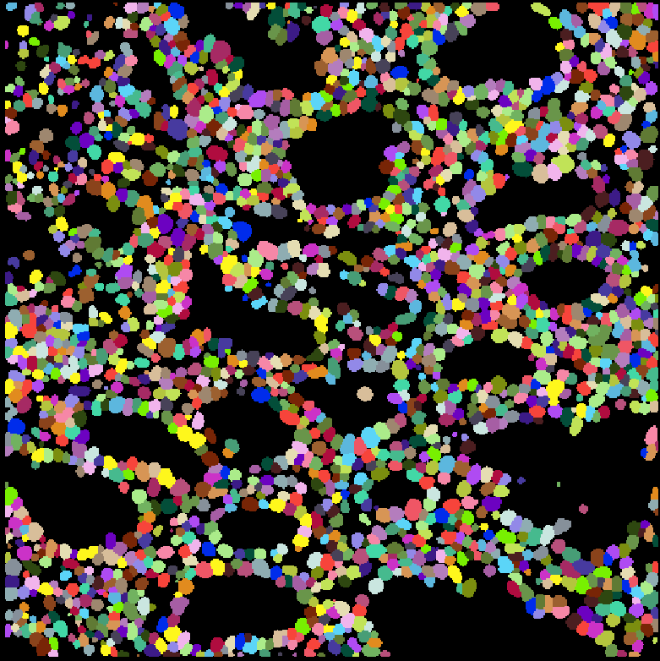
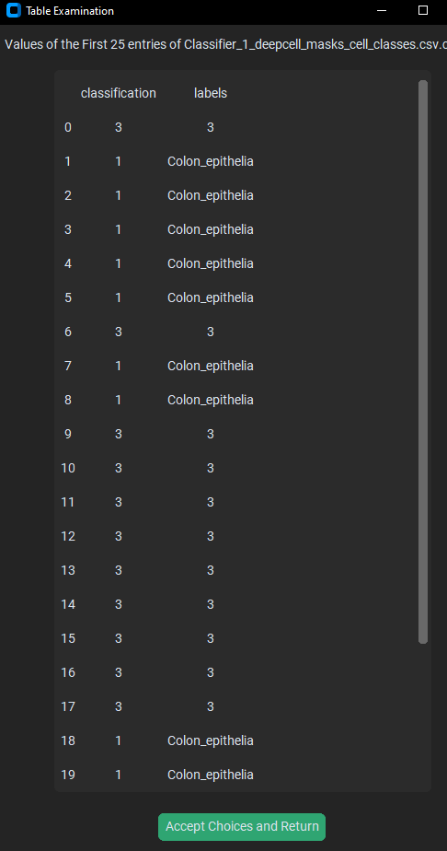
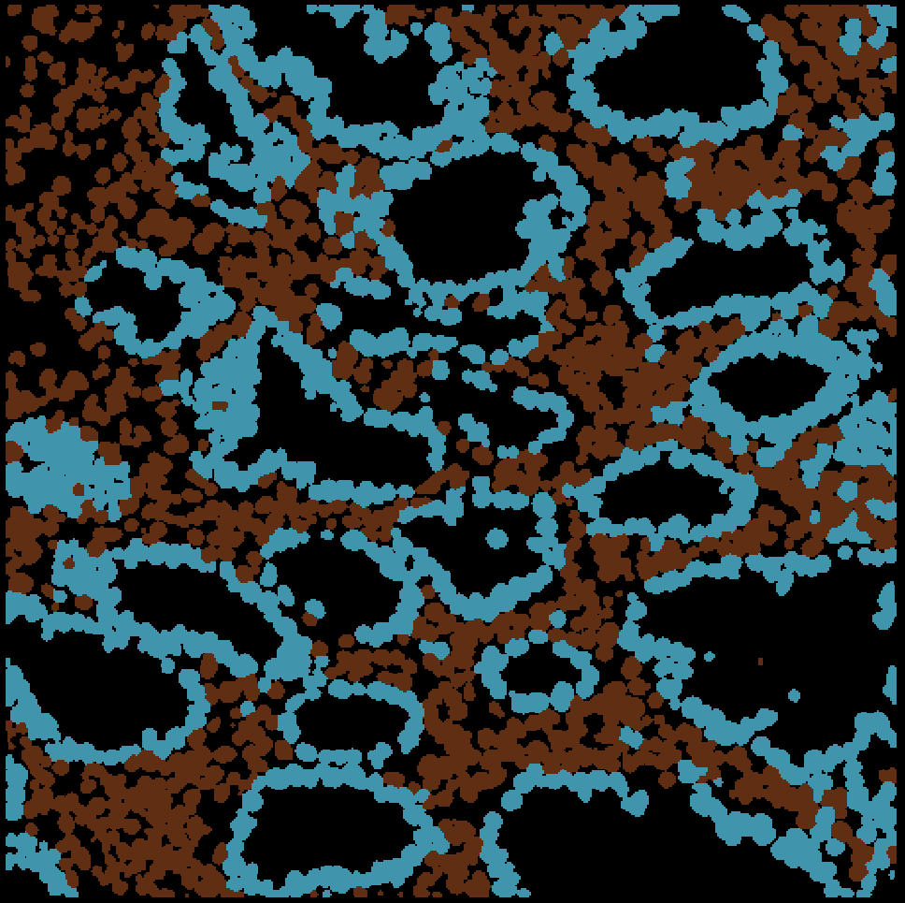
Classy cell by most common pixel class inside it (statistical mode, usually for supervised classifiers)
Cell masks are grouped into classes by which pixel class is most abundant inside them
A csv file with the class label for every cell is also created. This can be loaded into a single cell analysis created from the same masks. This provides another way to group cells in that part of the program!
You may see color changes in the classy masks because of how the ‘background’ class can be treated differently than other classes

Slide 6
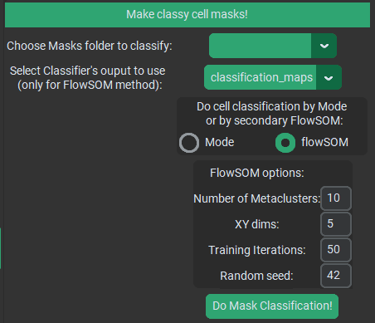
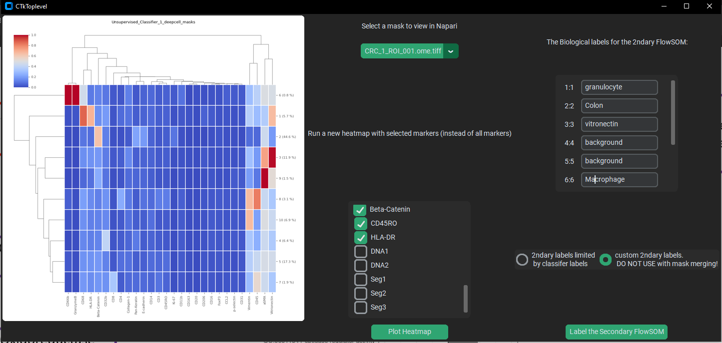
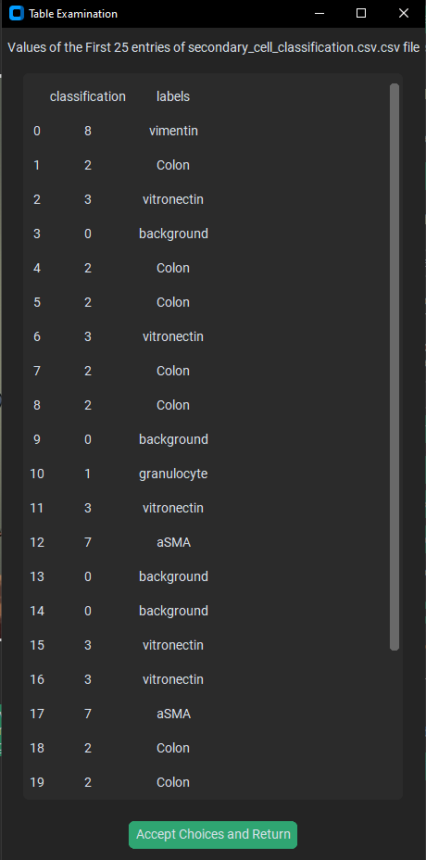
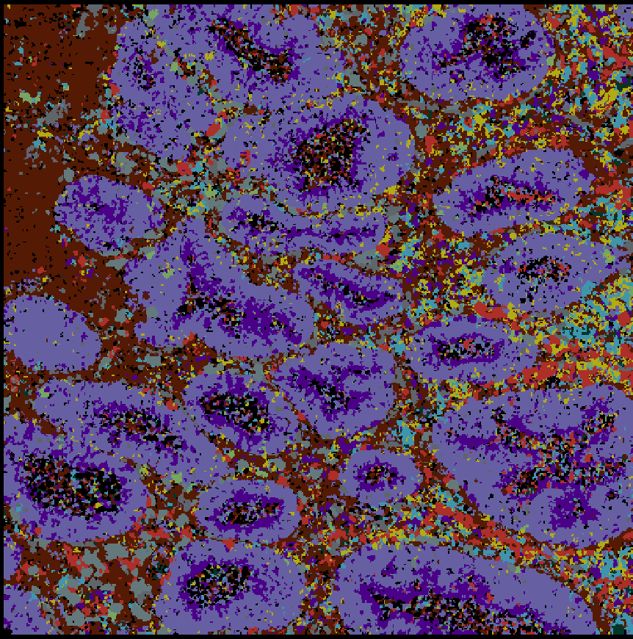
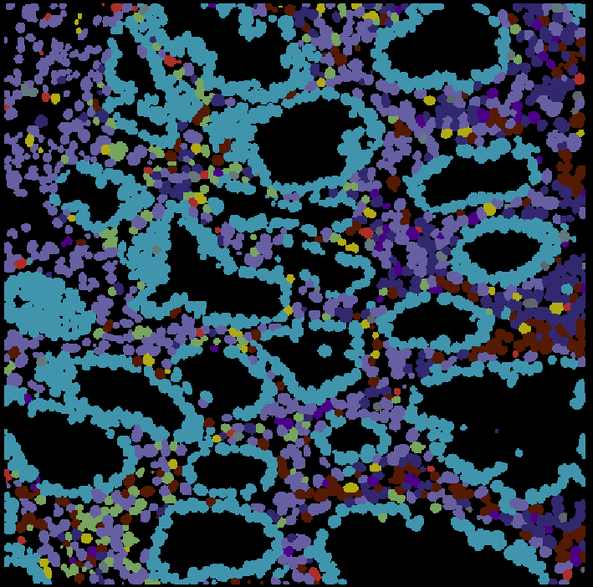
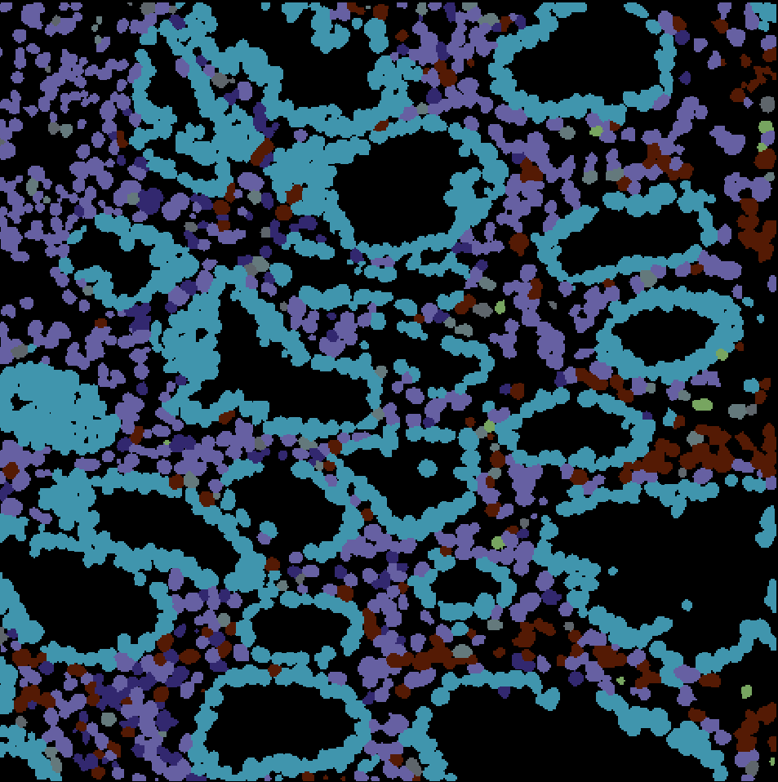
Segmentation masks
Class expression heatmap & image examination
Annotate / Merge
Initial cell classes
Labeled cell classes
Pixel classification (usually unsupervised for this)
FlowSOM cluster on % of each pixel class inside cell

Slide 7
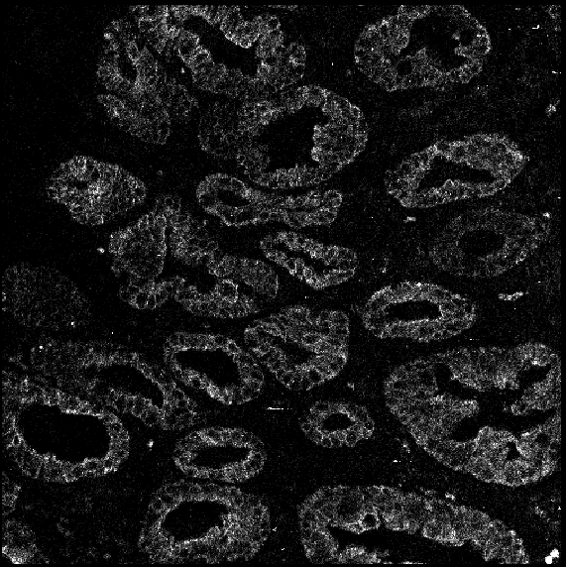
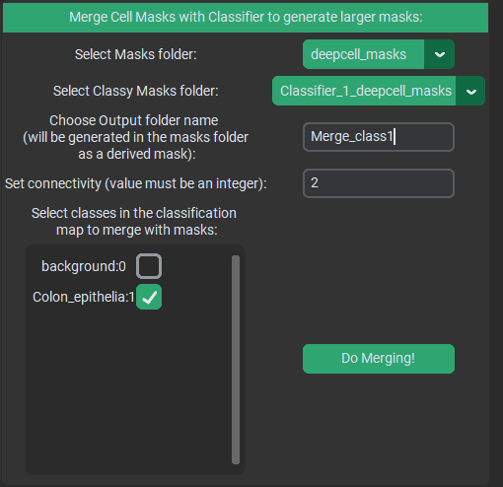
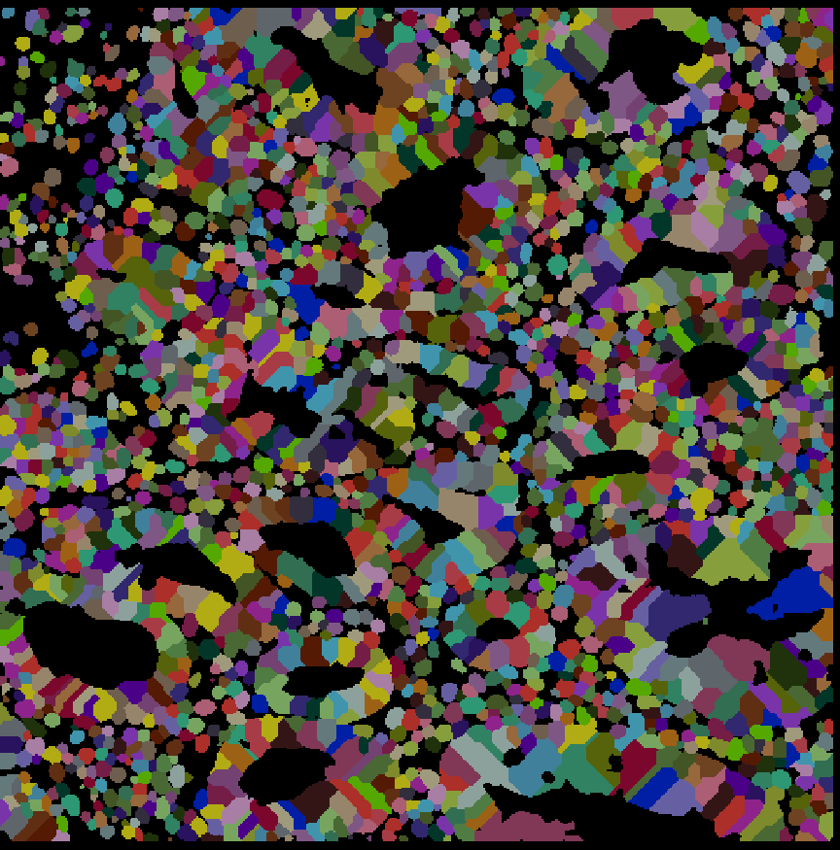
Choose masks and classified masks (pixel classification maps automatically found in the loaded classifier)
Original Image
Pixel Class
Initial Segmentation
Classified Segmentation
Select class to extend into
Extended Segmentation into surrounding, matching pixel classes

