Slide 1
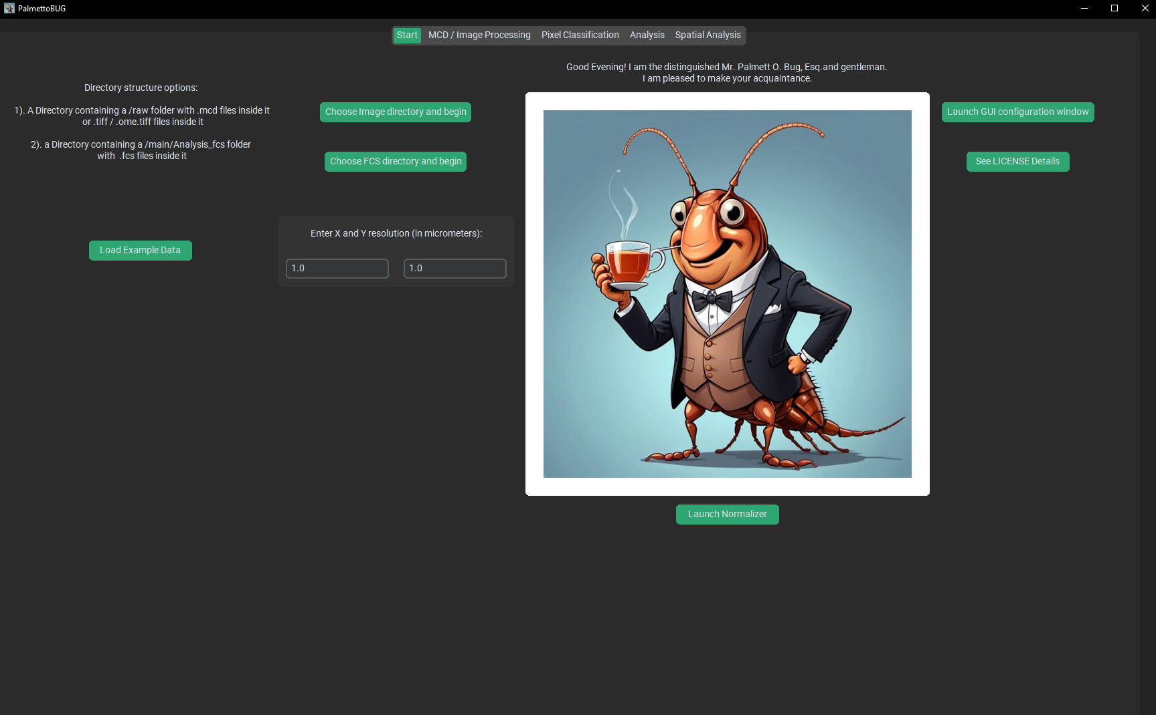

Slide 2
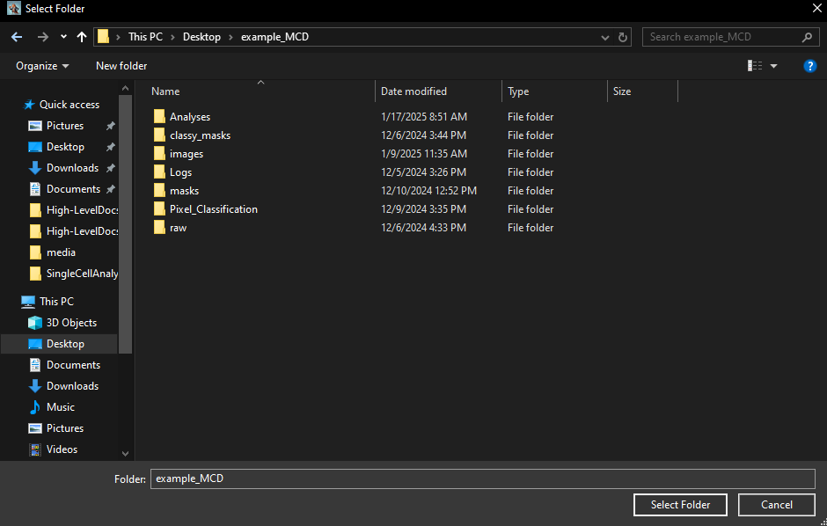
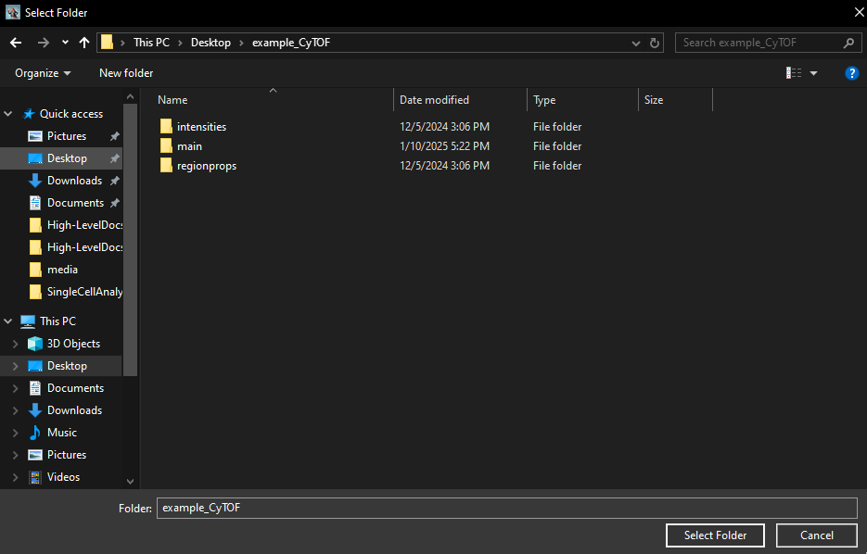
What matters for loading an imaging experiment is that there are either .mcd or .tiff files in the following sub-folder of the directory you chose:
/raw
What matters for loading a solution-mode experiment is that there are .fcs files in the following sub-folder of the directory you chose:
/main/Analysis_fcs

