Slide 1
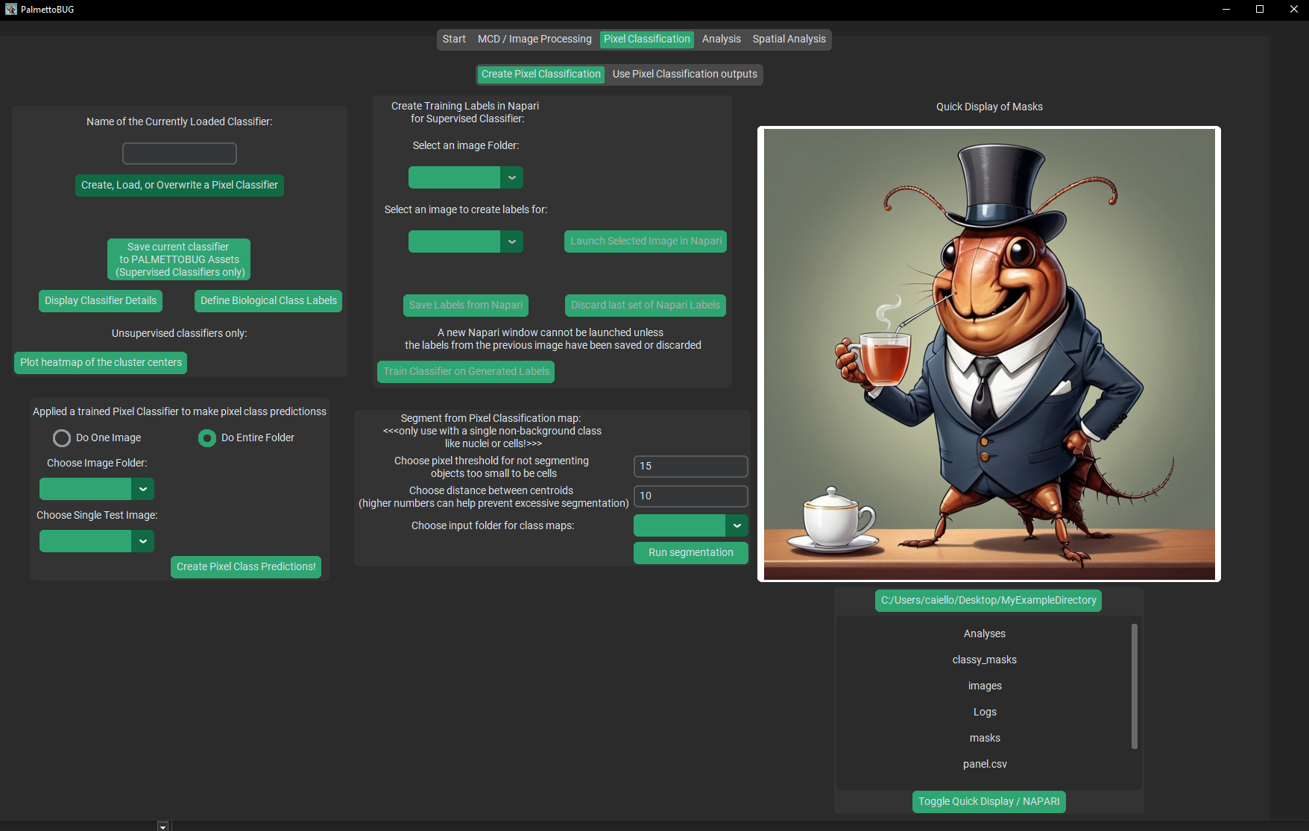
Create and/or examine a classifier
Train a supervised classifier
Predict classification maps from a classifier
Segment images from classification maps

Slide 2
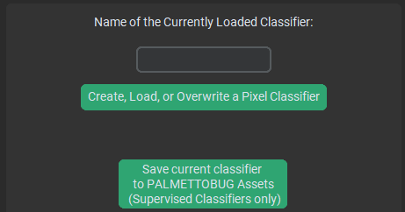
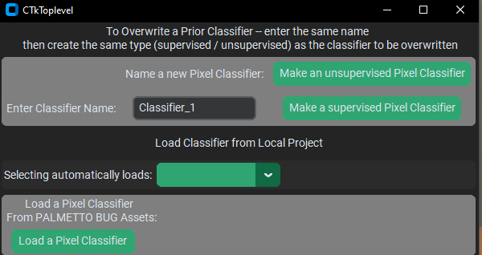
Make a new supervised classifier
Any supervised classifier you have previously made in this project will be available to reload
You can save a supervised pixel classifier to your PalmettoBUG installation and load it again later here in any project.

Slide 3
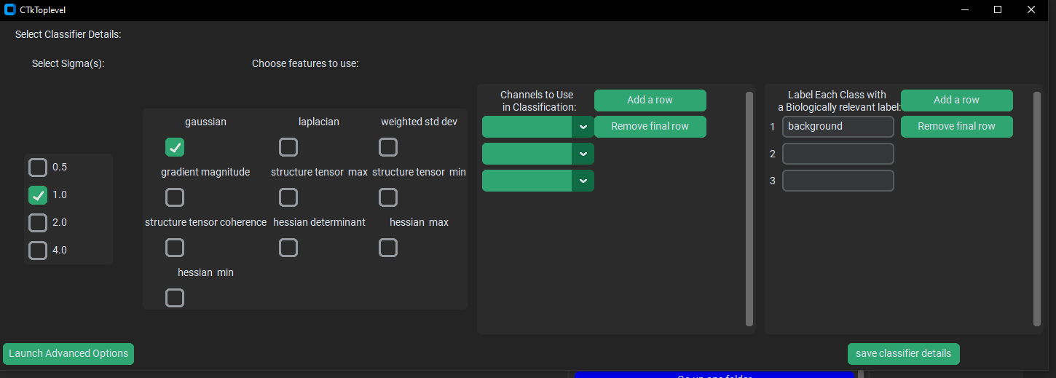
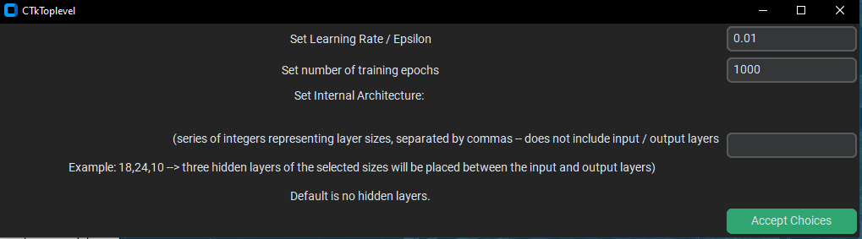

Higher sigmas are higher levels of gaussian blurring of the image before calculating features.
Multiple sigmas are often wise as it can help provide information at multiple scales to the classifier
Select channels
Be sure to give the classifier a unique name, to avoid overwriting previous classifiers
Biological Labels must be given to each output class before creating it
Features are transformations of the channels that can provide additional information to the classifier
Advanced options are not commonly used, except if you want to add hidden layers

Slide 4
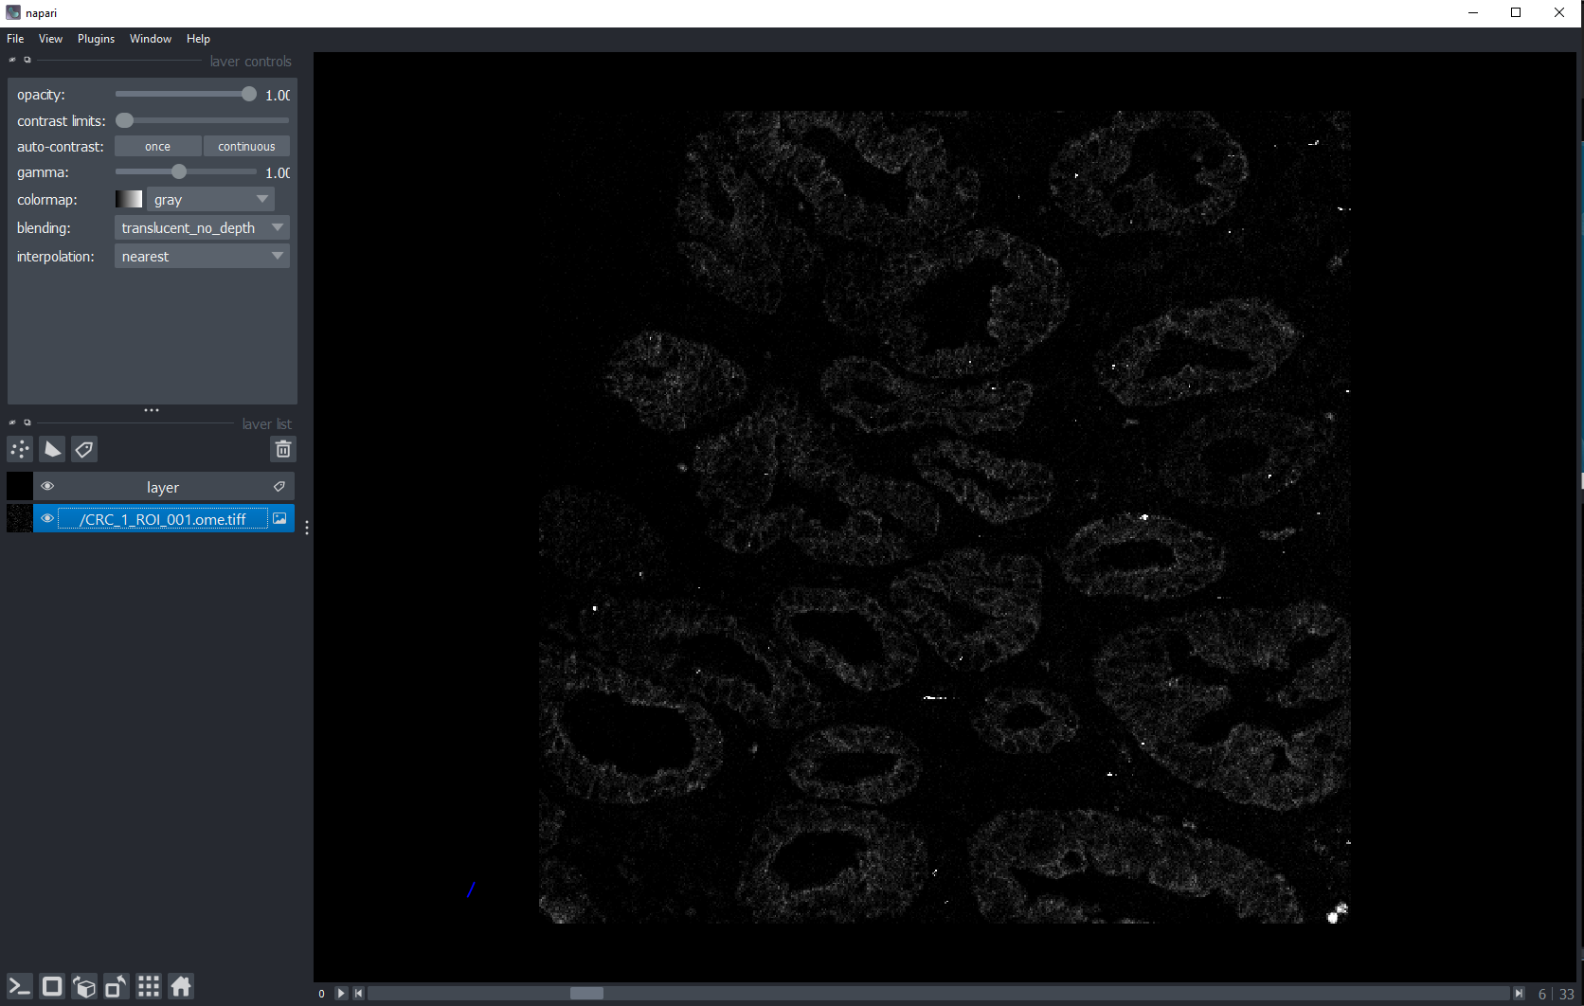
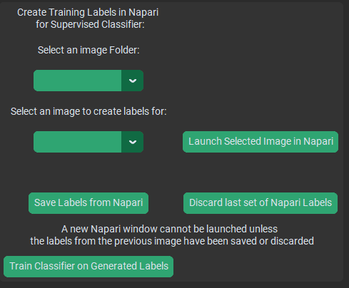
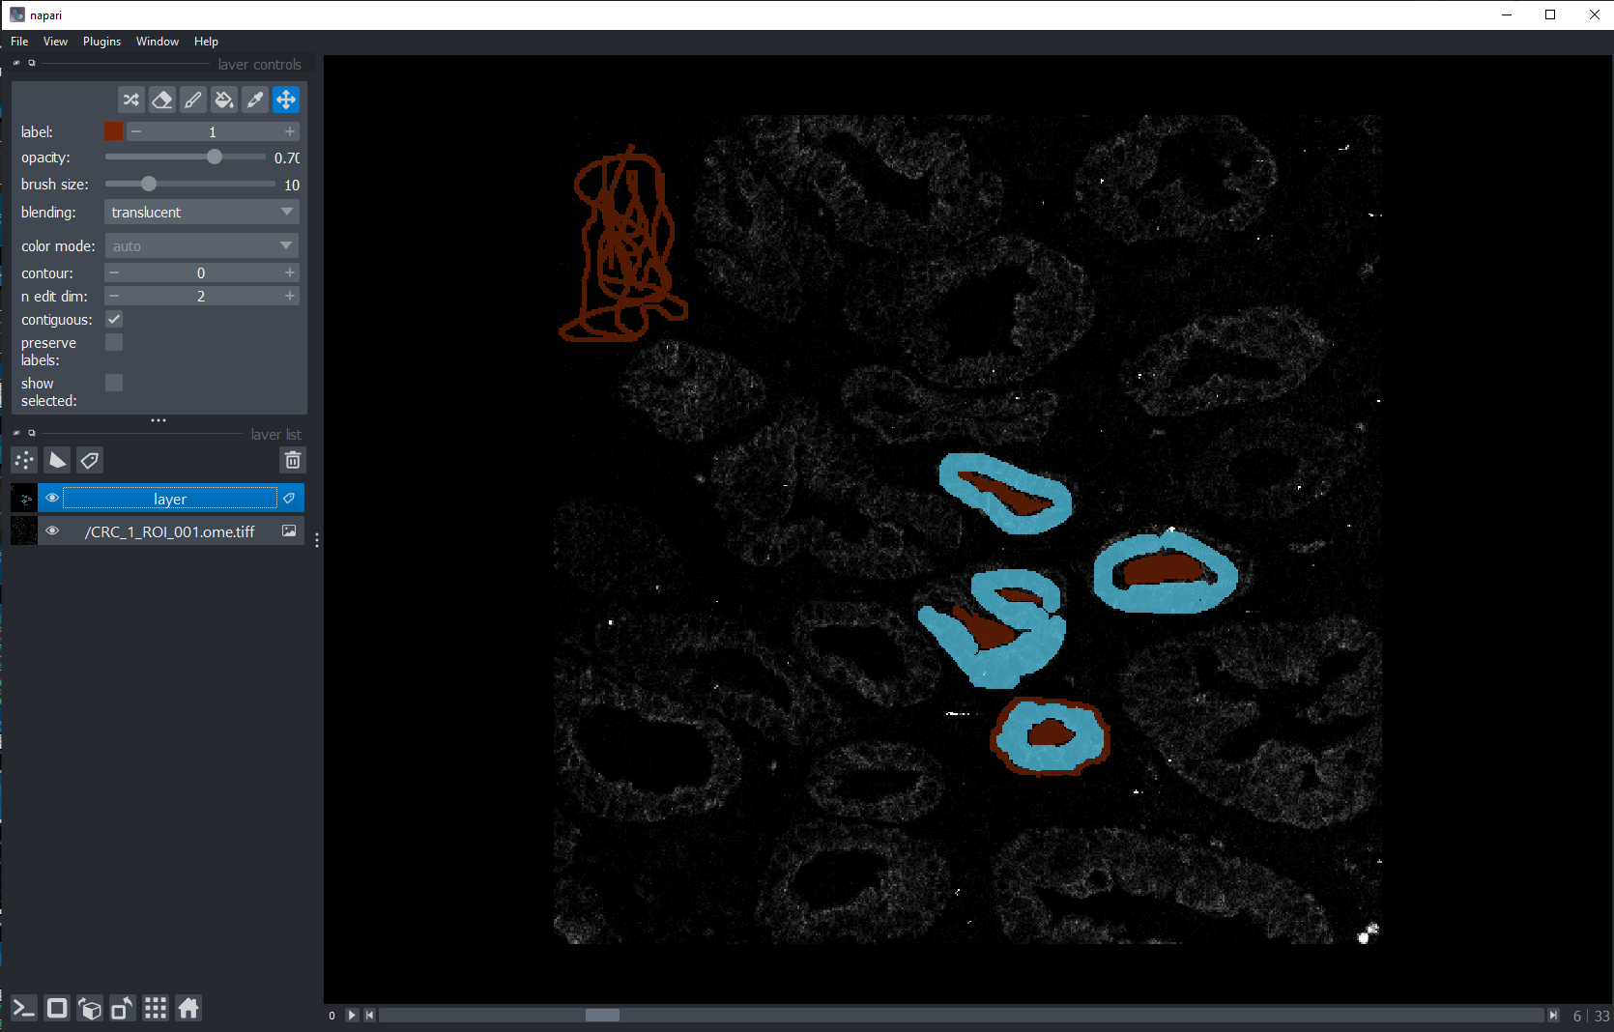
Select an image folder, an image, and then launch that image in Napari
Use Napari to create training labels on the image, then close Napari
Once created, save the labels you made (or discard)
Once you have made all the training labels that you wanted to, train the classifier on them

Slide 5
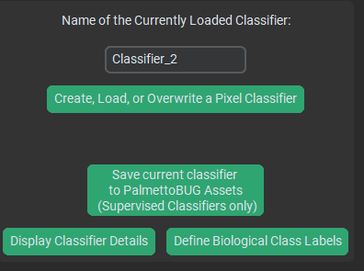
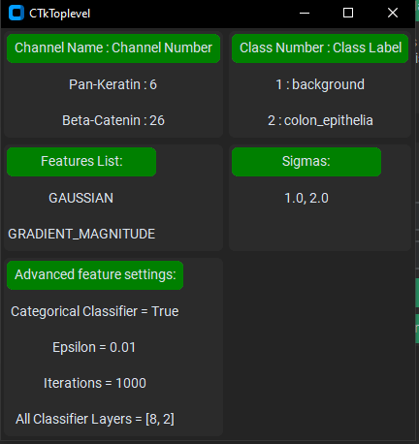
Key commands: erase, create, brush size, move image
Select class to make labels for (every class needs to have at least some labels!)
“Layer” is the training the labels you are making. Select this when you are creating the labels
It can be very good to open the classifier details before launching training labels, since it can help you remember the classes and channel numbers
Select the named image below if you want to change the contrast of the image channels
It’s good to have labels close to each other, to help the classifier decipher borders
Find the right channel

Slide 6
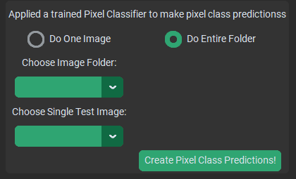
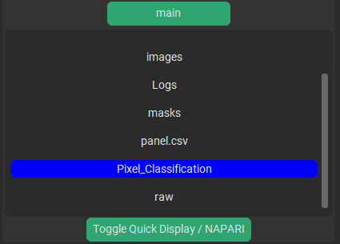
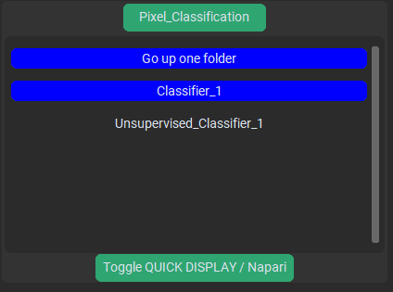
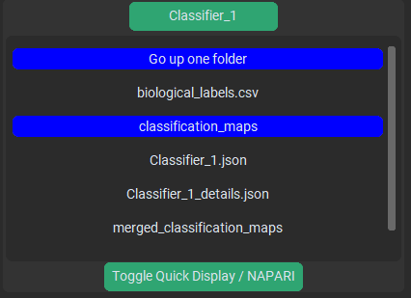
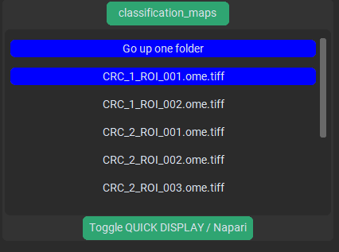
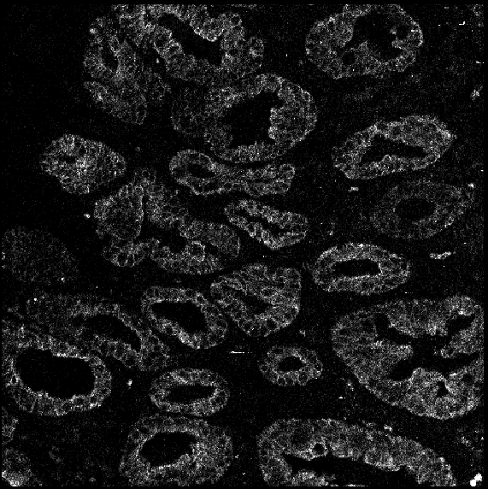
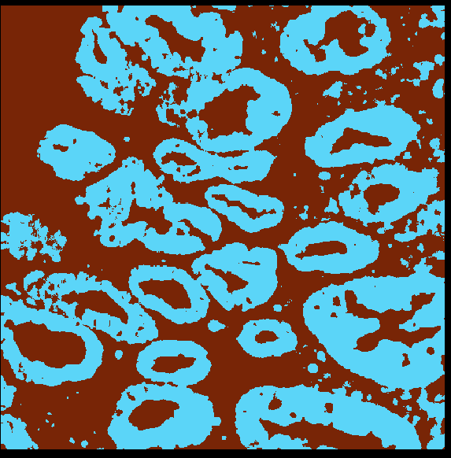
Select what image(s) to predict on, then run
The predictions will be silently written to the /classification_maps folder of the pixel classifier.
From there, they can be accessed by the rest of the program
The directory display can be used to see a pixel class prediction map in Napari
Pixel_classification → {Classifier Name} → classification_maps → {image name}
example path: /Pixel_classification/Classifier_1/classification_maps/CRC_1_ROI_001.ome.tiff
Example prediction

Slide 7
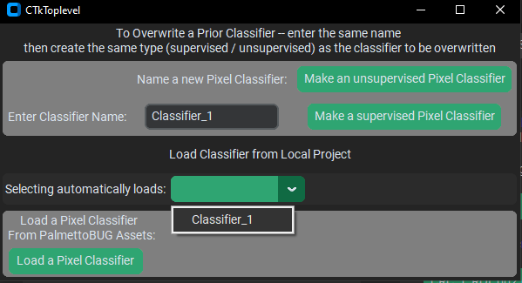
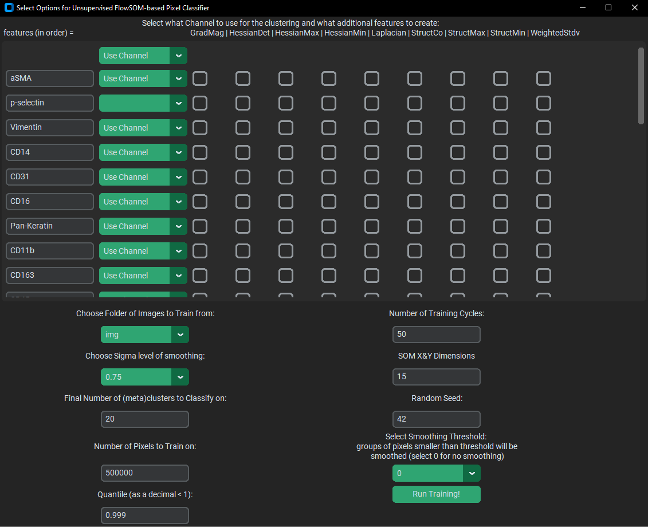
Channels and features are selected here. Unlike in a supervised classifier, channels can have different features from each other
“Unsupervised_” will be added to the name of any unsupervised classifier that you create
There are a variety parameters for unsupervised training – including the feature generation, sampling, and FlowSOM
When you create the classifier, it also runs the training

Slide 8
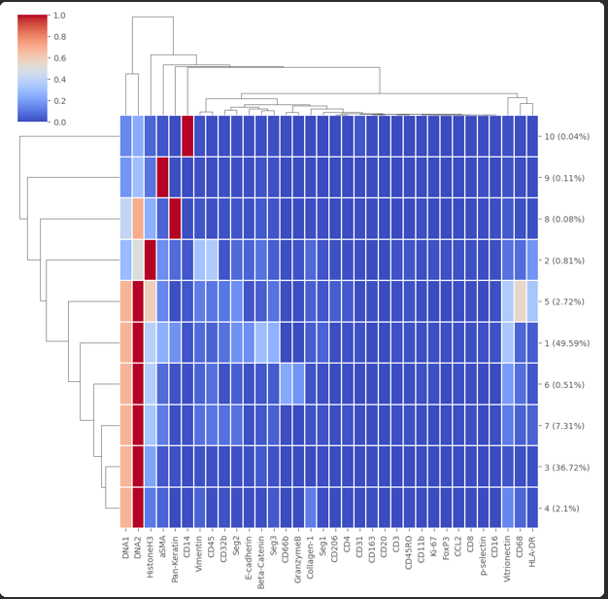
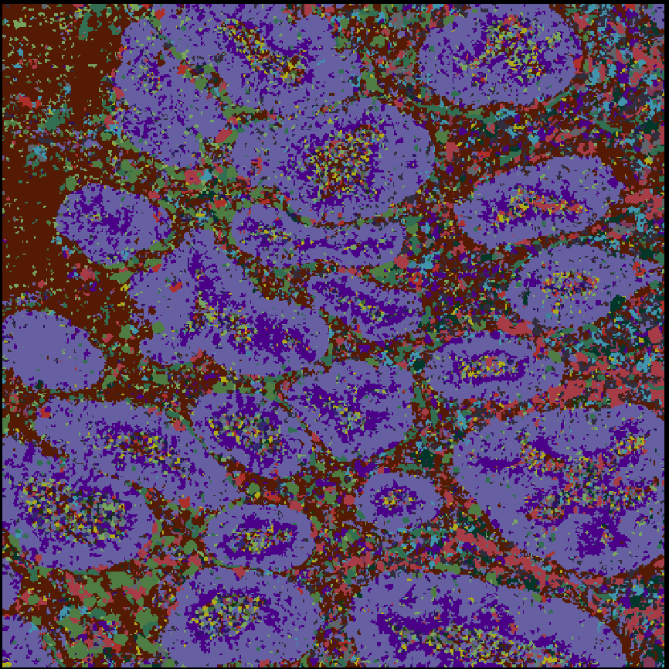
When an entire folder is predicted, a heatmap is created
The procedure and buttons for supervised and unsupervised classifier prediction is the same
These heatmaps can also be created after-the-fact from a folder of pixel class predictions
Example prediction
Note the many small regions of pixel classes in the example

Slide 9
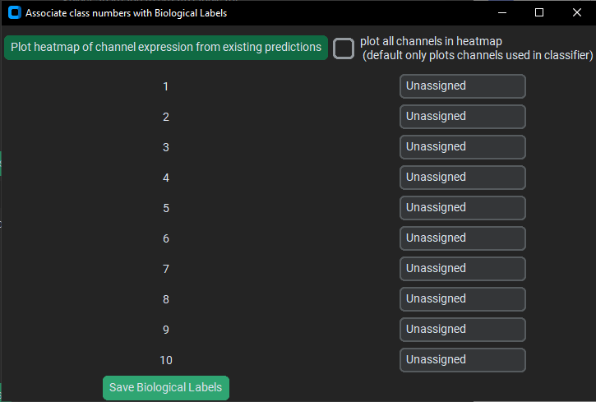
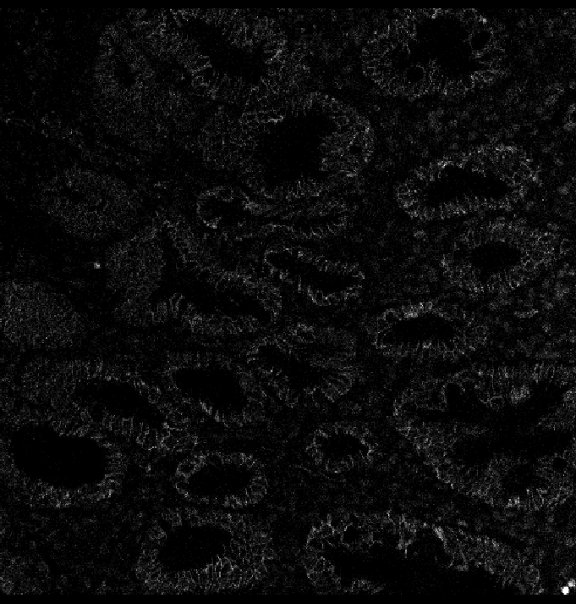
Example Annotation
When you first annotate, the class will all be “Unassigned”.
The names of the classes are flexible, except note that ‘background’ (all lowercase) is a special name that is ignored in downstream steps
The heatmap and the images themselves assist in the merging

Slide 10
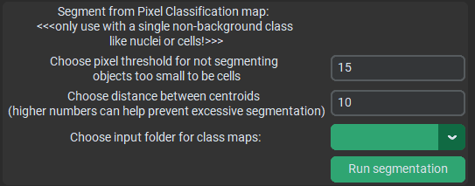
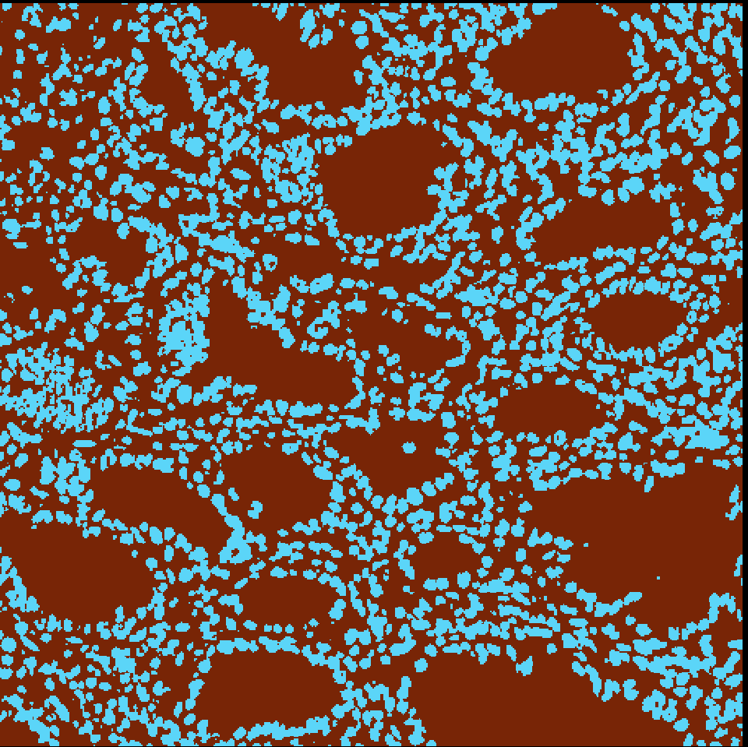
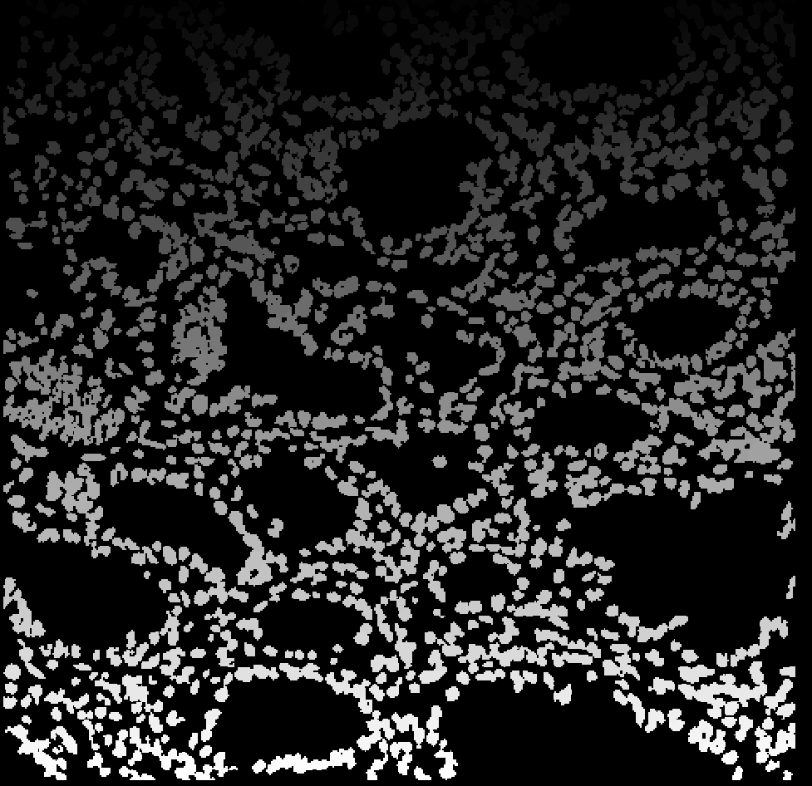
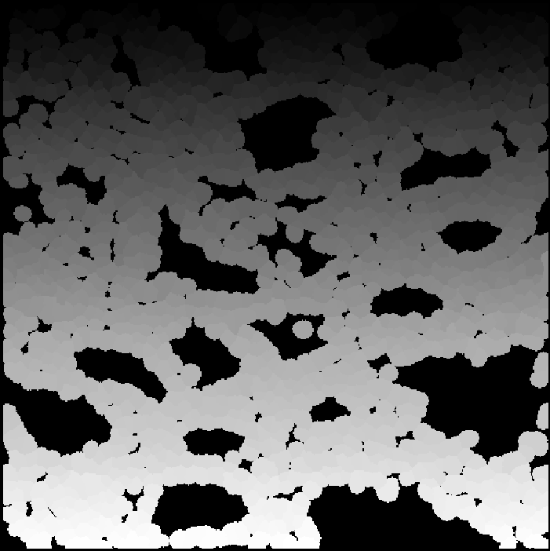
Segmentation objects will not be allowed to be smaller than this,
Nor closer to each other than this (centroid-to-centroid)
Classifier for Nuclei
Segmentation
Expansion of the segmentation masks (in the isoSegDenoise sister program) can be useful in this case to hopefully capture cytoplasm around the nuclei

