Slide 1
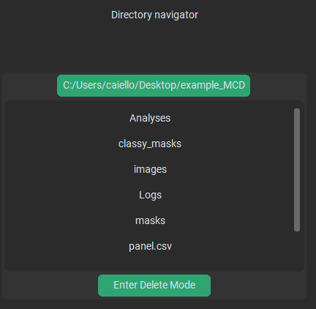
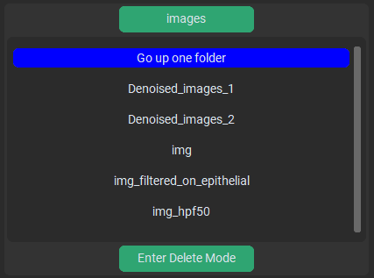
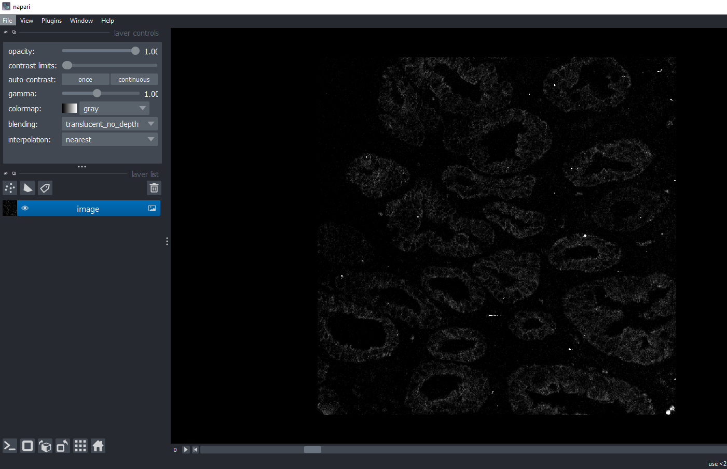
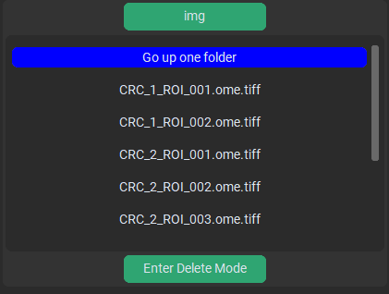
When data is first loaded
Navigating
Current location on the disk,
This is also the top-level of the directory navigator (you can’t go into any folder above this)
The folder you are in
This returns you to the top-level directory
All folders and files in the current location are listed in this scroll menu
If you really want to, you can delete files directly from inside PalmettoBUG (you cannot delete folders). Be careful what you delete!
Clicking on different file types does different things:
>> .tiff’s open in a new Napari window
>> .csv open a table window
>> .png files (except in the initial & Image Processing tabs) will be displayed inside PalmettoBUG

Slide 2
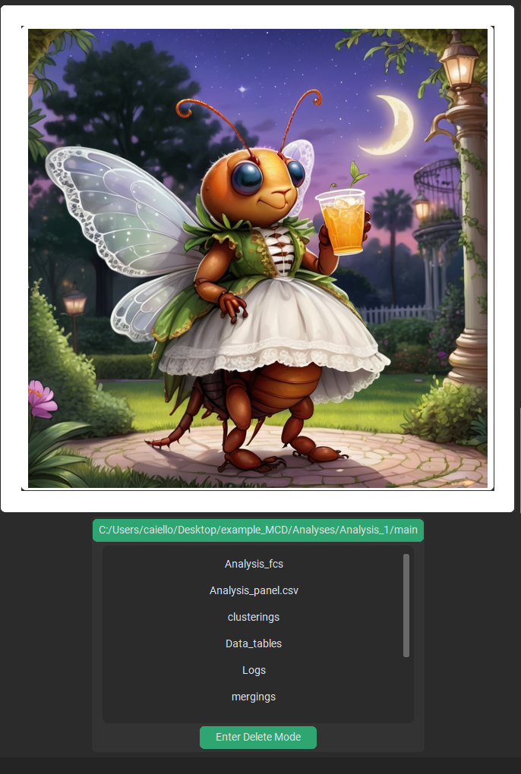
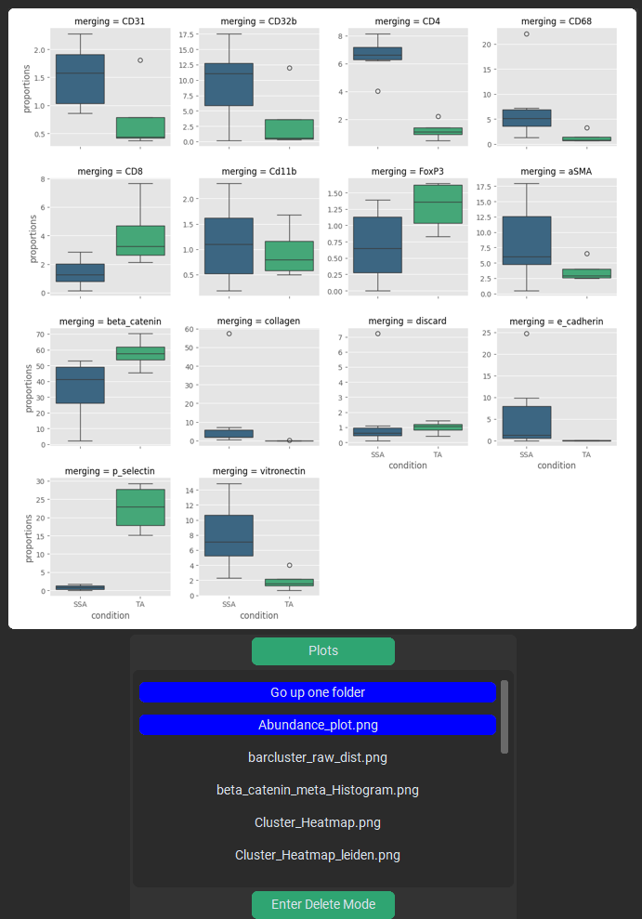
The Plot display sits on top of the directory display
Making a plot, or clicking a plot (aka, .png file) inside the directory display will show that plot here

Slide 3
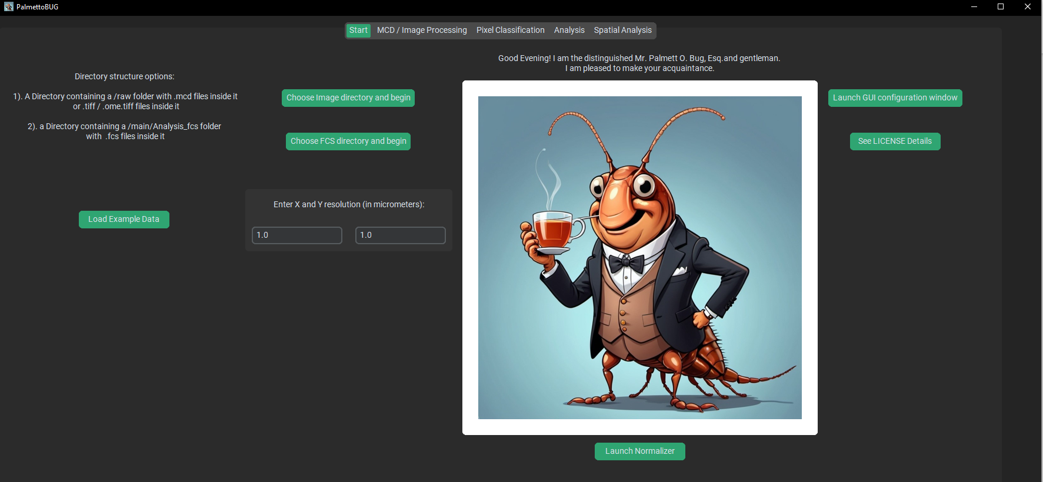
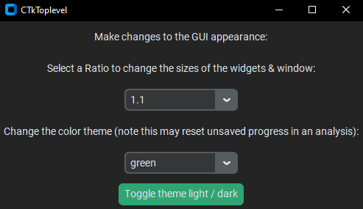
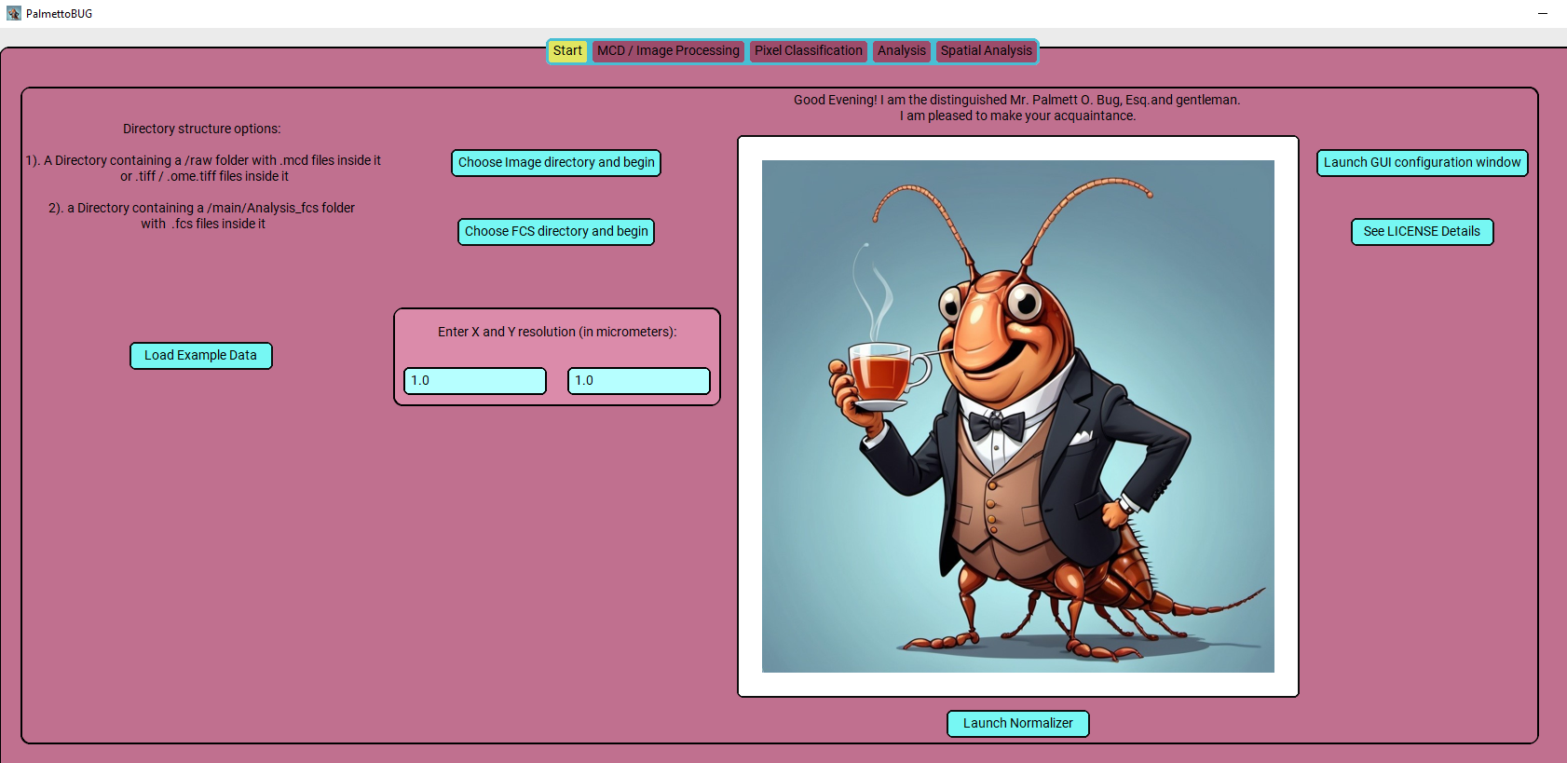
This resizes all the widgets in the program
Changing the color scheme can be fun
This is the “TestCard” Theme in light mode

