Slide 1
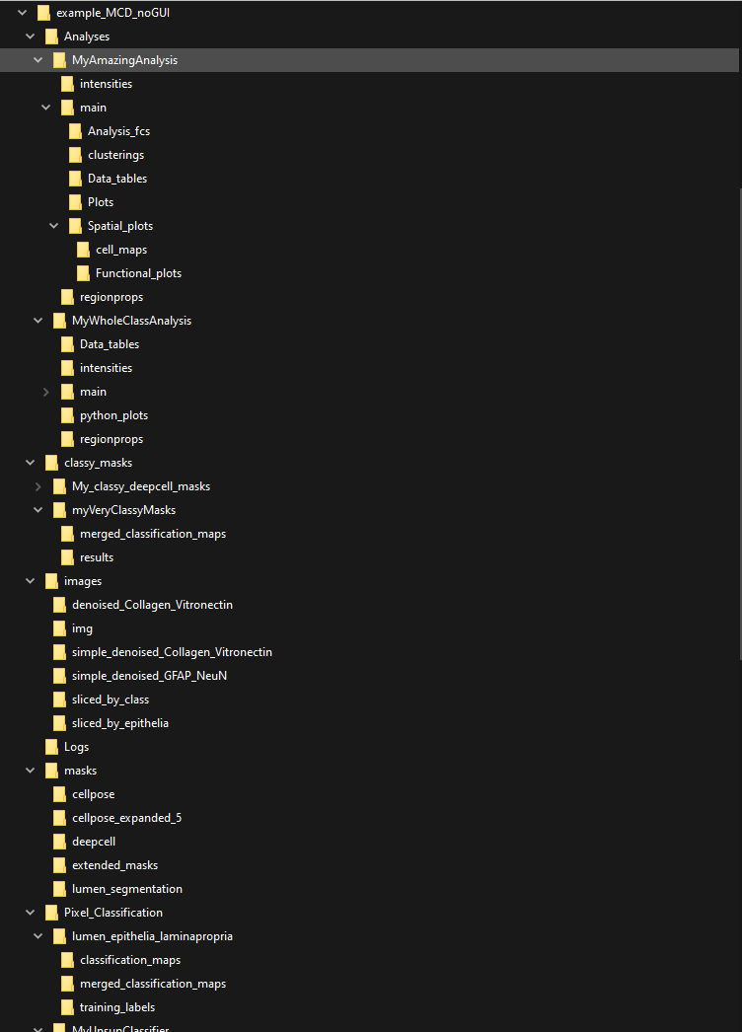
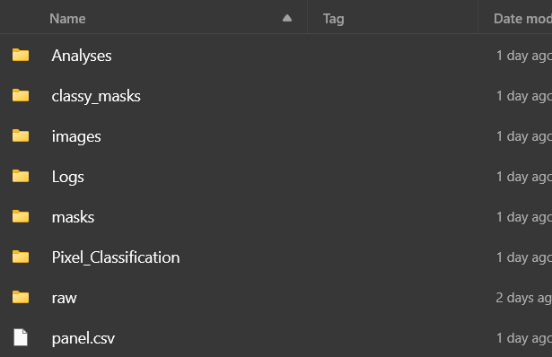
How big could a project really be?
The first level of files and sub-folders in a PalmettoBUG project
One project can have more than one analysis, each with its own sub-folder in /Analyses
And it all starts with just a few lonely data files in /raw …
Each time a pixel classifier is used to classify cells into groups, a sub-folder is made in /classy_masks
Each time a new set of images is made, such as by denoising, a sub-folder is made in /images
If you are trying a variety of different denoising, segmentation, or pixel classification methods, then the project directory can expand very quickly!
Each time a new set of segmentation masks is made, a sub-folder is made in /masks
Each time a new pixel classifier is made, a sub-folder is made in /Pixel_classification

Slide 2
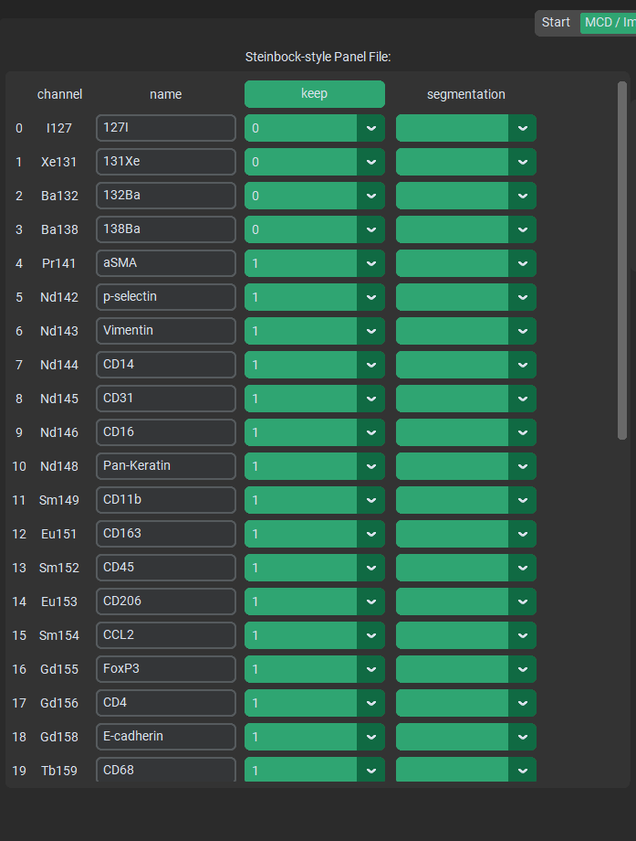
The panel.csv file, as displayed in PalmettoBUG
Before each Image Processing step is performed,
The panel file is re-saved with the current selections in GUI. This means that what you see in the GUI should always be accurate to the panel file in project directory.

Slide 3
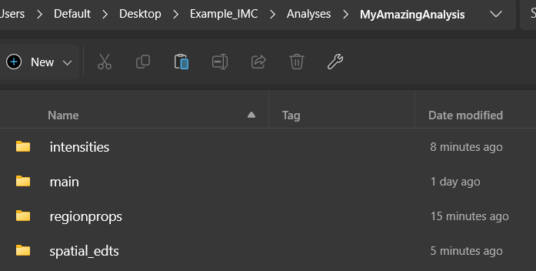
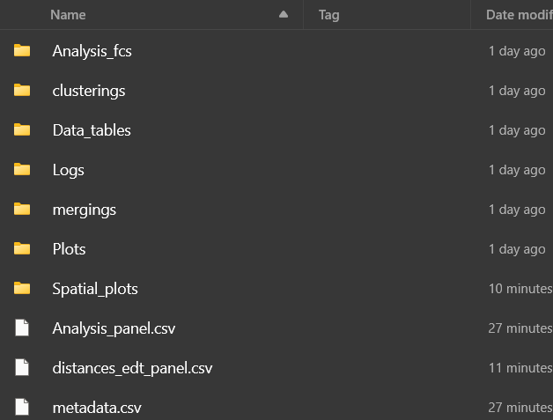
Intensities, regionprops, and spatial_edt folders contain .csv files of data that can be used by an imaging-based analysis
Your raw FCS files (converted from intensities .csv’s in an imaging experiment)
Outputs: plots, statistics tables, cell type / clustering annotations, etc.
Metadata and panel files

Slide 4
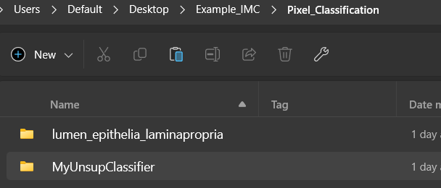
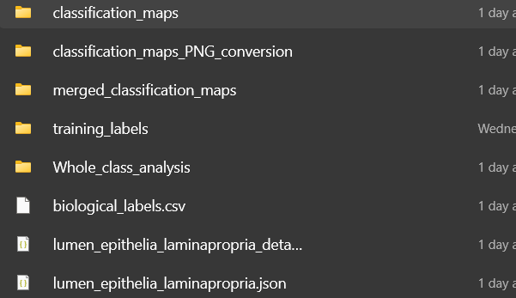
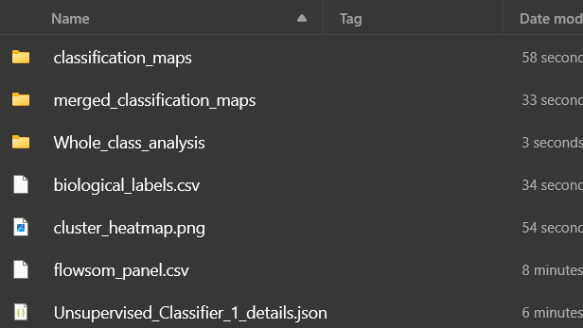
Whole-Class Analysis folders can be in either type of classifier – but only show up if needed. Their internal structure is very similar to a standard PalmettoBUG analysis
Every Pixel Classifier created has its own named folder
Only supervised classifiers need training labels
Both types of classifier use a biological_labels.csv to track class name & numbers, similar naming convention for where the classifier outputs are stored, and use a _details.json file to record the parameters of the classifier
Supervised classifiers have two .json files – together they can be used to recreate the classifier, including the trained neural net for prediction!
Unsupervised Classifiers have a couple extra files associated with their setup & annotation

Slide 5
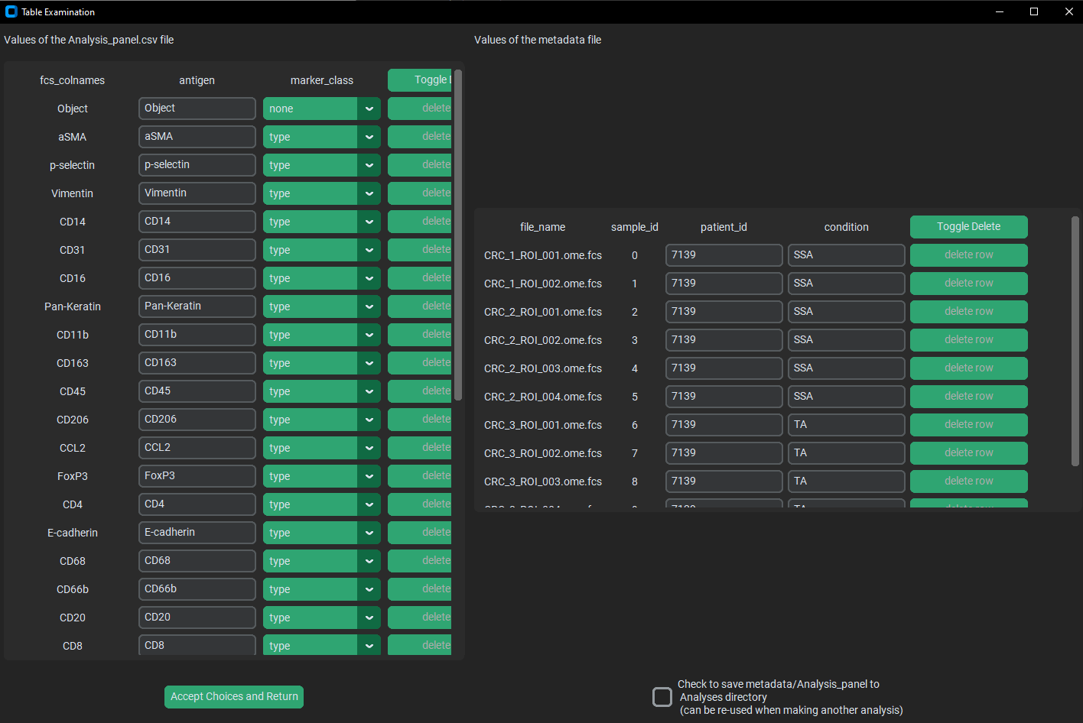

Slide 6
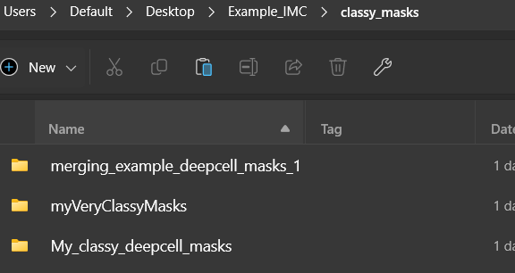
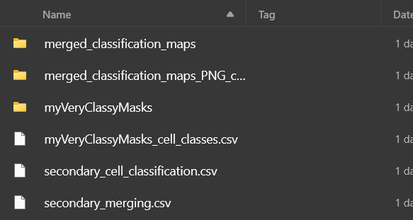
Every Cell mask classification has its own named folder
If the secondary / merging folder and .csv exist, then they supersede the primary folder / .csv.
Every classy mask folder has at least 1 .csv with its same name, and 1 primary masks folder with the same name. Mode-based mask classification ONLY has these
Secondary / merging files are only needed if the cell masks are being classified by a secondary FlowSOM – they contain information and outputs around the necessary merging / annotation step of the primary FlowSOM output
Any set of classy mask or pixel classifier maps can be converted to PNG files

