Slide 1
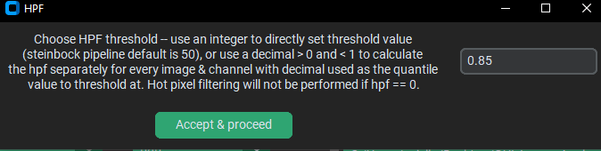
Hot pixel (>50 brighter than all surrounding pixels)
40
0
0
0
0
40
0
0
0
0
0
42
0
95
0
HPF
0
0
9
0
42
Placeholder
45
0
0
3
9
Threshold = 50
45
0
0
3
9
27
23
0
0
11
27
23
0
0
11

Slide 2
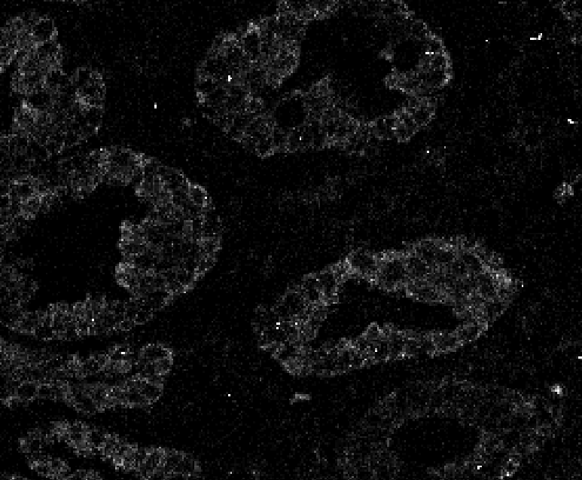
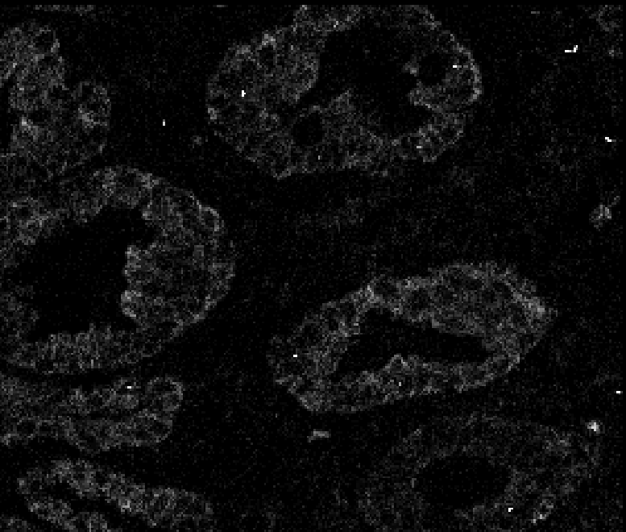

Slide 3
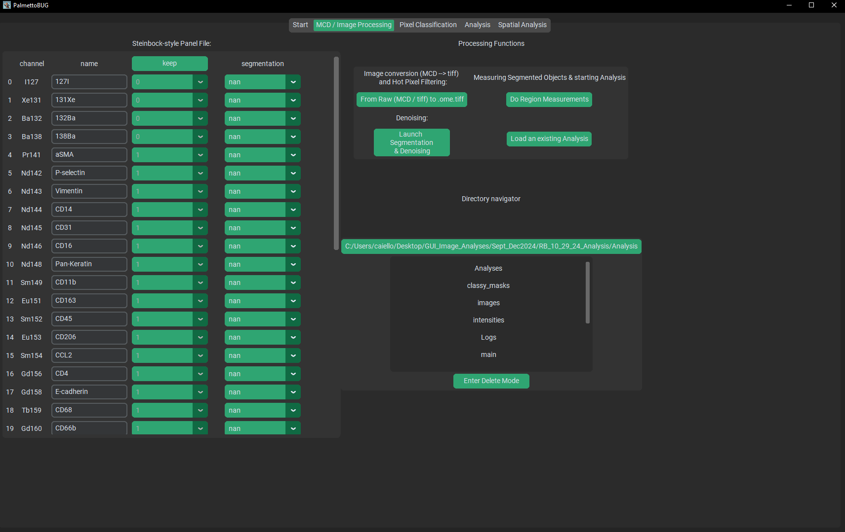
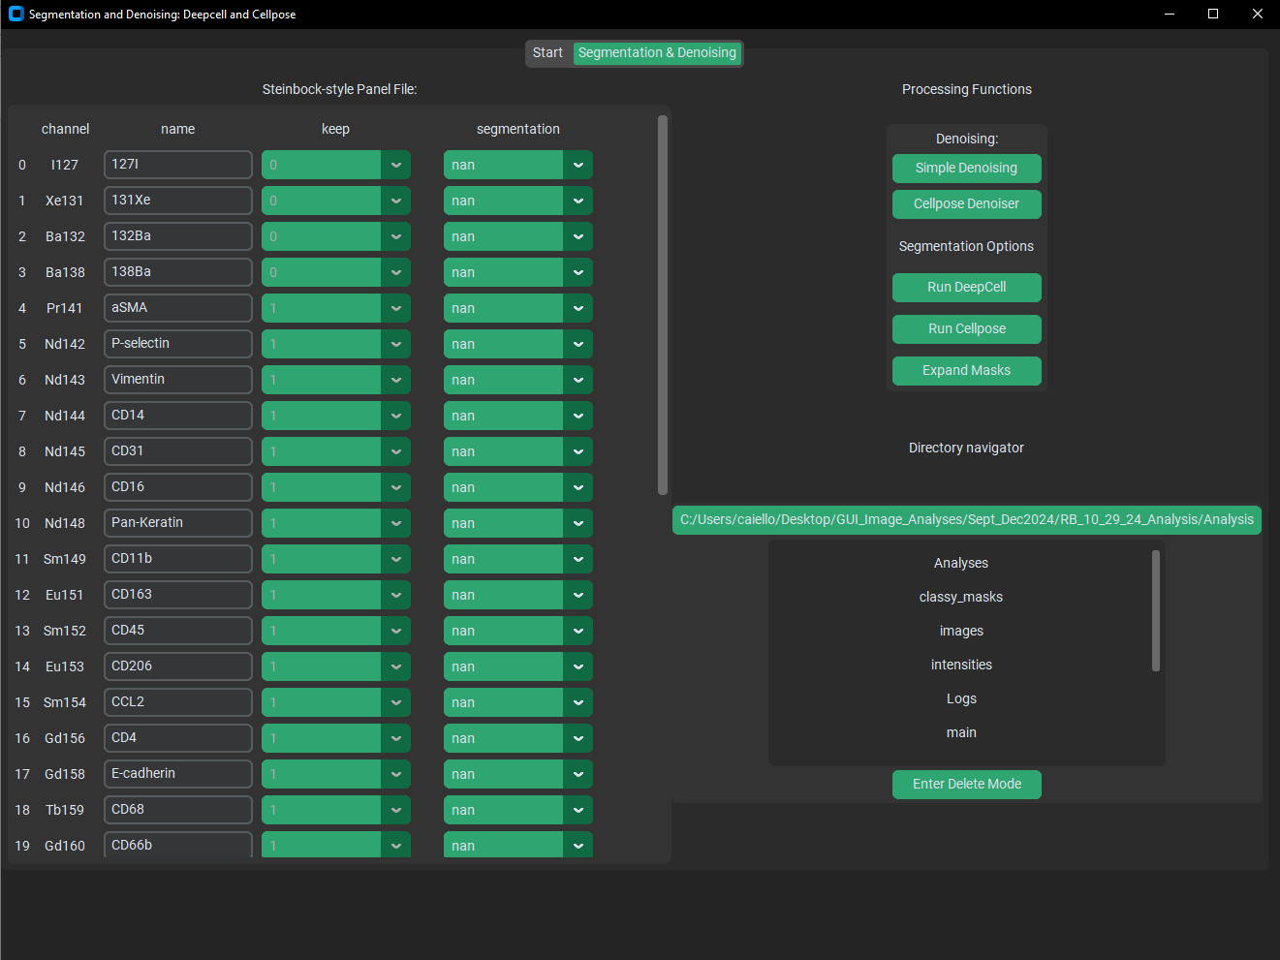
This launches the iSD subprogram in the current directory you are in. It will take some time to launch

Slide 4
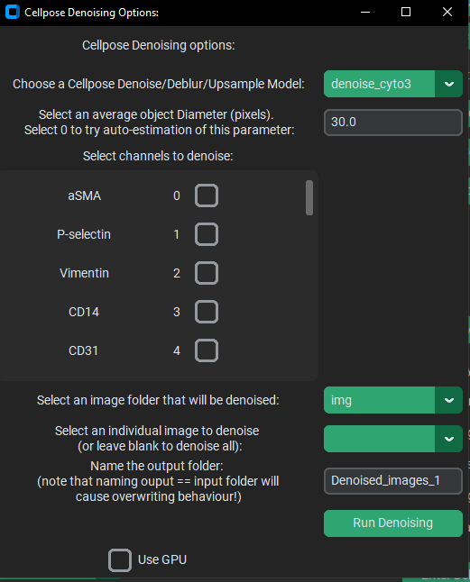
<< Regardez!
Les boutons dénoisé! >>
For Cellpose Denoising, you:
select a model and diameter
select the channel(s) to denoise
select the image(s) to denoise
Name a sub-folder of /images where the denoised images will be saved to

Slide 5
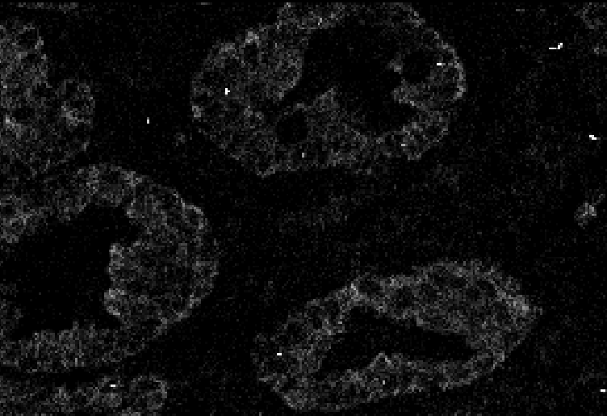
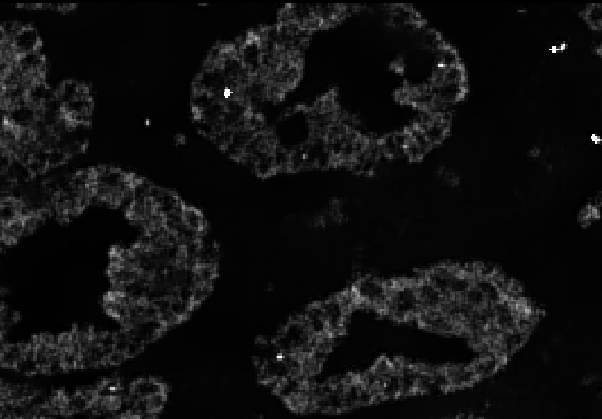
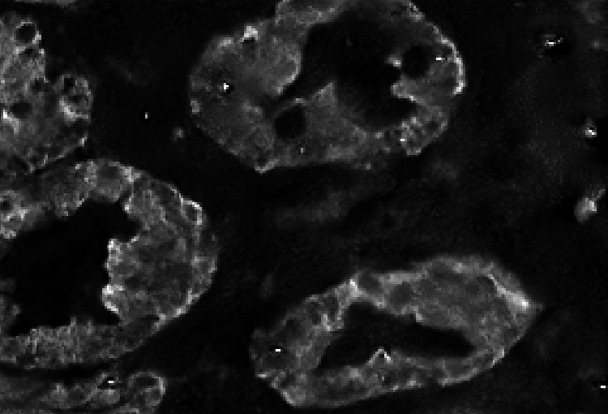
Starting image (after HPF)
Simple Denoise
Cellpose Denoise

Slide 6
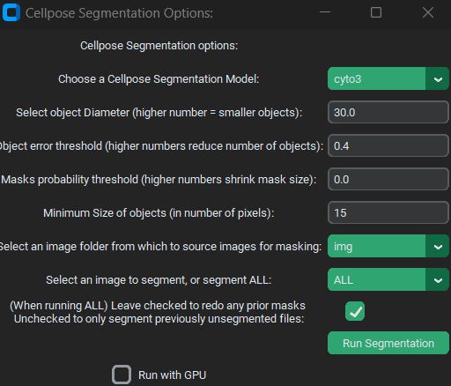
Behold!
The buttons segmentation!
Segmenting cells with Cellpose provides the most options to the user to change. DeepCell / Mesmer segmentation only requires that a folder of images (+ image) be selected

Slide 7
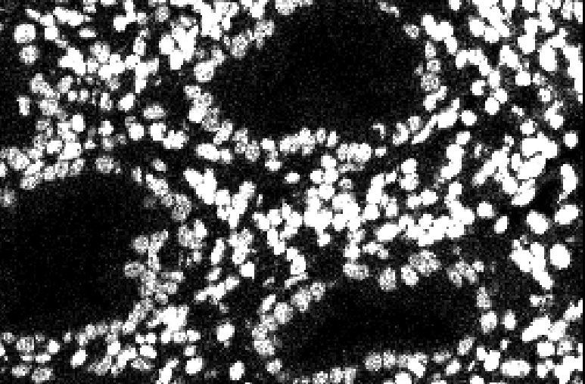
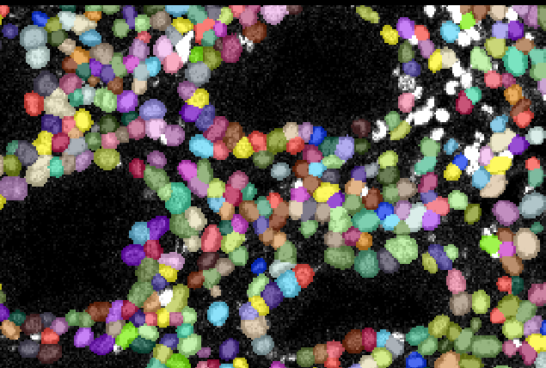
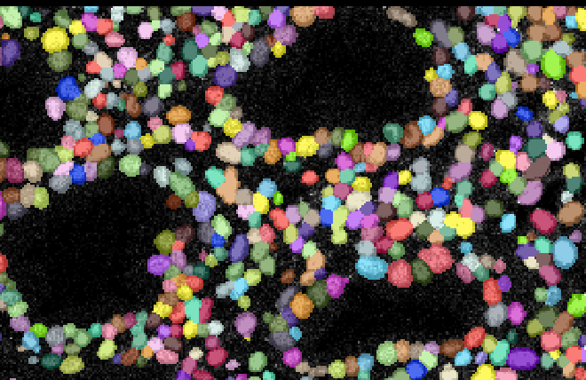
DNA channel
Cellpose Segmentation
(diameter = 65)
DeepCell segmentation
DeepCell can be better finding every cell & is more optimistic about separating densely packed cells

Slide 8
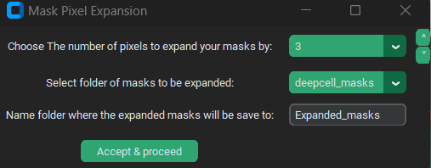
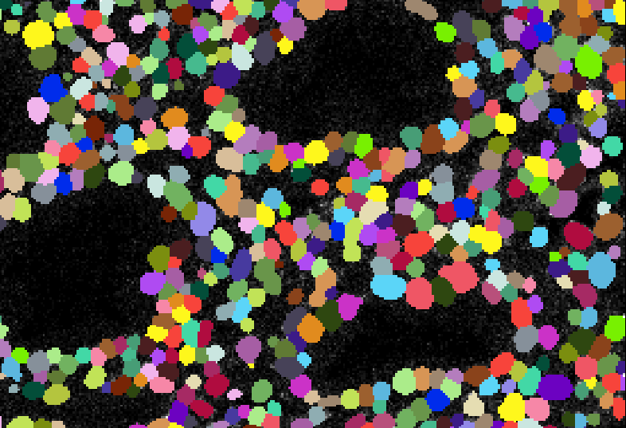
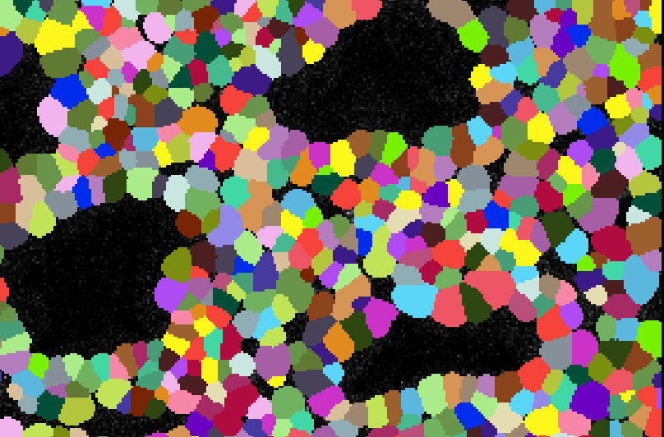
Mask Expansion by Three Pixels

Slide 9
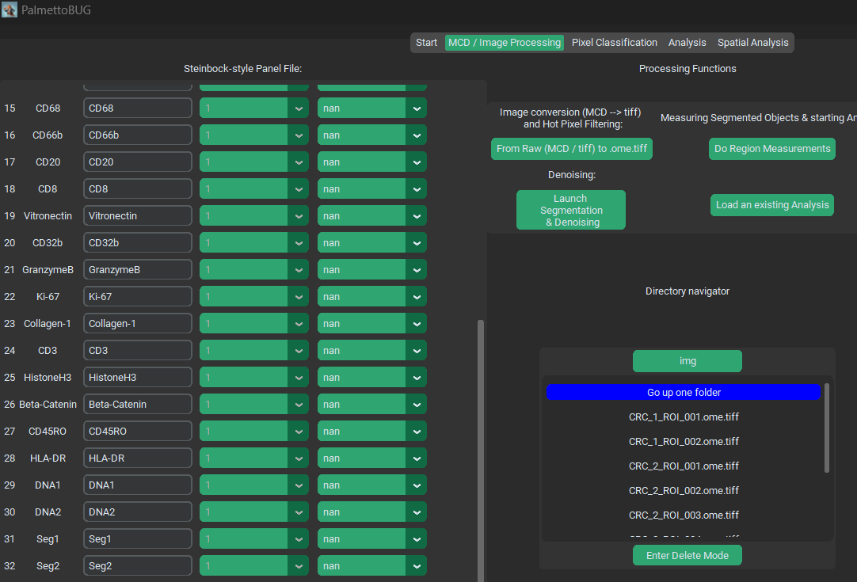
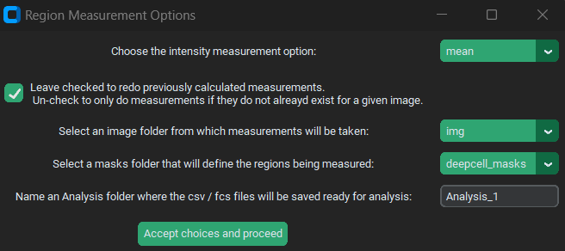
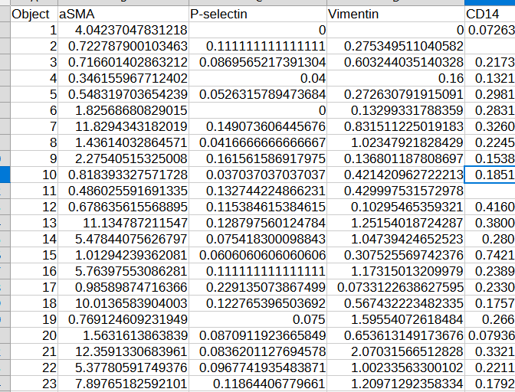
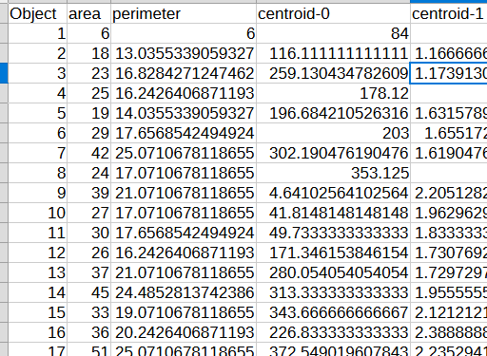
Here we name the new analysis inside the /Analyses folder
intensities
regionprops
First few columns / rows of example region measurement files

Slide 10
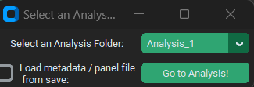
Any analysis folders that have made will be listed in this drop-down menu

