Slide 1
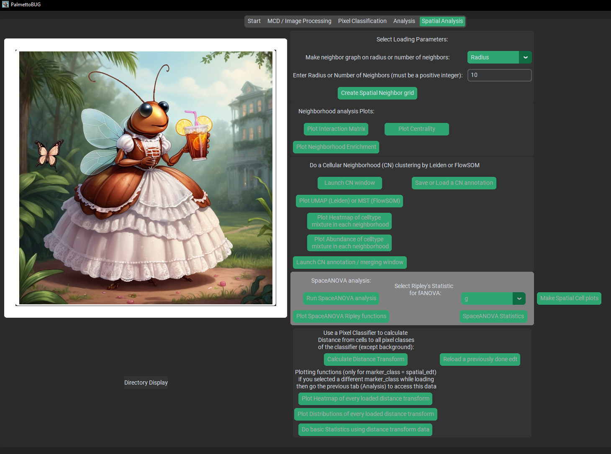
Spatial tab
Neighbors
Neighborhoods
SpaceANOVA
Plot cells
Distance-from-Pixel Class

Slide 2

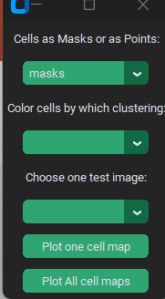
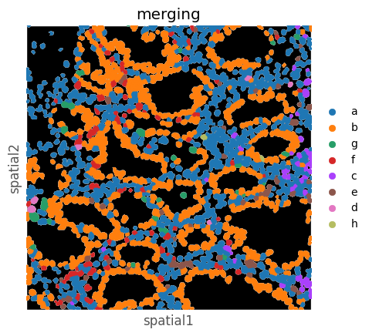
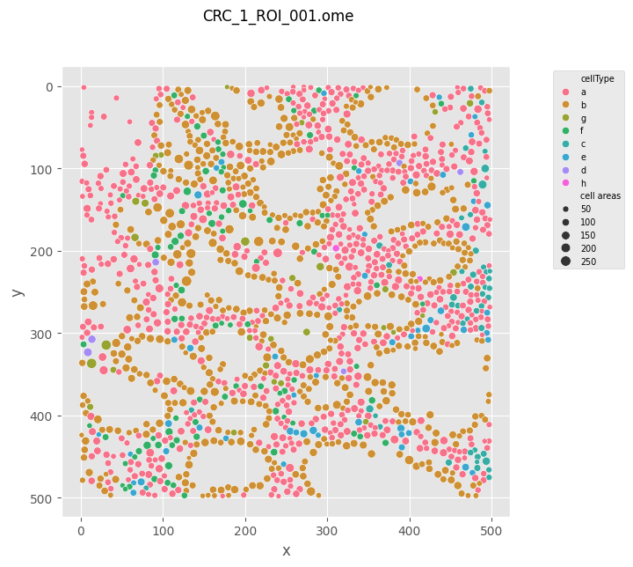
Plot Cells
“Masks”
“Points”
Color by

Slide 3
By Radius
Search radius
With the radius metric, the neighborly feeling is always mutual between cells, but cells don’t have the same number of neighbors (in fact some may not have any at all!)
By Nearest Neighbor (N = 5)
Every cell gets 5 connections to the 5 closest cells regardless of absolute distance
Note how by this metric, a particular cell’s nearest neighbors might not count that particular cell among their own nearest neighbors!

Slide 4
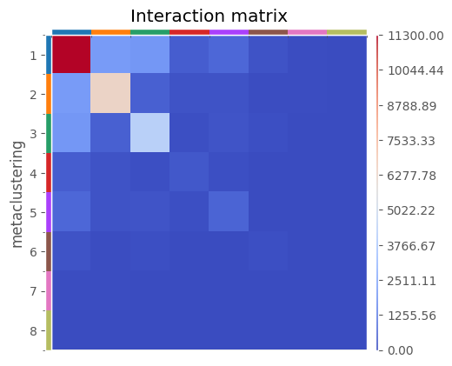
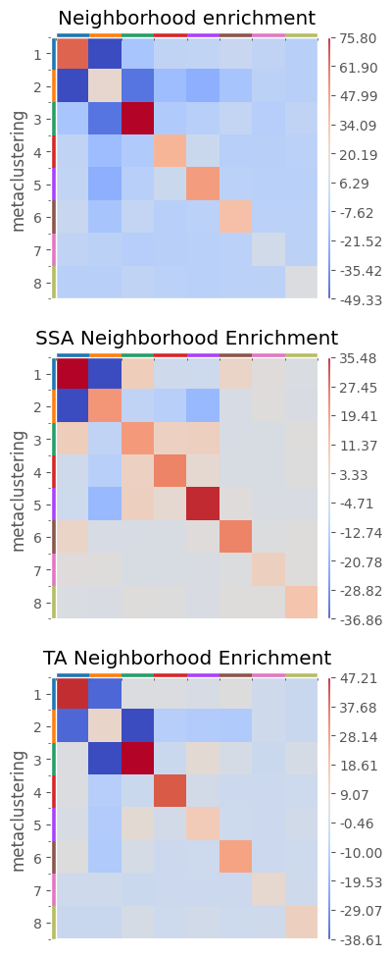
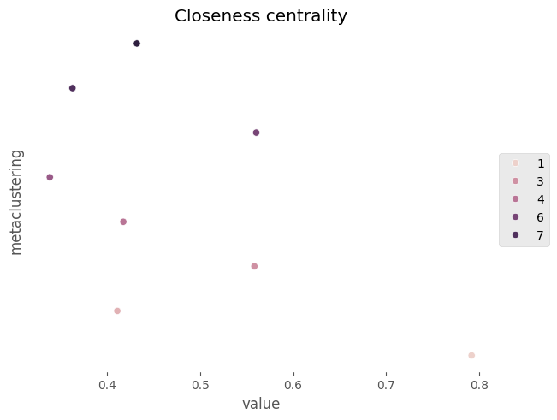
Example Spatial Neighbor Plots
Here I’m just using an un-annotated FlowSOM clustering to group the cells, the labels are just numbers

Slide 5
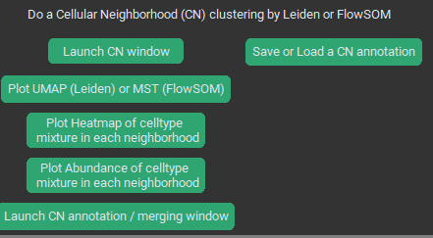
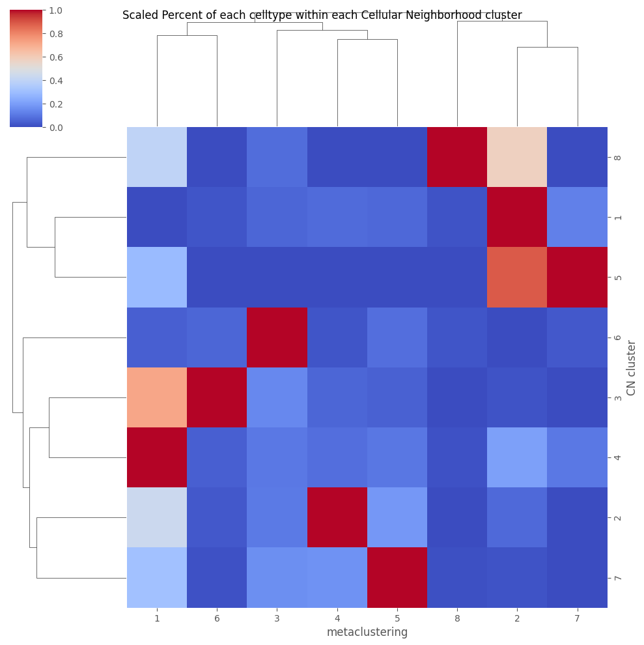
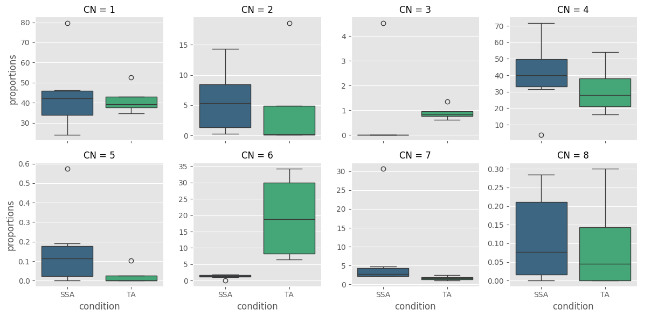
This handles the initial clustering
Saving a CN annotation can save time if you need to reload the project
These are for examining the CNs and annotating it
Neighbor Grid
Annotate & Plot
Cluster into Cellular Neighborhoods
0 / 67 / 33
100 / 0 / 0
33 / 67 / 0
Find the proportions of cell types among each cell’s neighbors
33 / 67 / 0
0 / 67 / 33
% Blue / Orange / Green

Slide 6
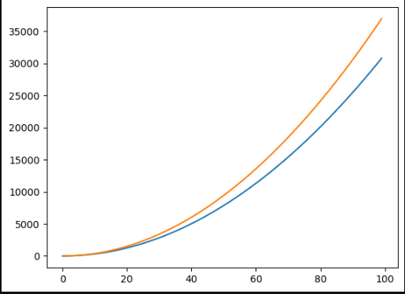
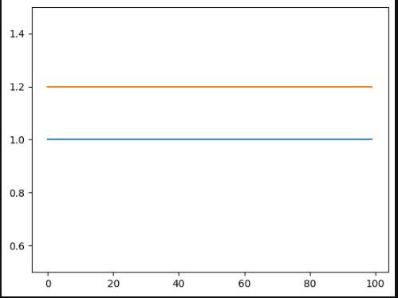
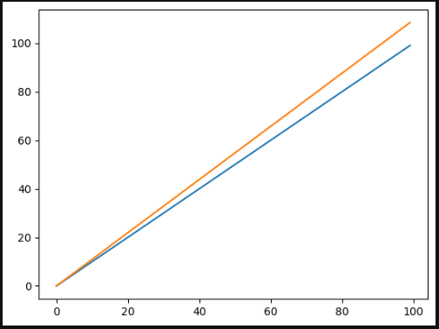
Simple example from a single point (normally these aggregate the statistic from ALL relevant cells in an image at once!)
K – cumulative function
g (pcf) – instantaneous function
The theoretical value of K in a truly random point patten (ignoring the density correction!) is simply:
K = πr²
g (pcf) is effectively the first derivative of K / L, corrected such that its theoretical value is:
g = 1
Radius = 1
K = 1
G = 1
g
K
radius
radius
Radius =2
K = 1
Ripley’s L is an adjusted version of K such that the function’s theoretical values shifts to:
L = sqrt(K / π) = r
G = 0
When points are closer to other points than would be expected by chance, values of the Ripley’s statistics are greater than the theoretical values (orange line), and the opposite when points are farther away than expected.
g proves its convenience here by how much easier it is to visually interpret.
L
Radius = 3
K = 2
Etc., for the whole range of chosen radii
G = 1
radius

Slide 7
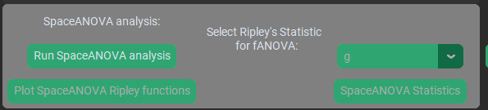
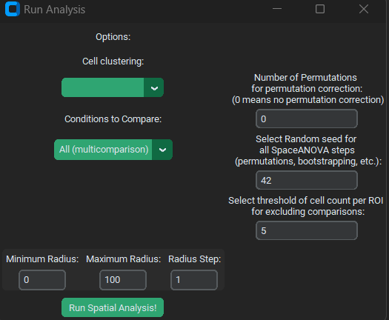
Doing permutations is recommended to correct for holes or inhomogeneities in the tissue
What cell types to use
Radii range to calculate over
Images with too few of a given cell type will be excluded from the calculation to avoid those images biasing the results
Because centroids, not cell edges, are used, radii between zero and about 10-20 often find none or very few cells

Slide 8
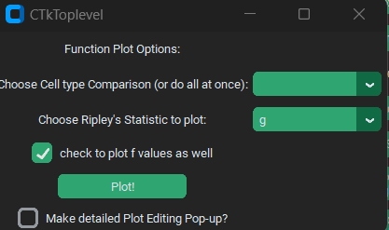
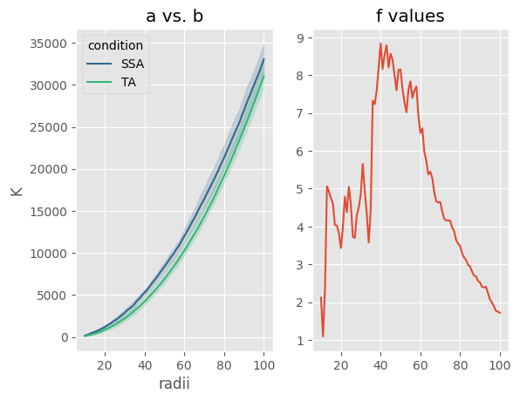
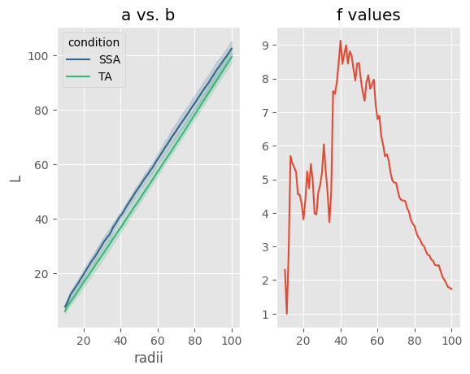
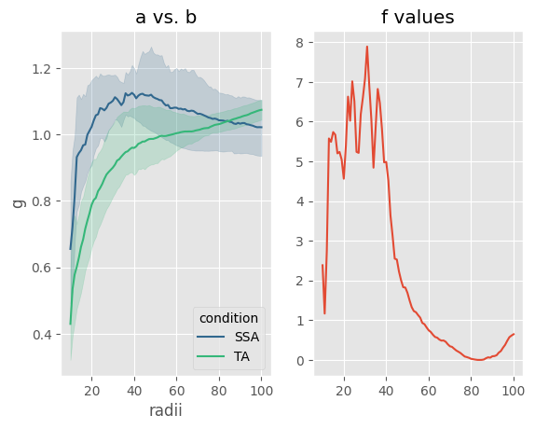
If this box is checked, an ANOVA will also be performed between the two conditions at each radii, and its F-statistic plotted next to the plot of the Ripley’s statistic.
This requires at least two conditions available for the cell type comparison in question
K, L, and g
K
L
g

Slide 9
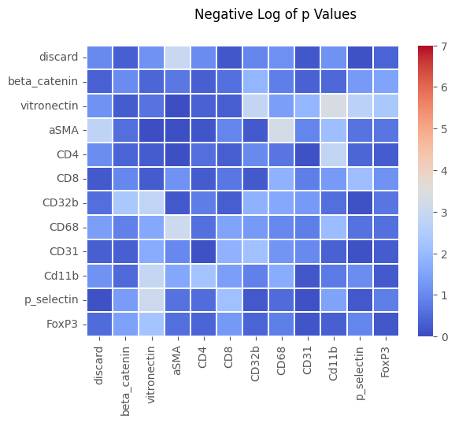
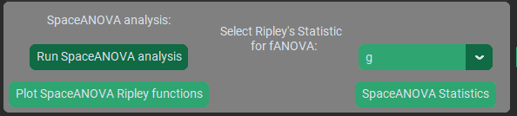
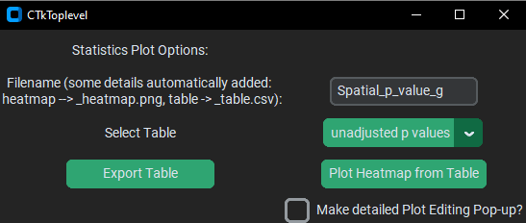
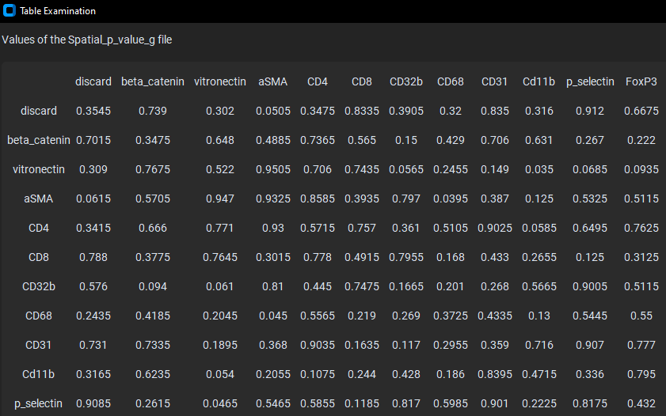
You can run fANOVA on K, L, or g curves
When you click the button, the fANOVA’s are run, so it can take a few seconds to open this window
Automatically saved as a .csv in /Spatial_plots

Slide 10
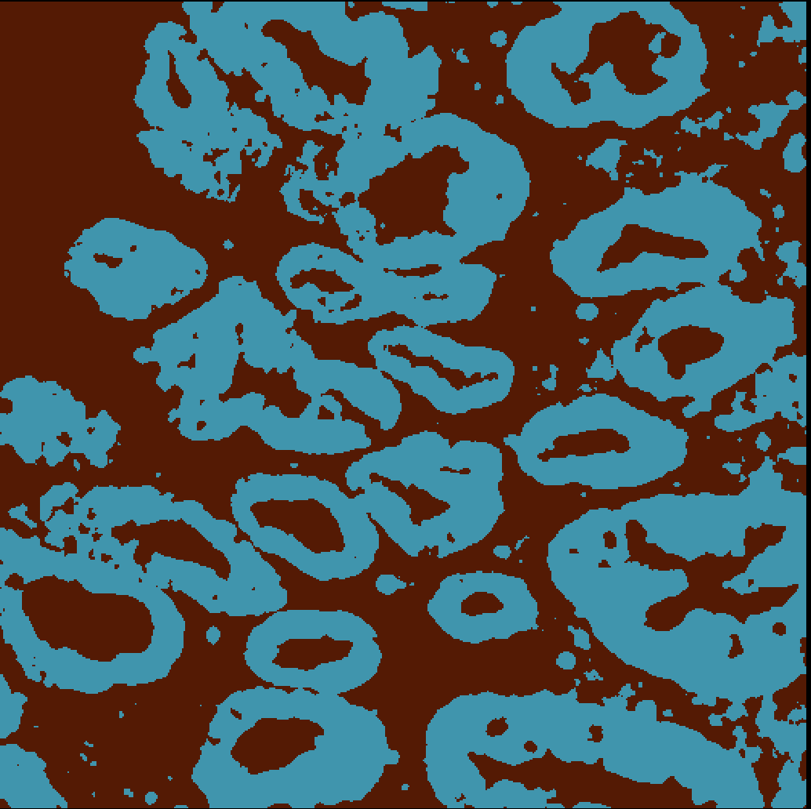
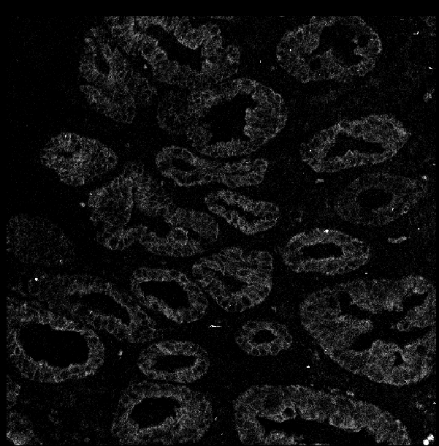
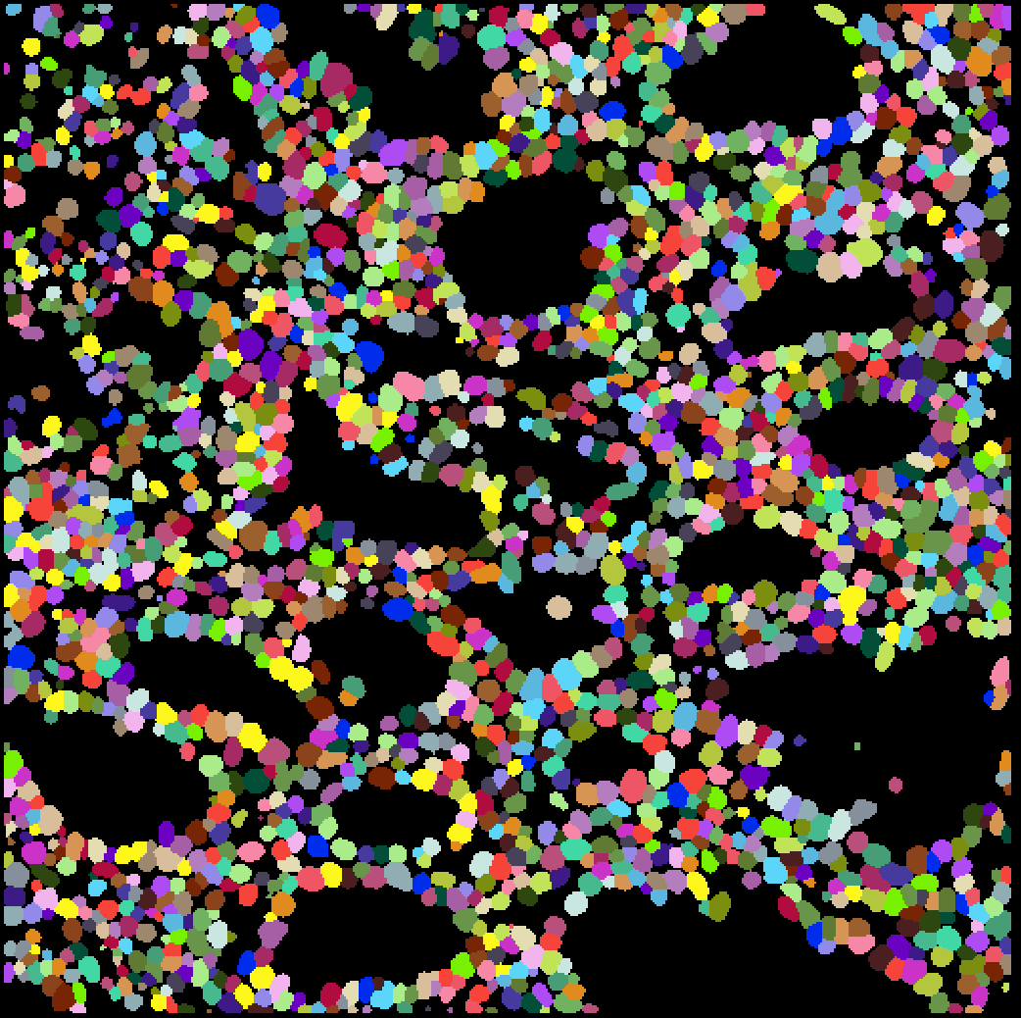
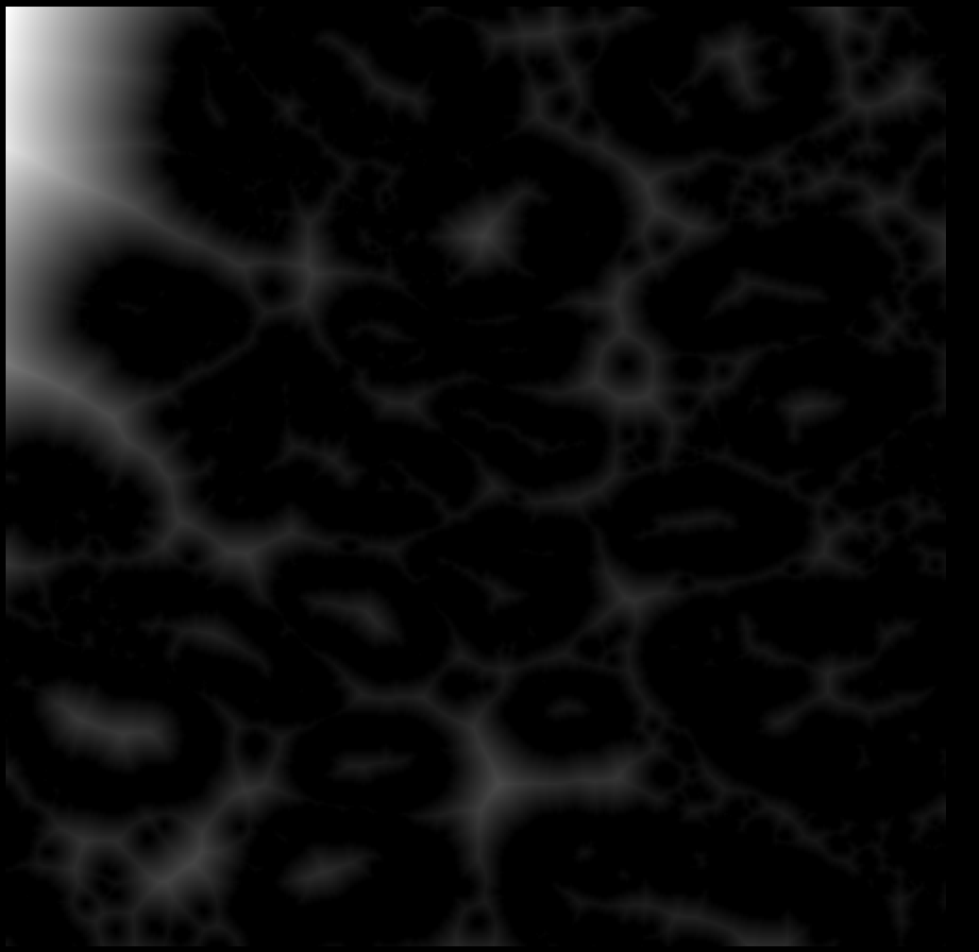
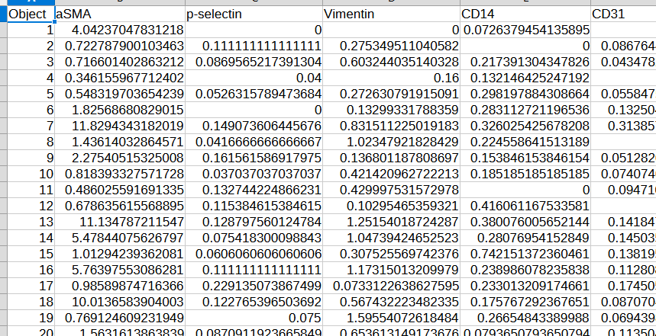
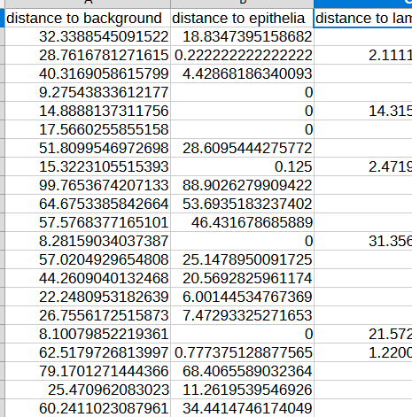
Pixel class maps
Original image, channel 6 (Pan-Keratin)
Masks
Pixels inside the class of interest (blue) are assigned a value of 0, while pixels outside the class are assigned a value based on their Euclidean distance from the nearest pixel in the class, so the brighter the EDT map, the farther away that region is from the class
In the normal course of the pipeline, the masks are used to read values off of the metal-channels / antigens in the dataset, to get single-cell intensity values
CSV / FCS files with single-cell data
EDT maps
In this case, the masks are used to read values off of the EDT map, creating a new “channel” in the dataset, which can be added to the analysis
Append the EDT data into the analysis!

Slide 11
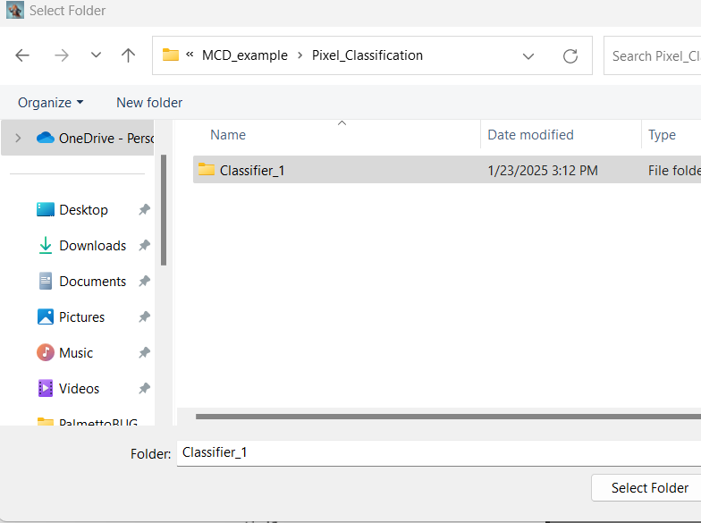
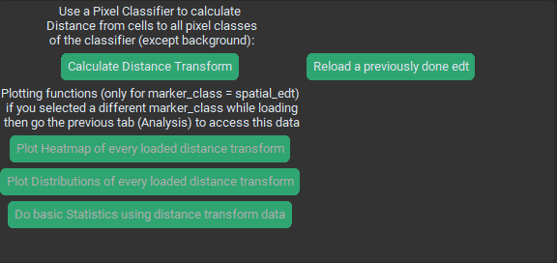
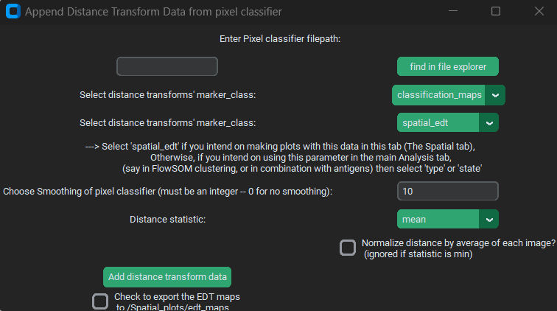
Select the folder of a pixel classifier in file explorer, or enter the path to the classifier directly
These fields determine the parameters of the EDT calculation, and nature of the output
If you want to see the Euclidean distance transform intermediates, check this box to save them

Slide 12
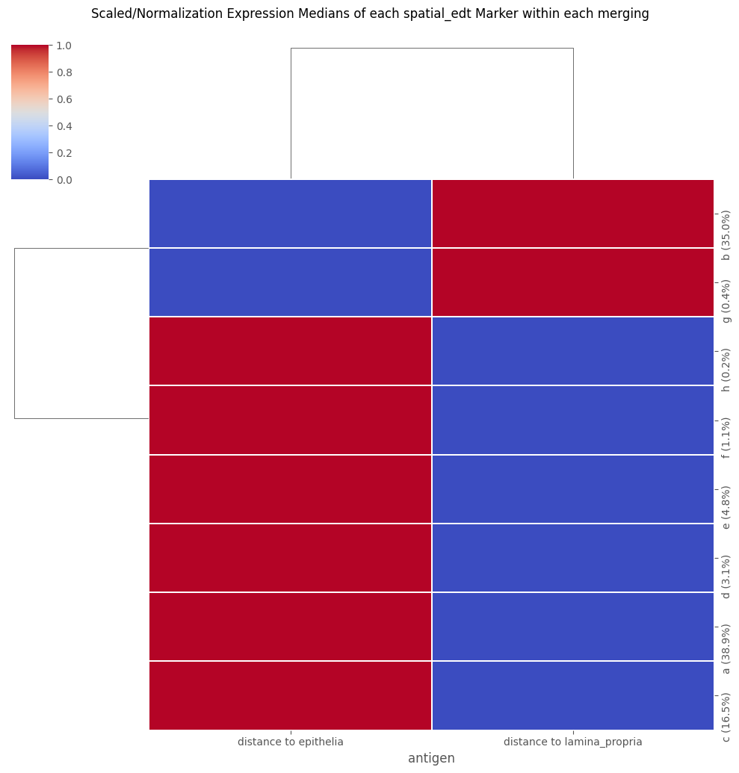
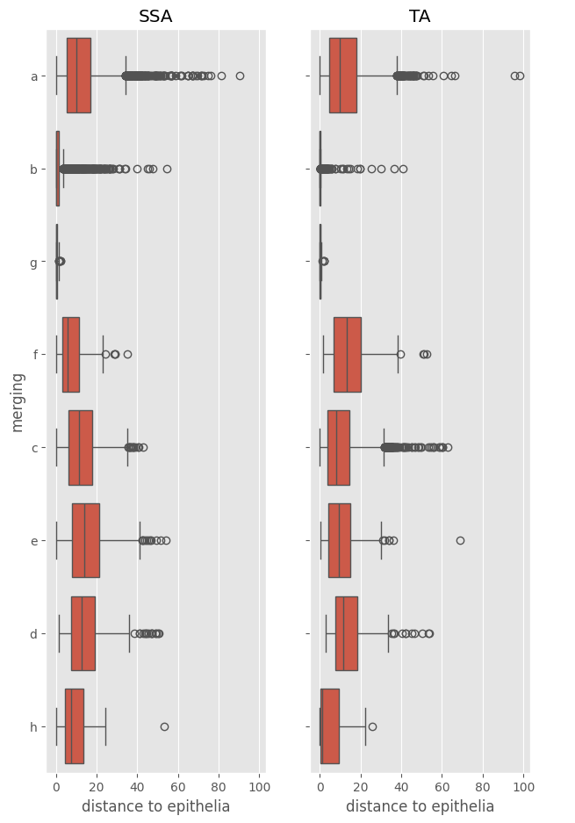
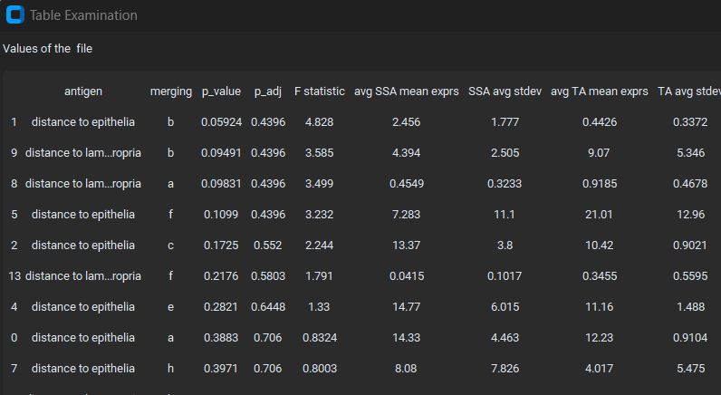
Remember that higher numbers in the distance transform means the cell types are further away from the pixel class of interest!
The Heatmap REQUIRES at least two “spatial_edt” channels to function!
The statistics calculation here is identical to the “state expression ANOVA” in the analysis tab, but only for the “spatial_edt” marker_class

