Slide 1
Visualization of scoliotic spine using ultrasound-accessible skeletal landmarks
Ben Church¹, Andras Lasso¹, Christopher Schlenger², Daniel P. Borschneck³, Parvin Mousavi⁴, Gabor Fichtinger^{1,3}, Tamas Ungi^{1,3}
Laboratory for Percutaneous Surgery, School of Computing, Queen’s University, Kingston, ON, Canada
Premier Chiropractic, Stockton, CA, USA
Department of Surgery, Queen’s University, Kingston, ON, Canada
Medical Informatics Laboratory, School of Computing, Queen’s University, Kingston, ON, Canada

Slide 2
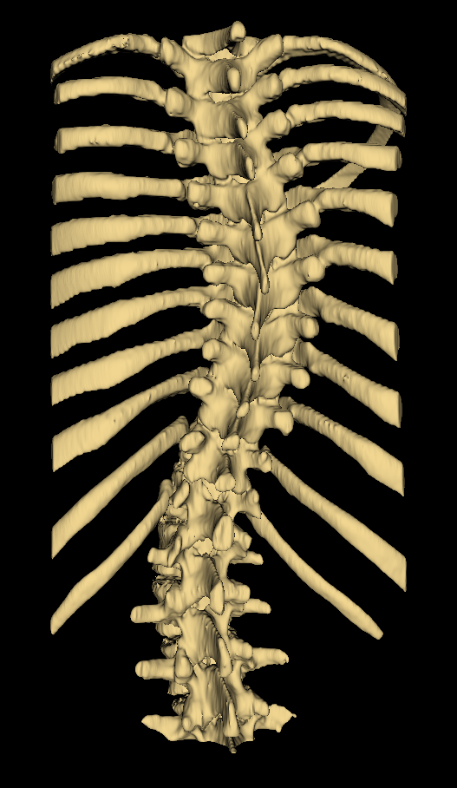
Introduction - Scoliosis
Scoliosis is lateral spinal curvature
Curvature often progresses until skeletal maturity
Regular assessment helps ensure early treatment

Slide 3
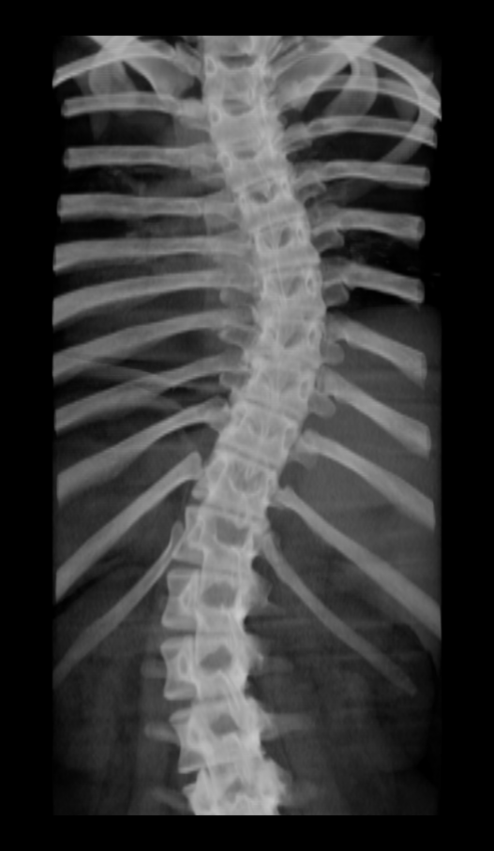
Introduction - Assessment
Gold-standard assessment method is X-ray imaging
Cobb angle is measured
Quantifies severity of scoliosis

Slide 4
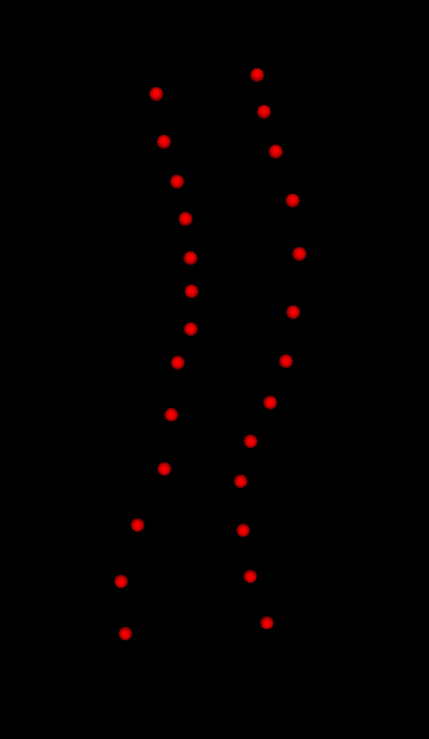
Introduction – Tracked Ultrasound
Health risks
Methods typically locate skeletal landmarks
Curvature extracted from landmarks

Slide 5
Problem Description
Current ultrasound methods do not produce easily interpreted visualizations

Slide 6
Problem Description
Simply registering corresponding landmarks does not encode realistic deformation
What kind of point sets produces accurate registration?

Slide 7
Contribution
A method for producing informative visualizations from transverse process locations
Landmark locations are supplemented with anchor points

Slide 8
Methods
Transverse processes located using patients’ prior CT scans
Anchor point locations calculated from landmark locations
Show model, model with TrPs, model with TrPs + anchor points

Slide 9
Methods
Anchor points offset towards anterior anatomy of vertebrae from landmarks
This conveys anterior-posterior scaling and vertebral rotation information

Slide 10
Methods
Directions of offsets determined from local inter-landmark geometry
Cross product of axial and lateral vectors point in desired direction

Slide 11
Methods
Landmark registration then computed the B-spline deformation field which warps model points to patients’
Deformation field was applied over average model, warping it to patient anatomy

Slide 12
Methods
Results visualizations were assessed compared to ground truth CT scans
Model to patient distance maps and Hausdorff distances were computed

Slide 13
Results

