Slide 1
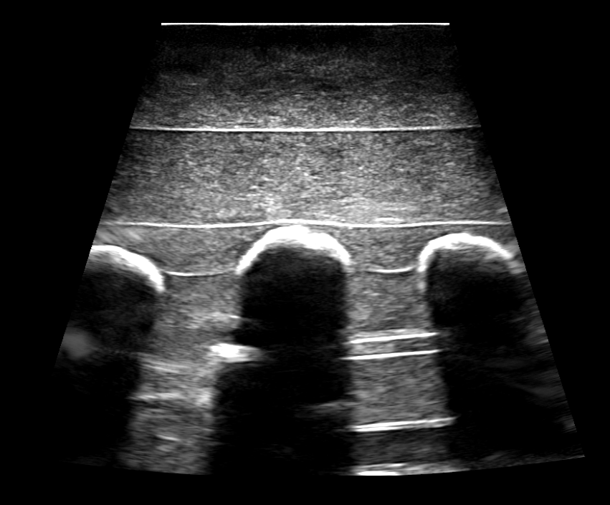
Visible bone surface
Invisible bone surfaces
Acoustic shadow

