Slide 1
3D Ultrasound for Scoliosis Quantification
Ben Church

Slide 2
Contents
Background
Scoliosis
Assessment
3D ultrasound
Ungi2014
Cheung2015

Slide 3
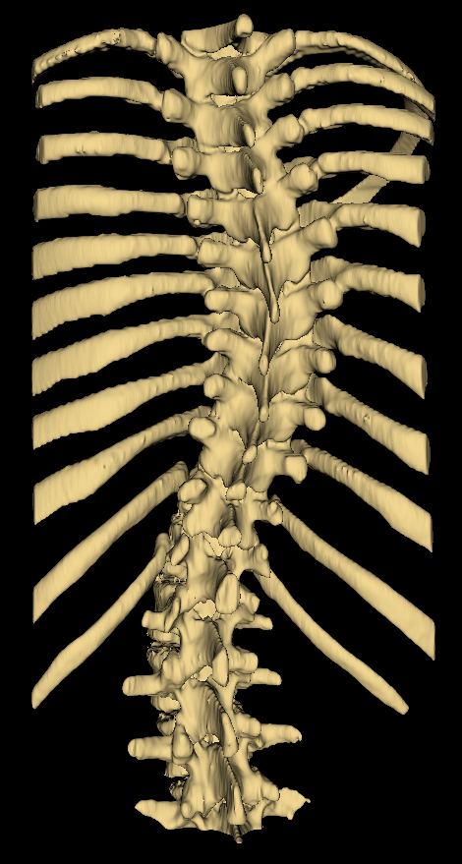
Background - Scoliosis
Pathological spinal curvature
Develops during growth
Must be monitored

Slide 4
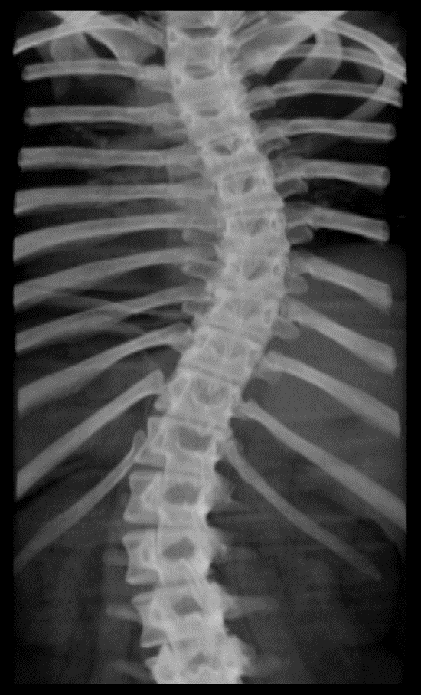
Background – Assessment
X-ray imaging is the gold-standard
Measure Cobb angle from X-ray, quantifying severity

Slide 5
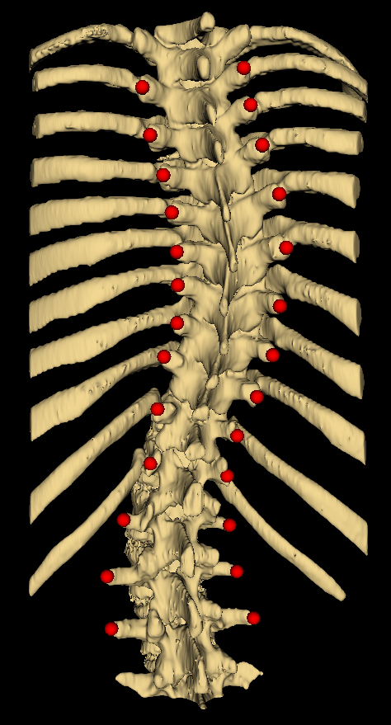
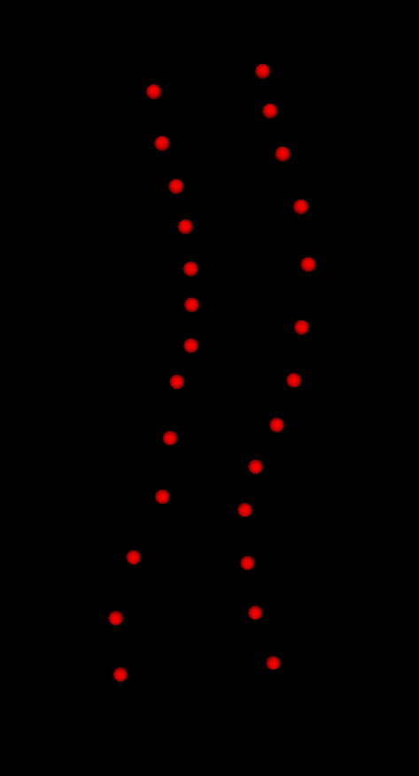
Background – 3D ultrasound
Risks of cumulative X-ray exposure have motivated use of 3D ultrasound
Provides landmark locations rather than macroscopic visualization
Curvature extracted from landmark locations

Slide 6
Ungi2014
Spinal Curvature Measurement by Tracked Ultrasound Snapshots

Slide 7
Ungi2014 – Motivation
Health risks of repeated X-ray exposure
Cost and inaccessibility of MRI
Inaccuracy of palpation and surface topography

Slide 8
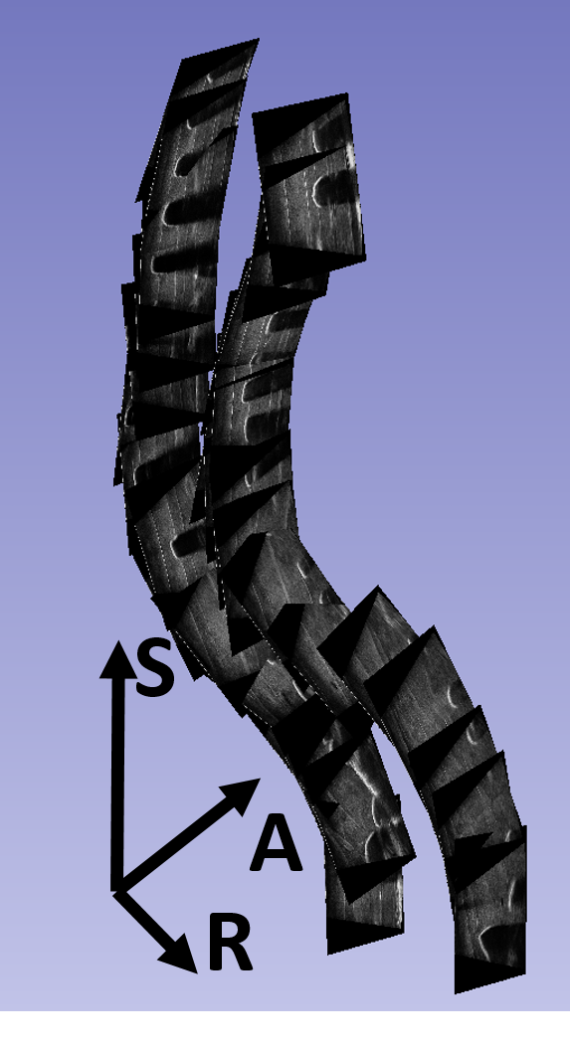
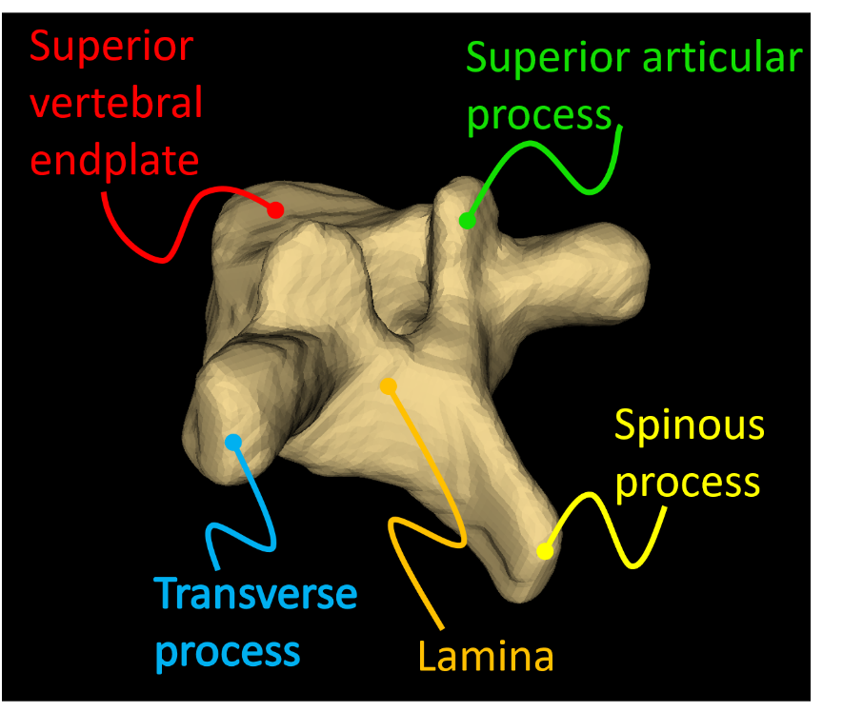
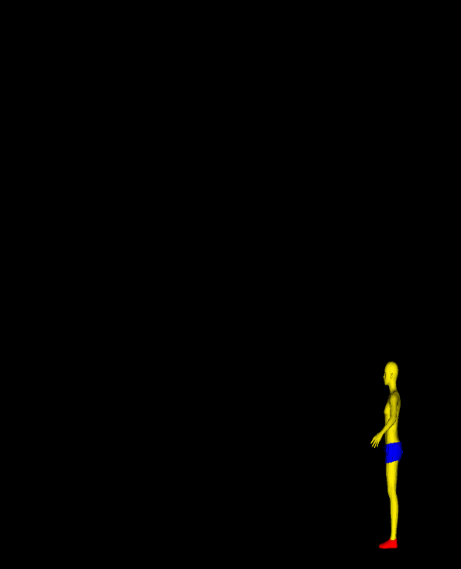
Ungi2014 – Method
Scan phantom models with image in sagittal plane
Locate transverse processes
Extract curvature

Slide 9
Ungi2014 – Validation
Examined correlation between their method and Cobb’s
Examined average errors and error ranges

Slide 10
Ungi2014 – Results
R = 0.998 for adult model
R = 0.977 for pediatric model
Angle errors < 3.1° < 5°

Slide 11
Ungi2014 – Critique
Phantom images unrealistically clear
Just used two phantom models
In vivo studies required

Slide 12
Cheung2015
Freehand three-dimensional ultrasound system for assessment of scoliosis

Slide 13
Cheung2015 – Motivation
Health risks of X-ray
Limitations of other methods described by [Ungi2014]
In vivo study required

Slide 14
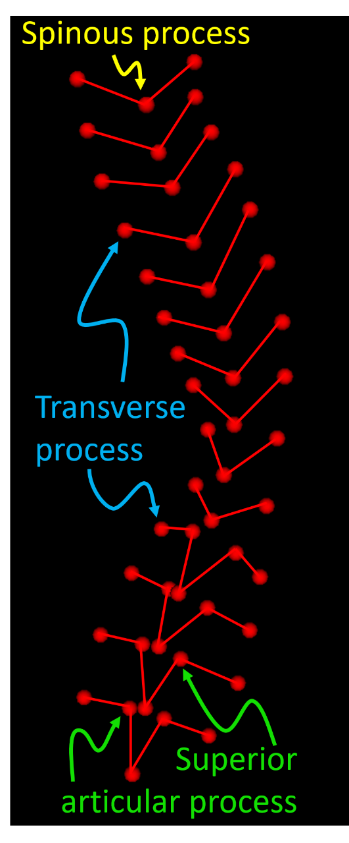
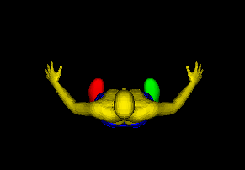
Cheung2015 – Method
Scan live patients with wide probe
Image in axial plane
Locate landmarks in software-generated model
Extract curvature using TPs, and TPs + SAPs

Slide 15
Cheung2015 – Validation
Compared their method’s angle to Cobb angle
Examined intra and inter-user variability

Slide 16
Cheung2015 – Results
X-ray Cobb angles ranged 1.9° to 29.9°
TP method ranged 0.48° to 20.7°
R² = 0.68
TP + SAP method ranged 0.8° to 25.9°
R² = 0.86

Slide 17
Cheung2015 – Critique
Cobb angle range only 1.9° to 29.9°
Mild to moderate
Unable to locate some landmarks
Used alternative landmarks
Discarded data
Method for dealing with imperfect data required

Slide 18
Thank you!
Questions?

Slide 19
References
[Ungi2014] T. Ungi, F. King, M. Kempston, Z. Keri, A. Lasso, P. Mousavi, J. Rudan, D. P. Borschneck, and G. Fichtinger, “Spinal Curvature Measurement by Tracked Ultrasound Snapshots”, Ultrasound in Medicine and Biology 2014; 40(2):447-454.
[Cheung2015] C.-W. J. Cheung, G.-Q. Zhou, S.-Y. Law, K.-L. Lai, W.-W. Jiang, and Y.-P. Zheng, “Freehand three- dimensional ultrasound system for assessment of scoliosis”, Journal of Orthopaedic Translation 2015; 3:123-133.

