Slide 1
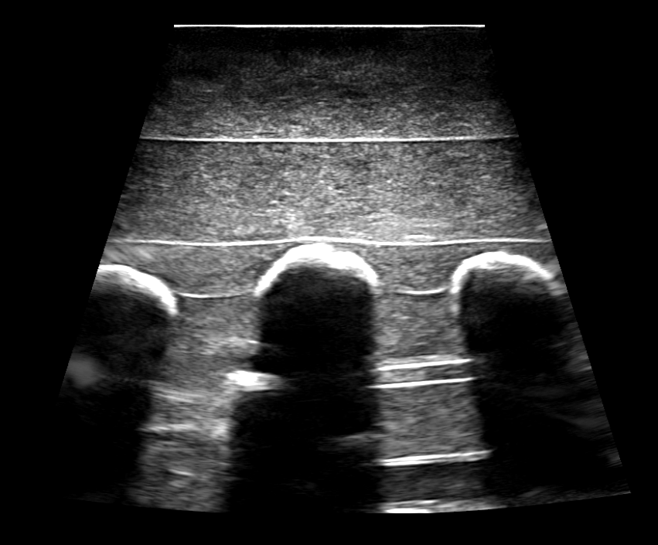
Visible bone surface
Invisible bone surfaces
Acoustic shadow

Slide 2
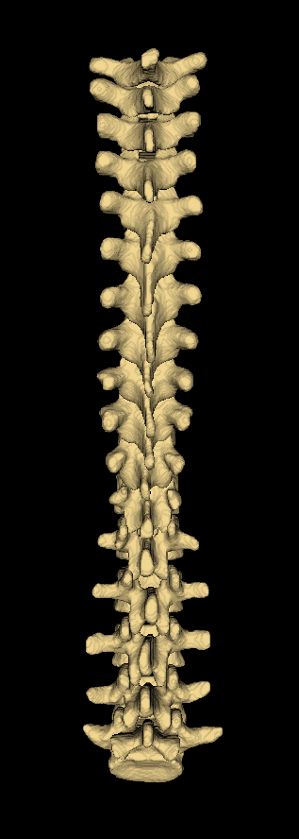
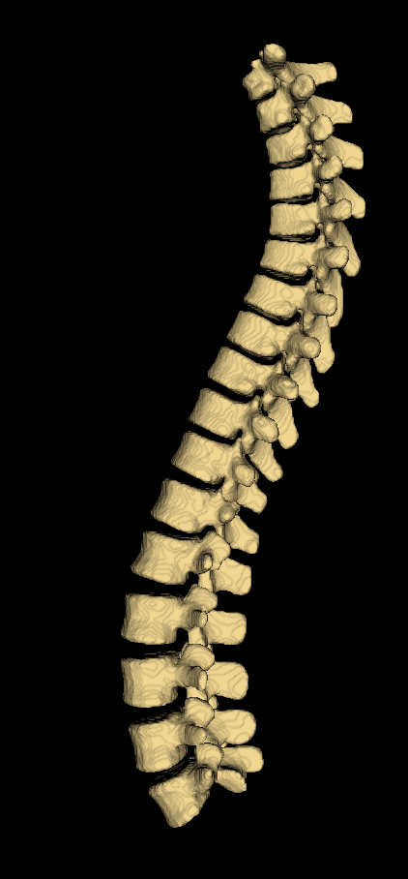
Left
Anterior
Superior
Inferior
Superior
Inferior
Right
Posterior

Slide 3
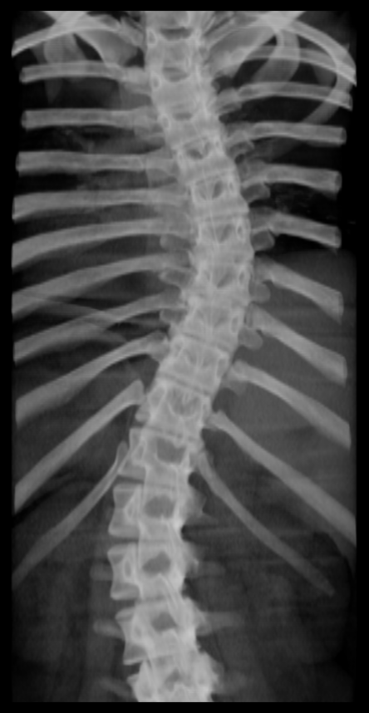

Slide 4
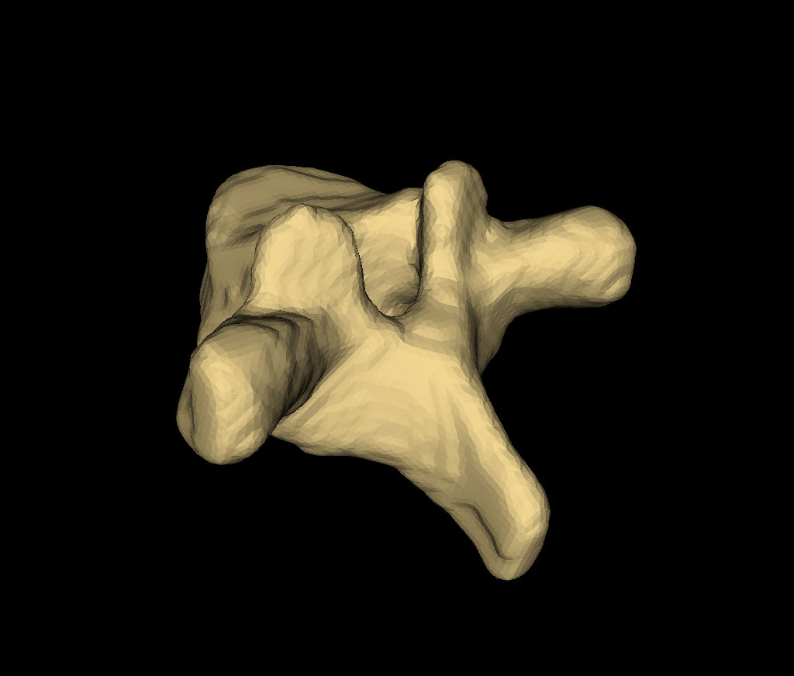
Superior vertebral endplate
Superior articular process
Spinous process
Transverse process
Lamina

Slide 5
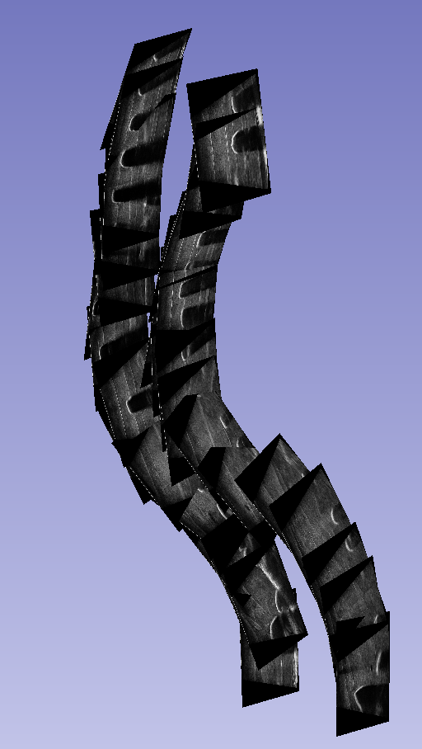
S
A
R

Slide 6
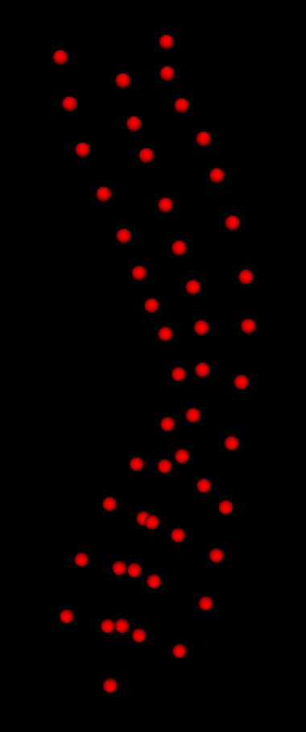
Spinous process
Transverse process
Superior articular process

