Slide 1
3D Ultrasound for Scoliosis Quantification
Ben church

Slide 2
Contents
Background
Scoliosis
3D ultrasound

Slide 3
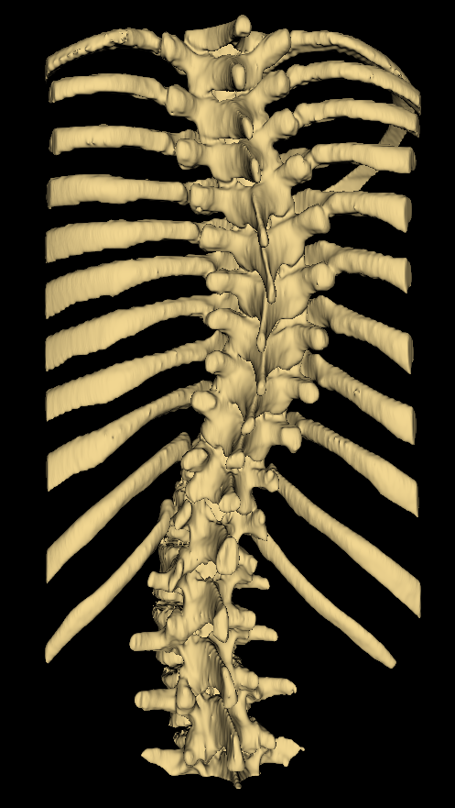
Background - Scoliosis
Pathological curvature of the spine
Develops during growth

Slide 4
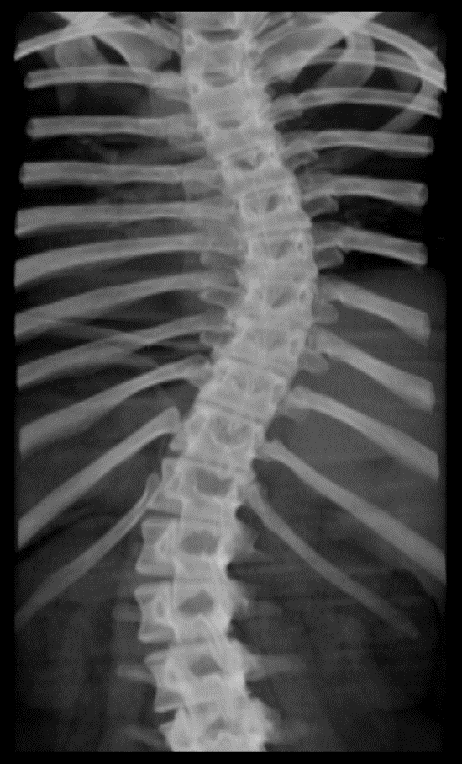
Background – Gold standard
Usually assessed with X-ray
Quantified in terms of Cobb angle

Slide 5
Background – 3D Ultrasound

