Slide 1
Assignment 1
ANN and Perceptron
5 marks
Farhana Zulkernine

Slide 2
General Instructions for Code and Submission (for all assignments)
You can use any programming language (preferred C, C++, Java, or Matlab)
Submit the source code with inline comments and comments in the beginning of the program saying briefly what your program does and how. (1 mark)
Submit the executable with anything else that may be required to run your binary (libraries, input). (1 mark)
Submit a text or word document file explaining your results. Your choice of initial values of variables and architecture of your network can influence your results. (2 marks)
Submit the outputs (classified data) (as a text or doc file). (1 mark)
Make one zip file named as Asg#_studentID.
Upload your assignment to the OnQ site.

Slide 3
Assignment 1
Iris data is one of the most popular datasets in machine learning tasks. Iris is a flowering plant with 260-300 different species.
Iris data contains the measurements of 3 different species of Iris: Setosa, Versicolour and Virginia.
The measurements included in this dataset are: Petal width, Petal length, Sepal width, Sepal length.
The following plot shows the relation between Petal width and length.
It’s inevitable that Irisa Setosa specie can be separated from the other two species using a straight line (linearly separable).

Slide 4
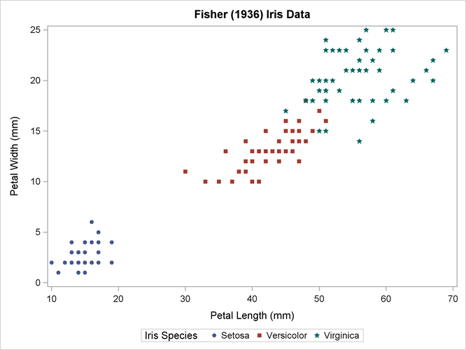
Assignment 1 - Plot of Iris data (Petal width and length)

Slide 5
Assignment 1 – Your Task
Using the above plot, design a ANN that can take an input of the petal width and length and return ‘yes’ if the this plant is Iris setosa and ‘no’ otherwise (Assume any linear separator).
Design a perceptron using the provided data (use the 4 features) to learn the correct separation between Iris setosa and the other 2 species using simple feedback learning.
Submit the equation of the linear separator (the ANN node) using the final weight vector.
Now apply error correction learning in your perceptron to separate Versicolour and Virginia (create separate functions as needed).
As before, submit the equation of the linear separator (the ANN node) using the final weight vector. Explain your design decisions and results: iterations, initial values, error thresholds etc.?
  Compute the classification accuracy (correctly classified/total points) for both cases and for both training and test data. Submit that information in the text file.
Create a function to write output to a text file, each line showing the data point and the predicted class value in the same order as the input data.

Slide 6
Assignment 1 – Data and Assumptions
Each new line in the dataset is a separate data point, and each data point is comma separated in this form:
(Sepal length in cm,Sepal width in cm,Petal length in cm,Petal width in cm, class)
Example: 5.1,3.5,1.4,0.2,Iris-setosa
The data is provided as two files: train.txt and test.txt.
Train.txt contains 40 data points for each class. Use this to train your perceptron.
Test.txt contains 10 data points for each class. Use this to test that your perceptron works correctly.

