Slide 1
Neural Networks for Scoliosis Quantification
Ben Church & Kyle MacNeil –CISC 874

Slide 2
Content
Background
Scoliosis
Assessment
Tracked ultrasound
Motivation
Methods
Pre-processing
Neural network
Results
Discussion

Slide 3
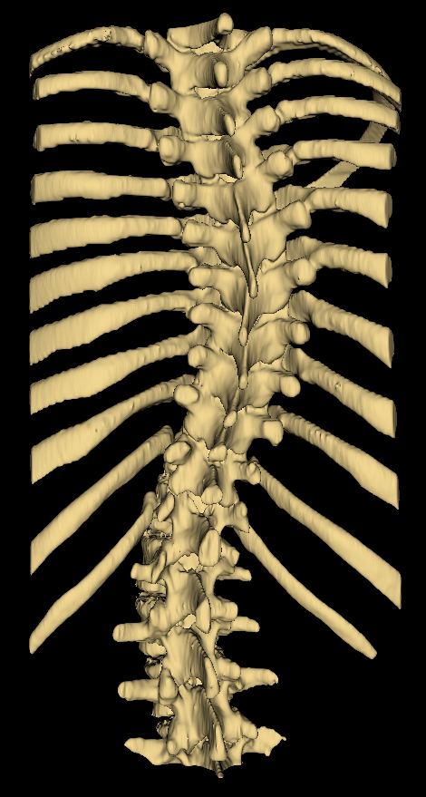
Background - Scoliosis
Pathological spinal curvature
Develops during growth
Must be monitored

Slide 4
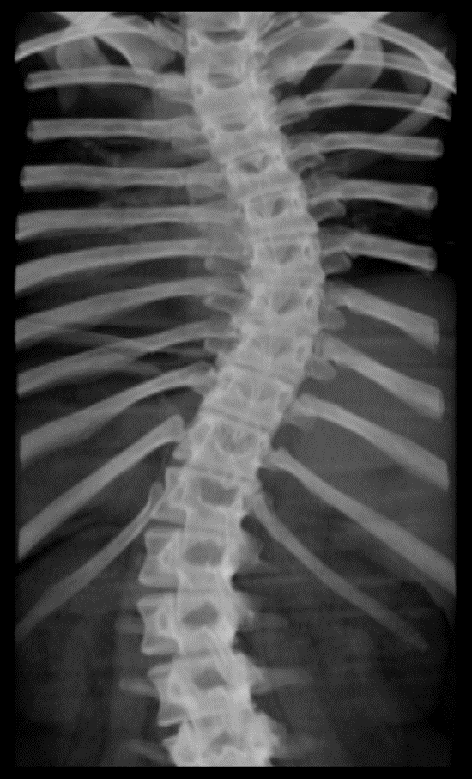
Background – Assessment
X-ray imaging is the gold-standard
Measure Cobb angle from X-ray, quantifying severity

Slide 5
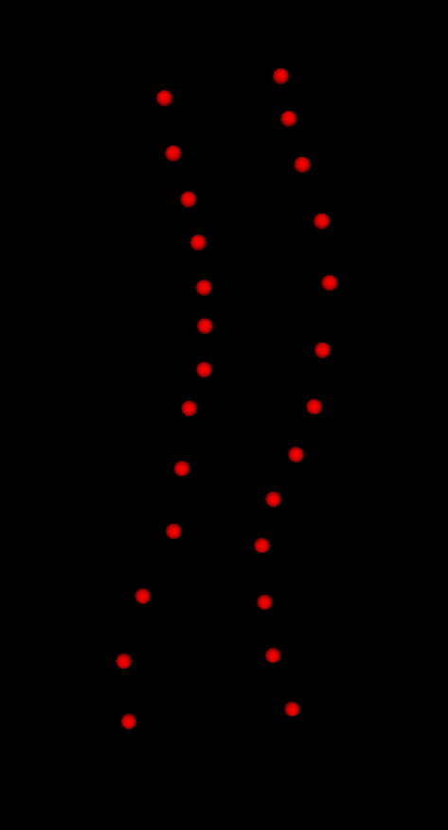
Background – Tracked ultrasound
Risks of cumulative X-ray exposure have motivated use of 3D ultrasound
Provides landmark locations rather than macroscopic visualization
Curvature extracted from landmark locations

Slide 6
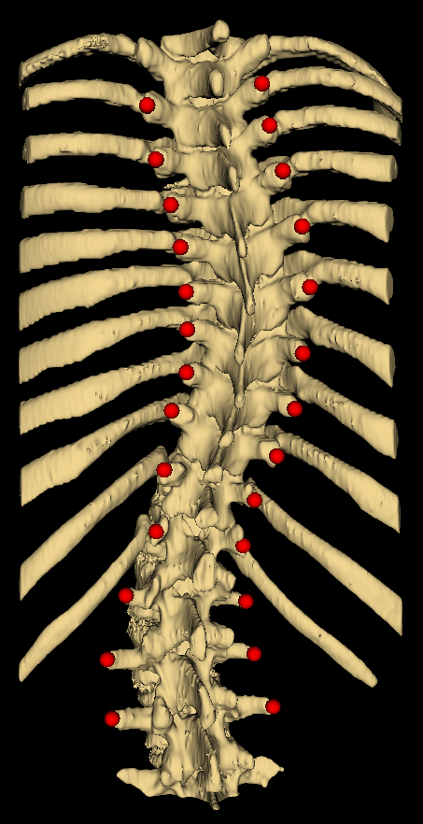
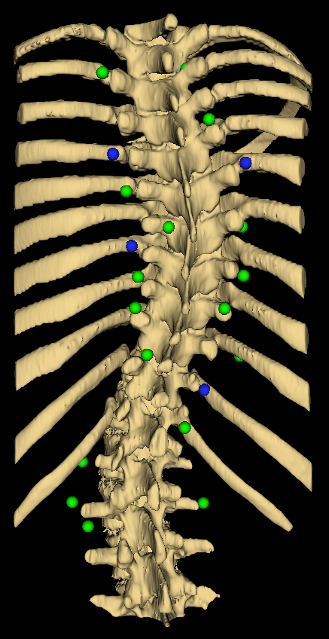
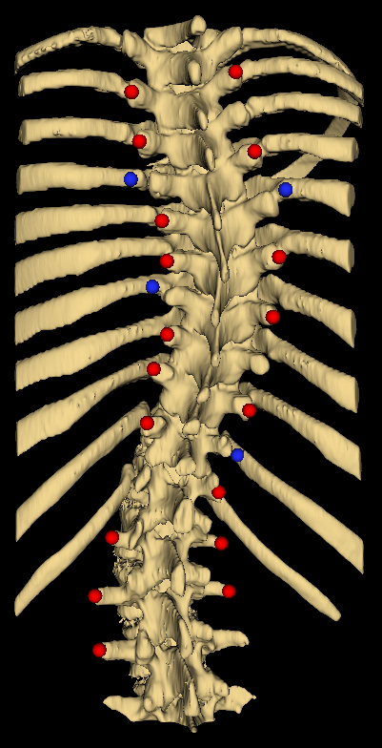
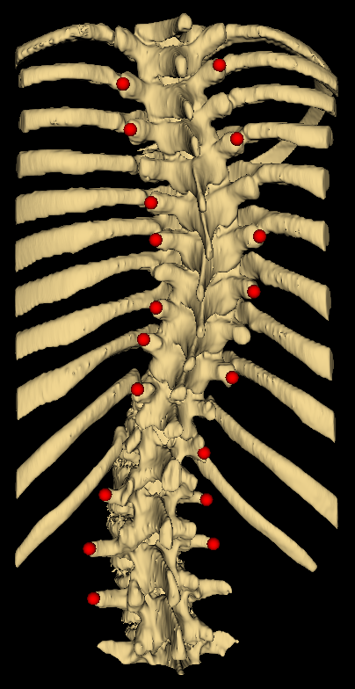
Motivation
3 expected error types:
Missing points
Misplaced points
Random noise
Can curvature be retrieved?

Slide 7
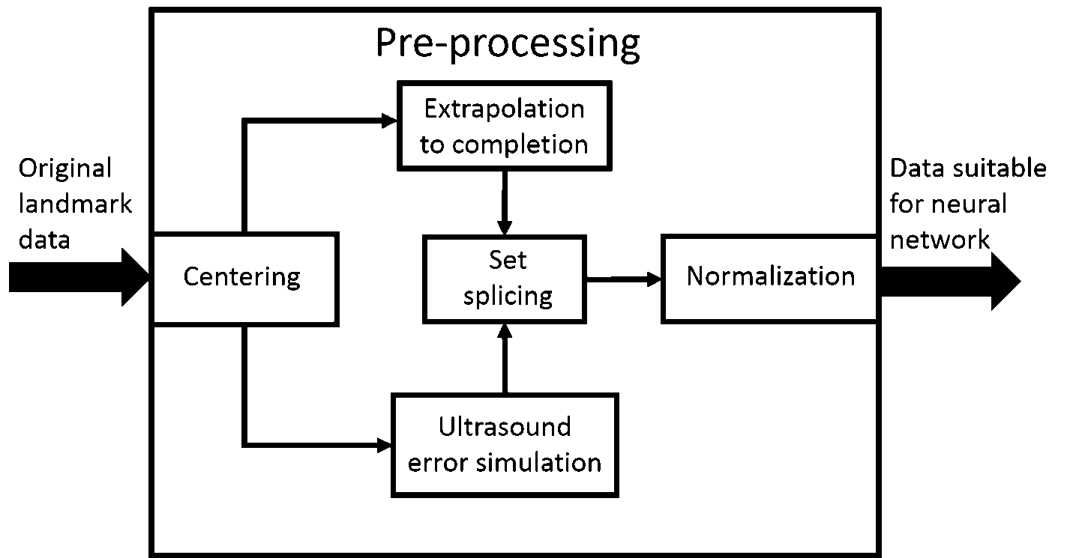
Methods – Pre-processing

Slide 8
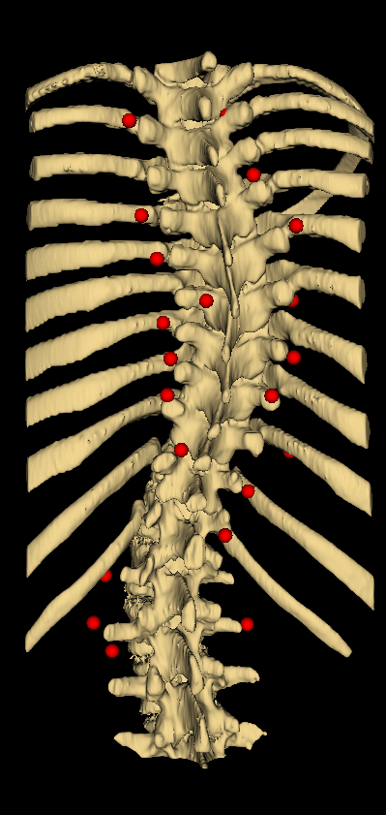
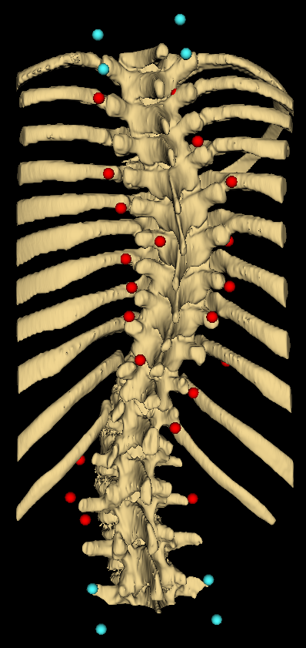


Slide 9
Feedforward backpropagation network
Curvature estimate

Slide 10
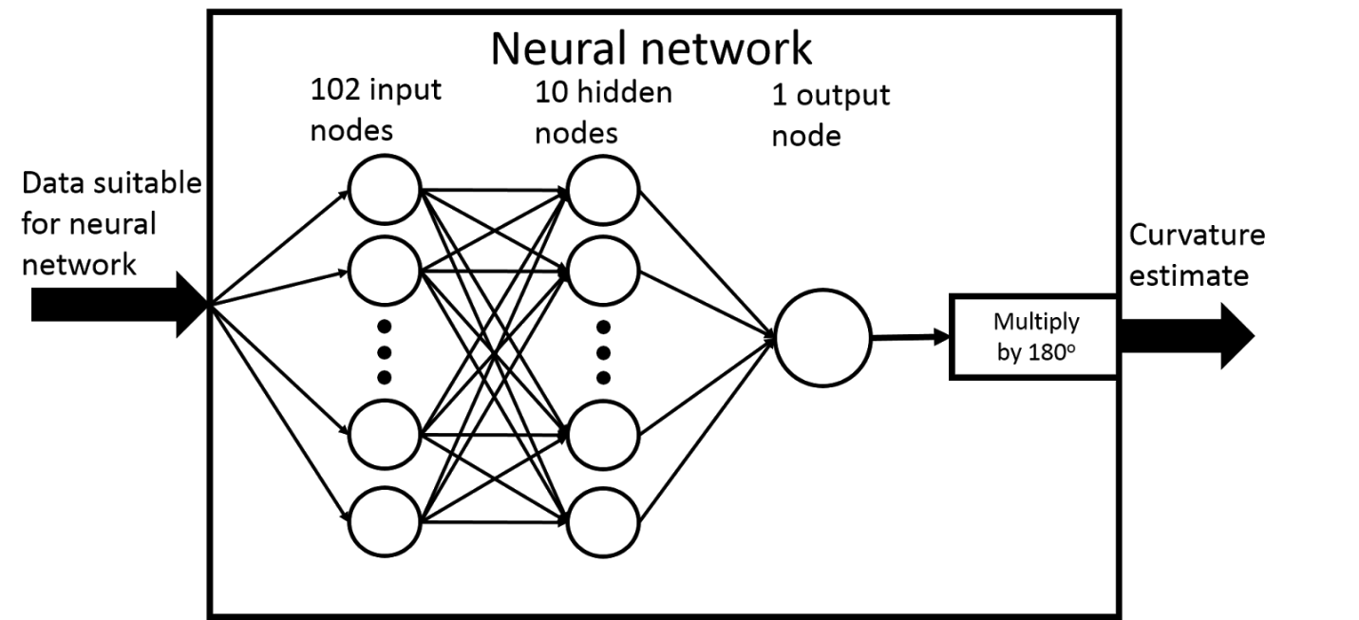
Methods – Neural network

Slide 11
Results
Modest increase in MSE with noise
Average error < clinically acceptable limit of error (5º)

Slide 12
Discussion
Our method vs. literature method
Supplements current methods with a tool for dealing with incomplete/imperfect data
Demonstrates robustness against noise
What next?

