Slide 1
Chapter 8 – Artificial Life
Ben Church & Itamar Tzadok

Slide 2

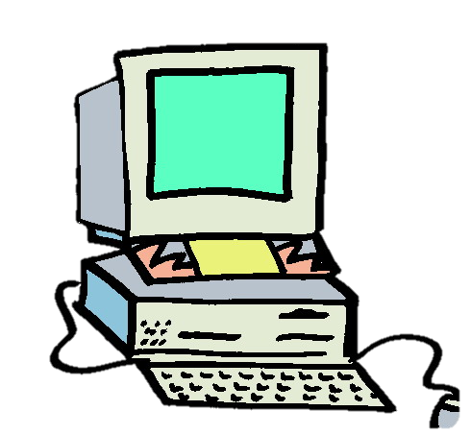


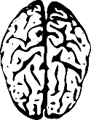

What is artificial life (AL)?
So far we’ve seen evolutionary computing, neurocomputing, swarm intelligence, and immunocomputing
All fields using algorithms inspired by life
What makes AL a field in its own right?
http://www.lakeshorelearning.com/media/images/free_resources/clip_art/school/computer.jpg
http://images.fanpop.com/images/image_uploads/Darwin-Fish-debate-761620_500_306.jpg
http://www.clker.com/cliparts/o/R/Q/f/z/T/brain-hi.png
http://images.clipartpanda.com/clipart-computer-clip-art-computers-420136.jpg
http://www.clipartbest.com/cliparts/LiK/rk9/LiKrk9RaT.jpeg
http://4.bp.blogspot.com/_tgM9xSZdl34/TQN7Fg1wEWI/AAAAAAAAGKk/_J2FFfLgQtQ/s320/computer%2Bvirus.jpg

Slide 3
What is artificial life (AL)?
AL differs from the listed fields mainly by intention.
Other fields:
Seek mainly to solve other problems using algorithms inspired by nature
Artificial life:
Develops and studies models of life for the sake of understanding life and those models

Slide 4
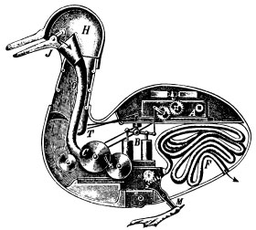
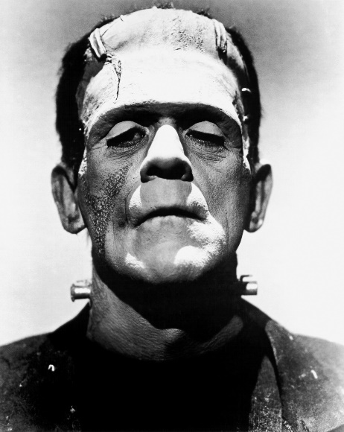
What is artificial life (AL)?
Natural life sciences employ reductionist method to explain life
Artificial life uses a constructive approach to explain and explore life
By Unknown - [1], Public Domain, https://commons.wikimedia.org/w/index.php?curid=1493624
By Universal Studios - Dr. Macro, Public Domain, https://commons.wikimedia.org/w/index.php?curid=3558176

Slide 5
A few ideas behind AL
Life is a process
Life can be explored constructively
‘Life’ is independent of substrate

Slide 6
Life-as-it-is
AL contributes models to biological sciences
AL refines its models with contributions of biological sciences
Biology is increasingly using AL

Slide 7
Life-as-it-could-be
Constructive approach allows exploration of novel forms of life
Low-level rules and agent interaction produce life-like complexity
A generalization of biology

Slide 8
Langton’s Features of AL Models (1988)
Ensembles, or ecosystems, of agents, or organisms, interacting
No privileged agents – No central control
Agents choose how to interact with agents and the environment
No global rules – Only individual rules
Emergent phenomena are patterns that transcend individuals

Slide 9
Scale of Models
Biospheres
Ecosystems
Populations
Organisms
Cellular life

Slide 10
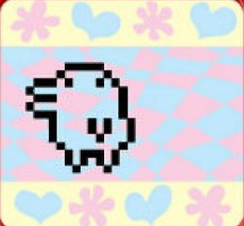
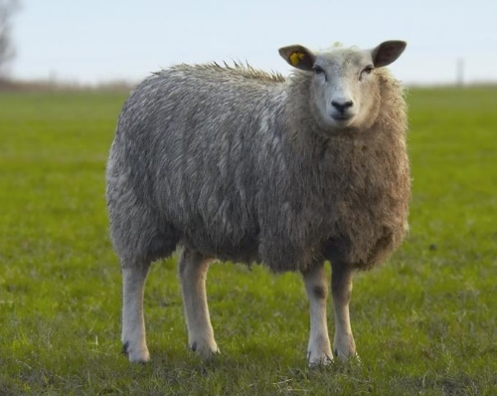
Two categories of AL
Virtual
Abstract
Synthetic
Concrete
https://www.thestar.com/content/dam/thestar/life/technology/2013/02/14/tamagotchi_returns_electronic_pet_reborn_as_mobile_app/tamagotchi.jpg.size.xxlarge.promo.jpg
http://www.eurostemcell.org/files/dolly1.jpg

Slide 11

The meaning of life
AL asks us to consider an age old question:
What does it mean to be alive?
To know this, we must see past the details of life’s many implementations
https://thumbs.dreamstime.com/z/thinking-robot-27761830.jpg

Slide 12
Farmer and Belin’s Criteria for life (1991)
Life is a pattern, not an object
Life involves self-reproduction
Information storage of a self-representation
Metabolism
Interaction with the environment
Interdependence of parts
Stability under perturbation
The ability to evolve

Slide 13
Some case studies
Reynolds’ boids
Dawkins’ biomorphs
Computer viruses
Hille’s Alie
Sony’s AIBO
Theraulaz and Bonabeau’s nest building

Slide 14
Reynolds’ Boids
Three rules define individual behavior
Flocking behavior emerges

Slide 15
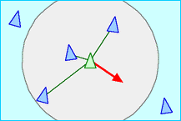
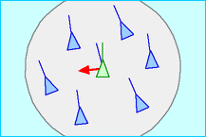
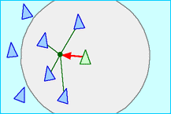
Reynolds’ Boids
Separation
http://www.red3d.com/cwr/boids/images/separation.gif
Three agent rules to produce flocking:
Alignment
http://www.red3d.com/cwr/boids/images/alignment.gif
Cohesion
http://www.red3d.com/cwr/boids/images/cohesion.gif

Slide 16

Reynolds’ Boids
https://youtu.be/GUkjC-69vaw

Slide 17
Farmer and Belin’s Criteria
Pattern, not an object
Self-reproduction
Information storage of a self-representation
Metabolism
Interaction with the environment
Interdependence of parts
Stability under perturbation
The ability to evolve

Slide 18
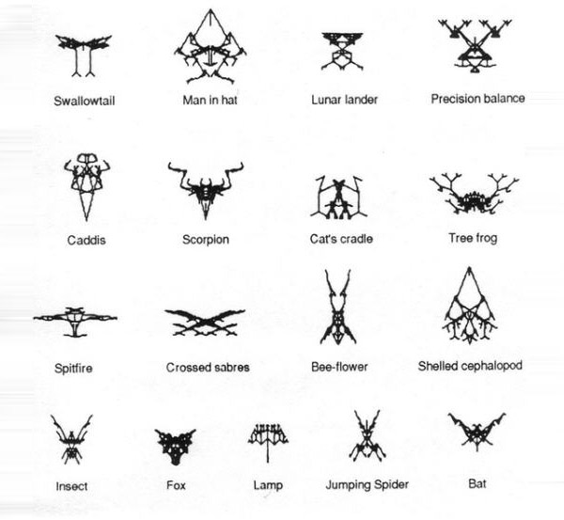
Dawkins’ Biomorphs
A biomorph is an image produced by a gene
Dawkins subjected these genes to evolution
Biomorphs are produced from genes in development phase
https://oncirculation.files.wordpress.com/2014/04/dawkins.jpg

Slide 19
Dawkins’ Biomorphs
The textbook cites Jones’ 15 gene approach (2001):
1 – 8 control overall shape
9 controls depth of recursion
10 – 12 control number of segmentations
14 controls size of segmentations
15 controls the shape used for drawing

Slide 20
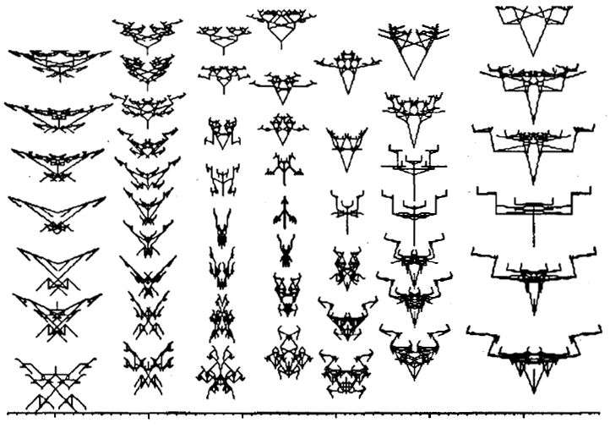
Dawkins’ Biomorphs
Evolutionary algorithm:
Variation driven by mutation
Fitness is aesthetic, therefore selection pressure is artificial
http://iasl.uni-muenchen.de/links/GCA_ill106.png

Slide 21
Farmer and Belin’s Criteria
Pattern, not an object
Self-reproduction
Information storage of a self-representation
Metabolism
Interaction with the environment
Interdependence of parts
Stability under perturbation
The ability to evolve

Slide 22
Computer Viruses
Viruses are on the border of life
How do their digital analogues compare?

Slide 23
Computer Viruses
Biological viruses:
Lack independent means of reproduction and propagation
Consist of genetic core surrounded by protein
Computer viruses:
Typically lack independent means of reproduction and propagation
Consist of fragment of computer code

Slide 24
Computer Viruses
Lifecycle:
Execution
Replication
Manipulation

Slide 25
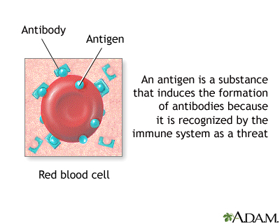
Computer Viruses
Like their biological analogues, they have prompted the development of immune systems
In the spirit of this analogy, anti-virus software can recognize virus signatures on programs
http://reidhosp.adam.com/graphics/images/en/9071.jpg

Slide 26
Farmer and Belin’s Criteria
Pattern, not an object
Self-reproduction
Information storage of a self-representation
Metabolism
Interaction with the environment
Interdependence of parts
Stability under perturbation
The ability to evolve

Slide 27
Synthesizing Emotional Behavior
What remains of emotion minus physiological changes?
Dörner (1999) proposed a theory of emotions as behavioral modulators

Slide 28
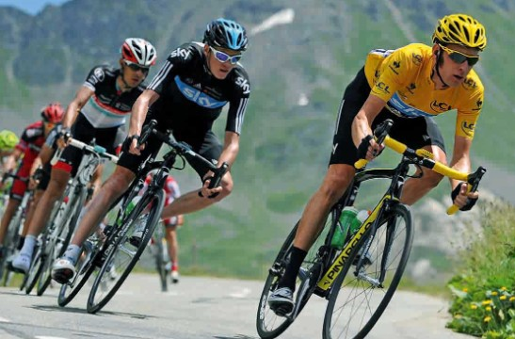
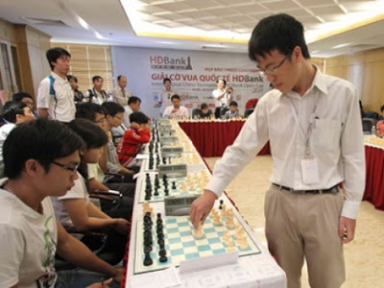
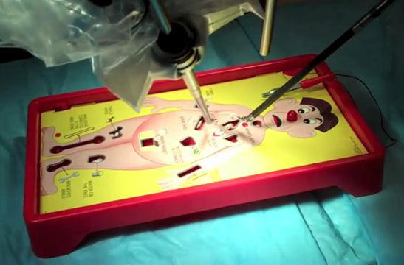

Synthesizing Emotional Behavior
Dorner identifies four modulators of goal-oriented behavior:
Activation – Rate of energy expenditure
Externality – Amount of time spent interacting with environment
Precision – Care taken in pursuit of goal
Focus – Attention paid to goal
http://i2.cdn.turner.com/cnnnext/dam/assets/130628145522-tour-26-story-top.jpg
http://2.bp.blogspot.com/-qnPW-D5mNlQ/T0JpNjT3SAI/AAAAAAAB-6o/IEz1RcLy_58/s400/Le%2BQuang%2BLiem%2Bsimul.jpg
http://www.hizook.com/files/users/3/DaVinci_Robot_Operation_BoardGame_2.png
http://www.lionsroar.com/wp-content/uploads/2009/08/burmese-monk-2-bk1.jpg

Slide 29
Synthesizing Emotional Behavior
Anxiety
Fear
Contentment
Sadness

Slide 30
Hille’s Alie
Virtual agent created by Hille
Behavior modifiable to synthesize emotion

Slide 31
Hille’s Alie
Alie demonstrates Dörners’ four behavior modulators:
Activation
Externality
Precision
Focus

Slide 32
Hille’s Alie
Participants were typically able to identify emotions
No information about behavior modulation was given
Anger was sometimes confused with excitement, and fear

Slide 33
Farmer and Belin’s Criteria
Pattern, not an object
Self-reproduction
Information storage of a self-representation
Metabolism
Interaction with the environment
Interdependence of parts
Stability under perturbation
The ability to evolve

Slide 34
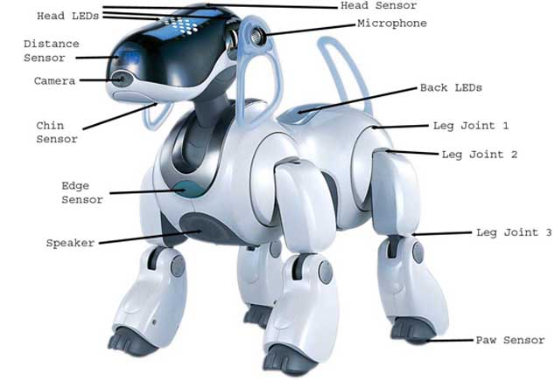
Sony’s AIBO
Our first example of synthetic AL
Many sensors and actuators
Collects input, learns to interpret it, and develops accordingly
http://faculty.berea.edu/pearcej/CSC126/bottasks/ers7-labeled.jpg

Slide 35
Sony’s AIBO
Sensory input and interaction steer personality development
Development consists of infant, child, teen, and adult phases
Personality conveyed through synthesized emotions

Slide 36
Sony’s AIBO
Five instincts guide AIBO:
Human interaction
Search for liked objects
Need to move
Need to recharge
Need to rest

Slide 37
Farmer and Belin’s Criteria
Pattern, not an object
Self-reproduction
Information storage of a self-representation
Metabolism
Interaction with the environment
Interdependence of parts
Stability under perturbation
The ability to evolve

Slide 38
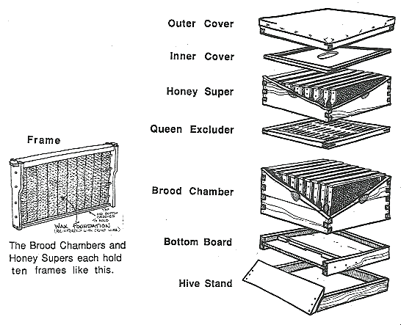
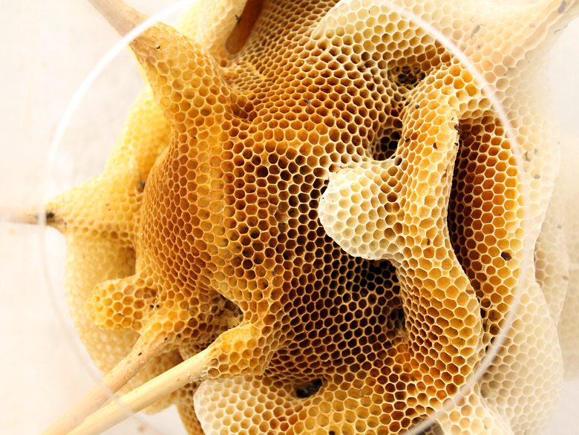
Theraulaz and Bonabeau’s Nest Building
Bees and wasps lack a global representation of their nest
Yet global order and complexity emerge
http://s3files.core77.com/blog/images/2014/07/RenRi-CloseUp.jpg
http://trianglewins.com/sam/bees/uploaded_images/Parts-of-a-beehive-799513.gif

Slide 39
Theraulaz and Bonabeau’s Nest Building
A few rules give rise to long range structure
Some initialization for each layer
Keep adding off existing cells
Other rules for enlarging nest with new layers

Slide 40
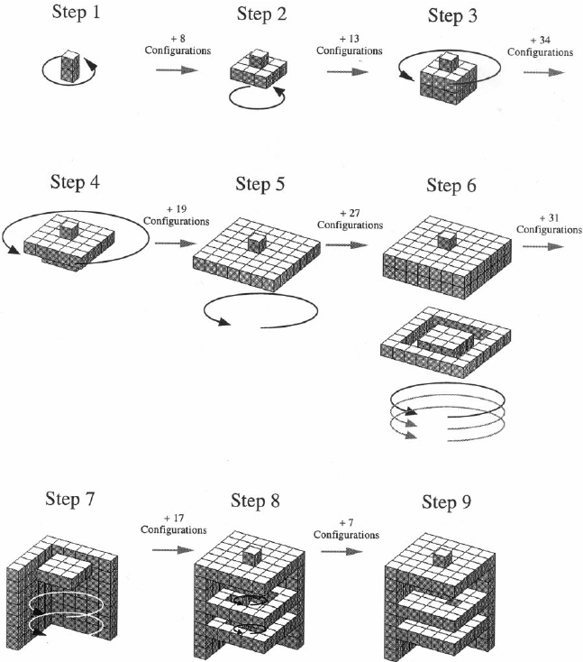
Theraulaz and Bonabeau’s Nest Building
Theraulaz and Bonabeau used lattice swarms
Different block types are placed depending on current local block configuration
Global structure arises from rules, without global representation
https://www.researchgate.net/profile/Guy_Theraulaz/publication/2879146/figure/fig3/AS:279515071827969@1443652994704/Fig-3-Building-stages-and-modularity-Successive-building-steps-in-the-construction-of.png

Slide 41
Farmer and Belin’s Criteria
Pattern, not an object
Self-reproduction
Information storage of a self-representation
Metabolism
Interaction with the environment
Interdependence of parts
Stability under perturbation
The ability to evolve

Slide 42
Is ALIFE a misnomer?

Slide 43
Analysis vs. Synthesis revisited

Slide 44
Synthesizing natural phenomena

Slide 45
Artificial computing?

Slide 46
Computing synthetic natural phenomena

Slide 47
Tierra

