Slide 1
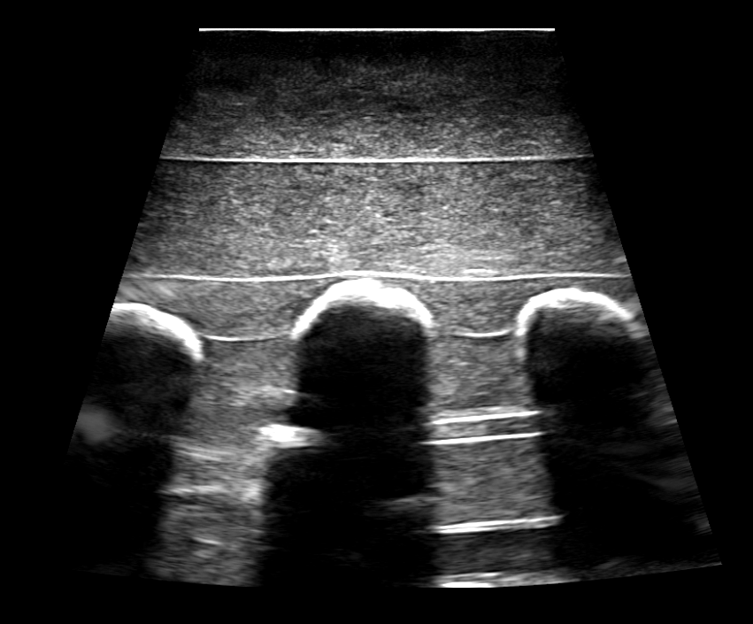
Visible bone surface
Invisible bone surfaces
Acoustic shadow

Slide 2
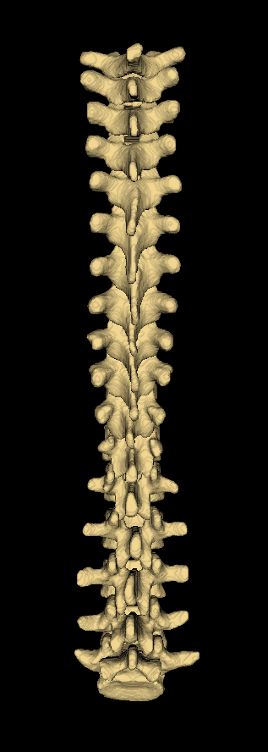
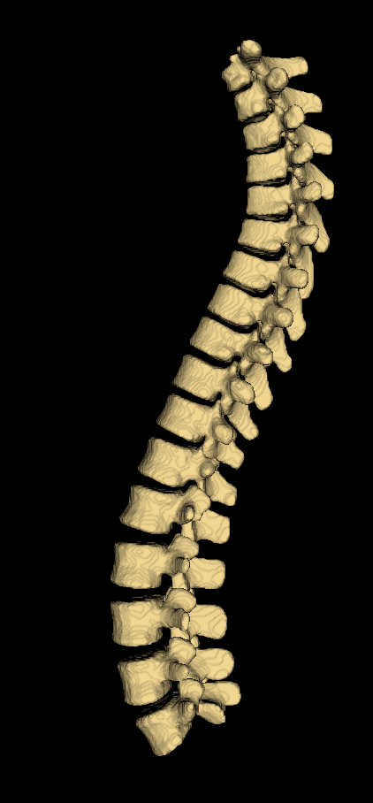
Left
Anterior
Superior
Inferior
Superior
Inferior
Right
Posterior

Slide 3
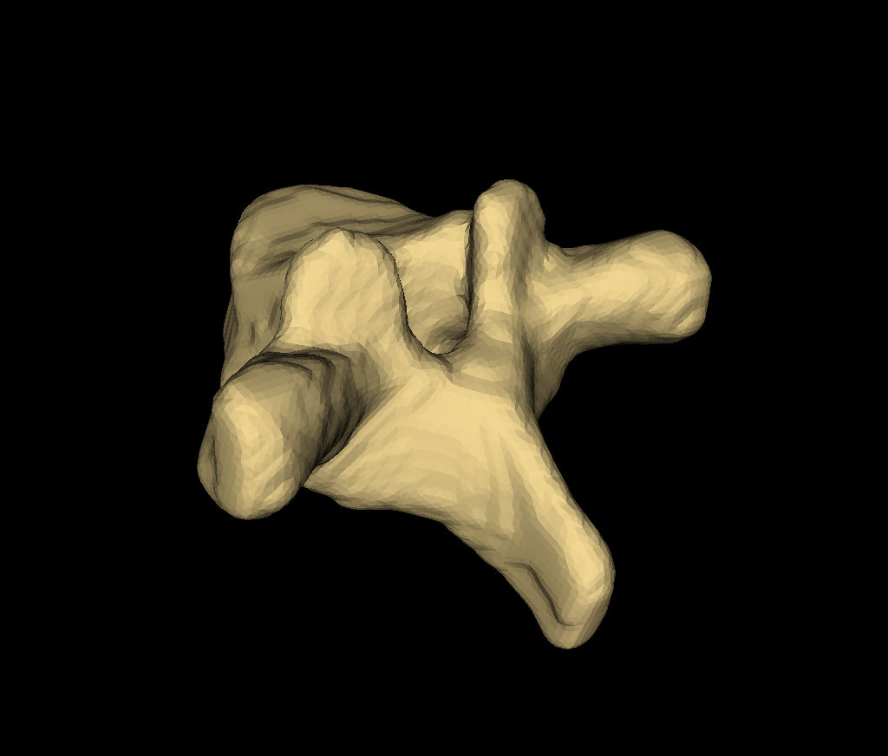
Superior vertebral endplate
Superior articular process
Spinous process
Transverse process
Lamina

Slide 4
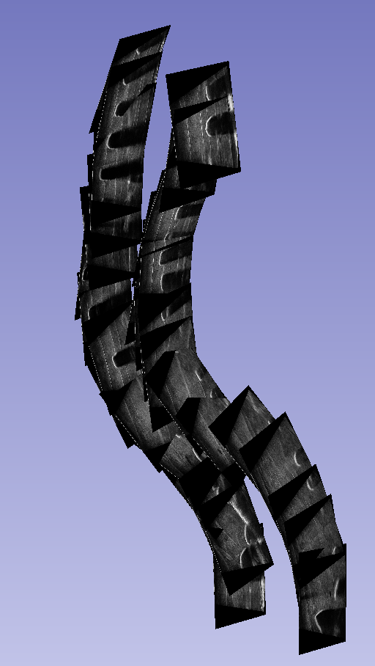
S
A
R

Slide 5
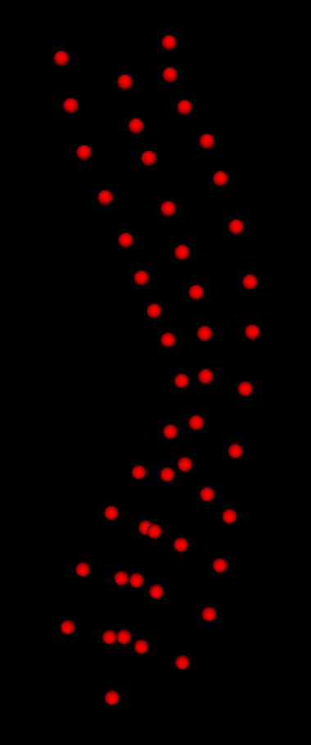
Spinous process
Transverse process
Superior articular process

