Slide 1
Chapter 8 – Artificial Life
Ben Church & Itamar Tzadok

Slide 2






What is artificial life (AL)?
So far we’ve seen evolutionary computing, neurocomputing, swarm intelligence, and immunocomputing
All fields using algorithms inspired by life.
What makes AL a field in its own right?
http://www.lakeshorelearning.com/media/images/free_resources/clip_art/school/computer.jpg
http://images.fanpop.com/images/image_uploads/Darwin-Fish-debate-761620_500_306.jpg
http://www.clker.com/cliparts/o/R/Q/f/z/T/brain-hi.png
http://images.clipartpanda.com/clipart-computer-clip-art-computers-420136.jpg
http://www.clipartbest.com/cliparts/LiK/rk9/LiKrk9RaT.jpeg
http://4.bp.blogspot.com/_tgM9xSZdl34/TQN7Fg1wEWI/AAAAAAAAGKk/_J2FFfLgQtQ/s320/computer%2Bvirus.jpg

Slide 3
What is artificial life (AL)?
AL differs from the listed fields mainly by intention.
Other fields:
Seek mainly to solve other problems using algorithms inspired by nature.
Artificial life:
Develops and studies models of life for the sake of understanding life and those models.

Slide 4
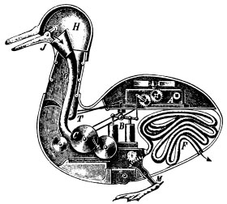
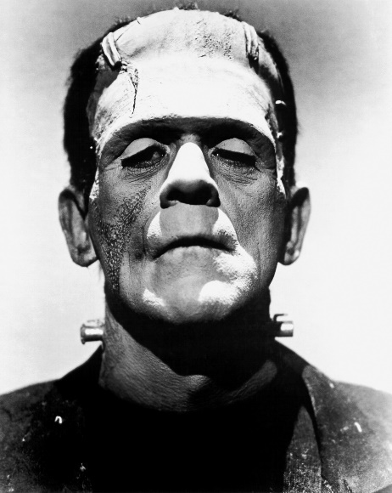
What is artificial life (AL)?
Natural life sciences employ reductionist method to explain life
Artificial life uses a constructive approach to explain and explore life
By Unknown - [1], Public Domain, https://commons.wikimedia.org/w/index.php?curid=1493624
By Universal Studios - Dr. Macro, Public Domain, https://commons.wikimedia.org/w/index.php?curid=3558176

Slide 5
A few ideas behind AL
Life is a process
Life can be explored constructively
‘Life’ is independent of substrate

Slide 6
Life-as-it-is
AL contributes models to biological sciences
AL refines its models with contributions of biological sciences

Slide 7
Life-as-it-could-be
Constructive approach allows exploration of novel forms of life
Low-level rules and agent interaction produce life-like complexity

Slide 8
Langton’s Features of AL Models (1988)
Ensembles, or ecosystems, of agents, or organisms, interacting
No privileged agents – No central control
Agents choose how to interact with agents and the environment
No global rules – Only individual rules
Emergent phenomena are patterns that transcend individuals

Slide 9

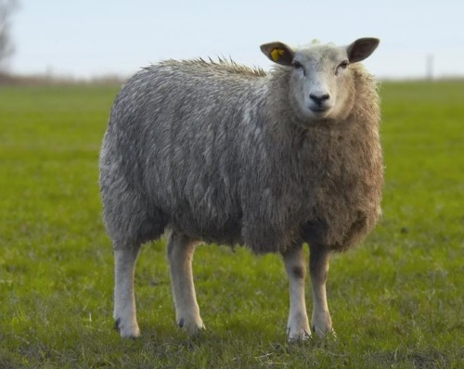
Two categories of AL
Virtual
Abstract
Synthetic
Concrete
https://www.thestar.com/content/dam/thestar/life/technology/2013/02/14/tamagotchi_returns_electronic_pet_reborn_as_mobile_app/tamagotchi.jpg.size.xxlarge.promo.jpg
http://www.eurostemcell.org/files/dolly1.jpg

Slide 10

The meaning of life
AL asks us to consider an age old question: What does it mean to be alive?
To know this, we must see past the details of life’s many implementations.
https://thumbs.dreamstime.com/z/thinking-robot-27761830.jpg

Slide 11
Farmer and Belin’s Criteria for life (1991)
Life is a pattern, not an object
Life involves self-reproduction
Information storage of a self-representation
Metabolism
Interaction with the environment
Interdependence of parts
Stability under perturbation
The ability to evolve

Slide 12
Some case studies
Reynolds’ boids
Dawkins’ biomorphs
Computer viruses
Synthesizing emotional behaviour
Sony’s AIBO
Theraulaz and Bonabeau’s nest building
+ Any others
+ Itamar’s studies

Slide 13
Reynolds’ Boids
Model of flocking behaviour

Slide 14
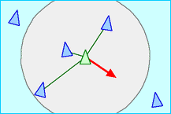
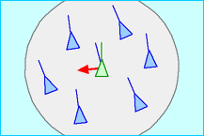
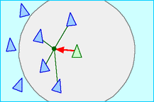
Reynolds’ Boids
http://www.red3d.com/cwr/boids/images/separation.gif
http://www.red3d.com/cwr/boids/images/alignment.gif
http://www.red3d.com/cwr/boids/images/cohesion.gif

Slide 15
Reynolds’ Boids
https://youtu.be/GUkjC-69vaw

