Slide 2
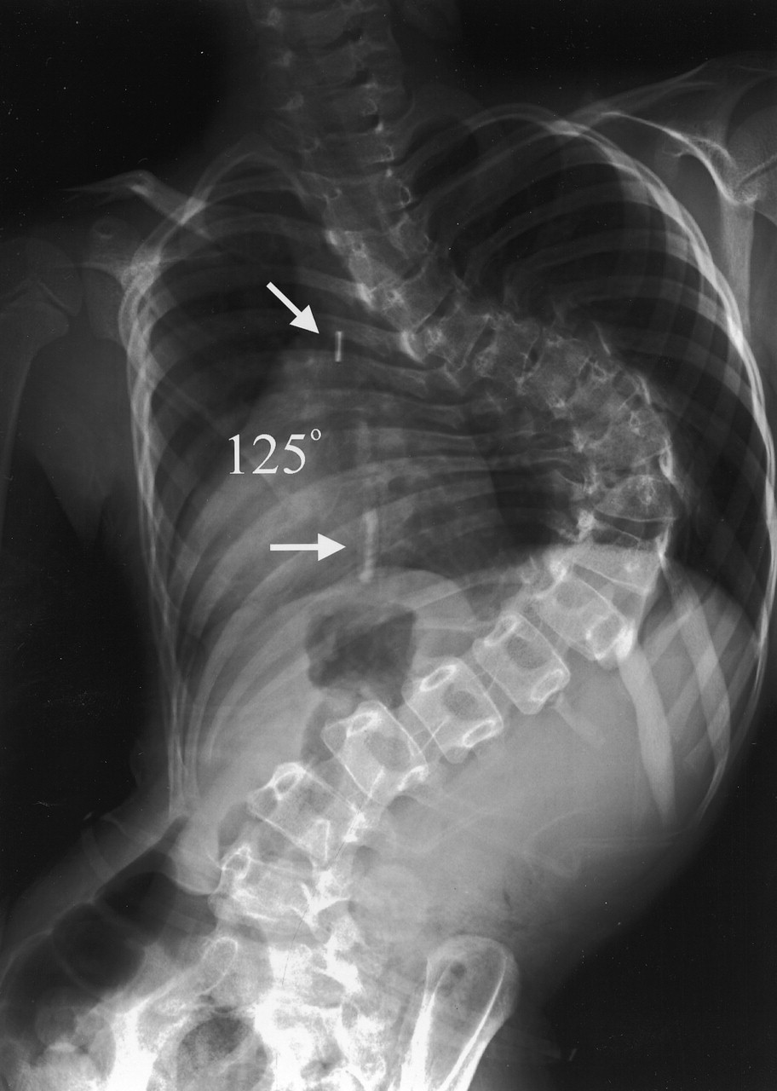
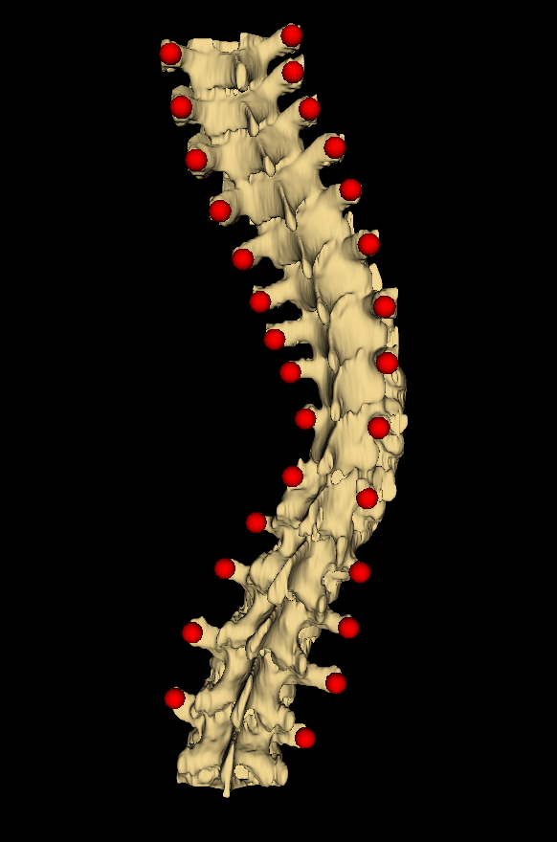
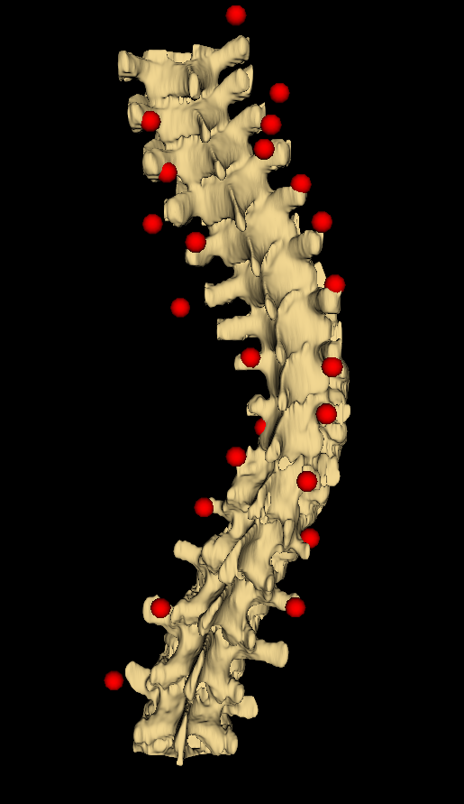
Neural Networks for Scoliosis Quantification
http://spinewave.co.nz/wp-content/uploads/scoliosis.jpeg

