Slide 1
3D Ultrasound for Scoliosis Quantification
Ben Church

Slide 2
Contents
Background
Scoliosis
3D ultrasound

Slide 3
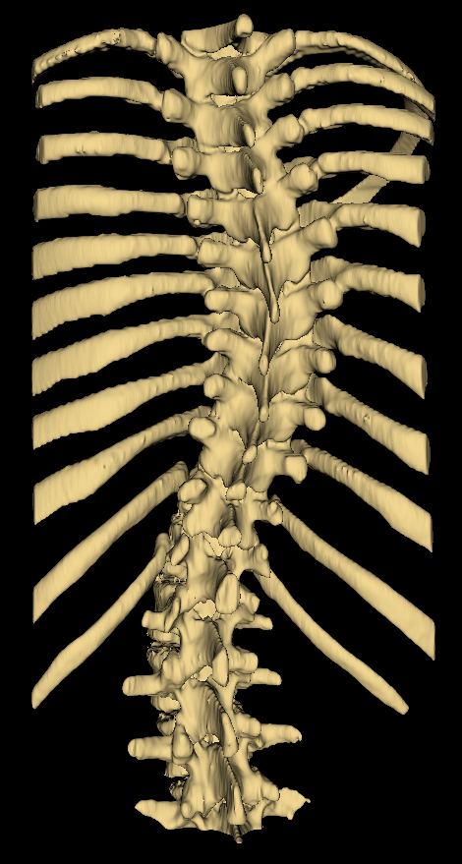
Background - Scoliosis
Pathological spinal curvature
Develops during growth
Must be monitored

Slide 4
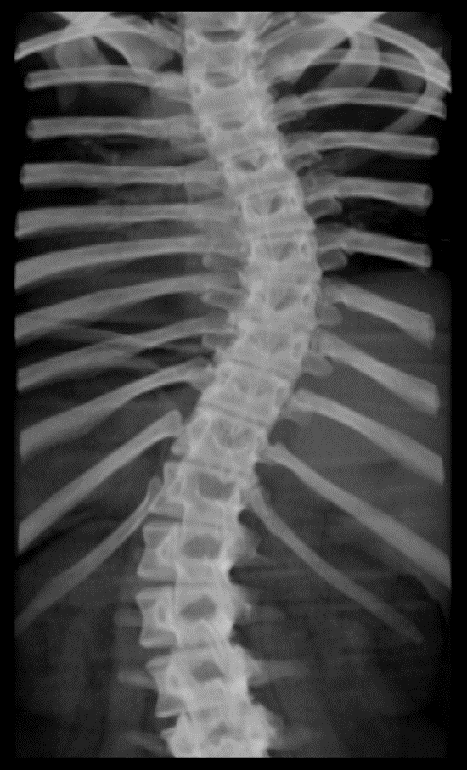
Background – Assessment
X-ray imaging is the gold-standard
Measure Cobb angle from X-ray, quantifying severity

Slide 5
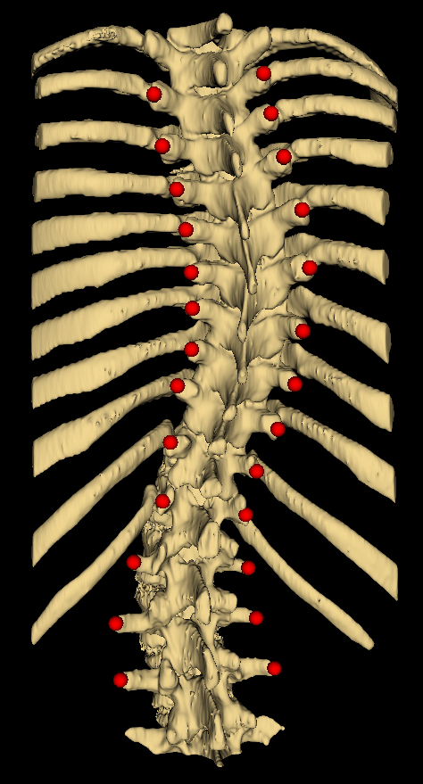
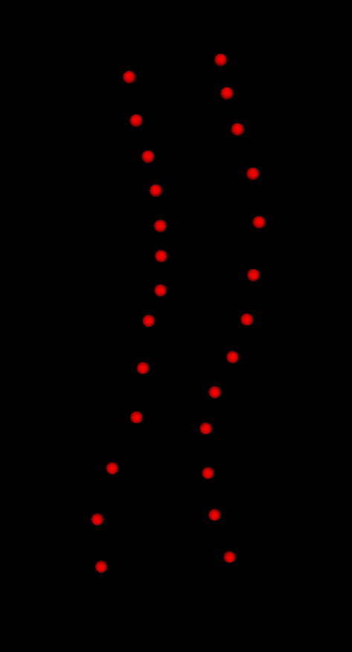
Background – Tracked ultrasound
Risks of cumulative X-ray exposure have motivated use of 3D ultrasound
Provides landmark locations rather than macroscopic visualization
Curvature extracted from landmark locations

Slide 6
Do the papers
s

