Slide 1
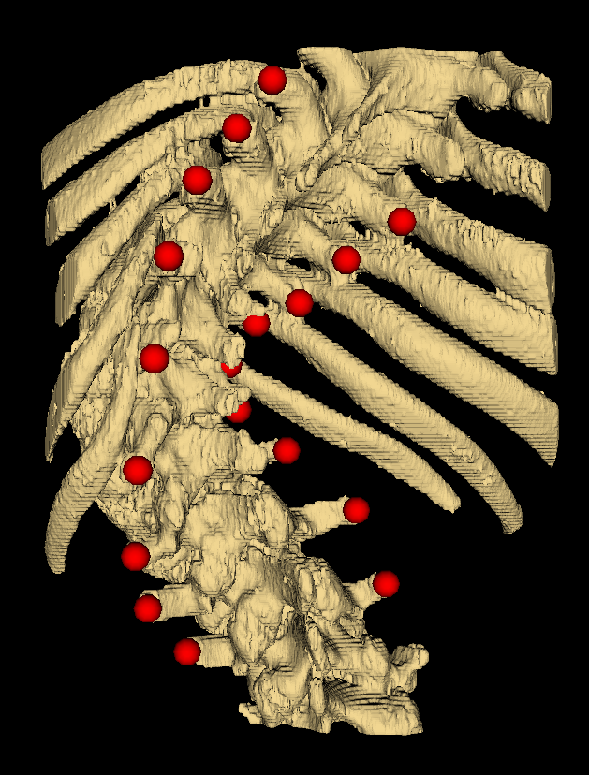
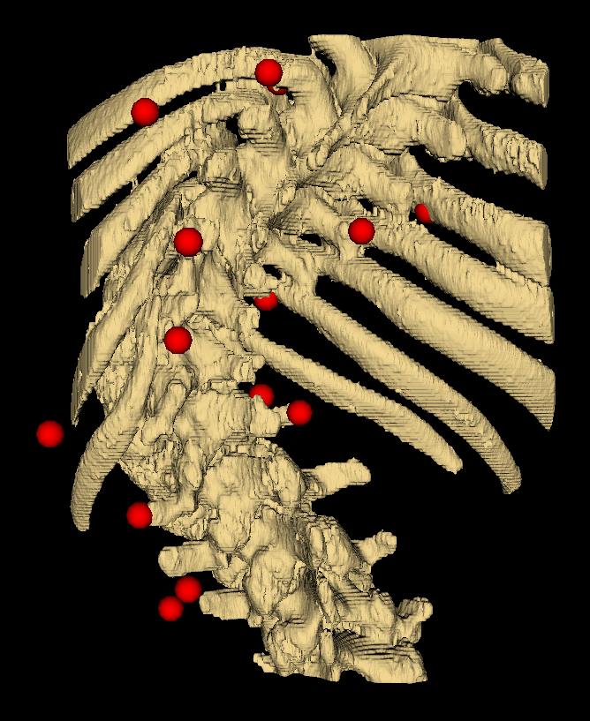
Neural Networks for Scoliosis Quantification
Ultrasound error simulation
Pre-processing module
Neural network
Ideal landmark data
Realistic landmark data
Compare
Ground-truth angle

