Slide 1
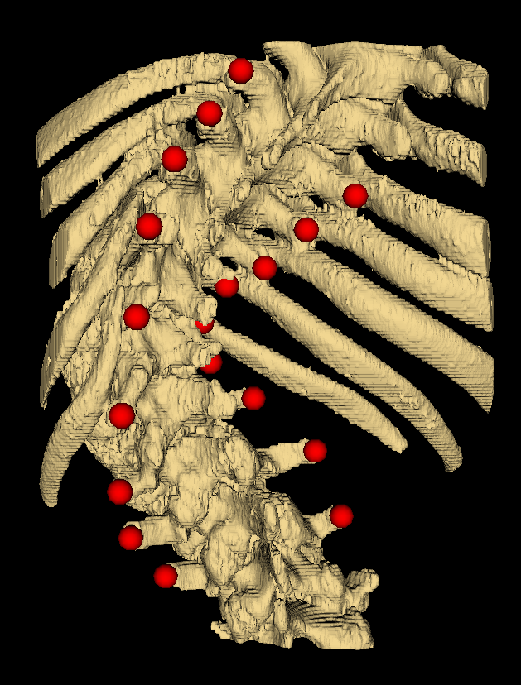
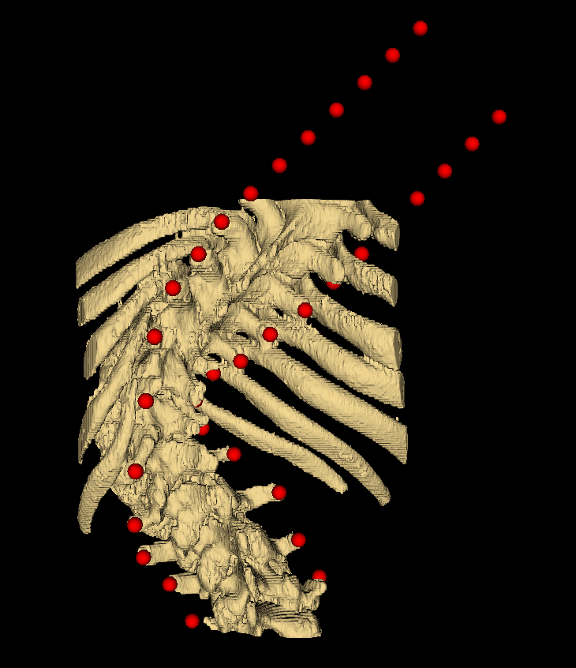
Landmark set extrapolation
Subtract average coordinate of each patients’ dimensions from the patient’s points, centering them
Divide all points’ cords by max abs val in that patient’s dimension, normalizing cords over [-1,1]
Original scan 2n 3D coordinates
Completed set 2*17 = 34 3D points
Compare
Neural network
Ground-truth angle

