Slide 1
Chapter 8 – Artificial Life
Ben Church & Itamar Tzadok

Slide 2
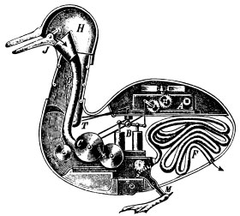

What is artificial life (AL)?
Natural life sciences employ reductionist method to explain life
Artificial life uses a constructive approach to explain and explore life
By Unknown - [1], Public Domain, https://commons.wikimedia.org/w/index.php?curid=1493624
By Universal Studios - Dr. Macro, Public Domain, https://commons.wikimedia.org/w/index.php?curid=3558176

Slide 3
A few ideas behind AL
Life is a process
Life can be explored constructively
‘Life’ is independent of substrate

Slide 4
Life-as-it-could-be
The constructive nature of AL allows us investigate novel forms of life

Slide 5
The meaning of life
AL asks us to consider an age old question: What does it mean to be alive?
To see past the details of life’s implementations is to know this

Slide 6
Some criteria for life [Farmer and Belin, 1991]
Life is a pattern, not an object
Life involves self-reproduction
Information storage of a self-representation
Metabolism
Interaction with the environment
Interdependence of parts
Stability under perturbation
The ability to evolve

