Slide 1
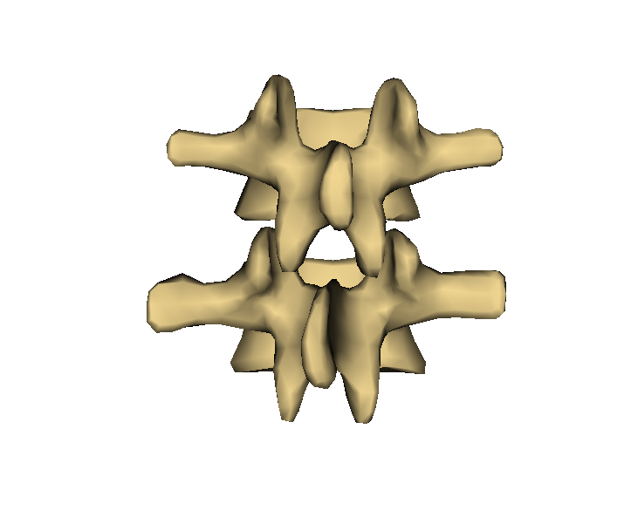
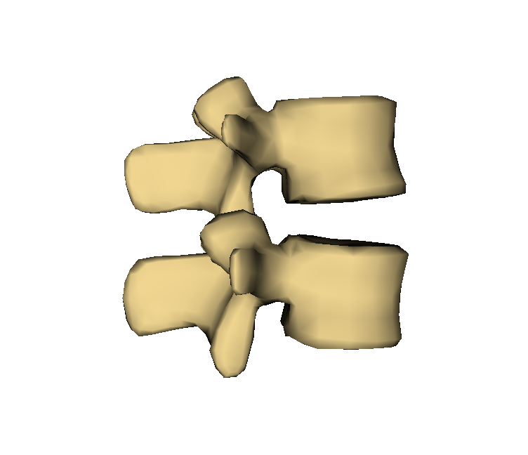
Vertebral body
Transverse process
Superior articular process
Facet joint
Spinous process
Inferior articular process
Lamina

