Slide 1
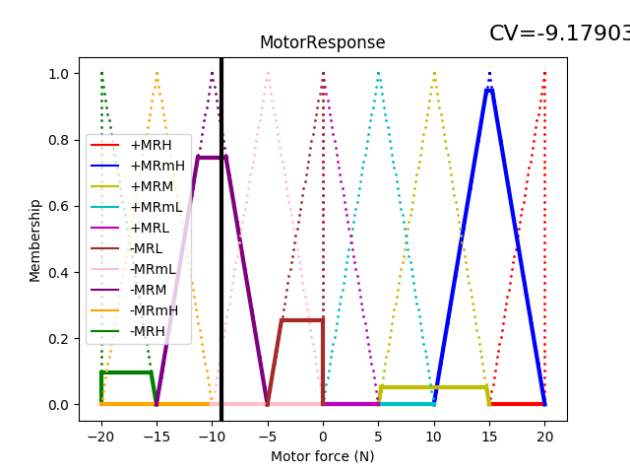

Slide 2
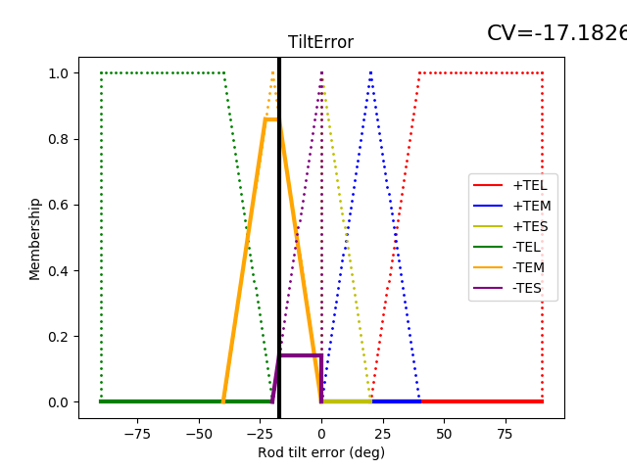
Left shoulder
Right shoulder
=
Left shoulder
Right shoulder
Left foot
Right foot

Slide 3
Left triangle area
Center rectangle area
Right triangle area

