Slide 1
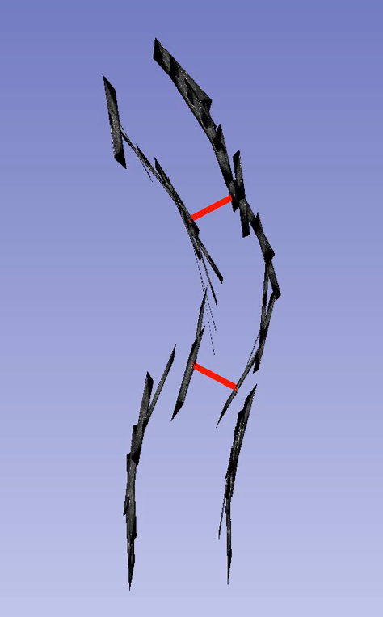
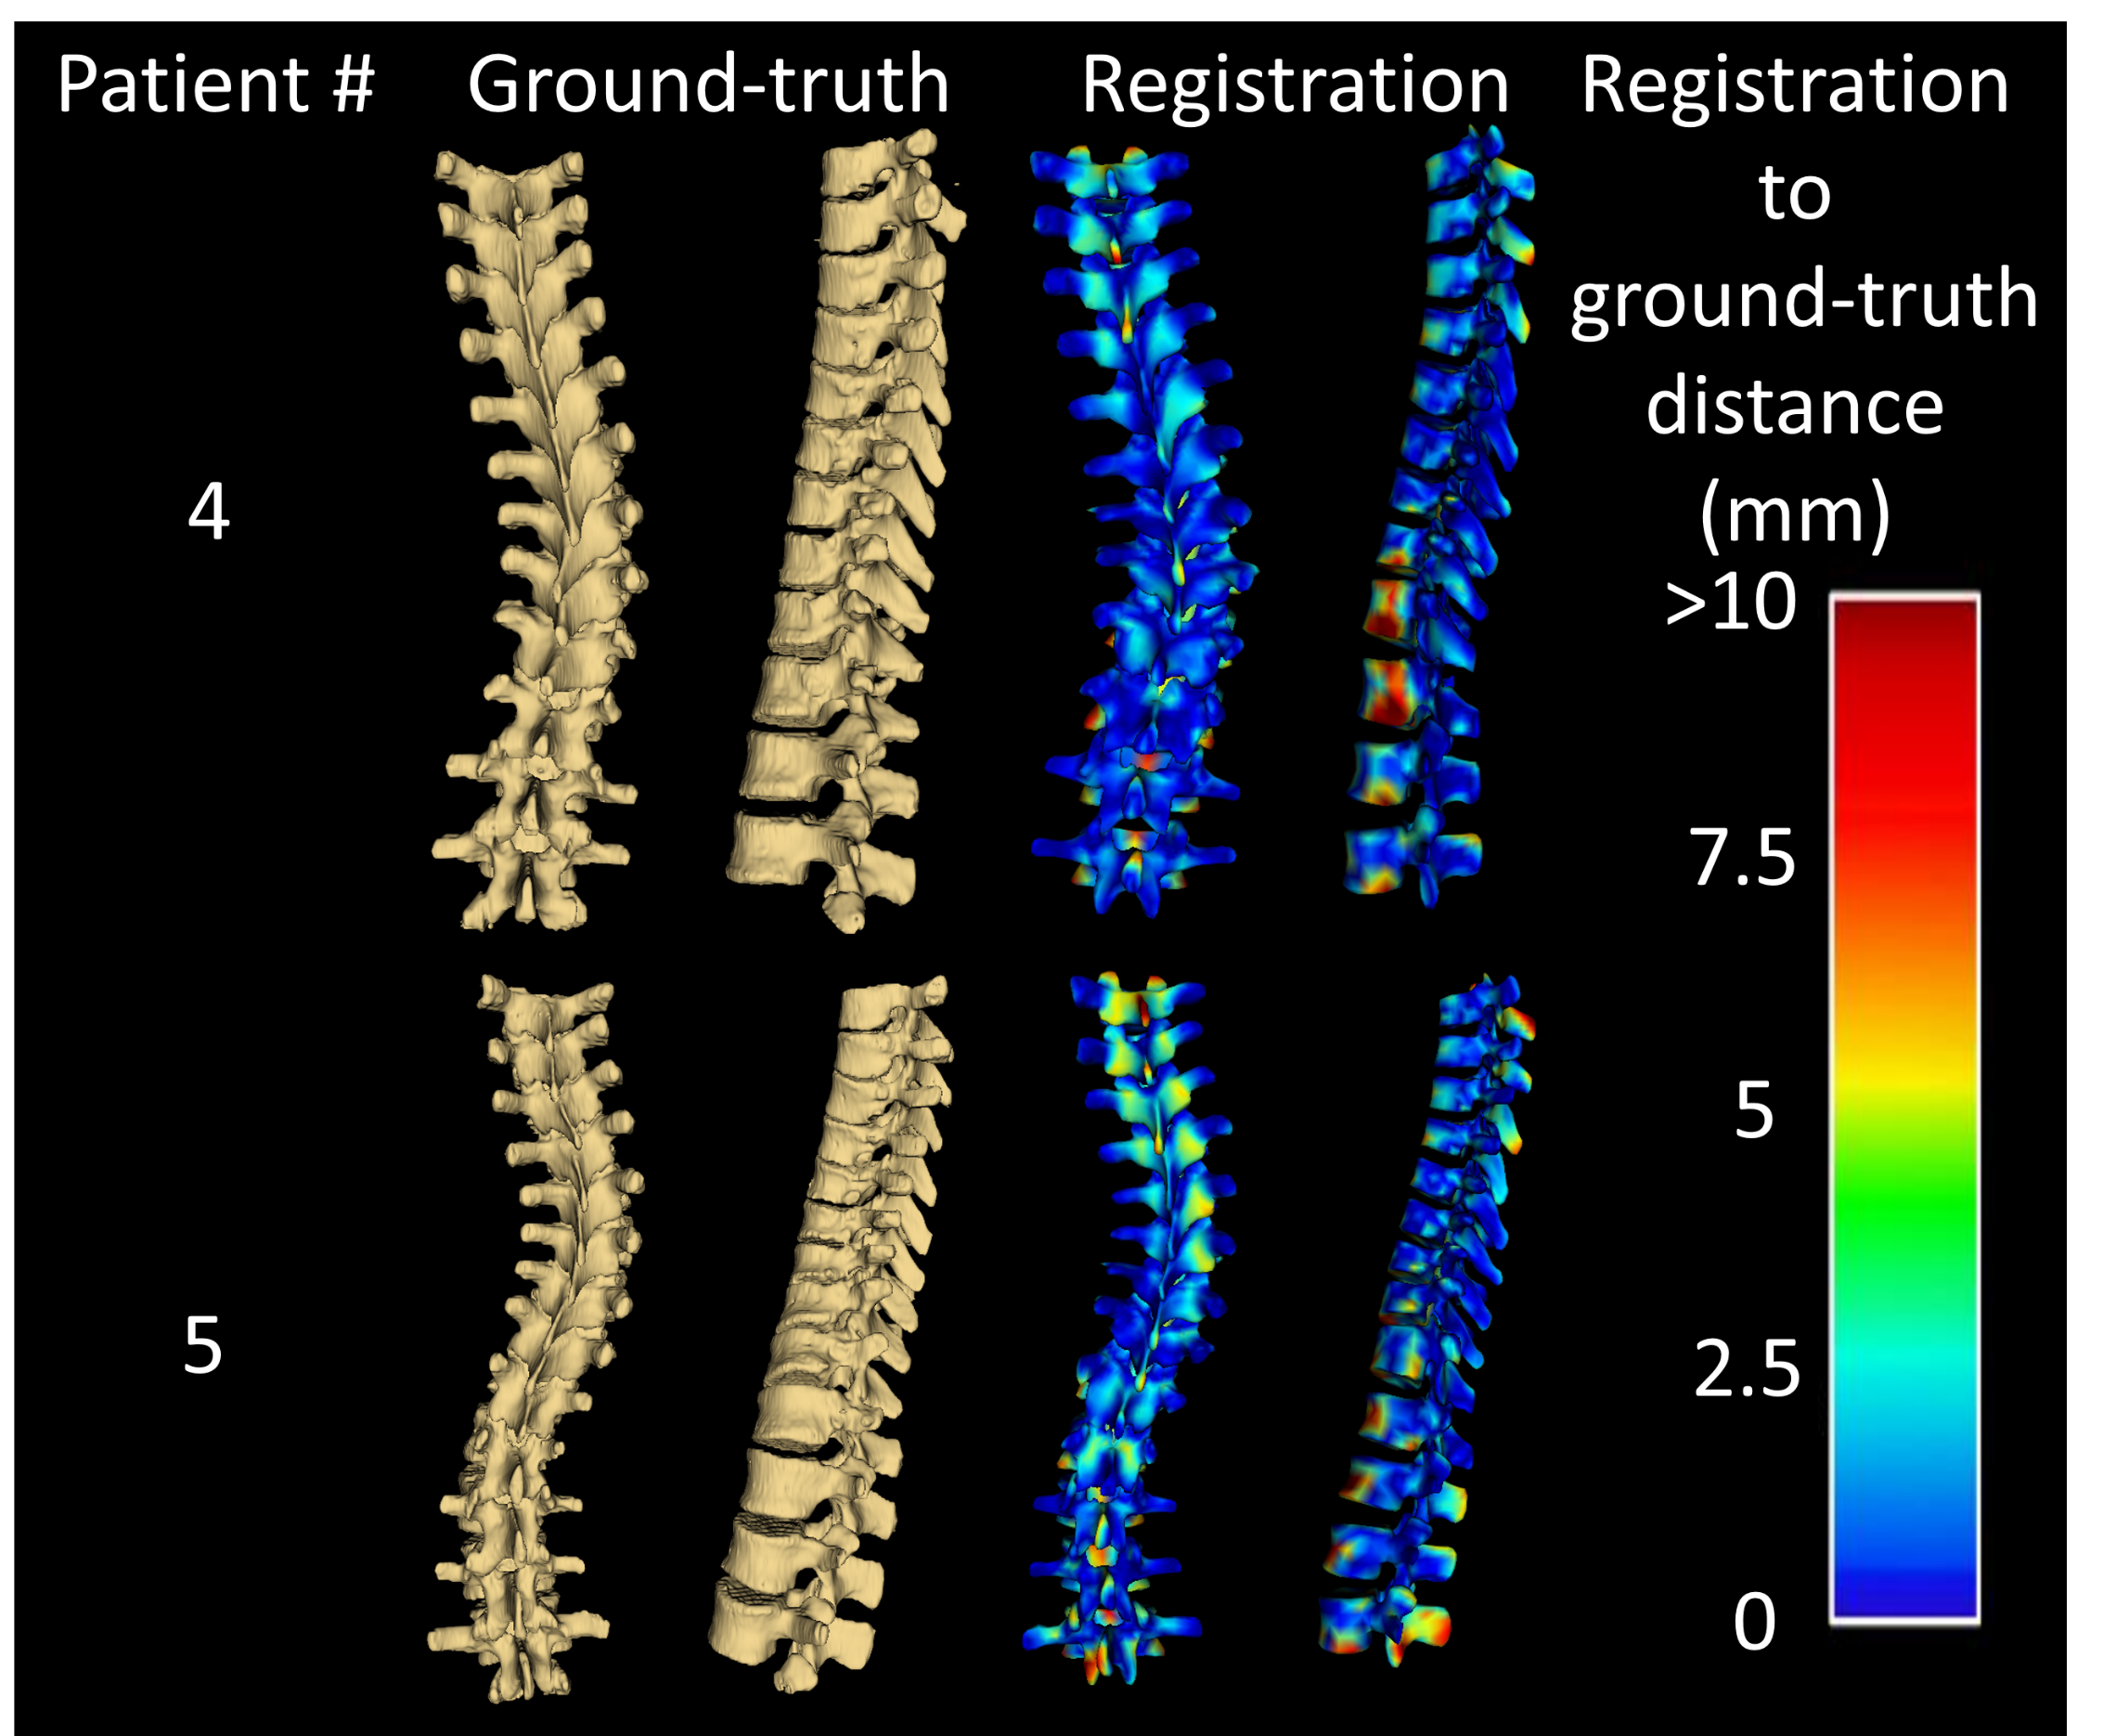
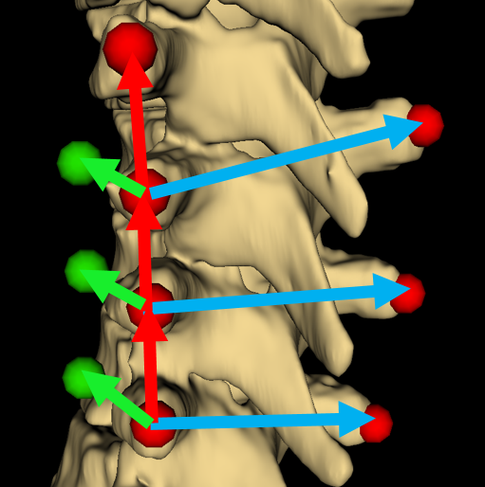
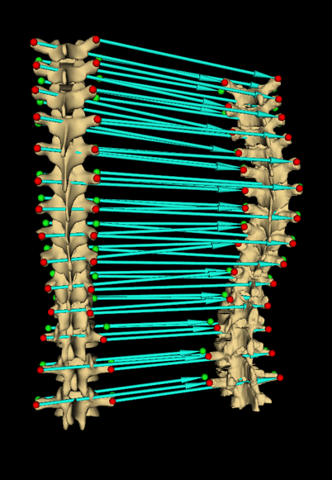
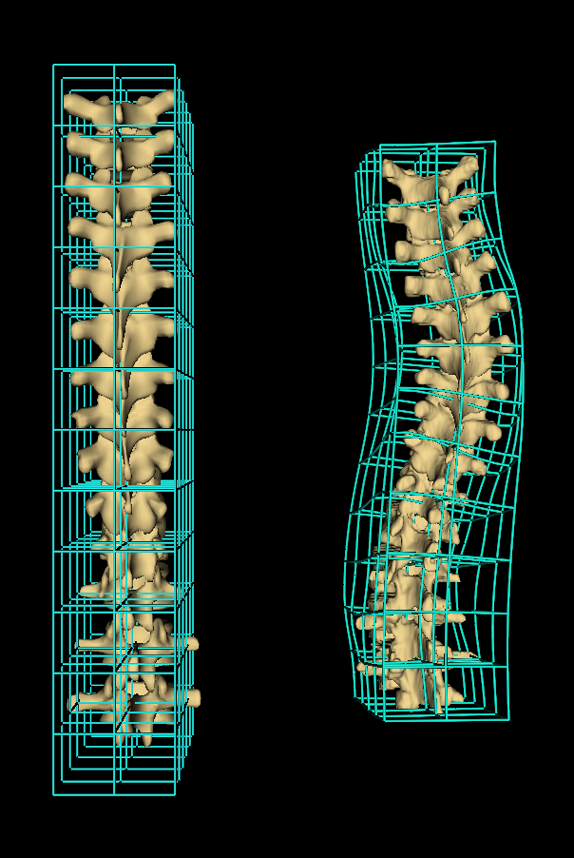



Scoliosis visualization using transverse process landmarks
Ben Church¹, Andras Lasso¹, Christopher Schlenger²,
Daniel P. Borschneck³, Parvin Mousavi⁴, Gabor Fichtinger^{1,3}, Tamas Ungi^{1,3} Laboratory for Percutaneous Surgery, School of Computing & Department of Surgery, Queen’s University, Kingston, ON
Introduction
Results
Spatially tracked ultrasound can be used to assess scoliosis quantitatively, without the need for ionizing radiation (Ungi et al. 2014)
Assessment methods use landmark locations rather than familiar , macroscopic visualizations such as X-ray or CT
Clinicians must relate ultrasound images and landmark locations to familiar patient anatomy
Registrations were generated for 5 patients and compared to prior CT-scan segmentations as ground-truth
Average and maximum Hausdorff distances were computed
Registration to ground-truth distances were computed and represented as error maps
Patient # | Avg. Hausdorff (mm) | Max. Hausdorff (mm)
1 | 2.8 | 20.0
2 | 2.3 | 24.0
3 | 2.4 | 17.7
4 | 2.9 | 18.1
5 | 3.3 | 23.8
Figure 1. Series of parasagittal ultrasound snapshots for locating transverse processes, with of curvature illustrated in red
Objective
To produce visualizations of scoliotic spines using transverse process locations as input
Figure 4. Registrations compared to CT-derived patient ground-truth. Error map shows distance between surfaces
Methods
Transverse processes located in patient and healthy-shaped model anatomy
Anchor points added to transverse process locations to constrain subsequent thin-plate spline registration in anterior-posterior direction and convey vertebral twist
Thin-plate spline displacement field applied to healthy-shaped model, warping to patient anatomy
Figure 2. Transverse process landmarks (red), and vector geometry used to add anchor points (green)
Conclusion
Method produces registrations depicting scoliotic deformation as informative and familiar surface visualizations
Figure 3. Registration computes transforms displacing model points to patient’s (left);
Transforms interpolated as thin-plate spline, warping healthy model to patient anatomy (right)
Acknowledgement
This work was made possible by funding from the Province of Ontario; and by Cancer Care Ontario (CCO) with funds provided by the Ministry of Health and Long-Term Care for an Applied Cancer Research Unit and Research Chair in Cancer Imaging. Funding was also provided by the Natural Sciences and Engineering Research Council of Canada under their Discovery Grants program and the Canadian Graduate Scholarship.
Reference
Ungi T et al. Spinal curvature measurement by tracked ultrasound snapshots. Ultrasound in medicine and biology. 2014 Feb;40(10):447-545.

