Slide 1
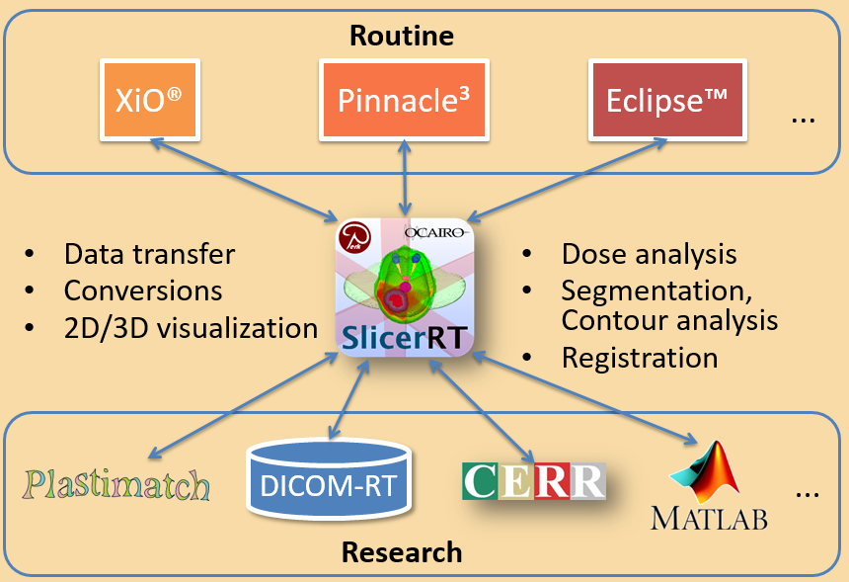
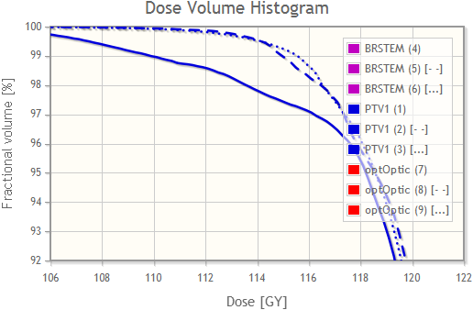
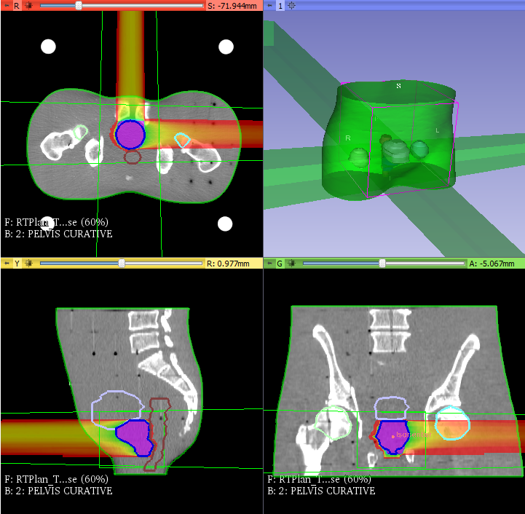
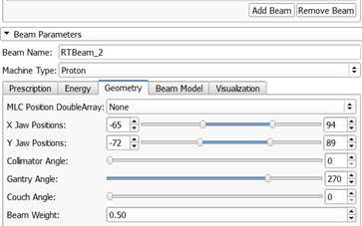
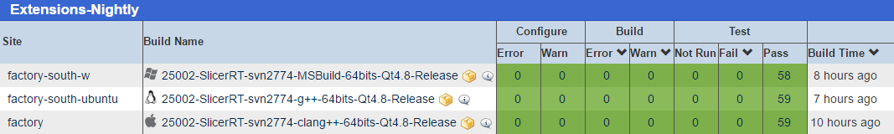
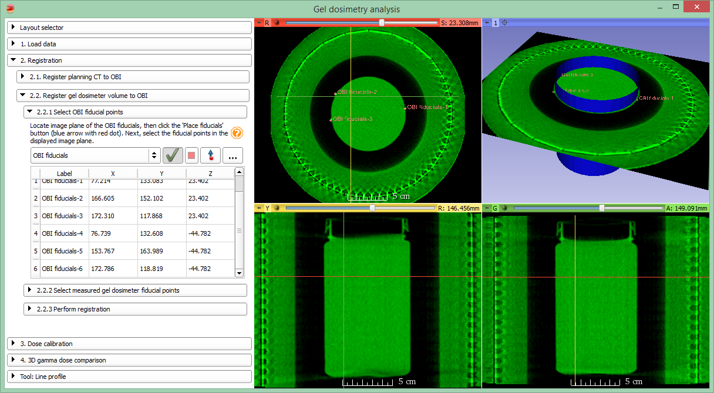
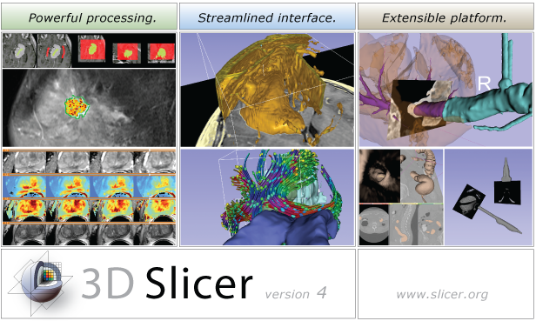
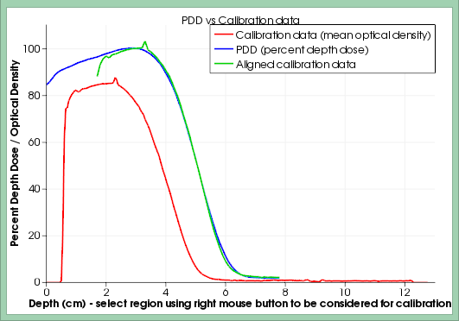
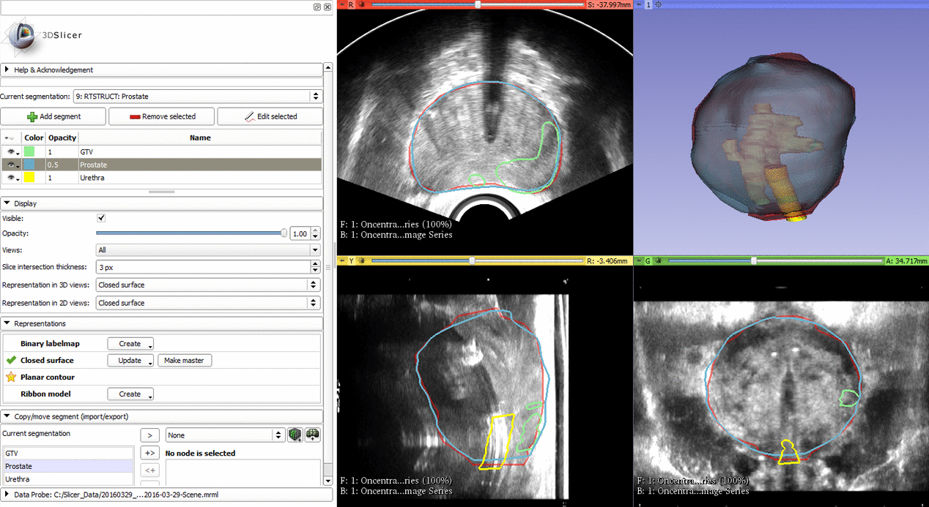
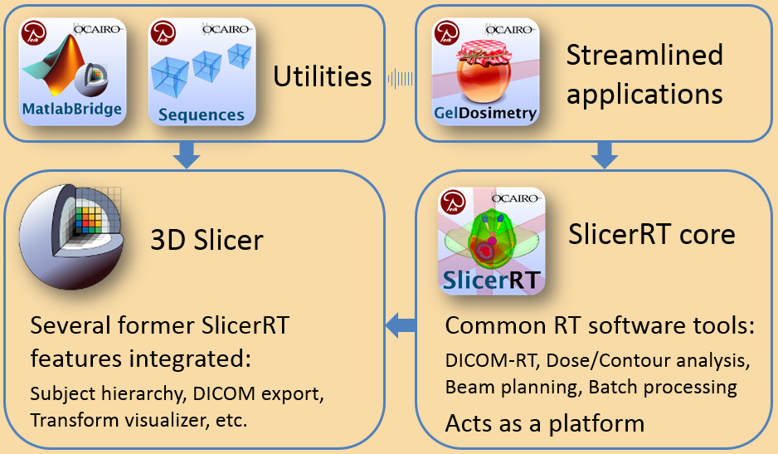






SlicerRT: an open source software platform to accelerate radiation therapy research
Csaba Pinter¹, Andras Lasso¹, Gregory C. Sharp³, An Wang², David Jaffray², Gabor Fichtinger¹
¹Laboratory for Percutaneous Surgery, School of Computing, Queen’s University, Kingston, ON
²Radiation Medicine Program, Princess Margaret Hospital, University Health Network, Toronto, ON
³Department of Radiation Oncology, Massachusetts General Hospital, Boston, MA, USA
Background
Use Cases
Radiation therapy (RT) software tools are mostly either
expensive, closed proprietary applications with fixed workflows or
free tools with limited extensibility, scope, reliability, or user support.
The challenge is bringing the ideas and tools together and bridging these two worlds to facilitate RT research.
Dose accumulation
Automate image-guided RT protocol by determining the displacement between the original plan and daily setup, and calculating the total administered dose.
Register anatomical images
Transform whole studies
Accumulate dose, compute DVH
Collaboration with PMH, Toronto
Pinter et al. MedPhys, 2012
Compare plans using DVH
The SlicerRT “Ecosystem”
Proton dose calculation
Uses the External beam planning module:
Handles arbitrary dose engines
Using the same user interface
Potentially replace a TPS
Collaboration with MGH, Boston
and CRO, Italy
Desplanques et al., MedPhys, 2014
Principles
Based on consensus discussions with RT researchers
Leverage existing tools, open to integrate 3rd party algorithms
Free, open-source license (BSD), contribute back to community
High quality software, developed using industrial standards
SlicerRT dashboard, performing automatic testing every night
Gel dosimetry analysis
Supports a 3D gel dosimetry workflow through a step-by-step, simplified user interface. Reduced processing time from hours to minutes.
Collaboration with KGH, Kingston, ON
Alexander et al., IC3DDose, 2014
Platform
The base platform of choice is 3D Slicer, a prevalent medical image analysis and visualization platform
Created from $50M “other people’s money” funding (> 2,000 years of labor)
Professionally engineered
http:// www.slicer.org
MRI/US fusion for prostate HDR brachytherapy
Deformable registration of prostate structures
Propagate contours from MRI to US
Enables usage of high quality contours delineated on MRI images for treatment planning and guidance
Collaboration with CHUM, Montreal
Ecosystem
A collection of components make SlicerRT a powerful “ecosystem” for rapid prototyping of medical applications. With the common RT research tools in SlicerRT core, and the utilities MatlabBridge that facilitates direct usage of Matlab algorithms in 3D Slicer and Sequences offering general support for sequential data, it is possible to easily create streamlined applications.
Results
SlicerRT became a popular toolkit for RT researchers by providing most frequently used features for objective comparison and analysis of RT data and allowing researchers to easily develop and share their additional custom methods. See http://www.SlicerRT.org for details.
SlicerRT is the most downloaded 3D Slicer extension: 7100 vs 3500 for 2nd
Available on Windows , Mac , and Linux
Acknowledgement
SlicerRT was made possible by funding from the Province of Ontario; by the Ontario Research Fund Research Excellence Program for the Ontario Consortium for Adaptive Interventions in Radiation Oncology (OCAIRO) and by Cancer Care Ontario (CCO) with funds provided by the Ministry of Health and Long-Term Care for an Applied Cancer Research Unit and Research Chair in Cancer Imaging.

