Slide 1
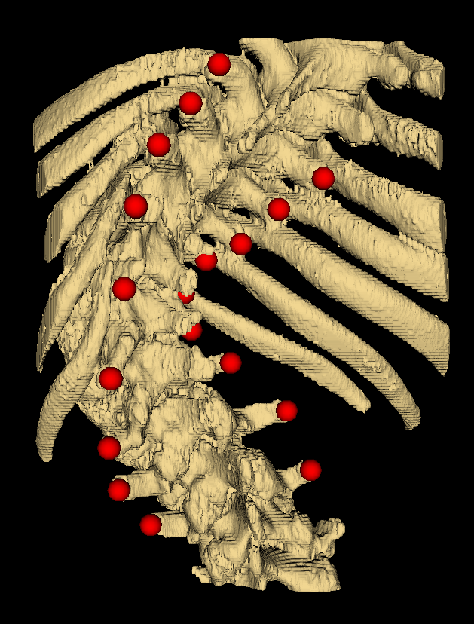
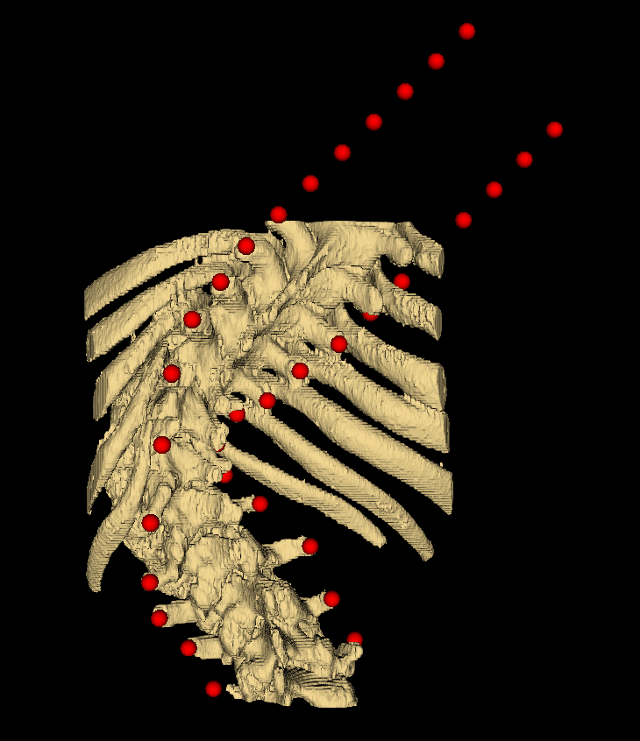
Landmark set extrapolation
Subtract average coordinate of each patients’ dimensions from the patient’s points, centering them
Divide all points’ cords by max abs val in that patient’s dimension, normalizing cords over [-1,1]
Original scan 2n 3D coordinates
Completed set 2*17 = 34 3D points
Compare
Neural network
Ground-truth angle

Slide 2
Original landmark data
Pre-processing
Completed, centered, normalized data with added errors
Neural network
Network curvature estimate
Compare
Performance
Ground-truth Cobb angle

Slide 3
Pre-processing
Extrapolation to completion
Original landmark data
Data suitable for neural network
Set splicing
Centering
Normalization
Ultrasound error simulation

Slide 4
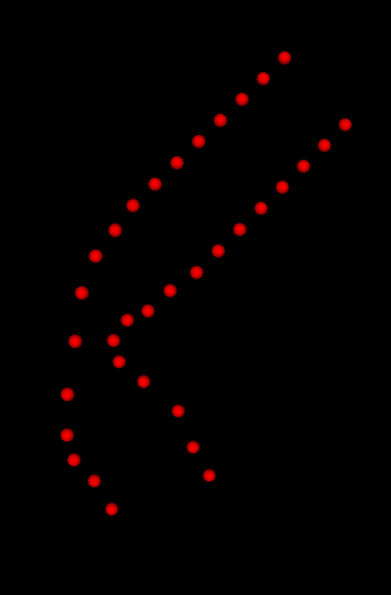
Pre-processing

Slide 5
Neural network
102 input nodes
10 hidden nodes
1 output node
Data suitable for neural network
Curvature estimate
Subtract 0.5
Multiply by 2 * MaxAngle

Slide 6
Curvature estimate
Neural network

