Slide 1
Improved exploit prediction with optimized CVSS equation
Ben Church

Slide 2
Outline
CVSS introduction
Background & Related work
Method
Optimization
Results
Discussion and conclusions

Slide 3
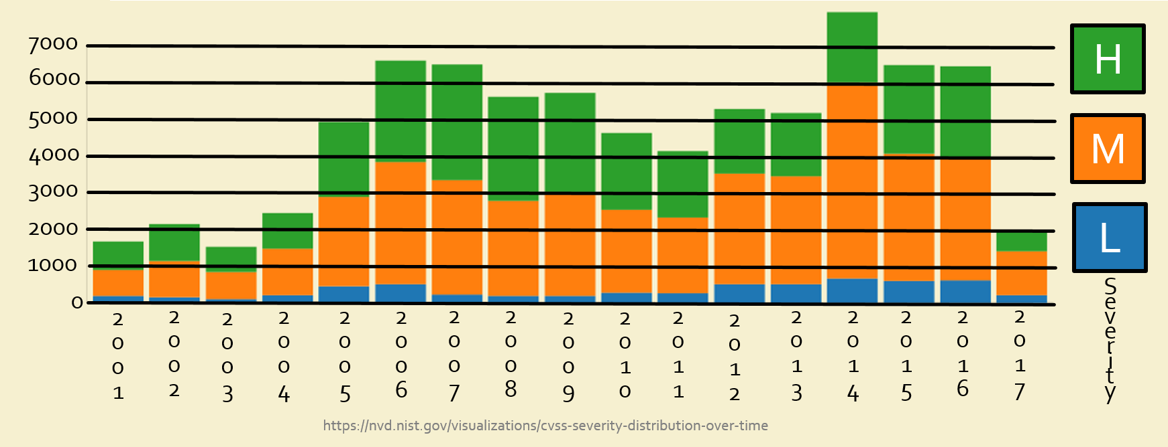
Intro – Vulnerability Volume
More vulnerabilities reported than can be addressed

Slide 4
Intro - Prioritization
Limited resources necessitate vulnerability prioritization [1]
Prioritization seeks to minimize risk

Slide 5
Intro – Risk from CVSS
Common Vulnerability Scoring System measures risk [2]
Scores in range 0-10 convey likelihood and severity of exploitation

Slide 6
Intro – CVSS Composition
Consists of three metric groups for three scores:
Base score
Temporal score
Environmental score

Slide 7
Intro – Base Score
Base score computed from six metrics
Metrics reflect exploit likelihood and severity
Base metrics
Confidentiality impact
Access vector
Access complexity
Integrity impact
Availability impact
Authentication
Likelihood
Severity
Example base vector to base score: AV:N/AC:L/Au:N/C:C/I:C/A:C = 10.0

Slide 8
Intro – CVSS Score Prediction
Khazaei et al. [3] predicted base scores from descriptions
This presupposes base score utility

Slide 9
Intro – CVSS Issues
Base scores not correlated with exploits [4,5]
Subjectivity in prediction from equation parameters
BaseScore = round_to_1_decimal(((0.6*Impact)+(0.4*Exploitability)–1.5)*f(Impact))
Impact = 10.41*(1-(1-ConfImpact)*(1-IntegImpact)*(1-AvailImpact))
Exploitability = 20* AccessVector*AccessComplexity*Authentication
f(impact)= 0 if Impact=0, 1.176 otherwise
AccessVector = case AccessVector of
requires local access: 0.395
adjacent network accessible: 0.646
network accessible: 1.0
AccessComplexity = case AccessComplexity of
high: 0.35
medium: 0.61
low: 0.71 ConfImpact = case ConfidentialityImpact of
none: 0.0
partial: 0.275
complete: 0.660

Slide 10
Intro – CVSS Issues
Inability to reflect risk necessitates specific systems [5]
Specific systems undermine standardization

Slide 11
Contribution
Improved exploit prediction by optimizing CVSS base score equation parameters

Slide 12
Method - Overview
CVE
Correlate
IDs
Exploited?
Scores
Metrics
Score vector
Search
Compute
Optimize
NVD
Base Equation

Slide 13
Method - Data
Range of entries from Common Vulnerabilities and Exposures (CVE - http://cve.mitre.org/)
Corresponding entries from National Vulnerability Database (NVD - https://nvd.nist.gov/)

Slide 14
Method - Data
CVE
NVD
…
…
CVE-2012-1234
Exploited?
CVE-2012-1234
Base Score
CVE-2012-1235
Exploited?
CVE-2012-1235
Base Score
CVE-2012-1236
Exploited?
CVE-2012-1236
Base Score
…
…

Slide 15
Method - Correlation
Vulnerabilities classified based on links to Exploit Database (EDB - https://www.exploit-db.com/)
Younis et al. [6] used intra-class correlation coefficient (ICC) to conveys distinctness of predictions

Slide 16
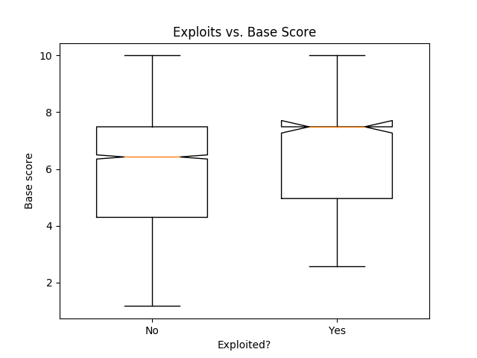
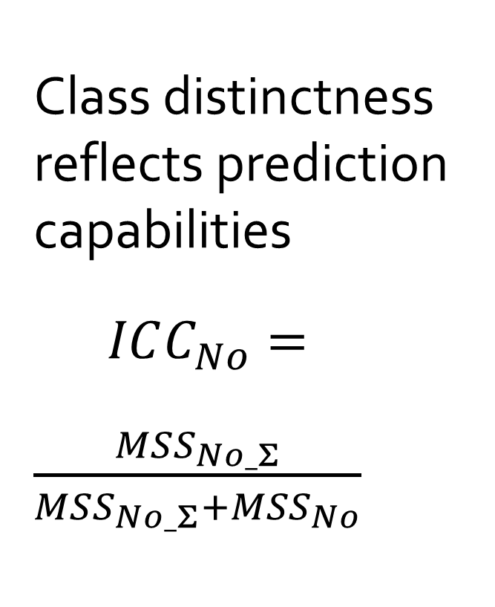
Method - Correlation
Class distinctness reflects prediction capabilities
$ICC_{No}=\frac{MSS_{No_Σ}}{MSS_{No_Σ}+MSS_{No}}$
μ_{Yes}
μ_{Σ}
μ_{No}

Slide 17
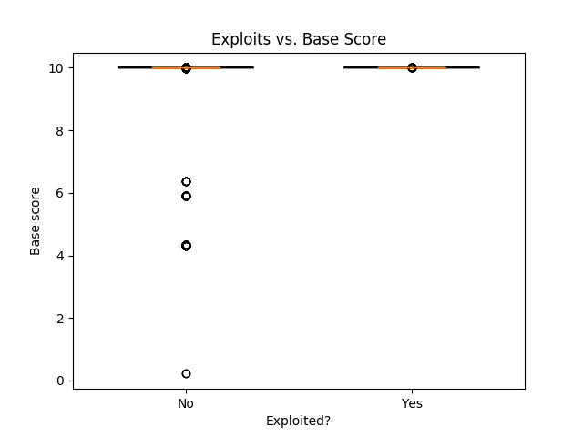
Method - Optimization
18 equation parameters were optimized for ICC
Base scores were recomputed with optimized equation

Slide 18
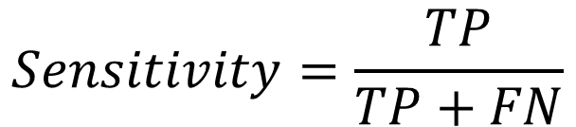
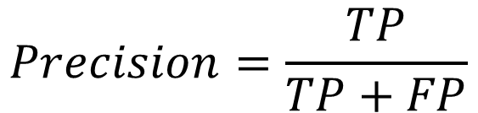
Method – Assessment Metrics
Binary classification allows sensitivity and precision calculation [6].
Real exploit? | Predicted exploit?
 | True | False
True | True positive (TP) | False negative (FN)
False | False positive (FP) | True negative (TN)
$$Sensitivity=\frac{TP}{TP+FN}$$
$$Precision=\frac{TP}{TP+FP}$$

Slide 19
Results - Metrics
ICC, Sensitivity, and precision were compared before and after optimization.
 | Original | Optimized
ICC | 0.52 | 0.83
Sensitivity | 0.14 | 1
Precision | 0.05 | 0.07
$$Sensitivity=\frac{TP}{TP+FN}$$
$$Precision=\frac{TP}{TP+FP}$$

Slide 20
Results - Confusion
Original
Optimized
Real exploit? | Predicted exploit?
 | True | False
True | 46 | 278
False | 3749 | 913
Real exploit? | Predicted exploit?
 | True | False
True | 324 | 0
False | 4512 | 141
$$Sensitivity=\frac{TP}{TP+FN}$$
$$Precision=\frac{TP}{TP+FP}$$

Slide 21
Discussion - Performance
Optimized base score equation improved all assessment metrics.
 | Original | Optimized
ICC | 0.52 | 0.83
Sensitivity | 0.14 | 1
Precision | 0.05 | 0.07

Slide 22
Discussion - Metrics
Final parameter values suggest flaws in equation metrics.
Original
Optimized
AccessVector = case AccessVector of
requires local access: 0.395
adjacent network accessible: 0.646
network accessible: 1.0
AccessComplexity = case AccessComplexity of
high: 0.35
medium: 0.61
low: 0.71 ConfImpact = case ConfidentialityImpact of
none: 0.0
partial: 0.275
complete: 0.660
AccessVector = case AccessVector of
requires local access: 0.934
adjacent network accessible: 0.003
network accessible: 0.934
AccessComplexity = case AccessComplexity of
high: 0.958
medium: 0.958
low: 0.958 ConfImpact = case ConfidentialityImpact of
none: 0.938
partial: 1.0
complete: 0.025

Slide 23
Discussion - Limitations
ICC optimization destroys intra-class variability
Over-prediction of exploitation becomes a problem

Slide 24
Discussion – Ongoing Work
Optimize on other performance metrics
Assess optimized equation on multiple vulnerability sets

Slide 25
Conclusions
Optimizing on ICC does not necessarily improve CVSS utility
Other metrics should be investigated
Statistical validation should be performed

Slide 26
Thank you! Questions?

Slide 27
References
Bozorgi M. Lawrence KS, Savage S, and Voelker GM. 2010 “Beyond Heuristics: Learning to Classify Vulnerabilities and Predict Exploits” Proceedings of the 16th ACM SIGKDD international conference on Knowledge discovery and data mining. 2010; 105- 114.
Mell P, Scarfone K, and Romanosky S. “A complete guide to the common vulnerability scoring system version 2.0” Published by FIRST-Forum of Incident Response and Security Teams. 2007.
Khazeai A, Ghasemzadeh M, and Derhami V. “An automatic method for CVSS score prediction using vulnerabilities description” Journal of Intelligent & Fuzzy Systems. 2016; 30:89-96.
Allodi L, and Massacci F. “Comparing Vulnerability Severity and Exploits Using Case-Control Studies” ACM Transactions on Information and System Security. 2014; 17(1):1-20.
Younis AA, and Malaiya YK. “Comparing and Evaluating CVSS Base Metrics and Microsoft Rating System” IEEE International Conference on Software Quality, Reliability and Security. 2015; 252-261.
Younis AA, Malaiya YK, and Ray I. “Evaluating CVSS Base Score Using Vulnerability Rewards Programs” International Federation for Information Processing. 2016, 471:62-75.

