Slide 1
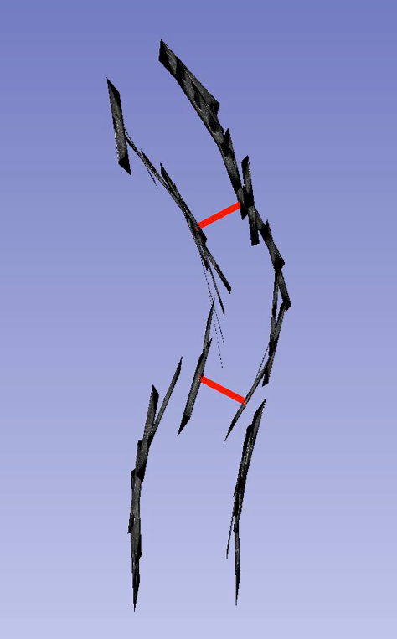
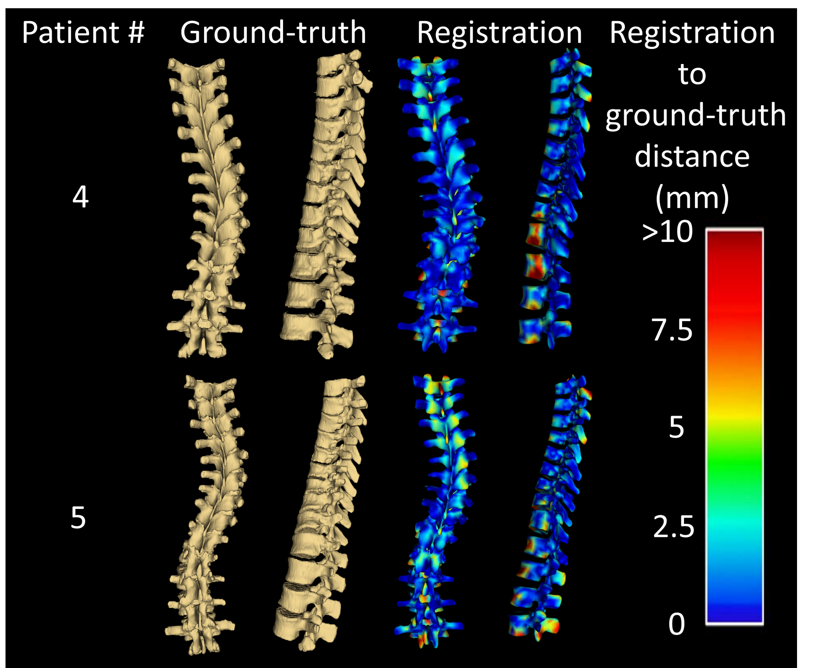
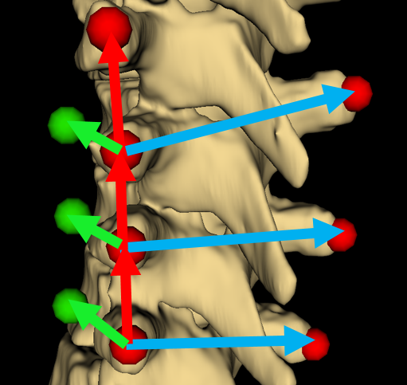
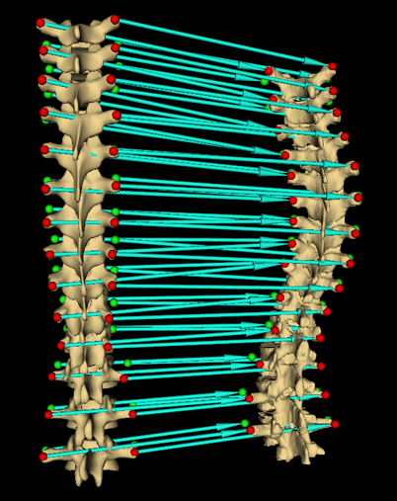
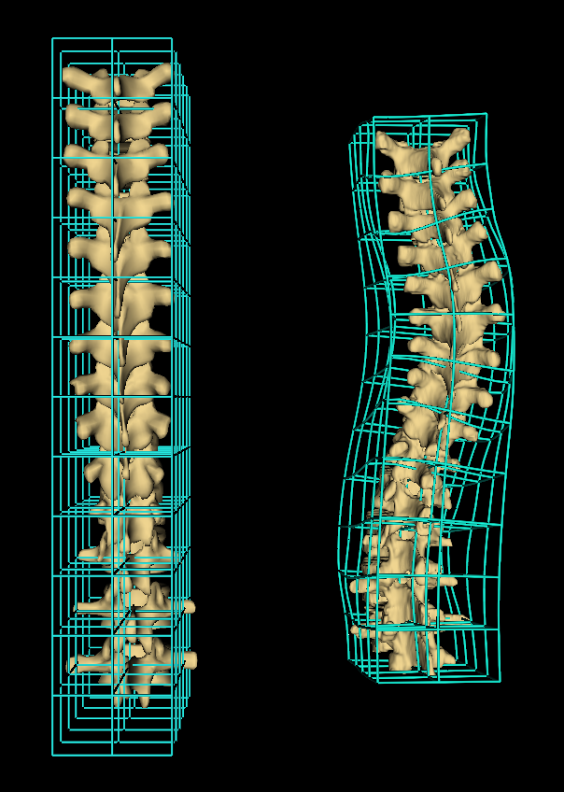



Scoliosis visualization using transverse process landmarks
Ben Church, Andras Lasso, Christopher Schlenger, Daniel P. Borschneck, Parvin Mousavi, Gabor Fichtinger, Tamas Ungi
Introduction
Results
Scoliosis must be monitored regularly
Repeated exposure to standard X-ray imaging presents health risks
Spatially tracked ultrasound can be used to assess scoliosis quantitatively (Ungi et al. 2014)
Assessment methods use landmark locations rather than familiar, macroscopic visualizations such as X-ray or CT
Angle of curvature measured as greatest angle between landmarks of any two vertebrae
Clinicians must relate ultrasound images and landmark locations to familiar patient anatomy
Registrations were generated for 5 patients and compared to prior CT segmentations as ground-truth
Average and maximum Hausdorff distances were computed
Registration to ground-truth distances were computed and represented as error maps
Patient # | Avg. Hausdorff (mm) | Max. Hausdorff (mm)
1 | 2.8 | 20.0
2 | 2.3 | 24.0
3 | 2.4 | 17.7
4 | 2.9 | 18.1
5 | 3.3 | 23.8
Fig 1. Series of ultrasound snapshots for locating transverse processes, with of curvature illustrated in red
Objective
To produce visualizations of scoliotic spines using ultrasound-accessible skeletal landmarks, the transverse process locations, as input
Methods
Transverse processes located in patient and healthy-shaped model anatomy
Anchor points added to transverse process locations to constrain subsequent thin-plate spline registration in anterior-posterior direction and convey vertebral twist
Thin-plate spline displacement field applied to healthy-shaped model, warping to patient anatomy
Figure 5. Registrations compared to CT-derived patient ground-truth. Error map shows distance between surfaces
Fig 2. Transverse process landmarks (red), and vector geometry used to add anchor points (green)
Conclusion
Method produces registrations depicting scoliotic deformation as familiar surface visualizations. Not validated for clinical intervention, but informative to clinicians assessing patient anatomy. Adaptable to methods using other symmetric landmarks.
Acknowledgement
This work was made possible by funding from: Province of Ontario; Cancer Care Ontario with funds from the Ministry of Health; Long-Term Care for an Applied Cancer Research Unit; Research Chair in Cancer Imaging; Natural Sciences and Engineering Research Council of Canada under the Discovery Grants program and Canadian Graduate Scholarship.
Reference
Figure 3. Registration computes transforms displacing model points to patient’s
Figure 4. Transforms interpolated as thin-plate spline, warping healthy model to patient anatomy
Ungi T et al. Spinal curvature measurement by tracked ultrasound snapshots. Ultrasound in medicine and biology. 2014 Feb;40(10):447-545.

