Slide 1
Neural Networks for Scoliosis Quantification
Ben Church

Slide 2
Content
Background
Scoliosis
Assessment
Tracked ultrasound
Motivation
Methods
Pre-processing
Neural network
Results
Discussion
Ongoing work

Slide 3
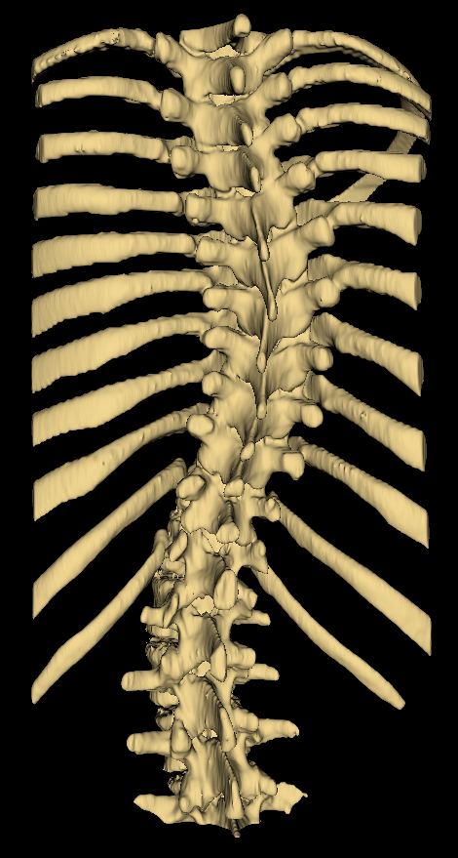
Background - Scoliosis
Pathological spinal curvature
Develops during growth
Must be monitored

Slide 4
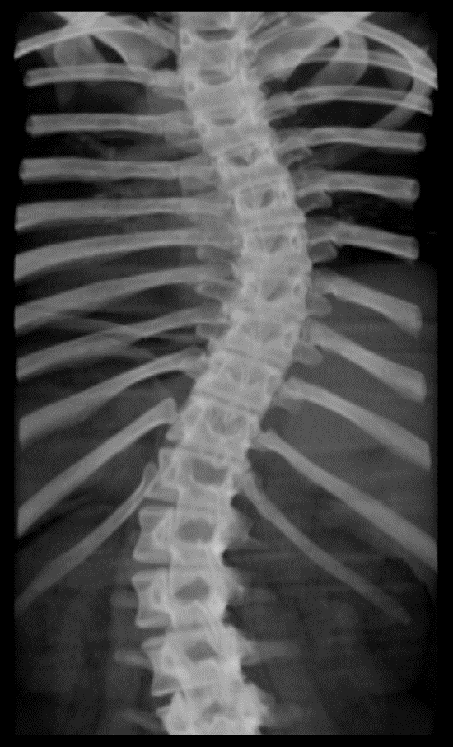
Background - Assessment
X-ray imaging is the gold-standard
Measure Cobb angle from X-ray, quantifying severity

Slide 5
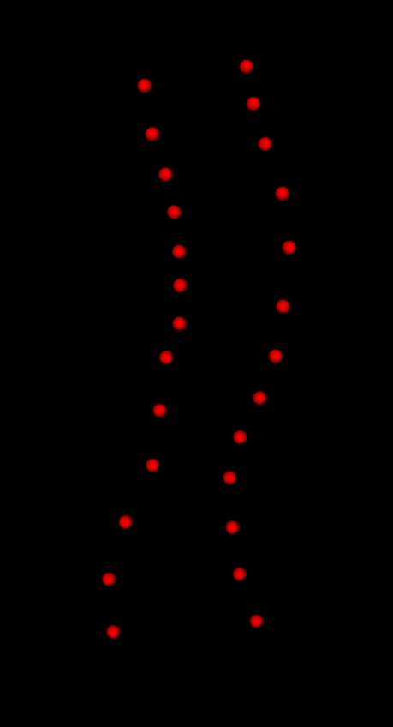
Background – Tracked ultrasound
Risks of cumulative X-ray exposure have motivated use of 3D ultrasound
Provides landmark locations rather than macroscopic visualization
Curvature extracted from landmark locations

Slide 6
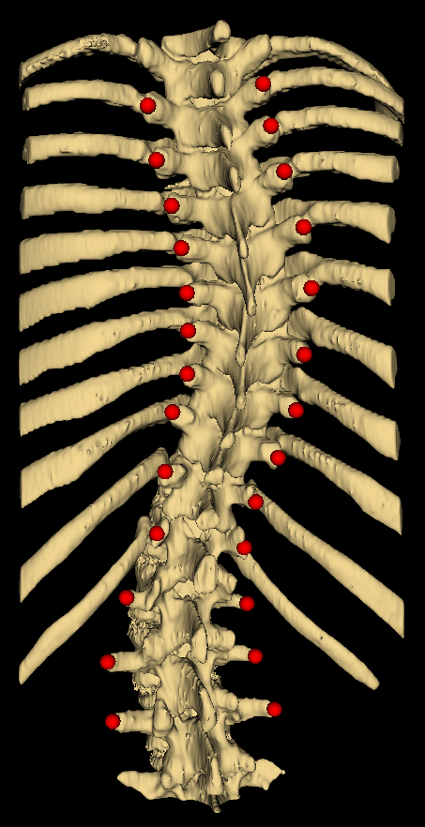
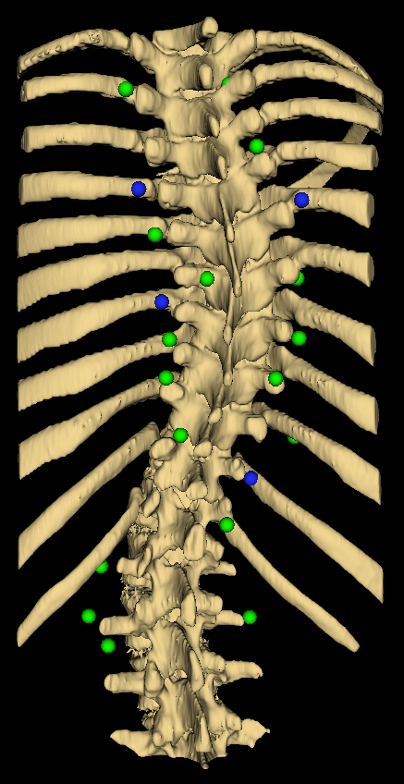
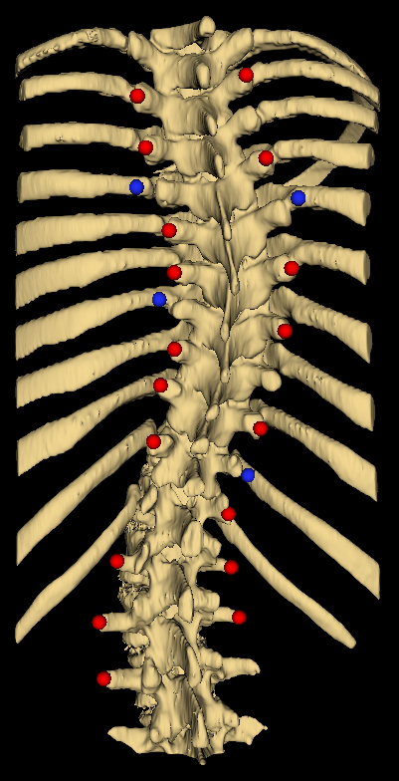
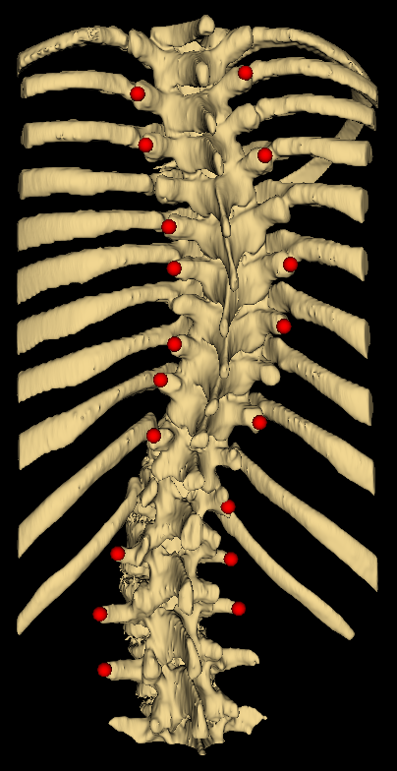
Motivation
3 expected error types:
Missing points
Misplaced points
Random noise
Can curvature be retrieved?

Slide 7
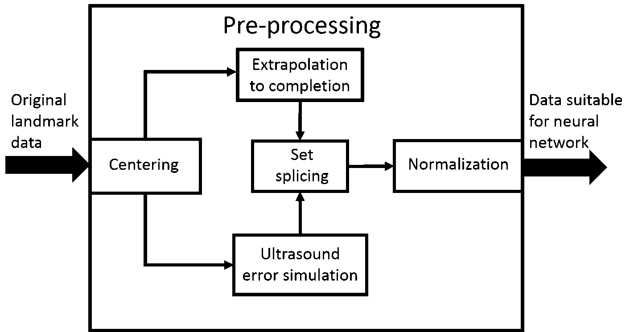
Methods – Pre-processing

Slide 8
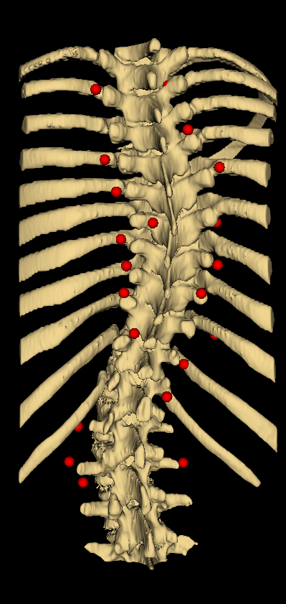
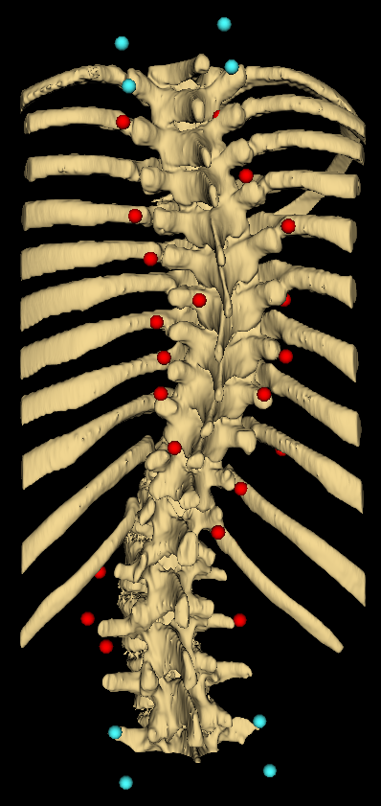


Slide 9
Feedforward backpropagation network
Curvature estimate

Slide 10
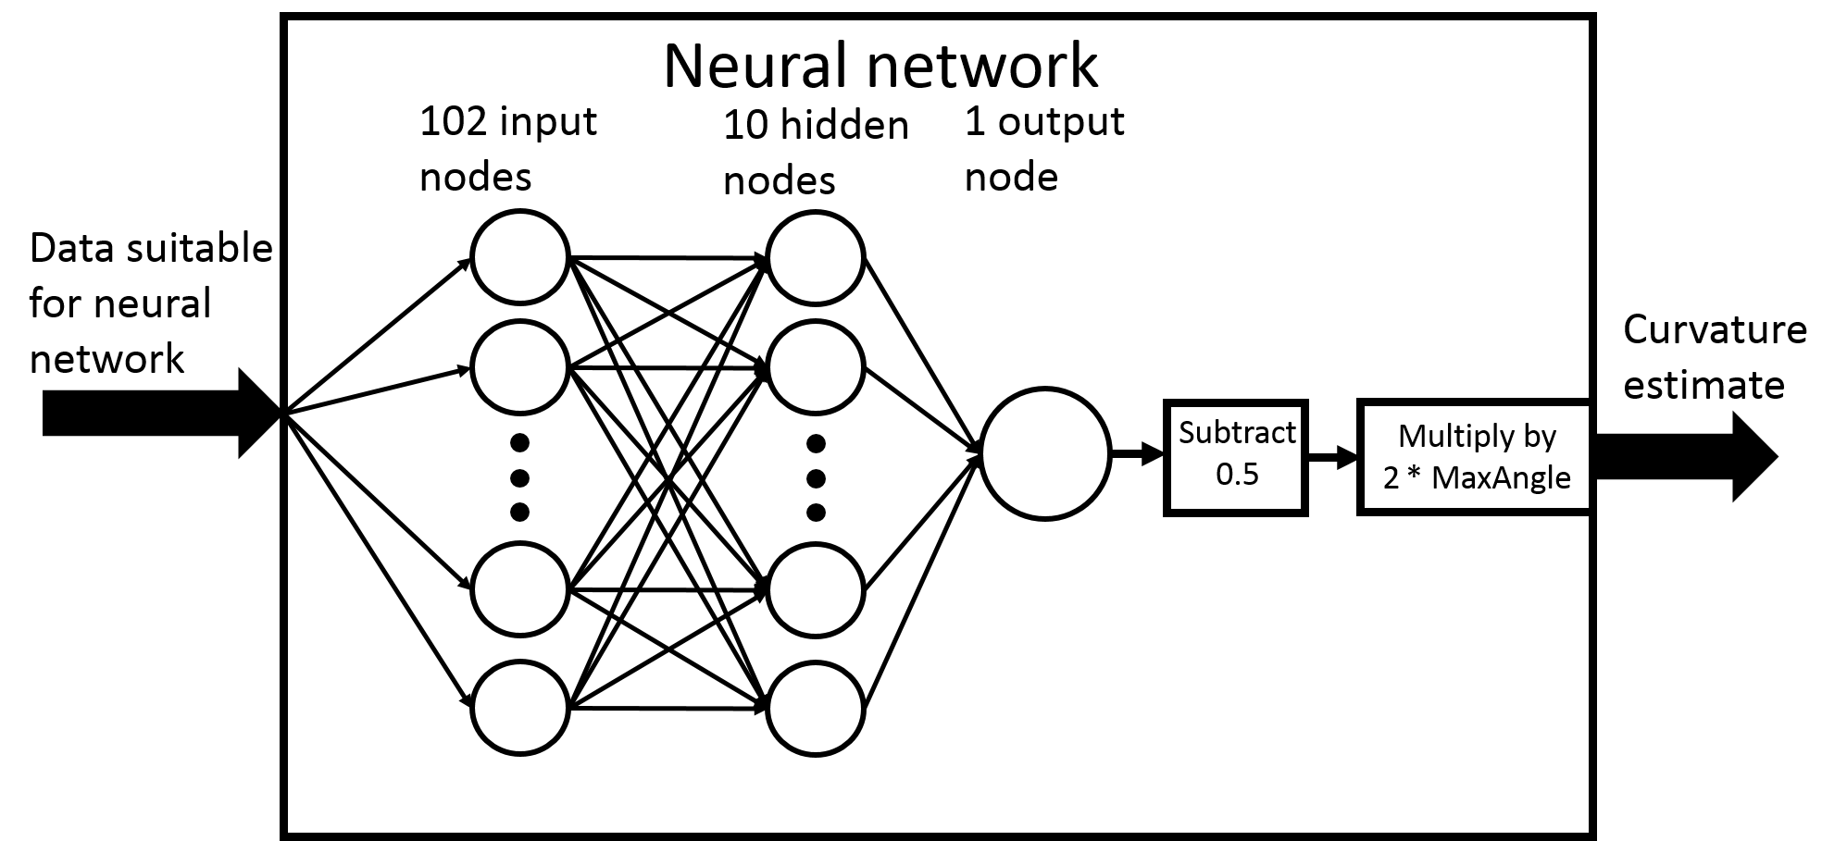
Methods – Neural network

Slide 11
Results

Slide 12
Discussion
Accuracy is unimpressive
Small training set
MATLAB results are uninformative
Does not indicate curve severity vs performance relationship

Slide 13
Ongoing work
Use neural network to estimate Cobb angle defining vertebrae
Alternative to direct angle estimation
Create method to repair missing points

Slide 14
Thank you! Questions?

