Slide 1
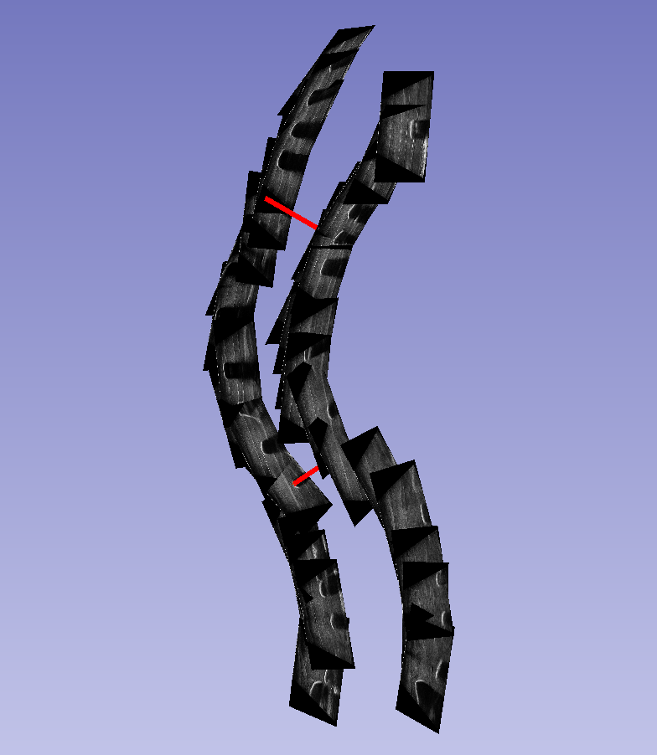
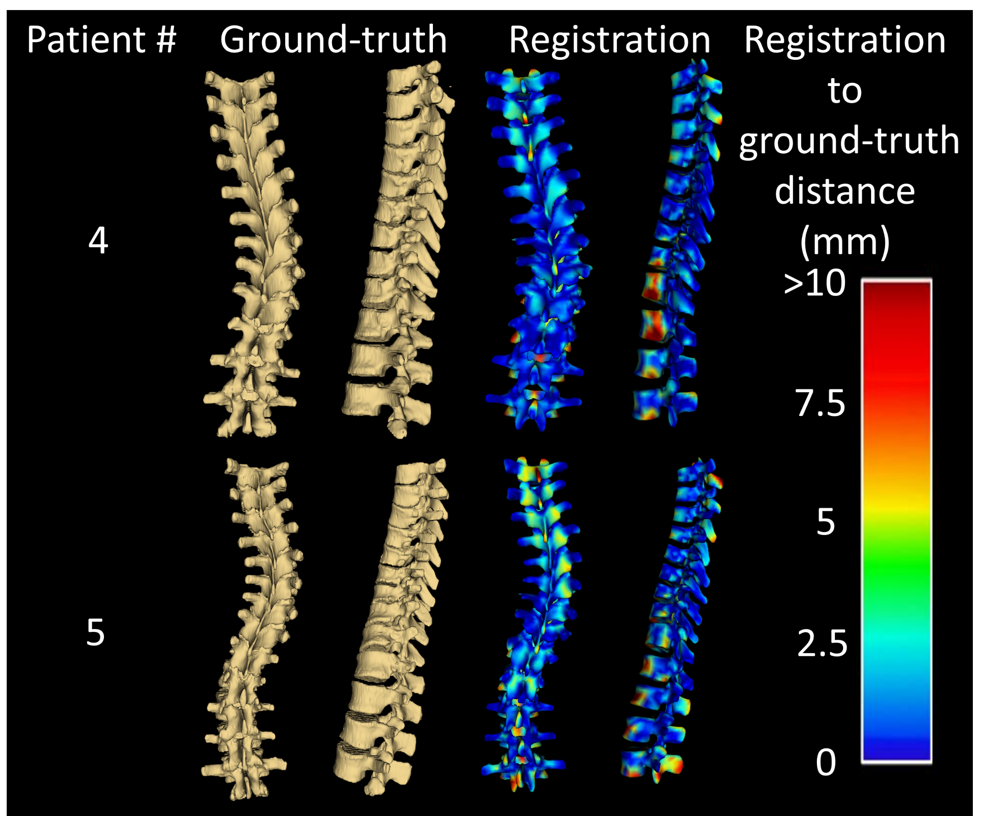
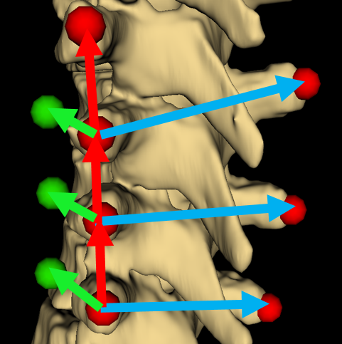
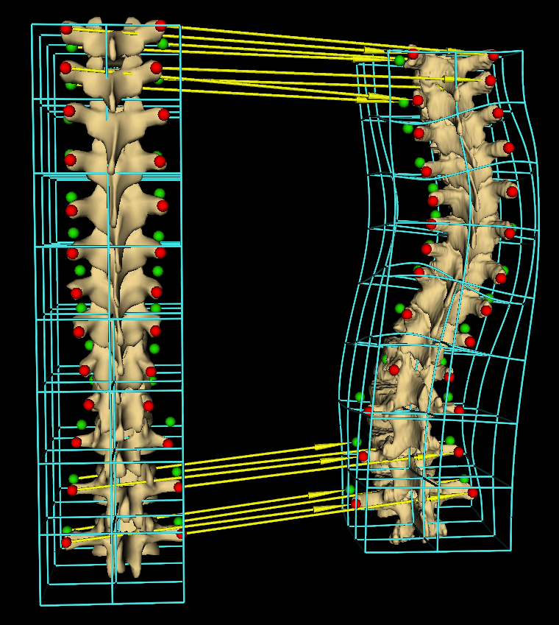



Spine Visualization from Transverse Process Landmarks
Ben Church, Andras Lasso, Christopher Schlenger, Daniel P. Borschneck, Parvin Mousavi, Gabor Fichtinger, Tamas Ungi
Queen’s University, Kingston, Canada
Introduction
Results
The spine is often visualized by CT, X-ray, resulting in radiation exposure or MRI, having limited availability.
Ultrasound is a safe, inexpensive, and accessible imaging modality.
Spine landmarks, such as transverse processes, can be localized in ultrasound [1].
Spinal curvatures can be measured from ultrasound landmarks (Fig 1).
Anatomic landmarks alone do not allow spine visualization in a familiar manner to the clinician and patient.
The model was registered to patient landmarks and compared to ground-truth segmentations.
Average and maximum Hausdorff distances were computed.
Surface registration errors were computed as heat maps and displayed on corresponding patient visualizations (Fig 4).
Patient # | Avg. Hausdorff (mm) | Max. Hausdorff (mm)
1 | 2.8 | 20.0
2 | 2.3 | 24.0
3 | 2.4 | 17.7
4 | 2.9 | 18.1
5 | 3.3 | 23.8
Fig 1. Series of ultrasound snapshots for locating transverse processes, with curvature angle illustrated in red
Objective
To visualize full spinal anatomy, in the presence of severe deformities, using sparse ultrasound-accessible landmarks (transverse processes) alone, without the need for ionizing radiation.
Methods
Anchor points extrapolated from the sparse landmarks were used to constrain the deformation of a healthy spine model [2] to patient anatomy.
For ground-truth, 5 CT volumes with spinal deformities were used.
Transverse processes were manually located on ground-truth CTs.
An anchor point was automatically added towards the vertebral body from each transverse process landmark.
Fig 4. Registrations compared to CT-derived patient ground-truth. Error maps show distance between surfaces from blue (most accurate) to red (least accurate).
Fig 2. Transverse processes (red), anchor points (green)
Conclusion
The direction to place anchor points was computed by cross producing vectors along the axis of the spine with vectors across the spine (Fig. 2).
Presence of anchor points allowed the subsequent landmark registration to represent anterior-posterior anatomic scale.
Model to patient landmark registration interpolated with thin-plate spline, producing a 3D displacement field (Fig 3).
The displacement fields were applied to the model, warping it to patient anatomy.
Using sparse landmarks, we were able to extrapolate anchor points sufficient to constrain the registration of a healthy model to the patient.
The resulting visualizations convey the overall form of the anatomy, suitable for assessment of pathologic deformation.
Our method is being improved by automatic landmarking, and handling cases with missing or incorrectly placed landmarks.
Acknowledgement
This work was made possible by funding from: Province of Ontario; Cancer Care Ontario with funds from the Ministry of Health; Long-Term Care for an Applied Cancer Research Unit; Research Chair in Cancer Imaging; Natural Sciences and Engineering Research Council of Canada under the Discovery Grants program and Canadian Graduate Scholarship.
Reference
Fig 3. Yellow arrows show sample landmark registration displacements and cyan wireframe showing the resulting displacement field
[1] Ungi T et al. Spinal curvature measurement by tracked ultrasound snapshots. Ultrasound in medicine and biology. 2014 Feb;40(10):447-545.
[2] An N. Human spine. https://grabcad.com/library/human-spine-1

