Slide 1
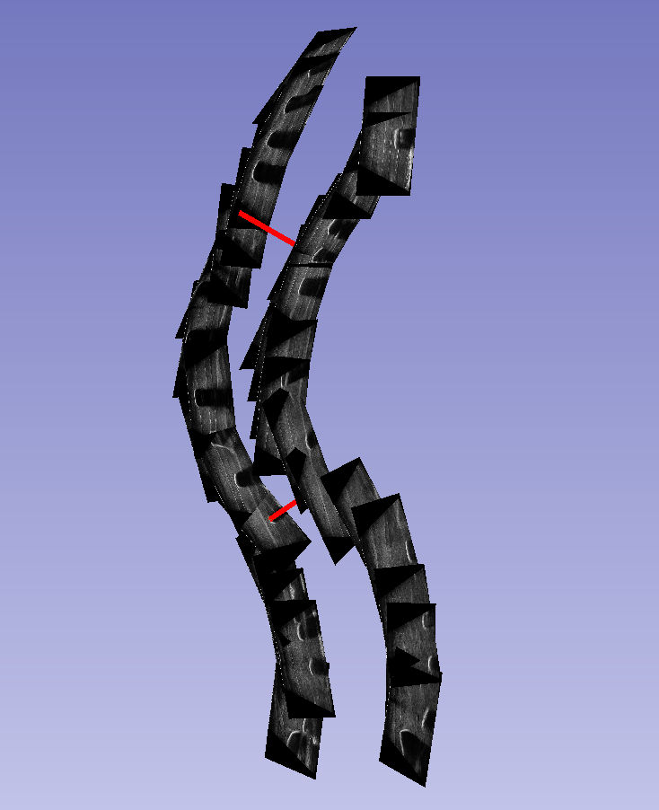
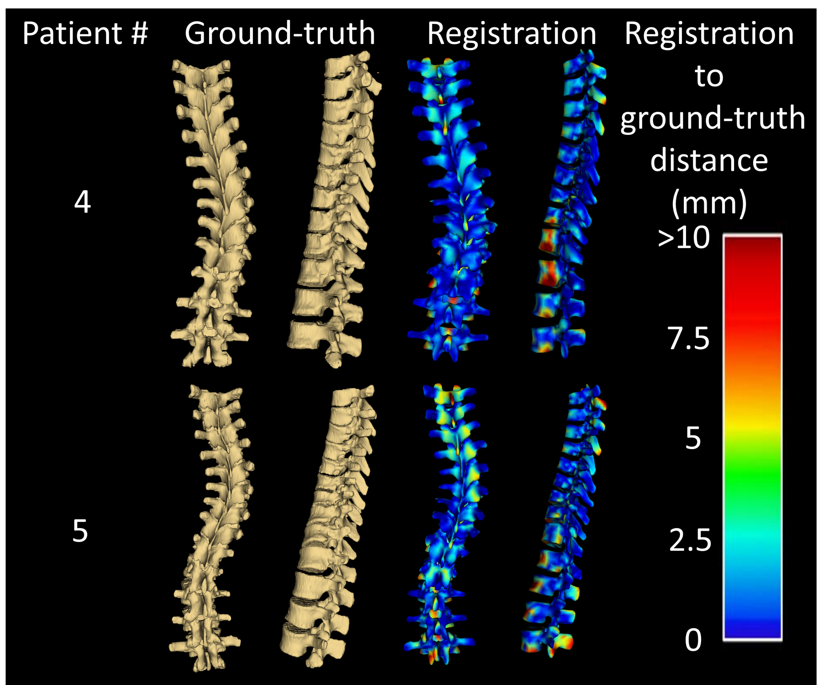
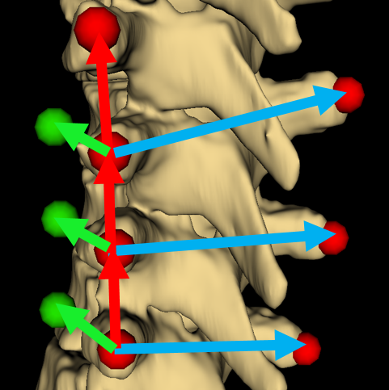
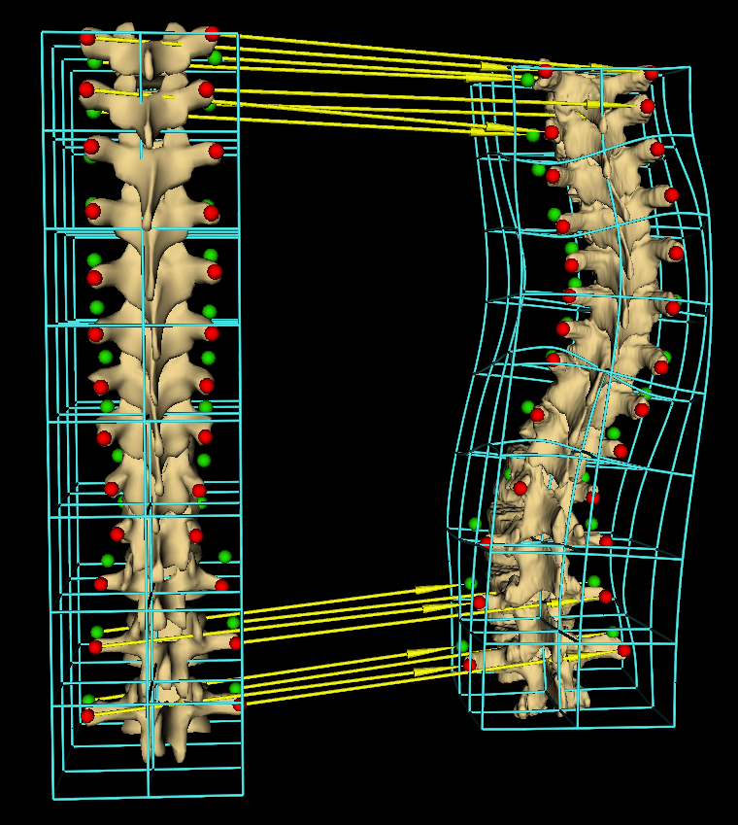



Spine Visualization from Transverse Process Landmarks
Ben Church, Andras Lasso, Christopher Schlenger, Daniel P. Borschneck, Parvin Mousavi, Gabor Fichtinger, Tamas Ungi
Queen’s University, Kingston, Canada
Introduction
Results
Ground-truth segmentations were used to evaluate registration.
Surface registration errors are displayed as heat maps over corresponding patient visualizations (Fig 4).
Patient # | Avg. Hausdorff (mm) | Max. Hausdorff (mm)
1 | 2.8 | 20.0
2 | 2.3 | 24.0
3 | 2.4 | 17.7
4 | 2.9 | 18.1
5 | 3.3 | 23.8
The spine is often visualized by X-ray and CT, resulting in radiation exposure or MRI, having limited availability.
Ultrasound is a safe, inexpensive, and accessible imaging modality where spine landmarks such as transverse processes can be localized [1].
Spinal curvatures can be measured from ultrasound landmarks (Fig 1).
Anatomic landmarks alone do not allow visualization of the spine in a familiar manner to the clinician and patient.
Fig 1. Series of ultrasound snapshots for locating transverse processes, with curvature angle illustrated in red
Objective
To visualize full spinal anatomy, in the presence of severe deformities, using sparse ultrasound-accessible landmarks (transverse processes) alone, without the need for ionizing radiation.
Methods
Key Contribution: Anchor points automatically extrapolated from sparse landmarks could be used to warp a healthy spine model to patient anatomy to enable visualization of the full spine.
For ground-truth, 5 CT volumes with spinal deformities were used.
Transverse processes were manually located on CTs; for each process an anchor point was computed by the cross product of vectors along the axis of the spine and those across the spine (Fig. 2).
Fig 4. Registrations compared to CT-derived patient ground-truth. Heat map shows the distances between surfaces from blue (most accurate) to red (least accurate).
Conclusion
Fig 2. Transverse processes (red), anchor points (green)
Using sparse landmarks, we were able to extrapolate anchor points and constrain the registration of a healthy model to patient anatomies with severe deformities.
The resulting visualizations convey the overall form of the anatomy, suitable for assessment of pathologic deformation.
Our method is being improved by automatic landmarking, and handling cases with missing or incorrectly placed landmarks.
Anchor points allowed the subsequent landmark based registration to represent anterior-posterior anatomic scale.
Model to patient landmark registration interpolated with thin-plate spline produced a 3D displacement field and was used to warp the model to the patient anatomy. (Fig 3).
Acknowledgement
This work was made possible by funding from Cancer Care Ontario, and the Natural Sciences and Engineering Research Council of Canada.
Reference
[1] Ungi T et al. Spinal curvature measurement by tracked ultrasound snapshots. Ultrasound in medicine and biology. 2014 Feb;40(10):447-545.
[2] An N. Human spine. https://grabcad.com/library/human-spine-1
Fig 3. Yellow arrows show sample landmark registration. Wireframe is the displacement field

