Slide 1
CVSS Validation and Prediction
Ben Church

Slide 2
Content
CVSS Background
Evaluating CVSS Base Score Using Vulnerability Rewards Program [1]
An automatic method for CVSS score prediction using vulnerabilities description [2]

Slide 3
Background - CVSS

Slide 4
CVSS - Introduction
Common vulnerability scoring system
Quantitative vulnerability risk score
Can help prioritize vulnerability addressment
Metrics mostly objective, quantitative

Slide 5
CVSS - Composition
Three metric groups describe different aspects of risk
Base metrics
Temporal metrics
Environmental metrics
Confidentiality impact
Access vector
Exploitability
Confidentiality requirement
Target distribution
Integrity impact
Access complexity
Remediation level
Integrity requirement
Collateral damage potential
Availability impact
Authentication
Report confidence
Availability requirement

Slide 6
CVSS – Base Metrics
Intrinsic vulnerability characteristics
Time and context invariable
Incorporates likelihood and impact of an attack
Most popular CVSS score
Base metrics
Confidentiality impact
Access vector
Integrity impact
Access complexity
Availability impact
Authentication

Slide 7

CVSS – Temporal Metrics
Time-changing threat characteristics
May change with knowledge of exploit or steps taken to fix it
$0.33BS≤TS≤BS$
Temporal metrics
Exploitability
Remediation level
Report confidence

Slide 8
CVSS – Environmental Metrics
Application dependent
Allows reassessment of risk depending on relative importance of quality metrics
Necessitates adjustment of base score
Environmental metrics
Confidentiality requirement
Target distribution
Integrity requirement
Collateral damage potential
Availability requirement

Slide 9
CVSS - scoring
Base metrics
Confidentiality impact
Metrics combined into vectors and score computed
Access vector
Integrity impact
Access complexity
Availability impact
Authentication
Example base vector to base score: AV:N/AC:L/Au:N/C:C/I:C/A:C = 10.0

Slide 10
Evaluating CVSS Base Score Using Vulnerability Rewards Program [Younis2016]

Slide 11
Younis et al. - Motivation
Important to prioritize vulnerabilities
CVSS not always correlated with actual exploits and attacks [3]
Alternative CVSS validation methods possible

Slide 12
Younis et al. - Contribution
Seek to validate CVSS base scores using Vulnerability Reward Program (VRP) scales
They hope to explain why high-CVSS vulnerabilities may go unexploited or vice-versa

Slide 13
Younis et al. - Data
National Vulnerability Database (NVD) entries and scores with corresponding vulnerabilities in Firefox and Chrome databases
Decision to reward vulnerability discovery
Chrome reward amounts

Slide 14
Younis et al. - Methods
Compared CVSS score severity to VRP severity for Firefox and Chrome vulnerabilities
CVSS Scores | CVSS Severity | VRP Severity
0 – 3.9 | Low | Low
4.0 – 6.9 | Medium | Moderate
7.0 – 10.0 | High | High/Critical

Slide 15

Younis et al. - Methods
Examined CVSS confusion as:
True positive
$VRP≥medium AND CVSS=VRP$
True negative
$VRP=CVSS=low$
False negative
$\left(VRP≥high AND CVSS≤medium\right)$ $OR (VRP=medium AND CVSS=low)$
False positive
$\left(VRP≤medium AND CVSS=high\right)$ $OR (VRP=low AND CVSS≥medium)$

Slide 16

Younis et al. - Methods
Performed k-means clustering on CVSS scores
Sensitivity $=\frac{TP}{TP+FN}$
Precision $=\frac{TP}{TP+FP}$
$F_{β}=\frac{\left(1+β^{2}\right)×Precision×Sensitivity}{\left(β^{2}×Precision\right)+Sensitivity}$ where $β=2$

Slide 17

Younis et al. - Methods
Also examined FP and FN rates:
$FP rate=\frac{FP}{FP+TN}$
$FN rate=\frac{FN}{TP+FN}$

Slide 18
Younis et al. – Results
Only 1 and 2 True Negatives for Firefox and Chrome
High sensitivities and FP rates
Modest Spearman correlation
Repeated experiment with vulnerabilities segmented to make better use of CVSS range

Slide 19
Younis et al. - Discussion
Attribute high FP rate to large number of True Negatives
Reiterate low True Negative amounts
Conclude from Chrome reward amounts, proving exploitability is more valuable than discovering vulnerabilities

Slide 20
Younis et al. - Commentary
Reluctant to discuss CVSS validity
Results suggest CVSS is conservative in risk assessment
Proving exploitability is more financially valuable

Slide 21
An automatic method for CVSS score prediction using vulnerabilities description [Khazaei2016]

Slide 22
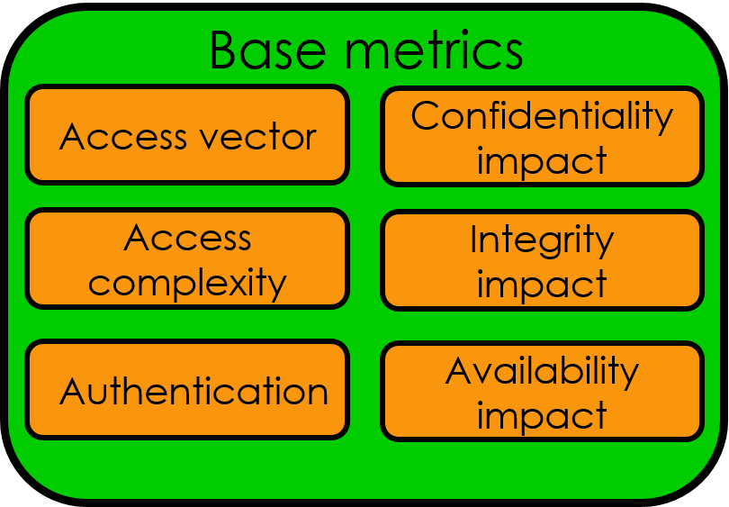

Khazaei et al. - Motivation
Vulnerability comparison standardization is important
CVSS is popular but metric scoring is subjective
= case AccessComplexity of
high: 0.35
medium: 0.61
low: 0.71

Slide 23
Khazaei et al. - Contribution
Demonstrate several methods for predicting CVSS base scores using the natural language in vulnerability descriptions
Used support vector machine (SVM), random-forest, and (offline and online) fuzzy system

Slide 24
Khazaei et al. - Data
19320 vulnerability descriptions from CVE (Common Vulnerabilities and Exposures)
Corresponding CVSS scores from OSVDB (Open Source Vulnerability Database)

Slide 25

Khazaei et al. - Methods
Useful words were extracted from descriptions and stemmed
Computed Term Frequency – Inverse Document Frequency:
$TF−IDF=f_{ij}∙\log\left(P_{i}^{−1}\right)$
$P_{i}=\frac{number of documents containing word i}{number of documents}$
Constituted feature vector structure and values, respectively

Slide 26
Khazaei et al. - Methods
Used linear discriminant analysis (LDA) and principal component analysis (PCA) to reduce feature vector dimensionality
Divided CVSS score scale into 10 classes

Slide 27
Khazaei et al. - Methods
Used support vector machine and random forest to classify vulnerability feature vectors
Performed on vectors without dimension reduction, LDA, and LDA + PCA

Slide 28

Khazaei et al. - Methods
Trained fuzzy system to output CVSS score
Used Gaussian membership function:
$μ_{i}\left(x\right)=e^{−\frac{1}{2}{\left(\frac{x−c_{i}}{σ}\right)}^{2}}$
Varied σ
Also trained on simulated time-series

Slide 29
Khazaei et al. – Results
Of SVM and Random-Forest, SVM had best accuracy at 86% for LDA data
Offline fuzzy system had 88%
Online, simulated time-series error converged at ~ 22% cumulative error

Slide 30
Khazaei et al. - Discussion
Automatic CVSS prediction reduces human errors and improves speed
The fuzzy system, easier and faster, outperformed SVM and Random-Forest

Slide 31
Khazaei et al. - Commentary
Does not reduce human error – human scores are ground truth
Refer to popularity of CVSS rather than validation study

Slide 32
Conclusions
CVSS base score over-sensitive, better correspondence for higher VRP scores
Useful (insofar as CVSS is useful) information can be computed from vulnerability descriptions

Slide 33
Thank you! Questions?

Slide 34
References
Younis A., Malaiya Y. K., and Ray I. “Evaluating CVSS Base Score Using Vulnerability Reward Programs”. International Federation for Information Processing 2016; 471:62-75.
Khazaei A., Ghasemzadeh M., and Derhami V. “An automatic method for CVSS score prediction using vulnerability description”. Journal of Intelligent & Fuzzy Systems 2016; 30:89-96.
Allodi L., and Massacci F. “Comparing Vulnerability Severity and Exploits Using Case-Control Studies”. ACM Transactions on Information and Systems Security 2014; 17(1):Art. 1.
Mell P., Scarfone K., and Romanosky S. “A Complete Guide to the Common Vulnerability Scoring System Version 2.0”. From: https://www.first.org/cvss/cvss-v2-guide.pdf (Published 2009).

Slide 35
APPENDIX I – CVSS Score Formulae [4]

Slide 36
CVSS Base score
BaseScore = round_to_1_decimal(((0.6*Impact)+(0.4*Exploitability)-1.5)*f(Impact))
Impact = 10.41*(1-(1-ConfImpact)*(1-IntegImpact)*(1-AvailImpact))
Exploitability = 20* AccessVector*AccessComplexity*Authentication
f(impact)= 0 if Impact=0, 1.176 otherwise
AccessVector = case AccessVector of
requires local access: 0.395
adjacent network accessible: 0.646
network accessible: 1.0
AccessComplexity = case AccessComplexity of
high: 0.35
medium: 0.61
low: 0.71
Authentication = case Authentication of
requires multiple instances of authentication: 0.45
requires single instance of authentication: 0.56
requires no authentication: 0.704
ConfImpact = case ConfidentialityImpact of
none: 0.0
partial: 0.275
complete: 0.660
IntegImpact = case IntegrityImpact of
none: 0.0
partial: 0.275
complete: 0.660
AvailImpact = case AvailabilityImpact of
none: 0.0
partial: 0.275
complete: 0.660

Slide 37
CVSS Temporal score
TemporalScore = round_to_1_decimal(BaseScore*Exploitability
*RemediationLevel*ReportConfidence)
Exploitability = case Exploitability of
unproven: 0.85
proof-of-concept: 0.9
functional: 0.95
high: 1.00
not defined: 1.00
RemediationLevel = case RemediationLevel of
official-fix: 0.87
temporary-fix: 0.90
workaround: 0.95
unavailable: 1.00
not defined: 1.00
ReportConfidence = case ReportConfidence of
unconfirmed: 0.90
uncorroborated: 0.95
confirmed: 1.00
not defined: 1.00

Slide 38
CVSS Environmental score
EnvironmentalScore = round_to_1_decimal((AdjustedTemporal+
(10-AdjustedTemporal)*CollateralDamagePotential)*TargetDistribution)
AdjustedTemporal = TemporalScore recomputed with the BaseScores Impact sub-equation replaced with the AdjustedImpact equation
AdjustedImpact = min(10,10.41*(1-(1-ConfImpact*ConfReq)*(1-IntegImpact*IntegReq)
*(1-AvailImpact*AvailReq)))
CollateralDamagePotential = case CollateralDamagePotential of
none: 0
low: 0.1
low-medium: 0.3
medium-high: 0.4
high: 0.5
not defined: 0
TargetDistribution = case TargetDistribution of
none: 0
low: 0.25
medium: 0.75
high: 1.00
not defined: 1.00
ConfReq = case ConfReq of
low: 0.5
medium: 1.0
high: 1.51
not defined: 1.0
IntegReq = case IntegReq of
low: 0.5
medium: 1.0
high: 1.51
not defined: 1.0
AvailReq = case AvailReq of
low: 0.5
medium: 1.0
high: 1.51
not defined: 1.0

