Slide 1
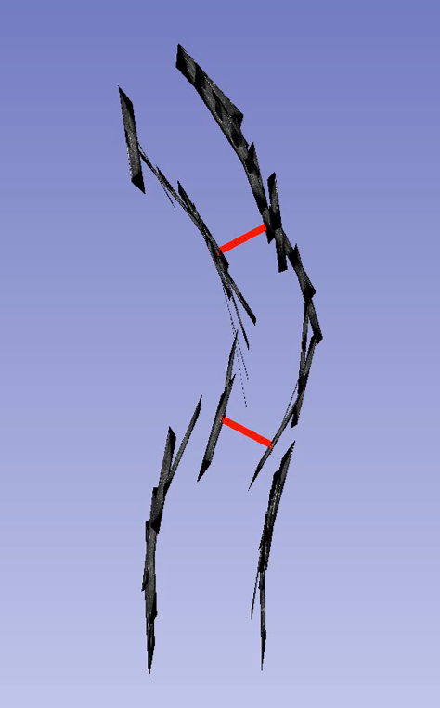
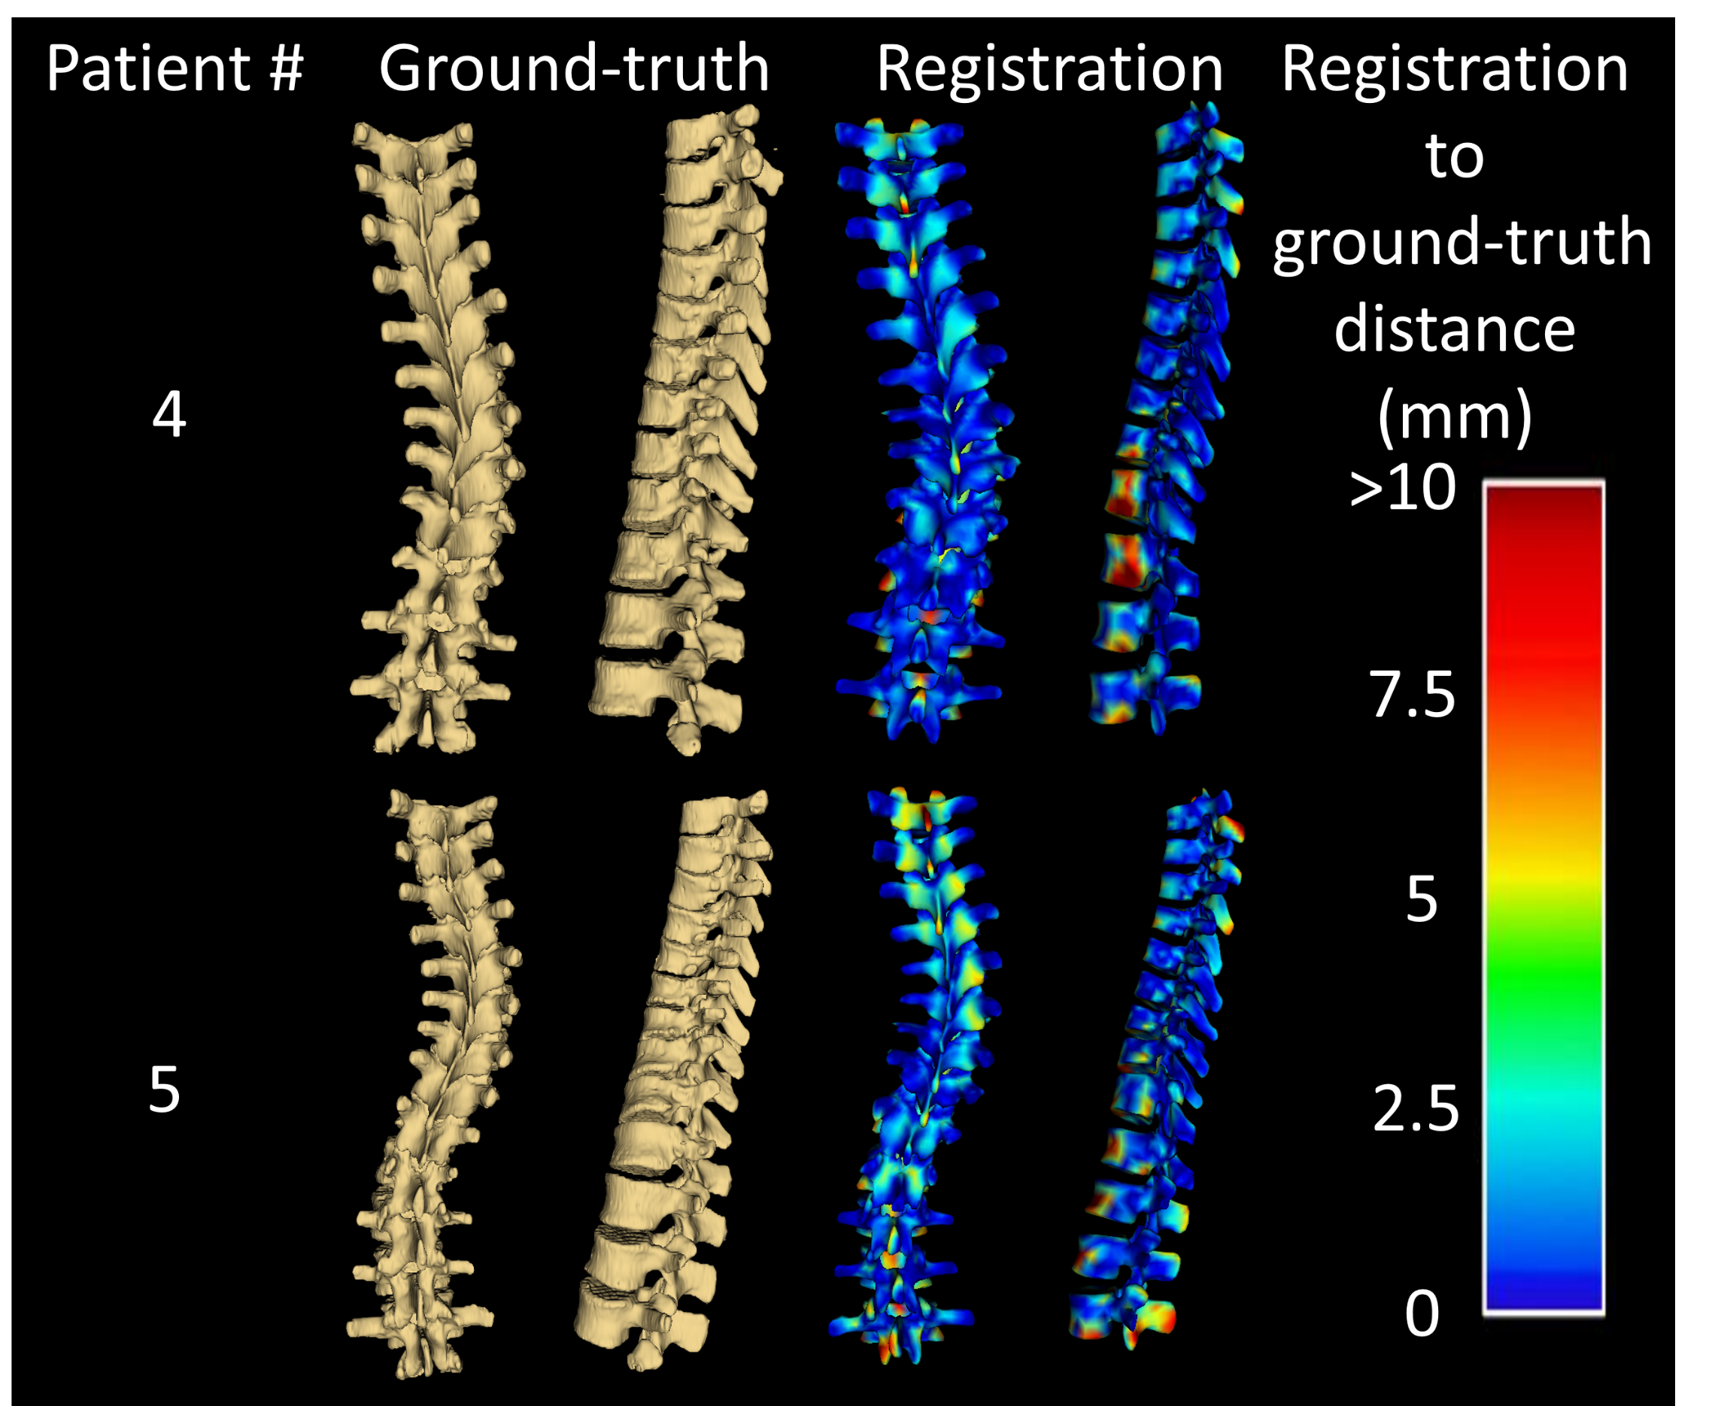
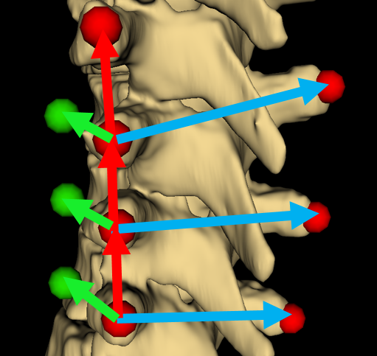
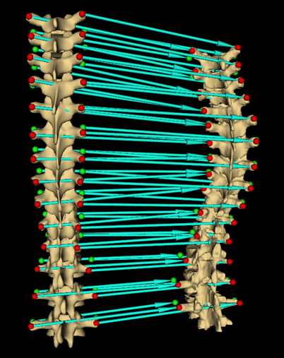
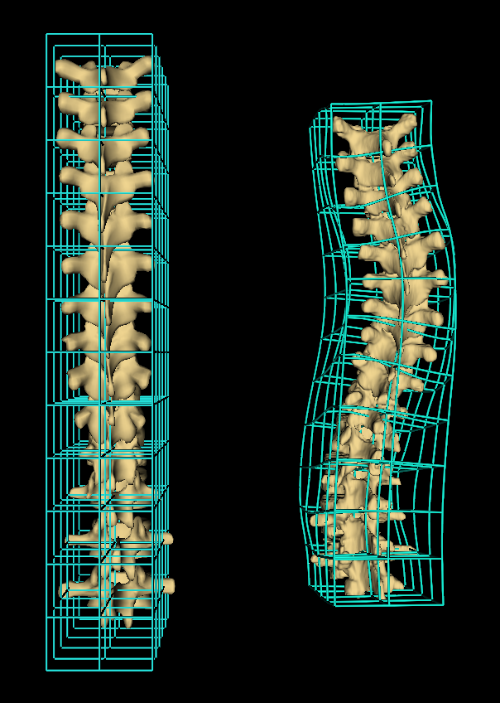



Spine visualization from transverse process landmarks
Ben Church, Andras Lasso, Christopher Schlenger, Daniel P. Borschneck, Parvin Mousavi, Gabor Fichtinger, Tamas Ungi
Queen’s University, Kingston, Canada
Introduction
Results
Spine anatomy is relatively large and complex, especially in cases of disease
Complete visualization often relies on CT, X-ray, or MRI
CT and X-ray require radiation exposure, while MRI has limited availability
Ultrasound is safe, inexpensive, and widespread
Skeletal landmarks such as the transverse processes can be located with spatially tracked ultrasound (Ungi et al. 2014)
The spine can be visualized by registering a generic spine model to patient transverse process locations
Registrations were generated for 5 scoliotic patients and compared to CT segmentation ground-truth
Average and maximum Hausdorff distances were computed
Registration to ground-truth distances were computed and represented as error maps
Patient # | Avg. Hausdorff (mm) | Max. Hausdorff (mm)
1 | 2.8 | 20.0
2 | 2.3 | 24.0
3 | 2.4 | 17.7
4 | 2.9 | 18.1
5 | 3.3 | 23.8
Fig 1. Series of ultrasound snapshots for locating transverse processes, with of curvature illustrated in red
Objective
To produce spinal visualizations suitable for diseased anatomy using the ultrasound-accessible transverse process locations as input
Methods
Patient and generic model transverse process locations marked with virtual landmark points (Fig 2)
Anchor points added to transverse process landmarks to constrain subsequent thin-plate spline registration in anterior-posterior direction and convey vertebral twist
Thin-plate spline displacement field applied to generic model, warping it to patient anatomy
Fig 5. Registrations compared to CT-derived patient ground-truth. Error map shows distance between surfaces
Fig 2. Transverse process landmark points (red), and vector geometry used to add anchor points (green)
Conclusion
The method produces spinal visualization similar to CT segmentations. It is sufficiently robust to deal with scoliotic anatomy. The method can also be adapted to other imaging modalities; visualizations can be generated from symmetric landmarks, whatever modality is used to locate them
Acknowledgement
This work was made possible by funding from: Province of Ontario; Cancer Care Ontario with funds from the Ministry of Health; Long-Term Care for an Applied Cancer Research Unit; Research Chair in Cancer Imaging; Natural Sciences and Engineering Research Council of Canada under the Discovery Grants program and Canadian Graduate Scholarship.
Reference
Fig 3. Registration computes transforms displacing model points to patient’s
Fig 4. Transforms interpolated as thin-plate spline, warping healthy model to patient anatomy
Ungi T et al. Spinal curvature measurement by tracked ultrasound snapshots. Ultrasound in medicine and biology. 2014 Feb;40(10):447-545.

