Slide 1
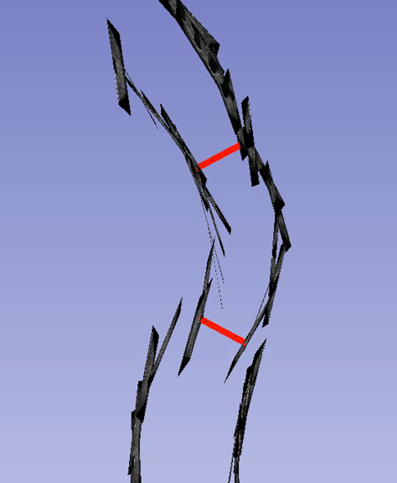
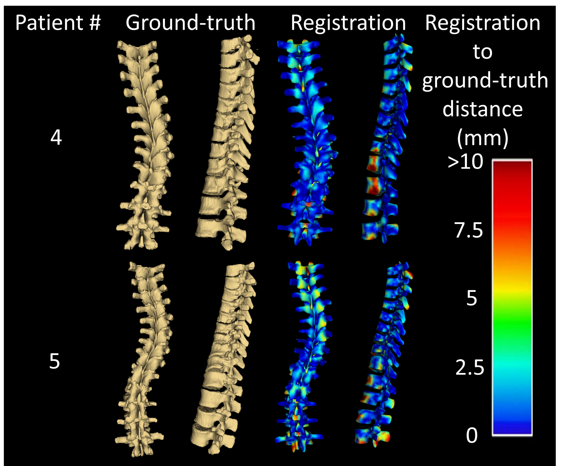
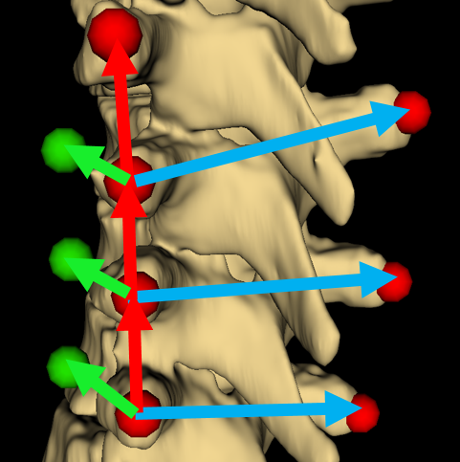
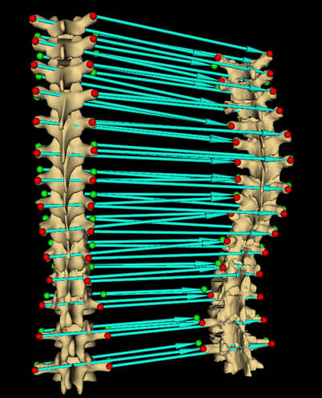
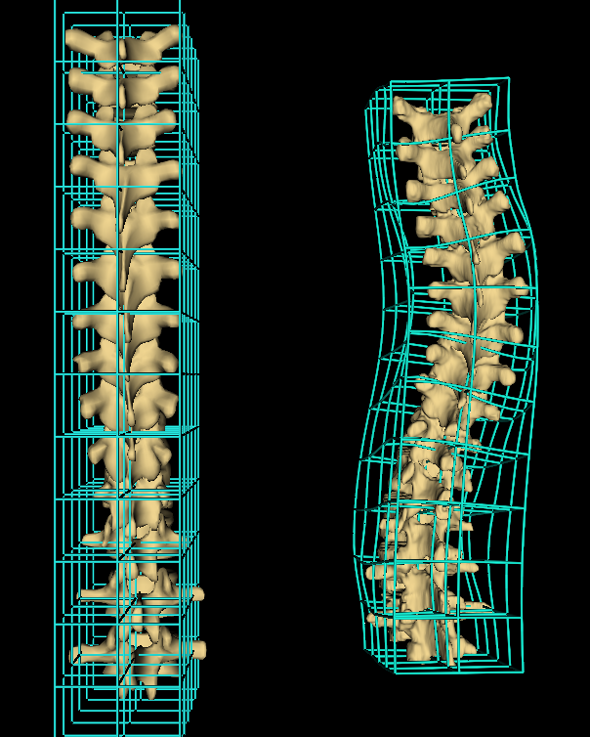



Spine visualization from transverse process landmarks
Ben Church, Andras Lasso, Christopher Schlenger, Daniel P. Borschneck, Parvin Mousavi, Gabor Fichtinger, Tamas Ungi
Queen’s University, Kingston, Canada
Introduction
Results
Spine anatomy is complex, and some diseases cause spine deformities
Pathological spine curvatures are often visualized by X-ray, CT, or MRI
The problem with CT and X-ray is radiation exposure, while MRI has limited availability and high cost
Ultrasound is a safe, inexpensive, and widely accessible alternative imaging modality
Spine landmarks, such as transverse processes can be localized in ultrasound (Ungi et al. 2014)
Spinal curvatures can be measured from ultrasound landmarks (Fig 1)
Atlas was registered to all patients CTs and compared to ground-truth segmentation
Average and maximum Hausdorff distances were computed
Registration to ground-truth distances were computed and represented as error maps
Patient # | Avg. Hausdorff (mm) | Max. Hausdorff (mm)
1 | 2.8 | 20.0
2 | 2.3 | 24.0
3 | 2.4 | 17.7
4 | 2.9 | 18.1
5 | 3.3 | 23.8
Fig 1. Series of ultrasound snapshots for locating transverse processes, with curvature angle illustrated in red
Objective
Visualize full spinal anatomy of patients with spinal deformities using ultrasound-accessible landmark localizations (transverse processes) as the only input for visualization
Methods
A publicly available, patient-based healthy spine surface model was used as a spine atlas (www.grabcad.com)
5 CT volumes with spinal deformities were used to test atlas registration using only transverse process points
Anchor points were automatically added to constrain in anterior extent and rotation of atlas vertebrae (Fig 2)
Thin-plate spline transformation was applied to interpolate between landmark and anchor points
Fig 5. Registrations compared to CT-derived patient ground-truth. Error map shows distance between surfaces from blue (most accurate) to red (least accurate)
Fig 2. Transverse processes (red), additional anchor points (green)
Conclusion
Registration of a healthy atlas based on transverse process landmarks allows visualization of spinal deformities
This registration method is robust because it does not directly depend on imaging modality and image quality
In the future, our method could be improved by automatic landmarking, and handling cases with missing or incorrectly placed landmarks
Acknowledgement
This work was made possible by funding from: Province of Ontario; Cancer Care Ontario with funds from the Ministry of Health; Long-Term Care for an Applied Cancer Research Unit; Research Chair in Cancer Imaging; Natural Sciences and Engineering Research Council of Canada under the Discovery Grants program and Canadian Graduate Scholarship.
Reference
Fig 3. Registration computes transforms displacing model points to patient’s
Fig 4. Thin-plate spline interpolation of healthy model to patient anatomy
Ungi T et al. Spinal curvature measurement by tracked ultrasound snapshots. Ultrasound in medicine and biology. 2014 Feb;40(10):447-545.

