Slide 1
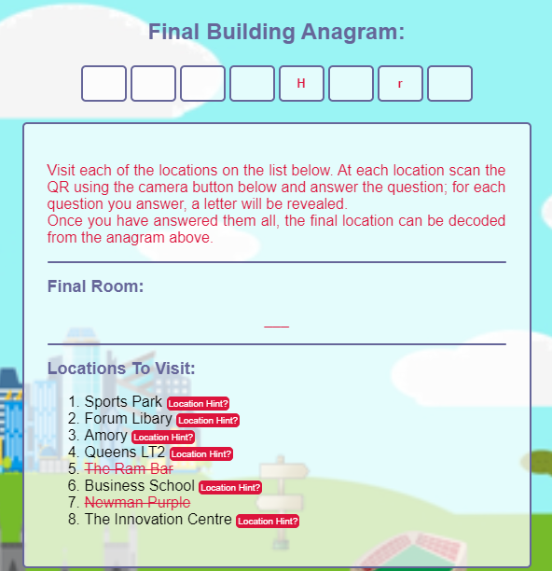

UNIVERSITY OF EXETER FRESHERS TREASURE HUNT
GAME PREMISE
Our treasure hunt ultimately takes the form of the world-famous hangman. As you visit each of the locations on the dashboard and scan the QR code, you are presented with a question. Successful answering of the question will result in you obtaining a letter, filling out an anagram of the building of the team’s tutor location. Once all letters have been obtained, the room of the tutor will be presented.
FUN FEATURES
Hangman, visiting new places, competitive feel with a sense of learning and achievement, inclusiveness
GROUP B

