Slide 1
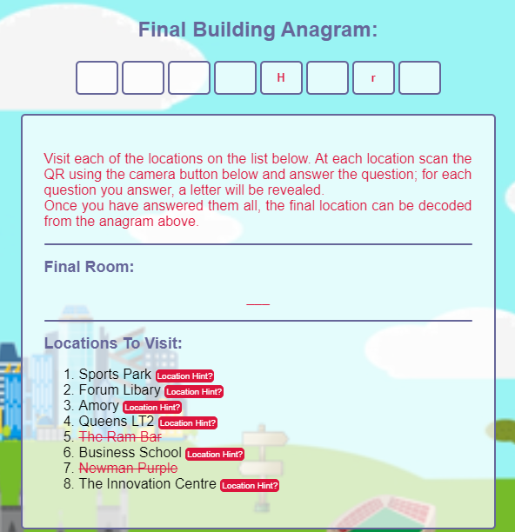

UNIVERSITY OF EXETER FRESHERS TREASURE HUNT
GAME PREMISE
Our treasure hunt ultimately takes the form of the world-famous hangman.
As you visit each of the locations on the dashboard and scan the QR code, you are presented with a question.
Successful answering of the question will result in you obtaining a letter, filling out an anagram of the building of the team’s tutor location.
Once all letters have been obtained, the room of the tutor will be presented.
FUN FEATURES
Hangman style game!
Visit all the main locations on the Streatham Campus
Have a competitive feel with a live leaderboard based on how many letters you have and how long you have taken
Sense of achievement in your teamwork
GROUP B

