Slide 1




Elon Tweets and Tesla Stock Analysis
BTMA 431 Mini Project
Ben Cook

Slide 2

Motivation
Corporations and CEO’s have been using social media sites such as Twitter for marketing and public relations from the very beginning. Traditional usage of these sites by companies have usually taken a very professional and “corporate” approach to marketing.
Over the past few years however, the trend has been moving towards “riskier” social media tactics to appear more relatable to the general public. CEO’s and Companies are slowly removing this professionalism in Tweets and instead using memes as a tool to attract attention.
One of the most prominent example of this is Elon Musk. Over the past few years Elon has moved from a relatively forgettable CEO to an internet sensation using his Twitter account and engaging with internet memes.
The goal of this project is to analyze the effect that Elon Musk’s Twitter activity has on Tesla’s stock price.

Slide 3
Question Breakdown
Main question: Does Elon Musk’s Twitter activity influence Tesla’s Stock Price
Sub question: Does the Frequency of Tweets impact stock price
Sub question: Does the Content of Tweets impact stock price

Slide 4
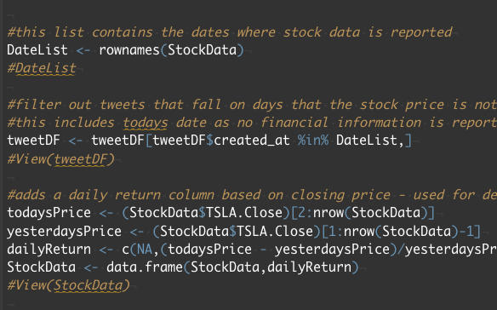
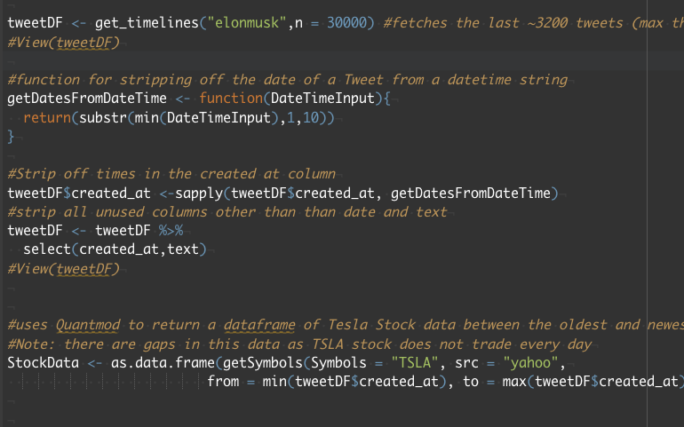
Data Sources and Collection
Utilized the Rtweet library to scrape the last ~3200 tweets
Filtered out unused columns
Utilized the Quantmod package to get Stock information In the date range of the oldest tweet to the newest (~ten months of data)
Filtered out Tweets where financial data is not available

Slide 5
Analysis 1: Frequency
Null Hypothesis: The frequency of Elon Musk Tweets have no predictive power on the change in Tesla Stock Price
Alternative Hypothesis: The frequency of Elon Musk Tweets have predictive power on the change in Tesla Stock Price

Slide 6
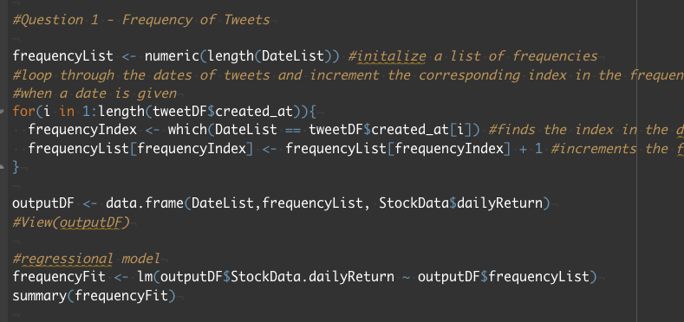
Frequency Implementation
Count the number of Tweets each day, add the count to an output data frame
Run a regression test on the daily return and the frequency list

Slide 7
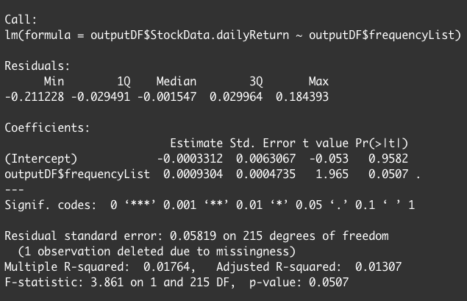
Frequency Result:
According to the output (completed on November 8th 2020), the p-value of 0.0507 > 0.05 so we accept the null hypothesis
As a result, the frequency of Elon Musk’s Tweets have no predictive power on Tesla’s stock price

Slide 8
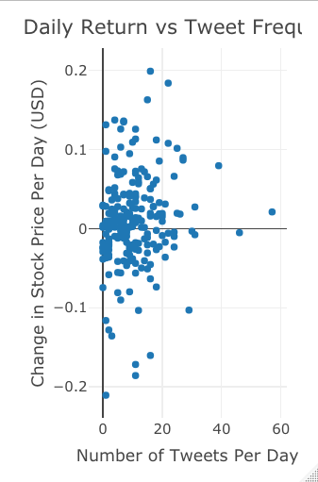
Frequency Visualization
Visualization shows clustered datapoints that don’t seem to have an obvious correlation

Slide 9
Analysis 2: Content
Null Hypothesis: The Content of Elon Musk Tweets have no predictive power on the change in Tesla Stock Price
Alternative Hypothesis: The Content of Elon Musk Tweets have predictive power on the change in Tesla Stock Price

Slide 10
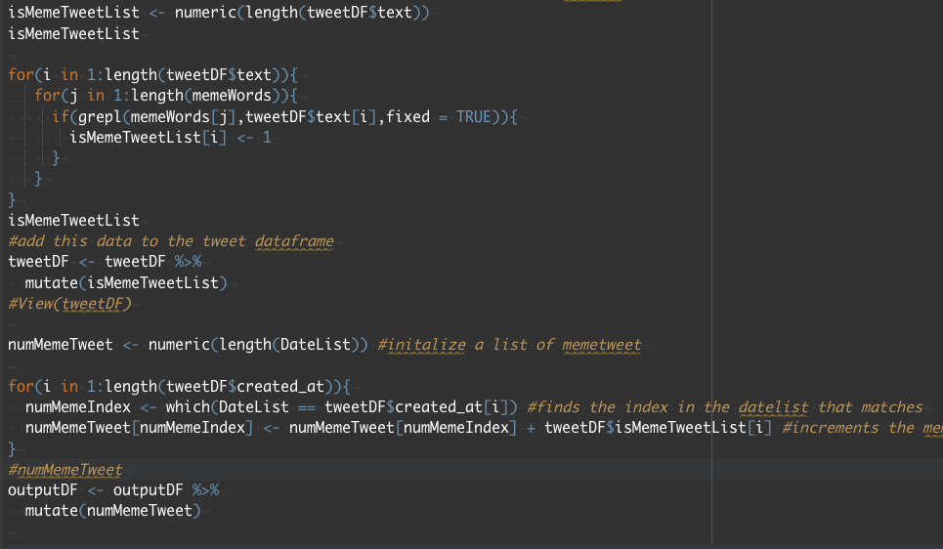
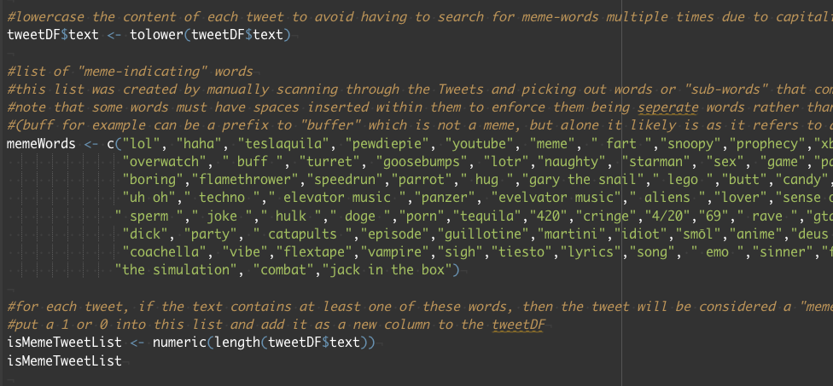
Content Implementation
Manually skimmed Elon’s Twitter and created a list of words that were most commonly found in tweets that can be considered “memes”
If a Tweet contains at least one of these words, then it is assigned a value of 1 (meme), otherwise it is assigned a value of 0
Counts the number of “meme” tweets per day and compares to the change in stock price
Run a regression test on the daily return and the number of meme tweets

Slide 11
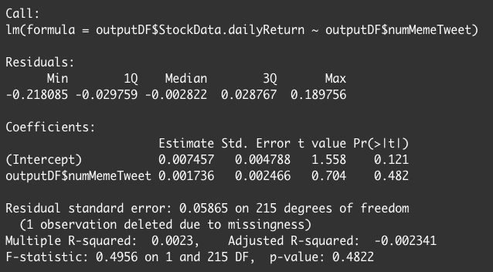
Frequency Result:
According to the output (completed on November 8th 2020), the p-value of 0.4822 > 0.05 so we accept the null hypothesis
As a result, the content of Elon Musk’s Tweets have no predictive power on Tesla’s stock price

Slide 12
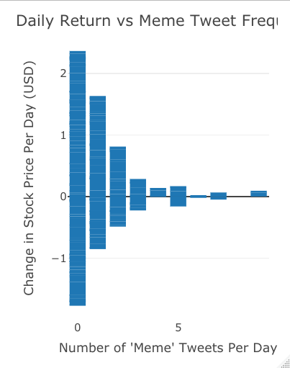
Visualization 2: Content
See a convergence from both the negative and positive sides
For the most part each bar is equally positive and negative indicating that the number of meme tweets does not significantly impact stock price

Slide 13
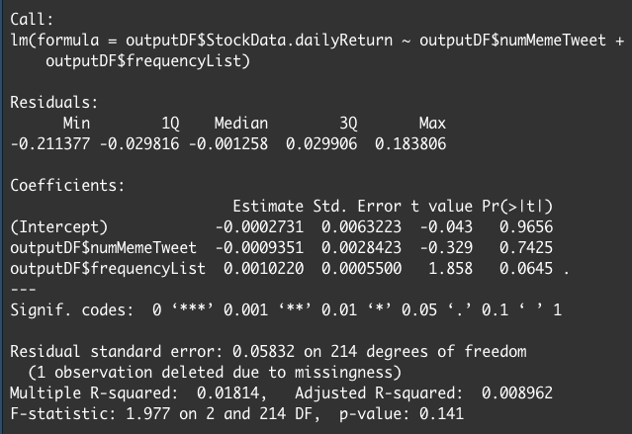
Combined Results
Since I had a data frame containing both the frequency of Tweets, as well as the number of meme tweets per day, I decided to run a combined regression to confirm my results
This combined regression returned the same result as the individual regressions indicating no significant predictive power

Slide 14
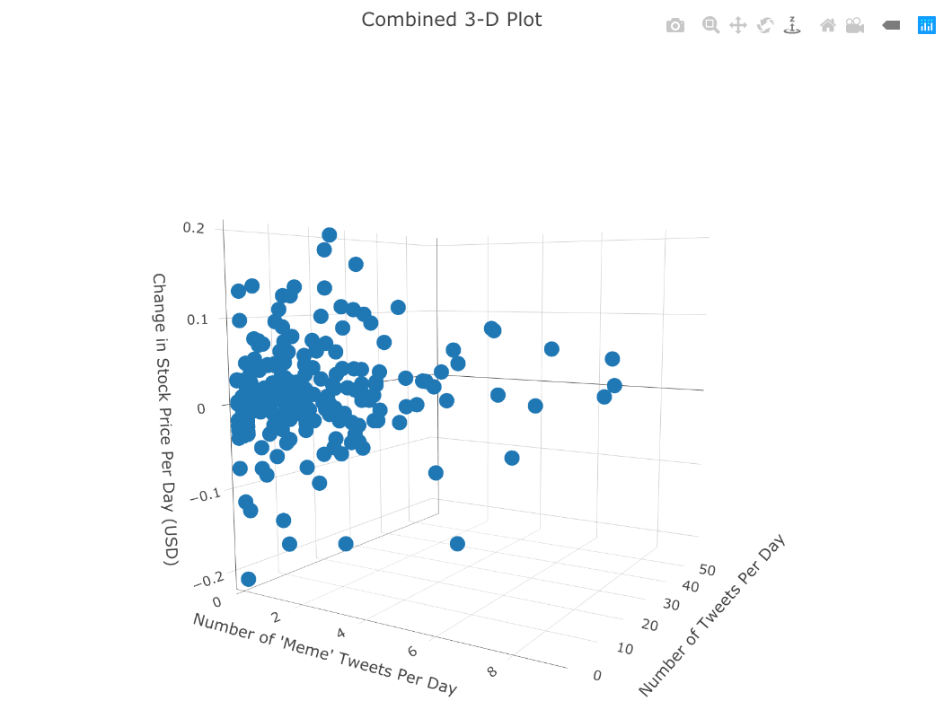
Combined 3-D Visualization
Note after running a correlation test between frequency of tweets and number of meme tweets the result was 0.49847…
This fairly strong correlation makes sense. As the number of Tweets increase then so too does the number of Tweets that are memes
This correlation may have caused multi-collinearity issues with the combined plot

Slide 15
Conclusion
Overall Elon Musk’s Tweets do not seem to have a significant impact on the overall change in stock price of Tesla.
More in-depth analysis can be done on specific tweets, as well as better algorithms and heuristics to more accurately classify a “meme” vs a “professional” Tweet would confirm this
This may be an incredibly difficult task as one would need to program an AI capable of understanding “sarcasm” to accurately categorize these Tweets.

