Slide 1

Midwestern State University
Department of Computer Science
B-Tree

Slide 2
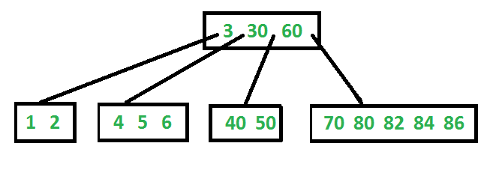
Background
Invented by Bayer, McCreight (1972)
General Idea:
Internal nodes of a B-tree of order t have between t/2 and t children
Exception for the root node.

Slide 3
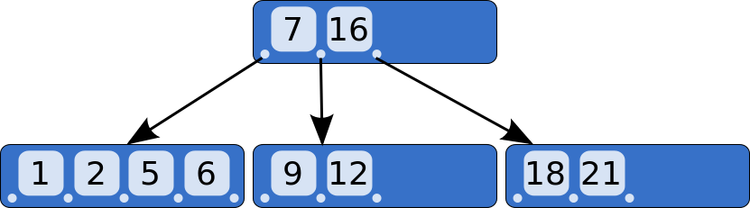
Background
B-tree is a tree data structure that keeps data sorted and allows searches, sequential access, insertions, and deletions in logarithmic time.
Often used as an external data structure, i.e., for data stored on disk
Since hard disks are 1000 – 100,000-times slower than RAM, it is crucial to minimize the number of disk accesses; this is achieved by choosing very large t (usually so that one node fills one disk page)
It’s normal for a B-Tree to have millions+ of nodes and have a height in the single digits !

Slide 4
Properties
All leaves are at same level.
A B-Tree is defined by the term minimum degree t. The value of t depends upon disk block size.
Every node except root must contain at least t-1 keys. Root may contain minimum 1 key.
All nodes (including root) may contain at most 2t – 1 keys.
Number of children of a node is equal to the number of keys in it plus 1.
All keys of a node are sorted in increasing order. The child between two keys k1 and k2 contains all keys in range from k1 and k2.
B-Tree grows and shrinks from root which is unlike Binary Search Tree. Binary Search Trees grow downward and also shrink from downward.
Like other balanced Binary Search Trees, time complexity to search, insert and delete is O(Log n).

Slide 5
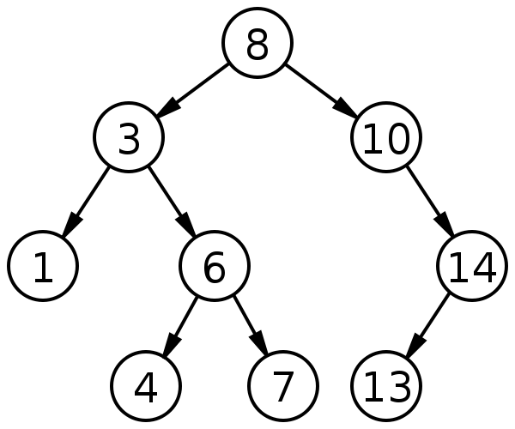
Properties
1. All leaves are at same level.

Slide 6
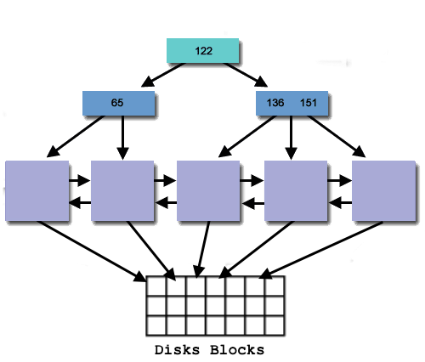
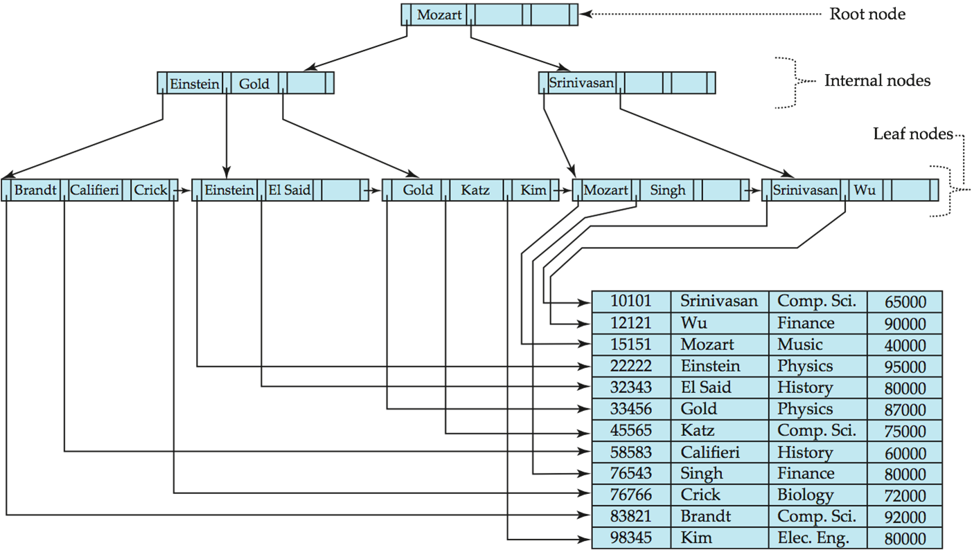
Properties
2. A B-Tree is defined by the term minimum degree t. The value of t
depends upon disk block size.

Slide 7
Properties
3. Every node except root must contain at least t-1 keys. Root may contain minimum 1 key.

Slide 8
Properties
4. All nodes (including root) may contain at most 2t – 1 keys.

Slide 9
Properties
5. Number of children of a node is equal to the number of keys in it plus 1.

Slide 10
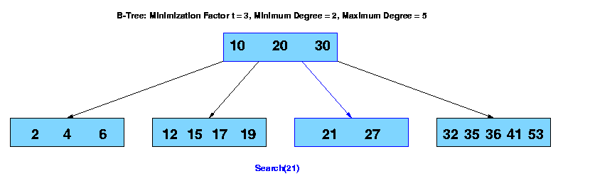
Properties
6. All keys of a node are sorted in increasing order. The child between two keys k1 and k2 contains all keys in range from k1 and k2.

Slide 11
Properties
7. B-Tree grows and shrinks from root which is unlike Binary Search Tree.
Binary Search Trees grow downward and also shrink from downward.
8. Like other balanced Binary Search Trees, time complexity to search, insert
and delete is O(Log n).

Slide 12
B-Tree Operations
Insert
Search
Delete
Fancy Slide ☺

Slide 13
B-Tree Operations
Insert
1) Initialize x as root.
2) While x is not leaf, do following
a) Find the child of x that is going to to be traversed next. Let the child be y.
b) If y is not full, change x to point to y.
c) If y is full, split it and change x to point to one of the two parts of y. If k is smaller than mid key in y, then set x as first part of y.
Else second part of y. When we split y, we move a key from y to its parent x.
3) The loop in step 2 stops when x is leaf. x must have space for 1 extra key as we have been splitting all nodes in advance. So simply insert k to x.

Slide 14
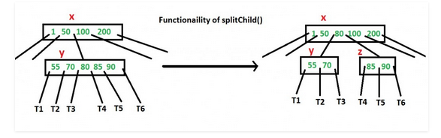
B-Tree Operations
Insert (Split)

Slide 15

B-Tree Operations
Insert

Slide 16

B-Tree Operations
Insert

Slide 17
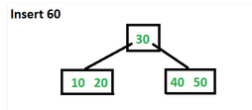
B-Tree Operations
Insert
Split First

Slide 18
B-Tree Operations
Insert

Slide 19
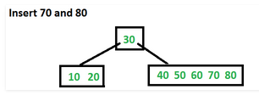
B-Tree Operations
Insert

Slide 20
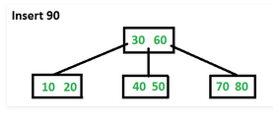
B-Tree Operations
Insert

Slide 21
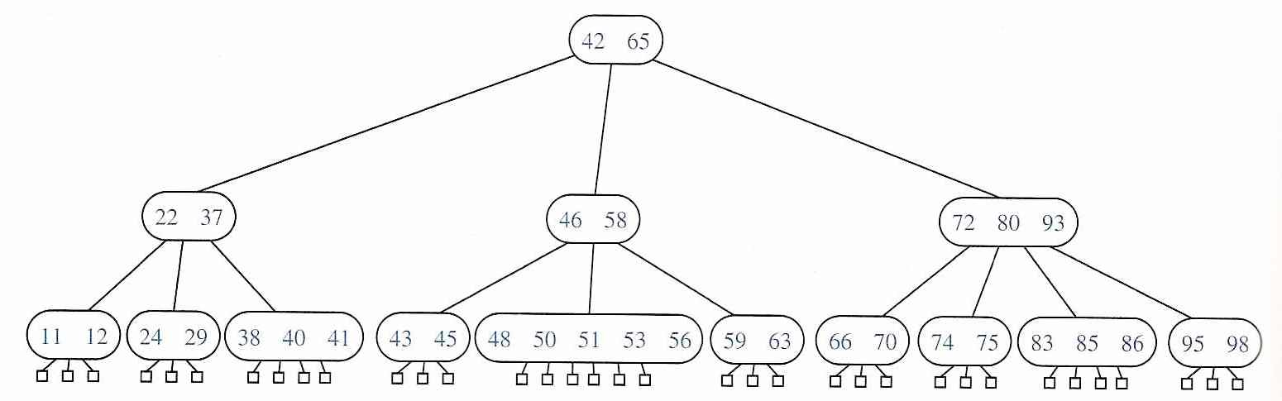
B-Tree Operations
Search

Slide 22
B-Tree Operations
Search
Search 70
70 > 42

Slide 23
B-Tree Operations
Search
Search 70
70 > 65

Slide 24
B-Tree Operations
Search
Search 70
70 < 72

Slide 25
B-Tree Operations
Search
Search 70
70 > 66

Slide 26
B-Tree Operations
Search
Search 70
70 == 70 Key found

Slide 27
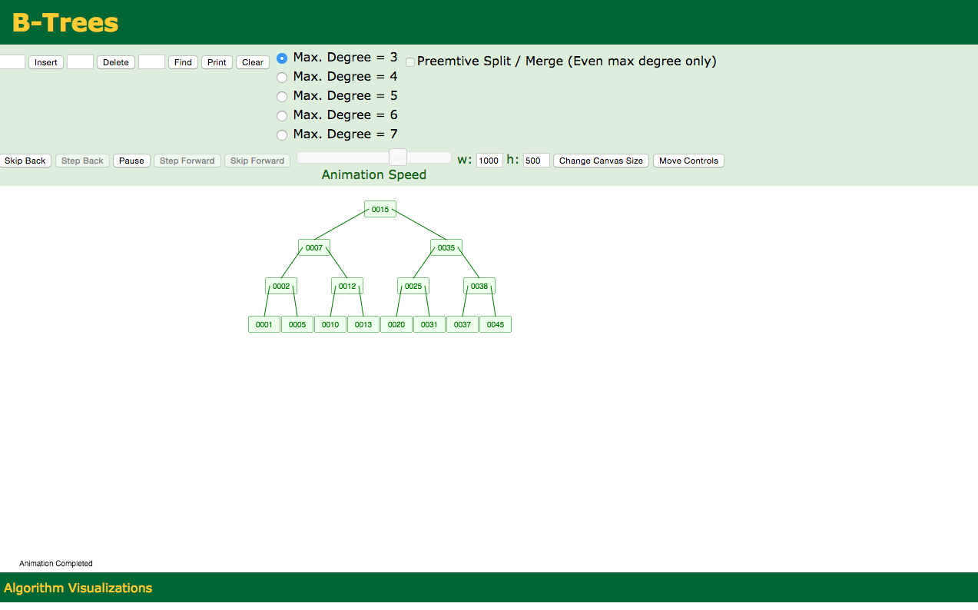
B-Tree Operations
Delete
https://www.cs.usfca.edu/~galles/visualization/BTree.html

