Slide 1
Madrid’s Real Estate Market Prediction Model
Or...
A journey of understanding market correlations
May 2024

Slide 2
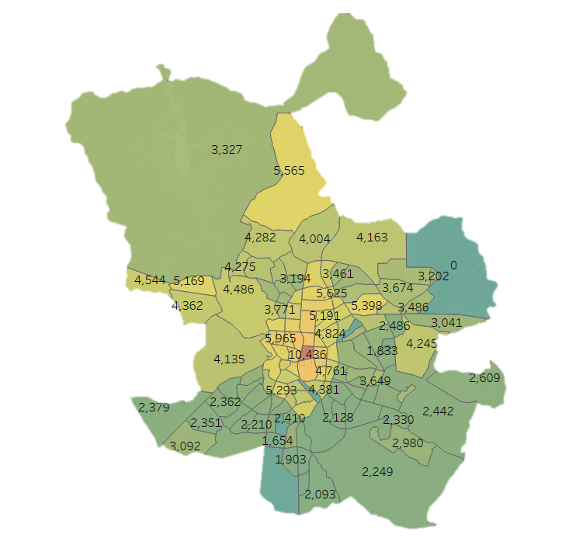
Current distribution

Slide 3
The questions that inspiring the model
Is it possible to predict the average price of a neighborhood without any pricing data?
Which variables should we add to our model?

Slide 4
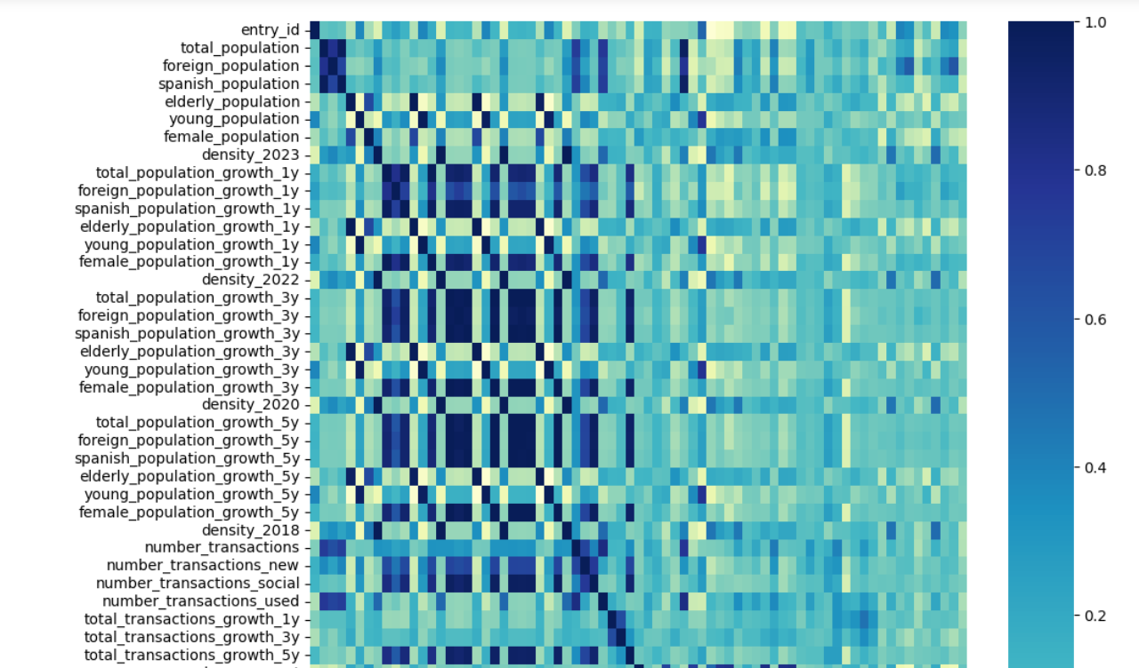
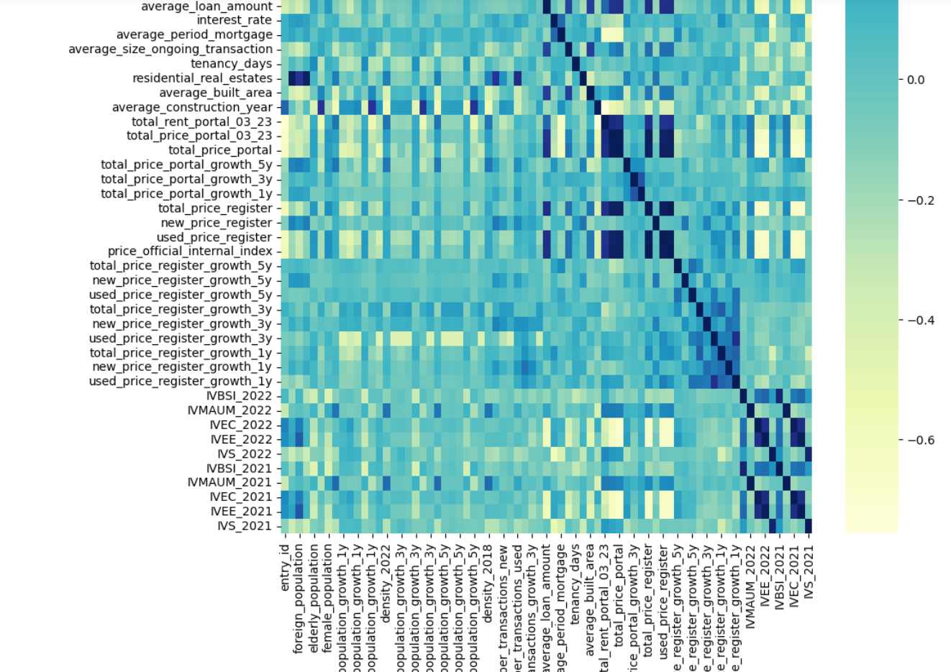
“At the age of six I wanted to be a cook. At seven I wanted to be Napoleon. And my ambition has been growing steadily ever since” Salvador Dalí
Ambitious starting point: collect all possible data.

Slide 5
“La modération est le trésor du sage” Voltaire
...Dream team of features
Population data: Total, foreign, Spanish, elderly, young, female, density, and all the factors growth in 5 years
Transactions data: Total, growth in 5 years, average mortgage period, average size, days from last purchase
Property market data: Residential units' stock, average built area, average construction year
Services and social indexes: Social and equality wellbeing, mobility and urban environment, education and culture, employment and economy, and healthcare

Slide 6
...First findings
High correlation between
Group 1 market size | The stock of properties in each area and the population. The number of transactions and the stock of dwellings in each area. The number of transactions and the population.
Group 2 property characteristics | The average year of construction and the percentage of young population and its growth. The average built area and the size of the units sold last year.
Group 3 relevant dynamics | Elderly population and female population. The education and culture vulnerability index and the economy and employment vulnerability index.
High differences
Group 1 by corr | Density: From less than one to 450 people per square kilometres. Population: From 1,600 (of which 180 foreigners) to 70,000. Real Estate Stock: From 580 residential units to 30,000. Number of Transactions: 8 units versus 1,350 units
Group 2 by distance | Days from last purchase: From 400 to 11,000 days of holding V. Index of Mobility and Urban Environment: From 2 to 62 points
Group 3 by relevance | Foreign population growth: From 1% to 20% Female population growth: From -4% to 13%

Slide 7
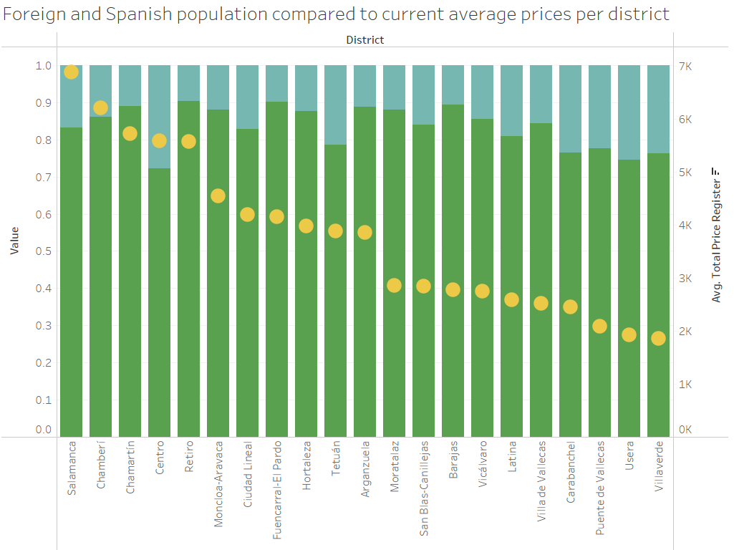
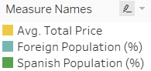
...is any of these features directly determining the price of an area
Foreign and Spanish population compared to current average prices per district

Slide 8
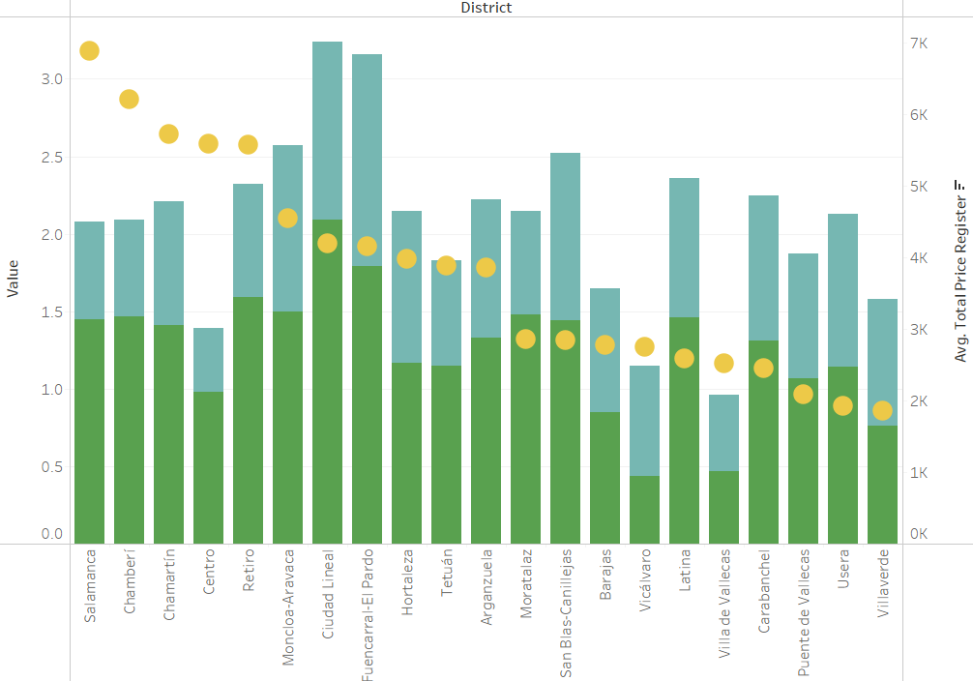
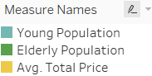
...not really
Young and old population compared to current average prices per district

Slide 9
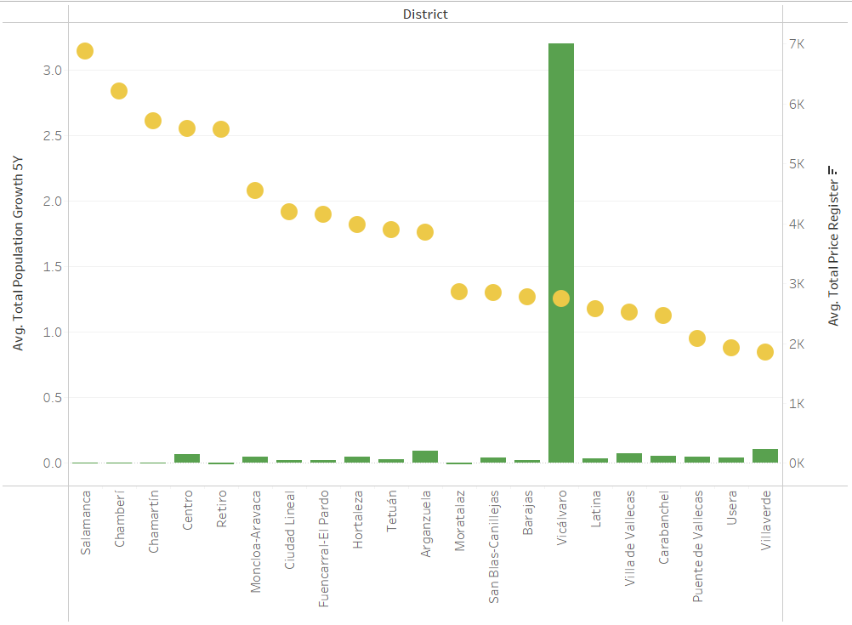

...no
Population growth in 5 years compared to current average prices per district

Slide 10
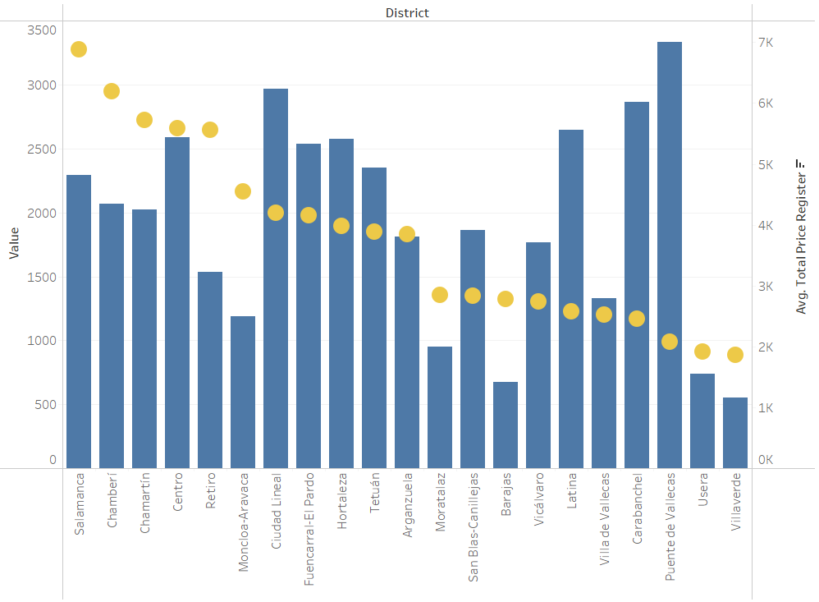

...well, no again...
Transactions compared to current average prices per district

Slide 11
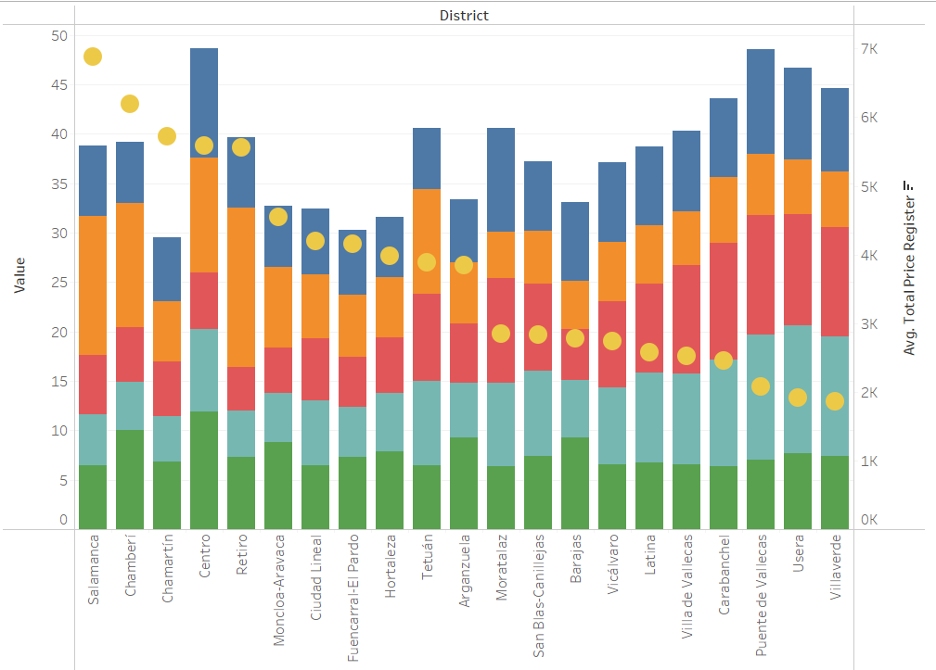
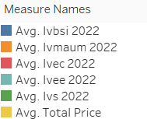
...Wait! There is something!
Vulnerability indexes compared to current average prices per district

Slide 12
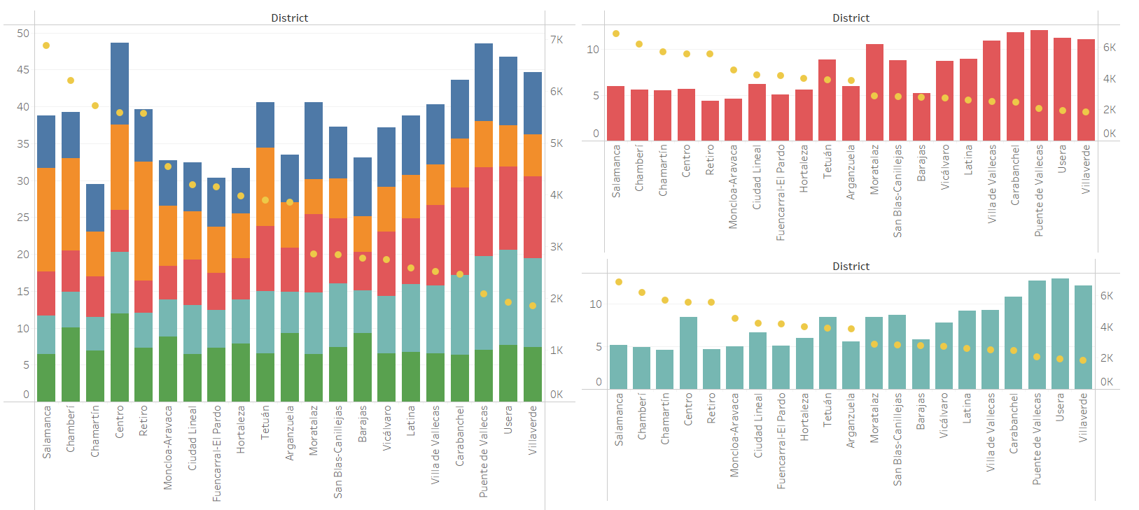
...Wait! There is something!
Education and culture index compared to current average prices per district
Education and culture index compared to current average prices per district
school absenteeism
insufficient education
internet access of household
special needs users
average income families with children in nursery schools
cultural centres
Economy and employment index compared to current average prices per district
population income under the 40% of the median
long-term unemployment rate
open retail spaces
training support
Economy and employment index compared to current average prices per district

Slide 13
...Let’s try a prediction model with our Dream Team
...Let’s reduce our Dream Team to its minimum, and modify if needed
 | Dream Team | Best Team
Linear Model | R2 Train: 0.775 R2 Test: 0.699 | R2 Train: 0.739 R2 Test: 0.669
Kneighbors | R2 Train: 0.847 R2 Test: 0.632 | R2 Train: 0.750 R2 Test: 0.615

Slide 14
Is it possible to predict the average price of a neighborhood without any pricing data?
Good enough
Which variables should we add to our model?
Total population
Foreign population
Spanish population
Average size of properties sold
Days from last purchase
Stock of properties in the area
Average size of the units in the area
Average construction year
IVEC and IVEE

