Slide 1
Car data lookup from license plate photo
Data Bootcamp Final Project
Jon Simpson
Nick Prentkowski
Ben Farniok
Terrence Cummings

Slide 2
Tasks
Heroku deployment and AWS S3 – Jon
Webpage for upload photo to S3 and display output – Nick
ML extract license plate number and stats from photo – Ben
APIs to retrieve car data based on license plate - Terry

Slide 3
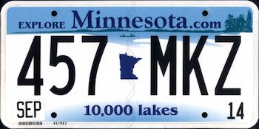
Architecture
HTML/CSS/JS (Nick)
Navigate to webpage
https://finalproj/index.html
Upload image
Upload
Image
[IMAGE]
OUTPUT
License Plate Number: 457MKZ
State: MN
Make: Chevrolet
Model: Trailblazer
Year: 2007
Avg sales price: $4,000
Heroku (Jon)
Launch
app
Python Flask (Terry)
Render index.html
OUTPUT
License Plate Number: [blank]
State: [blank]
Make: [blank]
Model: [blank]
Year: [blank]
Avg sales price: [blank]
Number
State
Make
Model
Year
Price
Upload image
AWS (Jon)
Store image at S3 URL
Python Flask (Ben)
Grab image from S3 URL
Extract # and state from image
Python Flask (Terry)
Call API with # and state
Re-render index.html

Slide 4
Flask app structure
#Dependencies, libraries, imports
import [….]
#Code to get car data and render webpage
app = Flask(__name__)
@app.route(“/”)
def home():
image = http://…
[Ben code]
num = 457MKZ
state = MN
[Terry code]
year = 2007
make = Chevrolet
model = Trailblazer
price = 4000
return render_template (“index.html”, image, num, state, year, make, model, price)
if __name__ == “__main__”:
app.run(debug=True)

