Slide 1
Comparison of the Relationship of Weather to Fires in California in 2103, 2015, and 2018
Team 7 – Ben Farniok, Lori Shannon, Mukaila Alimi

Slide 2
Hypothesis & Questions
2018 was the worst year of fire damage, with more than 1.8 million acres burned by wildland fires. That's the highest number of acres burned in the recorded history of California. 2018 was also one of the hottest years on record.
Is there a relationship to climate, more specifically the daily weather, and the date a wildfire starts?
Looking at locations by latitude and longitude and by year, are there patterns that exist between weather and fires?
How does temperature, humidity, wind speed, and wind gust factor into the start of a fire? How did the weather influence the severity of the fire (based on the numbers of acres burned)?
Are fires more severe in certain locations and at certain times in the year?
We asked these questions to determine some of the factors that can contribute to a fire breaking out.

Slide 3
Data Sources
For a list of recorded fires from 2013, 2015, and 2018, we used the incidents archive from CAL Fire (https://www.fire.ca.gov/). For historical weather by location (pulled from the locations of the fires listed on CAL Fire), we used the World Weather Online API (https://www.worldweatheronline.com/).

Slide 4
Data Exploration & Cleanup
The exploration process was the biggest part of the work we did. Getting the data from CAL Fire took a few tries as we needed to get the data from the website and format it in a way we could use it with the weather data. Getting the historical data was an elaborate process as we were unable to get data from the first source we identified (NOAA) and had to switch to a new source (the World Weather Online API). Then we had to match up the datasets so we could perform our analyses.

Slide 5
Summary of Findings
Our findings confirmed some of our assumptions, but not all of them. We found a relationship of temperature and humidity to the likelihood of a fire starting. We also found a correlation between temperature and the size of the fire. We did not determine a pattern influenced by location, wind speed, or wind gust.
However, because we compared the weather data on the date the fire started, we lost a lot of valuable data in regards to how the weather changed throughout the duration of the fire and what effect that had on the fire.

Slide 6
Data Analysis
To analyze the data we collected and answer the questions we asked, we created several charts and plots to compare weather variables with fire statistics. Some of our assumptions were validated, while others were not. Overall, we did find a positive relationship of weather to both the date a fire started and to the size of fire.

Slide 7
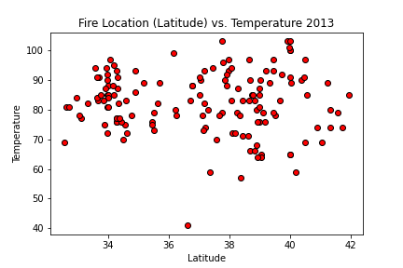
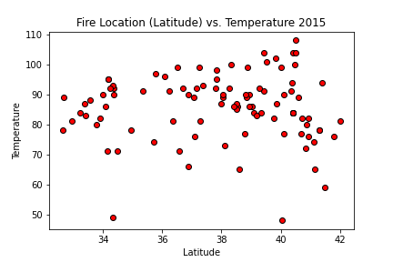
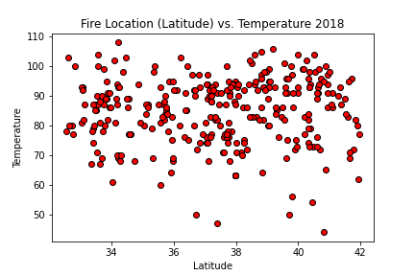
Plotting the Data: Location of the fire by Latitude vs. Temperature on the date the fire started
Is there a relationship of the high
temperature to the date a fire
breaks out?
How do the temperatures by
latitude (north vs south) impact
the start of a fire?
Do higher temperatures
lead to more fires?
Conclusion:
Yes, based on this data, higher
temperatures (above 80 degrees) may
contribute to the start of a fire.
San Diego 32.7157° N
San Francisco 37.7749° N
Eureka 40.8021° N

Slide 8
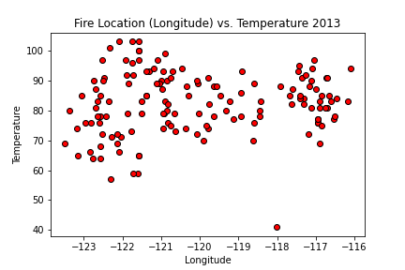
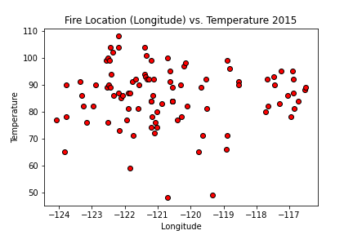
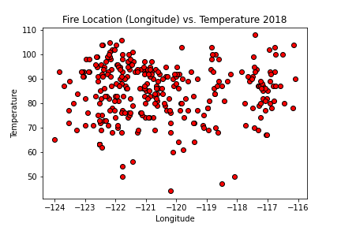
Plotting the Data: Location of the fire by Longitude vs. Temperature on the date the fire started
Is there a relationship of the high
temperature to the date a fire
breaks out?
How do the temperatures by
longitude (east vs west) impact
the start of a fire?
Do higher temperatures
lead to more fires?
Conclusion:
Yes, based on this data, higher
temperatures (above 80 degrees) may
contribute to the start of a fire.
Cape Mendocino 124.4095° W
Fresno 119.7871° W
Barstow 117.0173° W

Slide 9
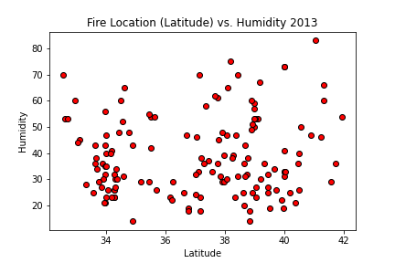
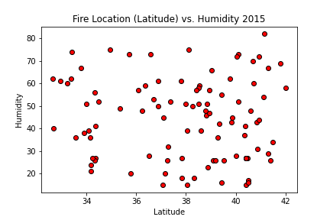
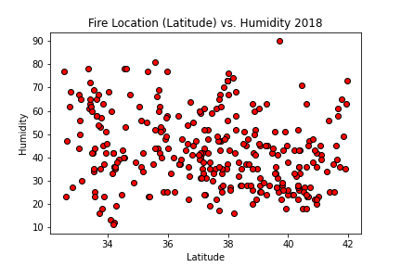
Plotting the Data: Location of the fire by Latitude vs. Humidity on the date the fire started
Is there a relationship of humidity levels
to the date a fire breaks out?
How does humidity by
latitude (north vs south) impact
the start of a fire?
Do lower humidity levels (drier conditions)
lead to more fires?
Conclusion:
Yes, based on this data, lower humidity rates
in 2013 and 2018 may have contributed to the
start of a fire. However, the data is not
consistent for 2015.
San Diego 32.7157° N
San Francisco 37.7749° N
Eureka 40.8021° N

Slide 10
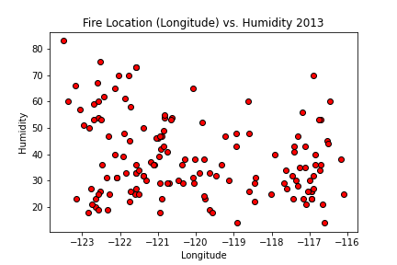
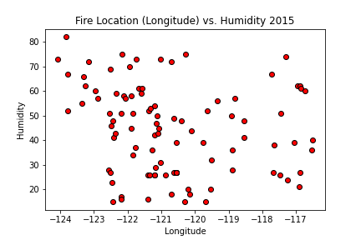
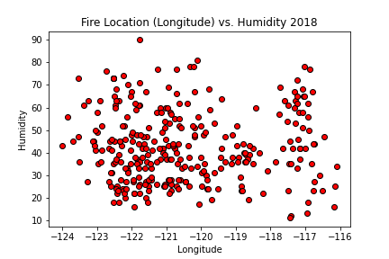
Plotting the Data: Location of the fire by Longitude vs. Humidity on the date the fire started
Is there a relationship of humidity levels
to the date a fire breaks out?
How does humidity by
latitude (east vs west) impact
the start of a fire?
Do lower humidity levels (drier conditions)
lead to more fires?
Conclusion:
Yes, based on this data, lower humidity rates
in 2013 and 2018 may have contributed to the
start of a fire. However, the data is not
consistent for 2015.
Cape Mendocino 124.4095° W
Fresno 119.7871° W
Barstow 117.0173° W

Slide 11
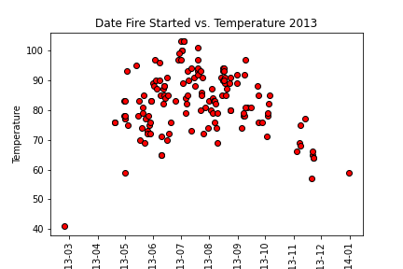
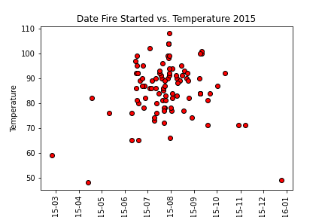
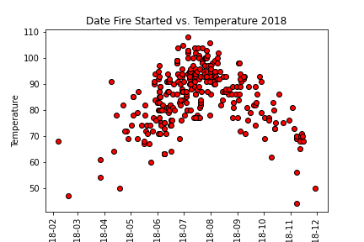
Plotting the Data: Weather Conditions the Day a Fire Starts - Temperature
Does the daily weather conditions increase
the likelihood a fire will break out?
Do higher temperatures lead to fires?
Is there a “fire season” when fires are more
likely to break out?
Conclusion:
Fire season was contained to a handful of
months in the year. However, during the worst
year ever of fires in California (2018), fires
broke out every month, especially when the
temperatures were higher.

Slide 12
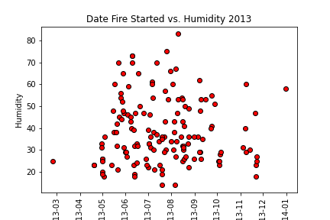
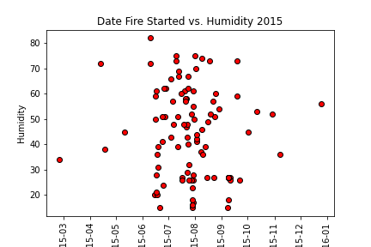
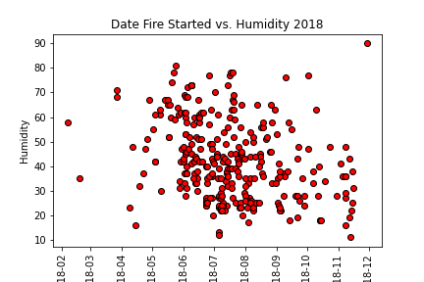
Plotting the Data: Weather Conditions the Day a Fire Starts - Humidity
Does the daily weather conditions increase
the likelihood a fire will break out?
Do humidity levels lead to fires?
Is there a “fire season” when fires are more
likely to break out?
Conclusion:
Lower levels of humidity do have some
effect on fires breaking out.

Slide 13
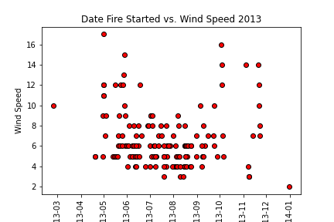
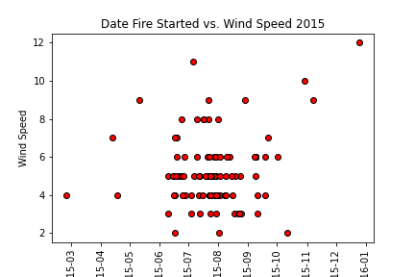
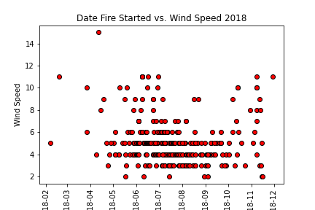
Plotting the Data: Weather Conditions the Day a Fire Starts – Wind Speed
Does the daily weather conditions increase
the likelihood a fire will break out?
Do higher wind speeds lead to fires?
Conclusion:
No, higher wind speeds do not lead to a
greater chance a fire will break out.

Slide 14
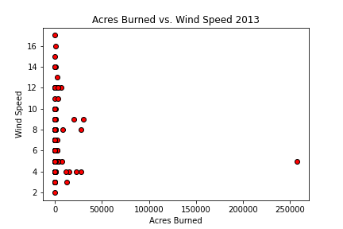
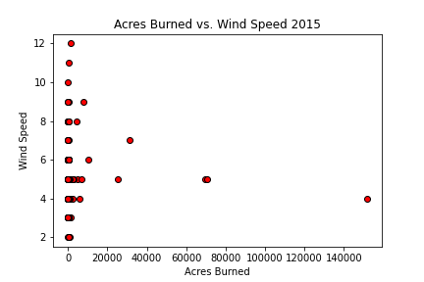
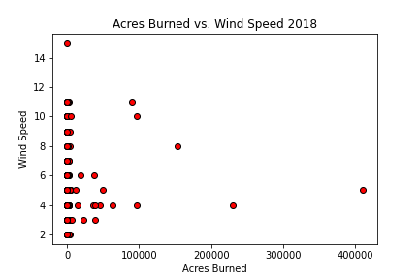
Plotting the Data: Size of Fire vs Wind Speed
Is there a relationship of wind speed on the
day a fire starts to the size of a fire in
acres burned?
Do windier conditions lead to larger fires?
Conclusion:
No, based on this data, higher winds do not
lead to larger fires.

Slide 15
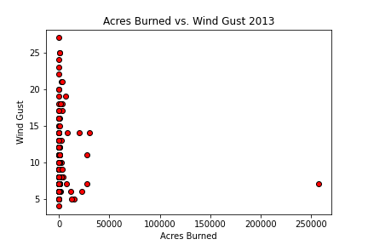
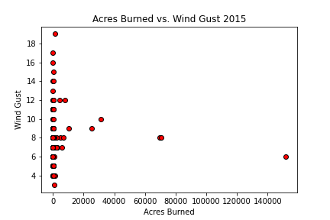
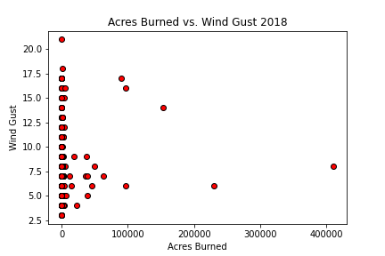
Plotting the Data: Size of Fire vs Wind Gusts
Is there a relationship of wind gusts on the
day a fire starts to the size of a fire in
acres burned?
Do higher wind gusts lead to larger fires?
Conclusion:
No, based on this data, higher wind gusts do not
lead to larger fires.

Slide 16
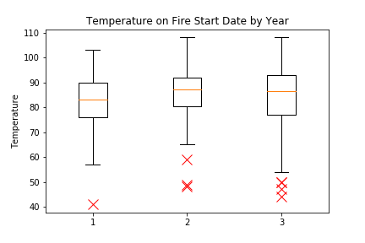
Plotting the Data: Comparing Temperature by Years
2013 2015 2018

Slide 17
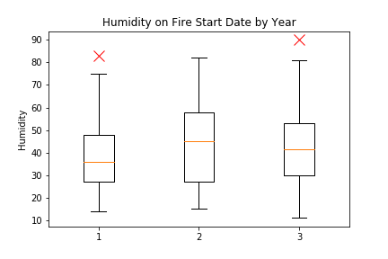
Plotting the Data: Comparing Humidity by Years
2013 2015 2018

Slide 18
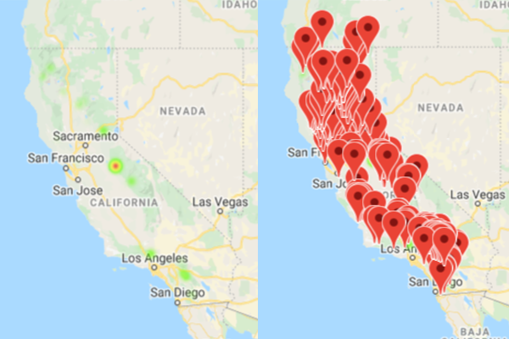
Visualizing the Data – 2013
Illustrations of fire sizes and locations

Slide 19
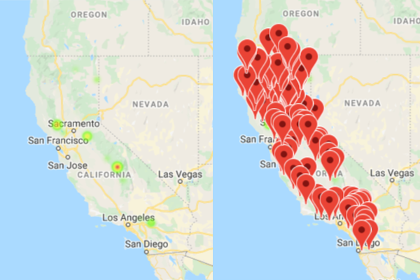
Visualizing the Data – 2015
Illustrations of fire sizes and locations

Slide 20
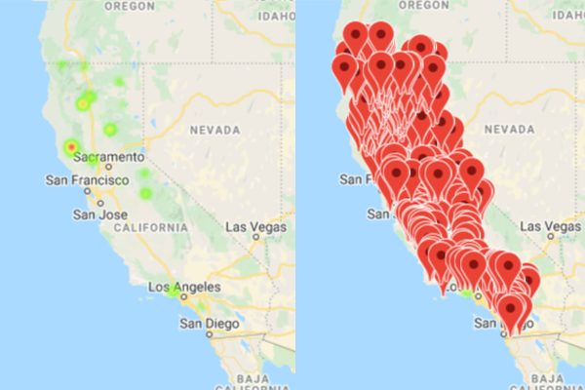
Visualizing the Data – 2018
Illustrations of fire sizes and locations

Slide 21
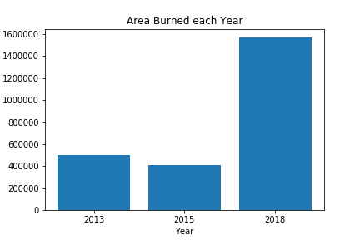
Visualizing the Data

Slide 22
Discussion & Post Mortem
Our findings confirmed some of our assumptions, but not all of them. We found a relationship between temperature and humidity to the likelihood of a fire starting. We also found a correlation between temperature and the size of the fire. We did not determine a pattern influenced by location, wind speed, or wind gust.
Given more time to gather additional data and conduct further analysis, we would look at weather throughout the entire duration of each fire incident. We believe there would be benefits at looking at the weather variables during a fire to see how those variables impacted fires, and, in turn, if fires change the weather.

Slide 23
Questions?
Questions, comments, or concerns?
Thank you!

