Slide 1
Comparison of the Relationship of Weather to Wildfires in California in 2015 & 2018
Team 7 – Ben, Lori, Alimi

Slide 2
Scope of Project
Using fire data from CAL fire, we will map out where fires occurred in 2015 and 2018. We will also show what the weather was during those periods to draw any correlations between weather and wildfires and the severity of the fires.
Looking at locations by county or lat/lon by year, how did the weather influence the severity of the fire (size of fire)? Are fires more severe in certain locations and at certain times in the year? How do incidences of rain, heat, other weather events impact wildfires?

Slide 3
Data Sources
CAL Fire
https://www.fire.ca.gov/incidents/2015/
https://www.fire.ca.gov/incidents/2018/
Historical Weather
National Centers for Environmental Information –
National Oceanic and Atmospheric Administration API
https://www.ncdc.noaa.gov/cdo-web/webservices/

Slide 4
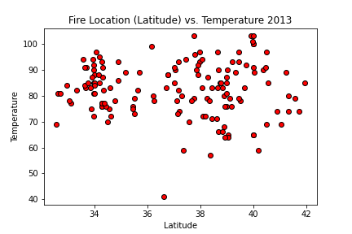
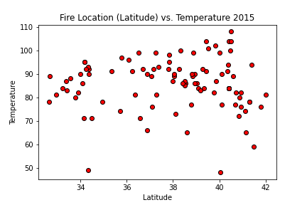
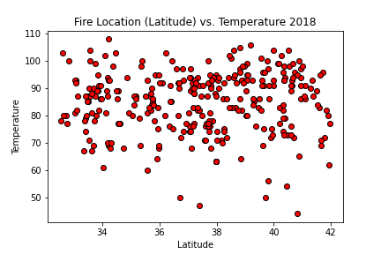
Plotting the Data: Location of the fire by Latitude vs. Temperature on the date the fire started
Is there a relationship of the high
temperature to the date a fire
breaks out?
How do the temperatures by
latitude (north vs south) impact
the start of a fire?
Do higher temperatures
lead to more fires?
Conclusion:
Yes, based on this data, higher
temperatures can contribute to
the start of a fire.
Lower latitudes = Southern California
Higher latitudes = Northern California

Slide 5
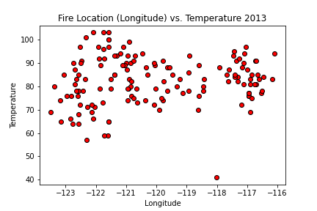
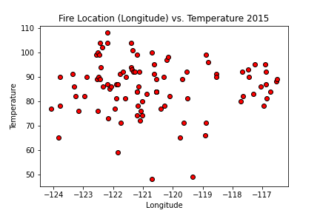
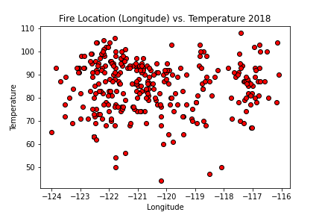
Plotting the Data: Location of the fire by Longitude vs. Temperature on the date the fire started
Is there a relationship of the high
temperature to the date a fire
breaks out?
How do the temperatures by
longitude (east vs west) impact
the start of a fire?
Do higher temperatures
lead to more fires?
Conclusion:
Yes, based on this data, higher
temperatures can contribute to
the start of a fire.
Lower longitude = Western California
Higher longitude = Eastern California

Slide 6
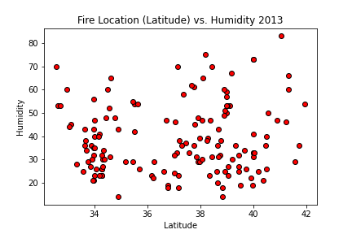
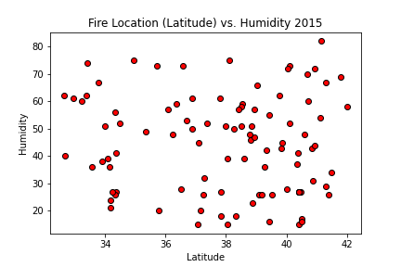
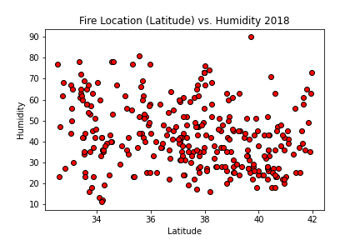
Plotting the Data: Location of the fire by Latitude vs. Humidity on the date the fire started
Is there a relationship of humidity levels
to the date a fire breaks out?
How does humidity by
latitude (north vs south) impact
the start of a fire?
Do lower humidity levels (drier conditions)
lead to more fires?
Conclusion:
Yes, based on this data, lower humidity rates
can contribute to the start of a fire.
Lower latitudes = Southern California
Higher latitudes = Northern California

Slide 7
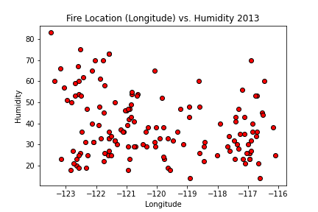
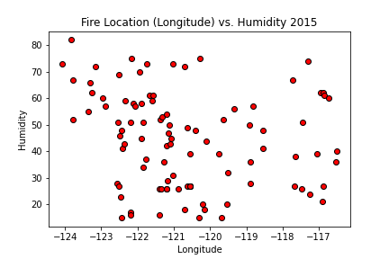
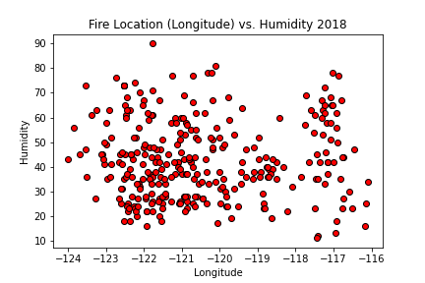
Plotting the Data: Location of the fire by Longitude vs. Humidity on the date the fire started
Is there a relationship of humidity levels
to the date a fire breaks out?
How does humidity by
latitude (east vs west) impact
the start of a fire?
Do lower humidity levels (drier conditions)
lead to more fires?
Conclusion:
Yes, based on this data, lower humidity rates
can contribute to the start of a fire.
Lower longitude = Western California
Higher longitude = Eastern California

Slide 8
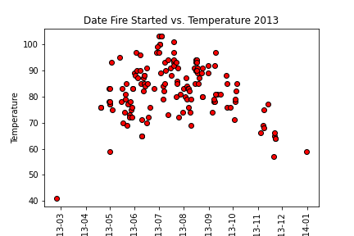
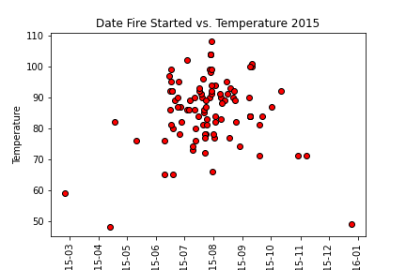
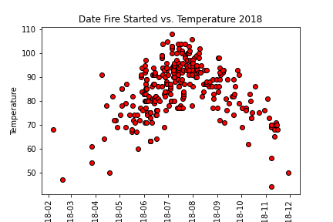
Plotting the Data: Weather Conditions the Day a Fire Starts - Temperature
Does the daily weather conditions increase
the likelihood a fire will break out?
Do higher temperatures lead to fires?
Is there a “fire season” when fires are more
likely to break out?
Conclusion:
Fire season was contained to a handful of
months in the year. During the worst year
of fires in California, fires broke out every
month, especially when the temperatures
were higher.

Slide 9
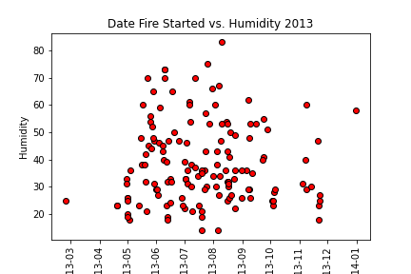
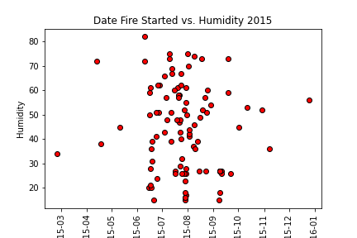
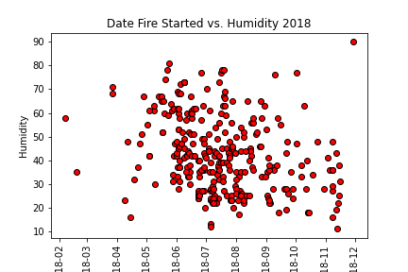
Plotting the Data: Weather Conditions the Day a Fire Starts - Humidity
Does the daily weather conditions increase
the likelihood a fire will break out?
Do humidity levels lead to fires?
Is there a “fire season” when fires are more
likely to break out?
Conclusion:
Lower levels of humidity do have some
effect on fires breaking out.

Slide 10
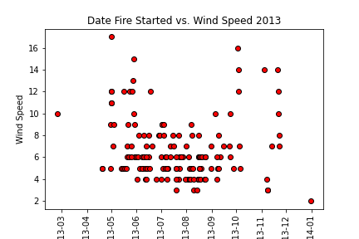
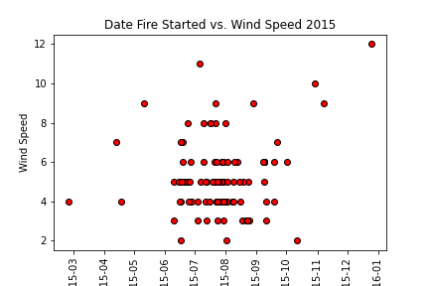
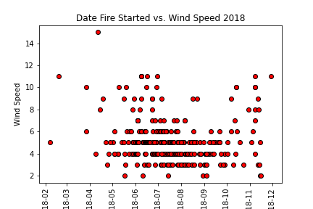
Plotting the Data: Weather Conditions the Day a Fire Starts – Wind Speed
Does the daily weather conditions increase
the likelihood a fire will break out?
Do higher wind speeds lead to fires?
Conclusion:
No, higher wind speeds do not lead to a
greater chance a fire will break out.

Slide 11
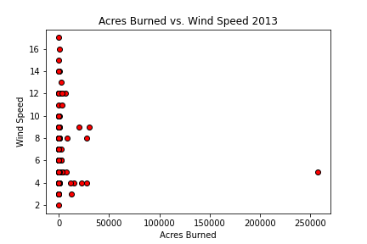
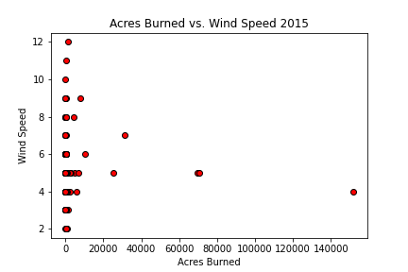
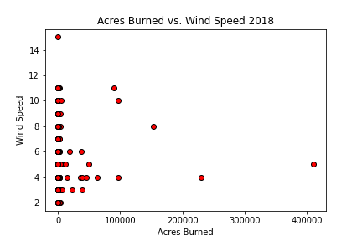
Plotting the Data: Size of Fire vs Wind Speed
Is there a relationship of wind speed on the
day a fire starts to the size of a fire in
acres burned?
Do windier conditions lead to larger fires?
Conclusion:
No, based on this data, higher winds do not
lead to larger fires.

Slide 12
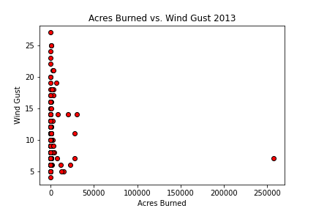
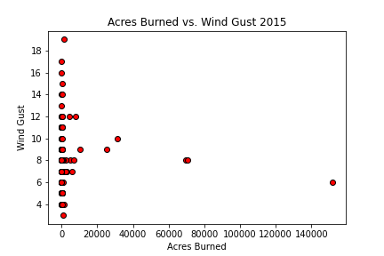
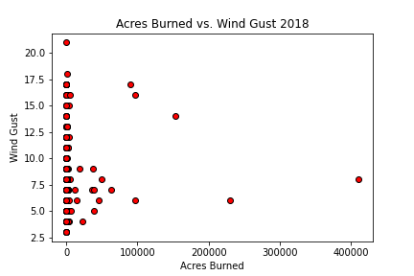
Plotting the Data: Size of Fire vs Wind Gusts
Is there a relationship of wind gusts on the
day a fire starts to the size of a fire in
acres burned?
Do higher wind gusts lead to larger fires?
Conclusion:
No, based on this data, higher wind gusts do not
lead to larger fires.

Slide 13
Visualizing the Data
Google maps with layers showing
Location of fire vs temp - by year
Location of fire vs humidity - by year
Location of fire vs precipitation - by year
Number of fires - 2015 vs 2018

