Slide 1
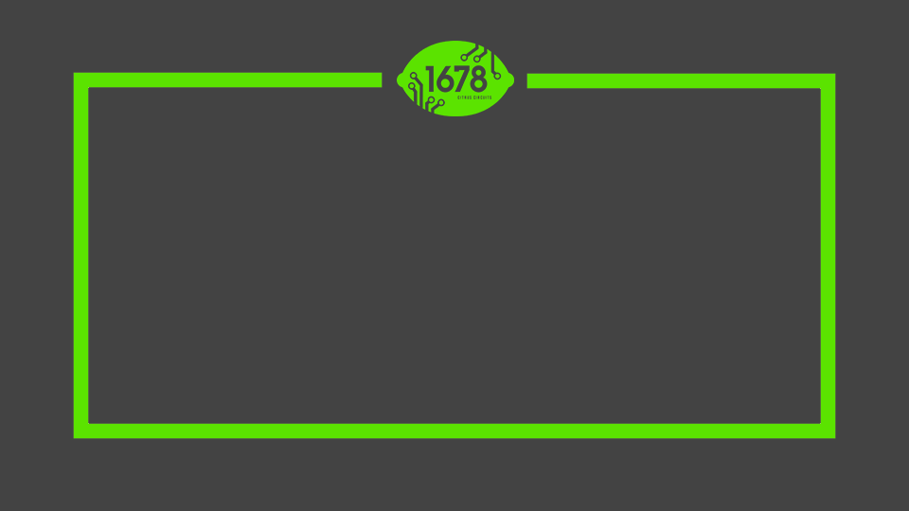
Citrus Circuits
Fall Workshop Series
Game Analysis
by Austin Haddox

Slide 2

Who Am I?
Austin Haddox
Strategy, Scouting, and Mechanical Mentor
Head of Data Analysis and Contract Management for SFCS
Going into 12th season in FRC
Started mentoring 1678 in 2019
Notes:
I have been the lead mentor of 1678 since its beginning in 2004.
I have a background in Civil Engineering but have been teaching math and robotics since 2001.
I’m married, have two children and am passionate about both windsurfing and mountain-biking

Slide 3
Overview
Types of Analysis
Understanding a Game
Scoring Systems
Kickoff
Competition Season
Notes:
My presentation begins with addressing the basic framework for everything we do in FIRST.
Some people use the acronym KISS but I’ve come up with my own called KISAR
Within the context of KISAR, I will discuss first drivetrain design, then mechanisms and finally electronics and pneumatics.
The last two sections discuss how the strategic design process can be effectively implemeted throughout build season and competition season
At the end of the presentation there will be a quiz and I have brought some 1678 t-shirts as prizes.

Slide 4
Purpose of Game Analysis
Better understand the game
Guide design decisions (The Whats)
Create match strategies
Create goals for your team
Notes:
My presentation begins with addressing the basic framework for everything we do in FIRST.
Some people use the acronym KISS but I’ve come up with my own called KISAR
Within the context of KISAR, I will discuss first drivetrain design, then mechanisms and finally electronics and pneumatics.
The last two sections discuss how the strategic design process can be effectively implemeted throughout build season and competition season
At the end of the presentation there will be a quiz and I have brought some 1678 t-shirts as prizes.

Slide 5
Types of Analysis
Notes:
A feature of most successful engineering designs is simplicity.
The goal in engineering is to find simple solutions to complex problems not vice versa.
In FRC, simplicity often goes hand in hand with robustness.

Slide 6
Types of Analysis
Holistic Analysis
Using FRC knowledge to evaluate a game
Numerical Analysis
Bringing a game to numbers to understand tradeoffs
Notes:
My presentation begins with addressing the basic framework for everything we do in FIRST.
Some people use the acronym KISS but I’ve come up with my own called KISAR
Within the context of KISAR, I will discuss first drivetrain design, then mechanisms and finally electronics and pneumatics.
The last two sections discuss how the strategic design process can be effectively implemeted throughout build season and competition season
At the end of the presentation there will be a quiz and I have brought some 1678 t-shirts as prizes.

Slide 7
Understanding a Game
Notes:
A feature of most successful engineering designs is simplicity.
The goal in engineering is to find simple solutions to complex problems not vice versa.
In FRC, simplicity often goes hand in hand with robustness.

Slide 8
Understanding a Game
Ways to score
Scoring Systems
Reading the rules
How will the game be played
Notes:
My presentation begins with addressing the basic framework for everything we do in FIRST.
Some people use the acronym KISS but I’ve come up with my own called KISAR
Within the context of KISAR, I will discuss first drivetrain design, then mechanisms and finally electronics and pneumatics.
The last two sections discuss how the strategic design process can be effectively implemeted throughout build season and competition season
At the end of the presentation there will be a quiz and I have brought some 1678 t-shirts as prizes.

Slide 9
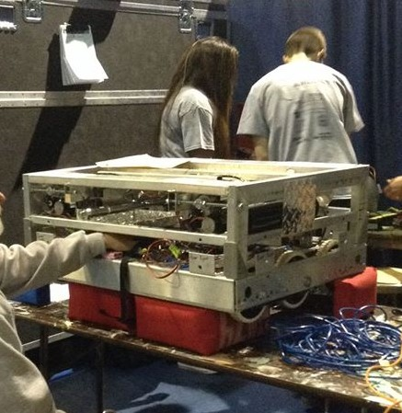
Golden Rule #1
Learn about previous games
Research what kinds of tasks we’ve seen in previous years
What strategies and designs were successful in those games
How much do teams normally score
Notes:
I’m going to be giving you 5 golden rules. The first is Keep It Simple.
Success in FIRST is meeting you goals
Every team can set meaningful goals
Don’t over-reach
Find the simplest way to do the job
Make your robot function – doesn’t have to look pretty
(Example of 1868 at Sac Regional)

Slide 10
Different ways to score: Auto/Teleop
Auto/Teleop Scoring Method
Single element (2011-2014, 2016, 2018, 2020, 2022)
Multiple elements (2011, 2015, 2017, 2019, 2023)
Continuous cumulative scoring (2012, 2013, 2016, 2017, 2019, 2020, 2022, 2023)
Threshold achievement scoring (2014, 2015, 2017, 2023)
Qualification Ranking converts to score in Playoffs (2012, 2016, 2017)
Possession time (2018)
Auto/Teleop Scoring Limit
Uncapped (2012-2014, 2016-2017, 2020, 2022)
Capped (2015, 2018, 2019, 2023)
Notes:
My presentation begins with addressing the basic framework for everything we do in FIRST.
Some people use the acronym KISS but I’ve come up with my own called KISAR
Within the context of KISAR, I will discuss first drivetrain design, then mechanisms and finally electronics and pneumatics.
The last two sections discuss how the strategic design process can be effectively implemeted throughout build season and competition season
At the end of the presentation there will be a quiz and I have brought some 1678 t-shirts as prizes.

Slide 11
Different ways to score: End Game/Rank
End Game Scoring Method
Single task / dual task (2012, 2013, 2016-2020, 2023)
Staged tasks (2013, 2019, 2022)
Assisted task (2012, 2018, 2019, 2020)
Ordinal (2011)
None (2014, 2015)
Ranking
Wins/ties only (2011-2014)
Qualification Score (2015)
Bonus achievements
Coopertition (2012)
Dual achievements/thresholds (2016-2023)
Notes:
My presentation begins with addressing the basic framework for everything we do in FIRST.
Some people use the acronym KISS but I’ve come up with my own called KISAR
Within the context of KISAR, I will discuss first drivetrain design, then mechanisms and finally electronics and pneumatics.
The last two sections discuss how the strategic design process can be effectively implemeted throughout build season and competition season
At the end of the presentation there will be a quiz and I have brought some 1678 t-shirts as prizes.

Slide 12
Scoring Systems
Notes:
A feature of most successful engineering designs is simplicity.
The goal in engineering is to find simple solutions to complex problems not vice versa.
In FRC, simplicity often goes hand in hand with robustness.

Slide 13
Linear Scoring
A Linear Scoring System is a system that grants points for every game piece that is scored.
Single Scoring Opportunity: A system that has you score either one game piece or one set of game pieces at a time.
Example: Score one ball or one item per cycle and get points per ball or item.
Multiple Scoring Opportunities: A system that allows you to score multiple game pieces per cycle.
Examples: 1) Shooting multiple balls or items per cycle. 2) Score multiple crates on a platform per cycle and get points for every crate scored.
Focus on max carrying capacity and how we score!
Notes:
My presentation begins with addressing the basic framework for everything we do in FIRST.
Some people use the acronym KISS but I’ve come up with my own called KISAR
Within the context of KISAR, I will discuss first drivetrain design, then mechanisms and finally electronics and pneumatics.
The last two sections discuss how the strategic design process can be effectively implemeted throughout build season and competition season
At the end of the presentation there will be a quiz and I have brought some 1678 t-shirts as prizes.

Slide 14
Non-Linear Scoring
Step Scoring: A system that does not grant points for every piece scored
Threshold: Once you score X amount of game pieces or score X amount of points then you get points.
Example: 1) You get 50 points after you score 10 balls. 2) RPs are often thresholds
Series: Having multiple thresholds of scoring.
Example: 1) You get 50 points for every 10 items you score. 2) You get 50 points for scoring 10 balls, 50 more points for scoring an extra 15 balls, etc. (Normally these have only a few thresholds)
Focus on how many cycles are required to score points and see if the extra time is worth the points!
Notes:
My presentation begins with addressing the basic framework for everything we do in FIRST.
Some people use the acronym KISS but I’ve come up with my own called KISAR
Within the context of KISAR, I will discuss first drivetrain design, then mechanisms and finally electronics and pneumatics.
The last two sections discuss how the strategic design process can be effectively implemeted throughout build season and competition season
At the end of the presentation there will be a quiz and I have brought some 1678 t-shirts as prizes.

Slide 15
Non-Linear Scoring
Dependent Scoring: A system that only grants points once something else is done
Multiplicative Bonus: Grants a bonus of points relative to another scoring method.
Example: 1) If you score a brick you get 0 points. However, if you do, your next cycle is worth 30 points rather than 10 (3x).
Additive Bonus: Grants a bonus of points once you score your cycle
Example: 1) If you score a brick you get 0 points. However, if you do, your next cycle is worth 15 points more than normal (+15).
Focus on what percentage of a max score cycle is from bonuses and decide if it is worth the extra time!
Notes:
My presentation begins with addressing the basic framework for everything we do in FIRST.
Some people use the acronym KISS but I’ve come up with my own called KISAR
Within the context of KISAR, I will discuss first drivetrain design, then mechanisms and finally electronics and pneumatics.
The last two sections discuss how the strategic design process can be effectively implemeted throughout build season and competition season
At the end of the presentation there will be a quiz and I have brought some 1678 t-shirts as prizes.

Slide 16
Max Score vs Unlimited Scoring
Max Score
Max Number of game pieces or scoring opportunities
Example: You only have 20 balls per alliance. Balls do not get reintroduced when scored and opponents can’t control your balls.
Focus on scoring every ball and stopping your opponents from scoring at least one ball!
Max number of total points between the two alliances
Example: 1) There are 100 possible points in the match (differential scoring).
Focus on scoring at least 51 points, it doesn’t matter what your opponents do because every point you score is one less that your opponents can.
Unlimited Score
Example: 1) There are 50 balls on the field, but balls get reintroduced when scored.
Focus on optimizing score by scoring either more per cycle or more cycles! This is a multiplicative relationship for your total score.
Notes:
My presentation begins with addressing the basic framework for everything we do in FIRST.
Some people use the acronym KISS but I’ve come up with my own called KISAR
Within the context of KISAR, I will discuss first drivetrain design, then mechanisms and finally electronics and pneumatics.
The last two sections discuss how the strategic design process can be effectively implemeted throughout build season and competition season
At the end of the presentation there will be a quiz and I have brought some 1678 t-shirts as prizes.

Slide 17
Different Types of Scoring Systems
Linear
Single scoring opportunity per cycle (2014, 2016, 2019, 2023)
Many scoring opportunities per cycle (2012, 2013, 2015, 2020, 2022)
Non-Linear
Step Scoring
Threshold (2016-2023)
Step (2017, 2020, 2023)
Dependent Scoring
Multiplicative Bonus (2015)
Additive Bonus (2014, 2018, 2020, 2023)
Ordinal ranking (2011)
Max Score
Max Number of game pieces or scoring opportunities (2017, 2019, 2023)
Max number of total points between the two alliances (2015, 2018)
Unlimited Scoring
Notes:
My presentation begins with addressing the basic framework for everything we do in FIRST.
Some people use the acronym KISS but I’ve come up with my own called KISAR
Within the context of KISAR, I will discuss first drivetrain design, then mechanisms and finally electronics and pneumatics.
The last two sections discuss how the strategic design process can be effectively implemeted throughout build season and competition season
At the end of the presentation there will be a quiz and I have brought some 1678 t-shirts as prizes.

Slide 18
Kickoff
Notes:
A feature of most successful engineering designs is simplicity.
The goal in engineering is to find simple solutions to complex problems not vice versa.
In FRC, simplicity often goes hand in hand with robustness.

Slide 19
Kickoff
Game Animation
Reading the rules
Analysis
Discussion
Notes:
My presentation begins with addressing the basic framework for everything we do in FIRST.
Some people use the acronym KISS but I’ve come up with my own called KISAR
Within the context of KISAR, I will discuss first drivetrain design, then mechanisms and finally electronics and pneumatics.
The last two sections discuss how the strategic design process can be effectively implemeted throughout build season and competition season
At the end of the presentation there will be a quiz and I have brought some 1678 t-shirts as prizes.

Slide 20
Golden Rule #2
Read the game manual!
Understand every inch of the key sections
Arena
Match Play
Scoring
Rule Violations
Game Rules
Notes:
I’m going to be giving you 5 golden rules. The first is Keep It Simple.
Success in FIRST is meeting you goals
Every team can set meaningful goals
Don’t over-reach
Find the simplest way to do the job
Make your robot function – doesn’t have to look pretty
(Example of 1868 at Sac Regional)

Slide 21
Golden Rule #3
Spreadsheets Spreadsheets Spreadsheets!
Using spreadsheets can help you quickly evaluate tradeoffs and strategy decisions
Notes:
I’m going to be giving you 5 golden rules. The first is Keep It Simple.
Success in FIRST is meeting you goals
Every team can set meaningful goals
Don’t over-reach
Find the simplest way to do the job
Make your robot function – doesn’t have to look pretty
(Example of 1868 at Sac Regional)

Slide 22
Scoring Calculators
Input Sheet
Per robot
Editable
Calculate totals for alliance
Points
RP
Try different combinations
Notes:
My presentation begins with addressing the basic framework for everything we do in FIRST.
Some people use the acronym KISS but I’ve come up with my own called KISAR
Within the context of KISAR, I will discuss first drivetrain design, then mechanisms and finally electronics and pneumatics.
The last two sections discuss how the strategic design process can be effectively implemeted throughout build season and competition season
At the end of the presentation there will be a quiz and I have brought some 1678 t-shirts as prizes.

Slide 23
Team Info | Blue Alliance |  |  | Red Alliance
Scoring Data | B1 | B2 | B3 | R1 | R2 | R3
Auto
Taxied? | Yes | Yes | Yes | Yes | Yes | Yes
#Low Goal | 2 | 0 | 0 | 5 | 0 | 1
#High Goal | 1 | 5 | 0 | 0 | 0 | 4
Teleop
#Low Goal | 3 | 0 | 5 | 3 | 0 | 4
#High Goal | 7 | 20 | 0 | 15 | 8 | 0
Climb Level | Medium | Traversal | None | Low | None | Low
Team Scores
Auto | 8 | 20 | 0 | 10 | 0 | 18
Teleop | 17 | 40 | 5 | 33 | 16 | 4
Climb | 6 | 15 | 0 | 4 | 0 | 4
Total Score | 31 | 75 | 5 | 47 | 16 | 26
Final
Alliance Score | 111 |  |  | 89
Cargo RP | 1 |  |  | 1
Hanger RP | 1 |  |  | 0
Winning RP | 2 |  |  | 0
Total RP | 4 |  |  | 1
Notes:
My presentation begins with addressing the basic framework for everything we do in FIRST.
Some people use the acronym KISS but I’ve come up with my own called KISAR
Within the context of KISAR, I will discuss first drivetrain design, then mechanisms and finally electronics and pneumatics.
The last two sections discuss how the strategic design process can be effectively implemeted throughout build season and competition season
At the end of the presentation there will be a quiz and I have brought some 1678 t-shirts as prizes.

Slide 24
Golden Rule #4
Understand Cycles
Karthik’s rule of (2-4-8)
Modern Rule of Thumb (2-6-14)
Full field cycles under perfect conditions
Notes:
I’m going to be giving you 5 golden rules. The first is Keep It Simple.
Success in FIRST is meeting you goals
Every team can set meaningful goals
Don’t over-reach
Find the simplest way to do the job
Make your robot function – doesn’t have to look pretty
(Example of 1868 at Sac Regional)

Slide 25
Competition Season
Notes:
A feature of most successful engineering designs is simplicity.
The goal in engineering is to find simple solutions to complex problems not vice versa.
In FRC, simplicity often goes hand in hand with robustness.

Slide 26
Competition Season
Competitions
Scouting
Analysis
Data Visualization
Notes:
My presentation begins with addressing the basic framework for everything we do in FIRST.
Some people use the acronym KISS but I’ve come up with my own called KISAR
Within the context of KISAR, I will discuss first drivetrain design, then mechanisms and finally electronics and pneumatics.
The last two sections discuss how the strategic design process can be effectively implemeted throughout build season and competition season
At the end of the presentation there will be a quiz and I have brought some 1678 t-shirts as prizes.

Slide 27
Golden Rule #5
Watch Competitions!
Watch the game be played
Evaluate how your team compares to others
Find unique autos/strategies
Defense
Notes:
I’m going to be giving you 5 golden rules. The first is Keep It Simple.
Success in FIRST is meeting you goals
Every team can set meaningful goals
Don’t over-reach
Find the simplest way to do the job
Make your robot function – doesn’t have to look pretty
(Example of 1868 at Sac Regional)

Slide 28
Scouting
Collect data on robots
Match strategy
Picklist creation
Store data for post competition analysis
Notes:
My presentation begins with addressing the basic framework for everything we do in FIRST.
Some people use the acronym KISS but I’ve come up with my own called KISAR
Within the context of KISAR, I will discuss first drivetrain design, then mechanisms and finally electronics and pneumatics.
The last two sections discuss how the strategic design process can be effectively implemeted throughout build season and competition season
At the end of the presentation there will be a quiz and I have brought some 1678 t-shirts as prizes.

Slide 29
Analysis
Review scouting data in after competitions
Look at trends across weeks and regions
Pre-Scout competitions
Adjust your expectations as the season goes on
Notes:
My presentation begins with addressing the basic framework for everything we do in FIRST.
Some people use the acronym KISS but I’ve come up with my own called KISAR
Within the context of KISAR, I will discuss first drivetrain design, then mechanisms and finally electronics and pneumatics.
The last two sections discuss how the strategic design process can be effectively implemeted throughout build season and competition season
At the end of the presentation there will be a quiz and I have brought some 1678 t-shirts as prizes.

Slide 30
Golden Rule #6
Sykes Database & Statbotics
Collects TBA data
Every robot at every competition
Great for pre-scouting and evaluating
Updates it every week
Notes:
I’m going to be giving you 5 golden rules. The first is Keep It Simple.
Success in FIRST is meeting you goals
Every team can set meaningful goals
Don’t over-reach
Find the simplest way to do the job
Make your robot function – doesn’t have to look pretty
(Example of 1868 at Sac Regional)

Slide 31
Data Visualization
Graphs
Charts
Tables
Tableau, Microsoft Power BI, Excel, Google Sheets
Notes:
My presentation begins with addressing the basic framework for everything we do in FIRST.
Some people use the acronym KISS but I’ve come up with my own called KISAR
Within the context of KISAR, I will discuss first drivetrain design, then mechanisms and finally electronics and pneumatics.
The last two sections discuss how the strategic design process can be effectively implemeted throughout build season and competition season
At the end of the presentation there will be a quiz and I have brought some 1678 t-shirts as prizes.

Slide 32
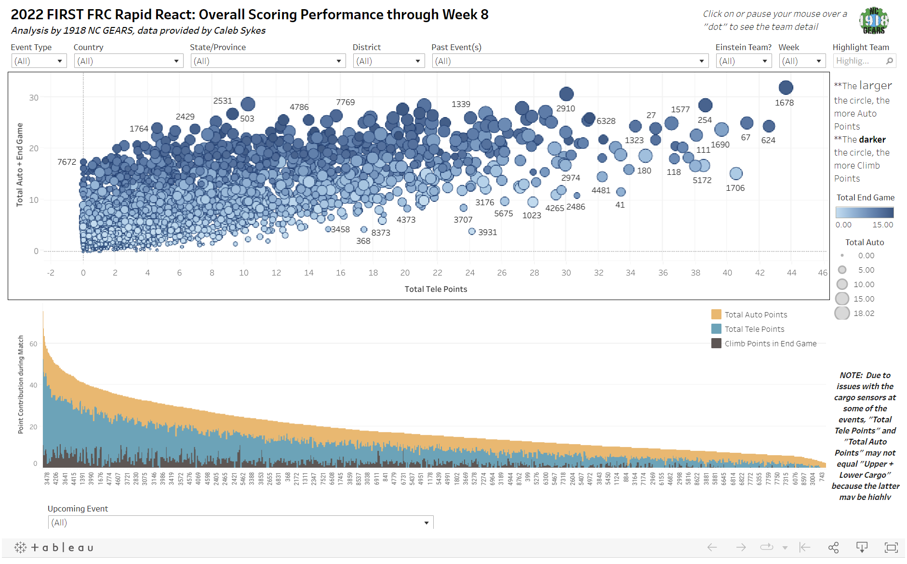
Notes:
My presentation begins with addressing the basic framework for everything we do in FIRST.
Some people use the acronym KISS but I’ve come up with my own called KISAR
Within the context of KISAR, I will discuss first drivetrain design, then mechanisms and finally electronics and pneumatics.
The last two sections discuss how the strategic design process can be effectively implemeted throughout build season and competition season
At the end of the presentation there will be a quiz and I have brought some 1678 t-shirts as prizes.

Slide 33
Summary
Types of Analysis – Holistic & Numerical
Understanding a Game – Golden Rules #1
Scoring Systems – Linear vs Non-Linear & Max vs Unlimited
Kickoff – Golden Rule #2, #3, and #4
Competition Season – Golden Rule #5 and 6
Notes:
Slap it on anything you want your team to be associated with
Easy recognition
same logo for many years -> has developed into recognizable icon
Consistent!
Protect your logo from manipulation and distortion! (i.e. scalability)
Variants for different situations
Don’t change every year - lose your identity
If you are changing, it’s a big deal! Be decisive and stick to your change
Logo, colors, fonts
Pick a few out and stick with them! Remember the RGB/CMYK/HEX codes on reference sheet

Slide 34
Resources
Chief Delphi – chiefdelphi.com
TBA - thebluealliance.com
Statbotics - statbotics.io
Notes:
Slap it on anything you want your team to be associated with
Easy recognition
same logo for many years -> has developed into recognizable icon
Consistent!
Protect your logo from manipulation and distortion! (i.e. scalability)
Variants for different situations
Don’t change every year - lose your identity
If you are changing, it’s a big deal! Be decisive and stick to your change
Logo, colors, fonts
Pick a few out and stick with them! Remember the RGB/CMYK/HEX codes on reference sheet

Slide 35
Citrus Circuits
Fall Workshop Series
Austin Haddox
Email: ahaddox612@gmail.com
Instagram:
@ihaddanox

Slide 36

Questions?
Give us Feedback!

