Slide 1
Neutrino Cross-correlations
by Ben Patterson
Supervisors: David Alonso, Felipe Oliveira Franco

Slide 2
IceCube Data
A cubic-kilometre detector of ice located at the South Pole
Detects muons produced from neutrino-ice interactions
Dominated by neutrinos from our atmosphere
Split into three energy bins from 0.3 to 300 TeV

Slide 3
2MPZ+WIxSC Data

Slide 4
Overdensity Maps

Slide 5
Cross Power Spectra

Slide 6
Testing the Null Hypothesis

Slide 7
Neutrino Radial Kernel

Slide 8
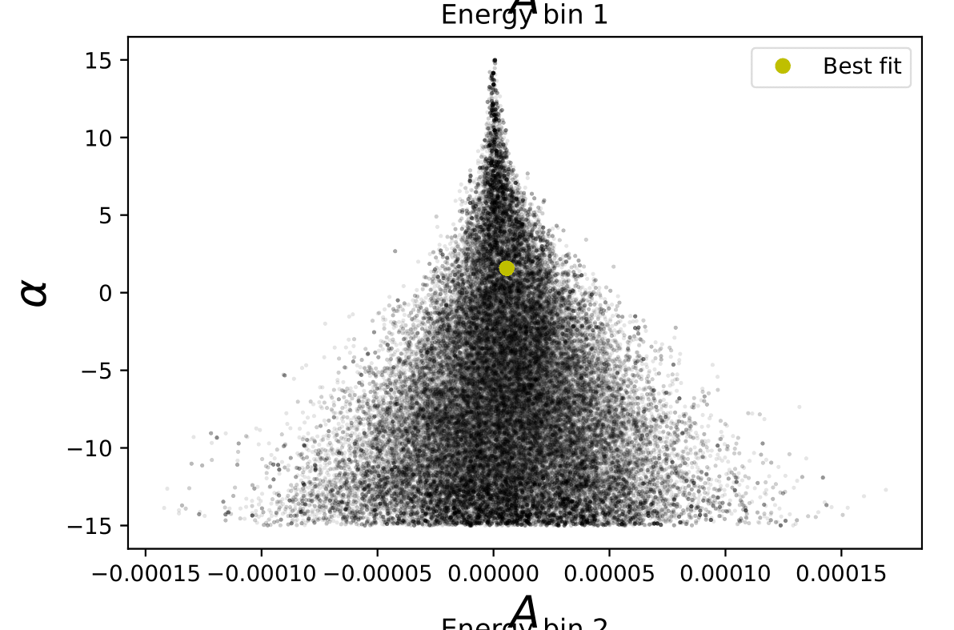
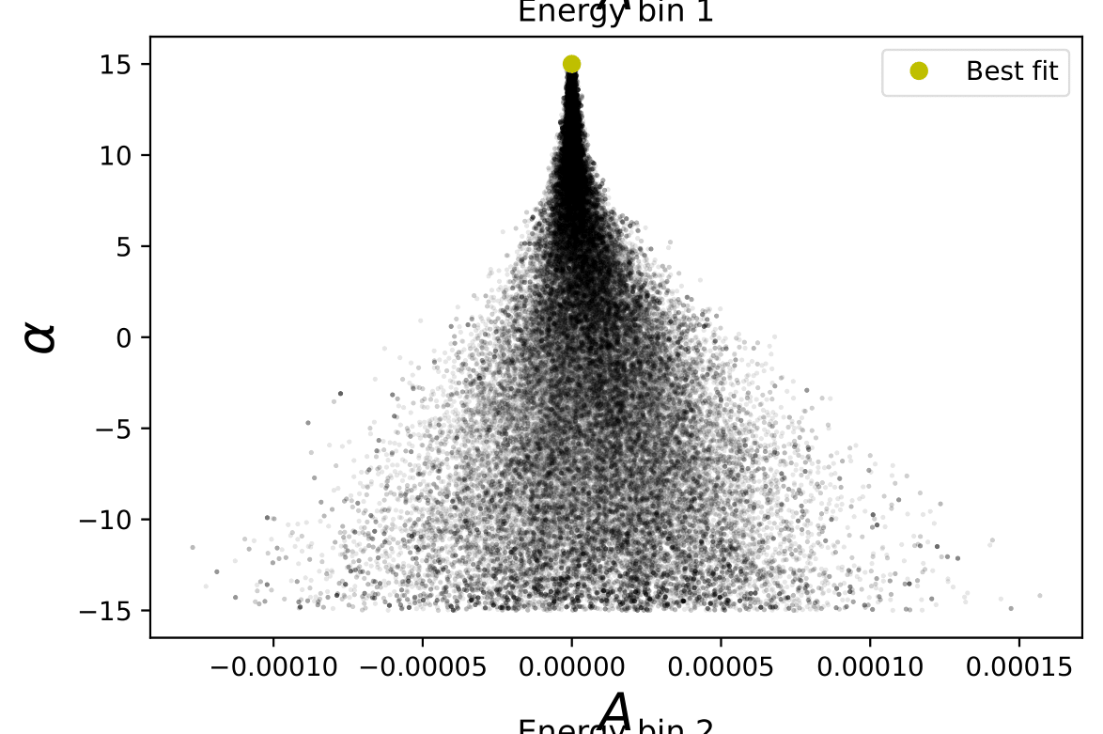
Constraining A and alpha
Volume prior on alpha

Slide 9
Constraining A and alpha
Energy bin 1
alpha = +2
alpha = 0
alpha = -2

Slide 10
Constraining Neutrino Densities
Use number flux maps
Use energy flux maps
Constrain the number density rate of neutrinos,
Constrain the luminosity density of neutrinos,

Slide 11
Constraining Neutrino Densities

Slide 12
Constraining Neutrino Densities

Slide 13
Summary
Attempted to find source of astrophysical neutrinos
No significant detection of correlation with galaxies
Present constraints on and

Slide 14
Extra Slides

Slide 15
Atmospheric Neutrinos
Earth
Northern hemisphere
Declination = 0
Southern hemisphere
IceCube detector

Slide 16
Removing First Data Point

Slide 17
Removing First Data Point

Slide 18
Number Density Rate Constraints

